Slide 1
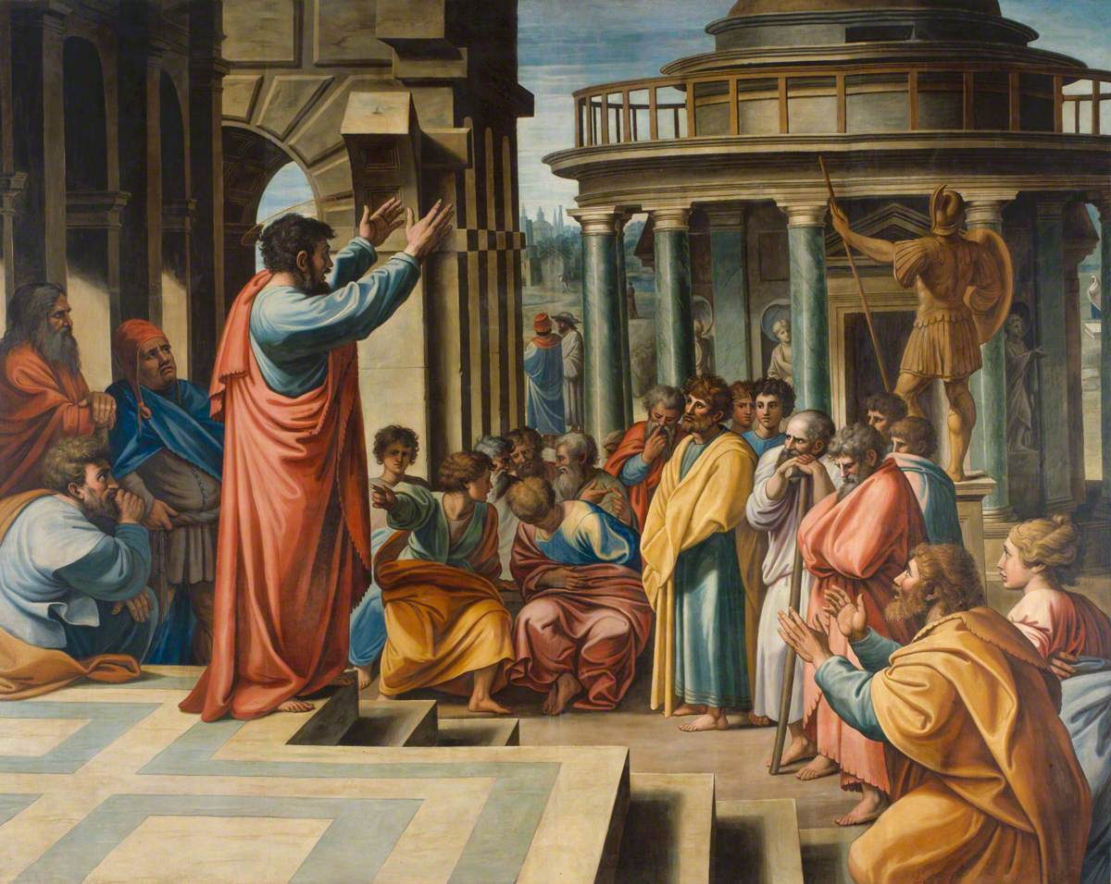
Acts 22

Slide 2
“What are you doing, weeping and breaking my heart? For I am ready not only to be imprisoned but even to die in Jerusalem for the name of the Lord Jesus.”
- Acts 21.13

Slide 3
1 “Brothers and fathers, listen now to my defense.” 2 When they heard him speak to them in Aramaic, they became very quiet.
Then Paul said: 3 “I am a Jew, born in Tarsus of Cilicia, but brought up in this city. I studied under Gamaliel and was thoroughly trained in the law of our ancestors. I was just as zealous for God as any of you are today. 4 I persecuted the followers of this Way to their death, arresting both men and women and throwing them into prison, 5 as the high priest and all the Council can themselves testify.

Slide 4
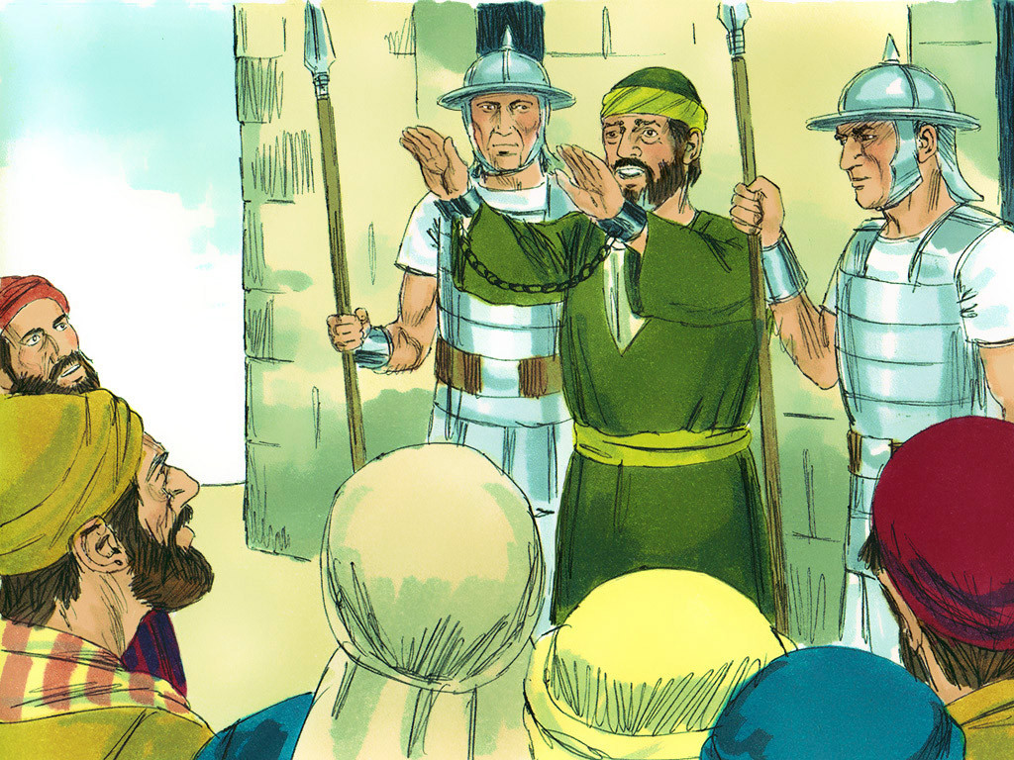

Slide 5
I even obtained letters from them to their associates in Damascus, and went there to bring these people as prisoners to Jerusalem to be punished. 6 About noon as I came near Damascus, suddenly a bright light from heaven flashed around me. 7 I fell to the ground and heard a voice say to me, ‘Saul! Saul! Why do you persecute me?’ 8 ‘Who are you, Lord?’ I asked. ‘I am Jesus of Nazareth, whom you are persecuting,’ he replied. 9 My companions saw the light, but they did not understand the voice of him who was speaking to me.

Slide 6
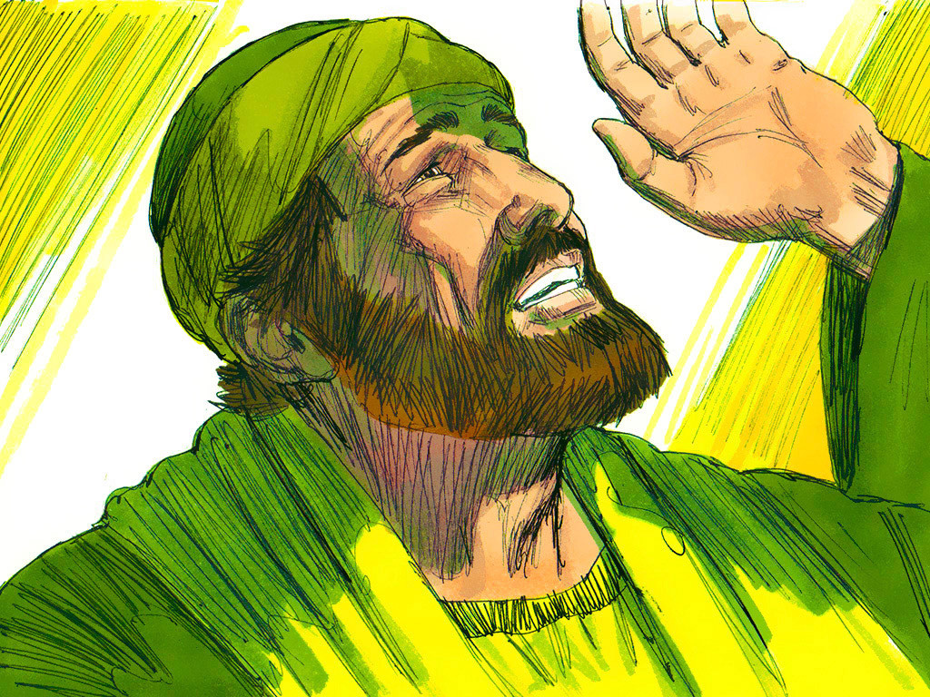

Slide 7
10 ‘What shall I do, Lord?’ I asked. ‘Get up,’ the Lord said, ‘and go into Damascus. There you will be told all that you have been assigned to do.’ 11 My companions led me by the hand into Damascus, because the brilliance of the light had blinded me. 12 A man named Ananias came to see me. He was a devout observer of the law and highly respected by all the Jews living there. 13 He stood beside me and said, ‘Brother Saul, receive your sight!’ And at that very moment I was able to see him.

Slide 8
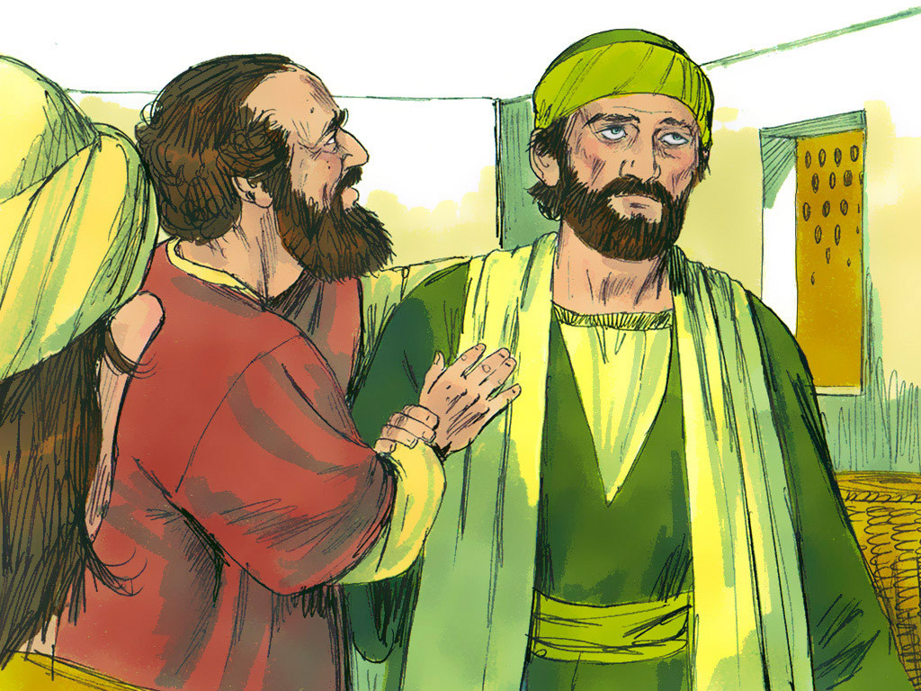

Slide 9
14 Then he said: ‘The God of our ancestors has chosen you to know his will and to see the Righteous One and to hear words from his mouth. 15 You will be his witness to all people of what you have seen and heard. 16 And now what are you waiting for? Get up, be baptized and wash your sins away, calling on his name.’

Slide 10
21 Then the Lord said to me, ‘Go; I will send you far away to the Gentiles.’”
22 The crowd listened to Paul until he said this. Then they raised their voices and shouted, “Rid the earth of him! He’s not fit to live!”

Slide 11
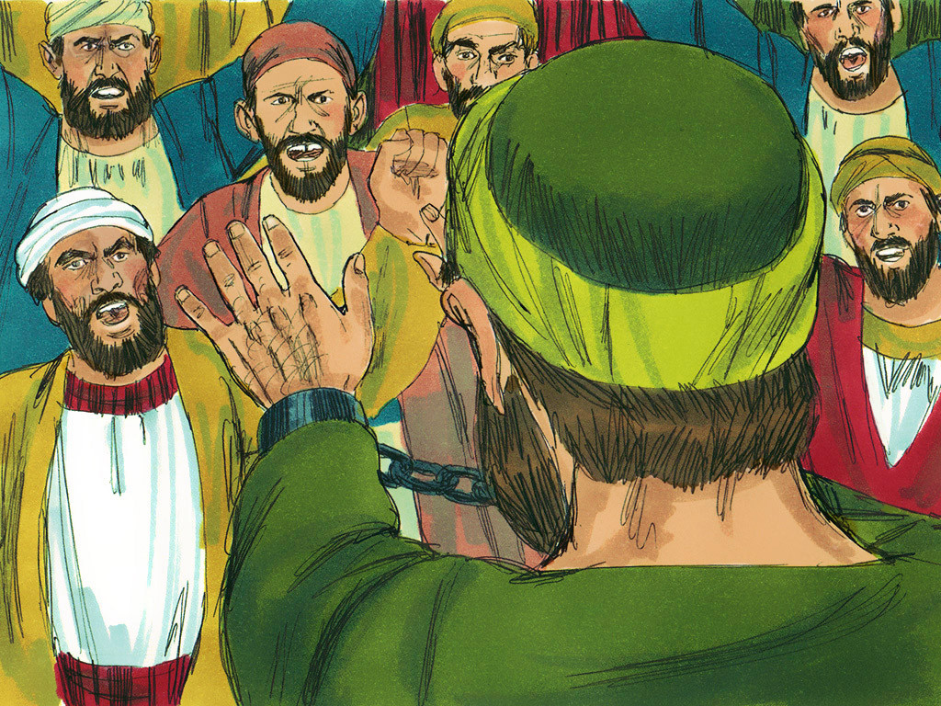

Slide 12
1. Willing to risk conflict for the sake of truth...

Slide 13
He was actually carried by the soldiers because of the violence of the crowd...

Slide 14
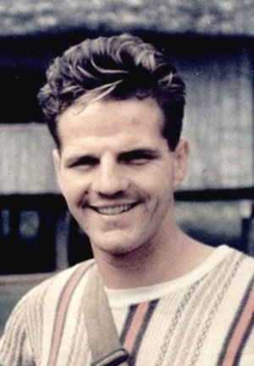
“Father, make of me a crisis man. Bring those I contact to decision. Let me not be a milepost on a single road; make me a fork, that men must turn one way or another on facing Christ in me.”
– Jim Elliot

Slide 15
“Do not think that I have come to bring peace to the earth...”
- Matthew 10.34

Slide 16
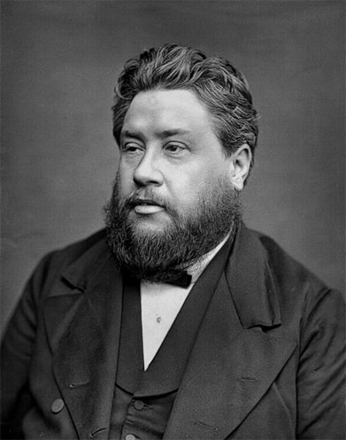
“Where the light comes, the darkness must retire. Where truth is, the lie must flee; or, if it stays, there must be a stern conflict, for the truth cannot and will not lower its standard, and the lie must be trodden underfoot.”
– Charles Spurgeon

Slide 17
“He has made us competent as ministers of a new covenant—not of the letter but of the Spirit; for the letter kills, but the Spirit gives life.”
- 2 Corinthains 3.6

Slide 18
“...it has been granted to you that for the sake of Christ you should not only believe in him but also suffer for his sake, engaged in the same conflict that you saw I had and now hear that I still have.”
- Philippians 1.30

Slide 19
2. A new way of seeing, a new way of being...

Slide 20
You will be a witness ... to everyone of what you have seen and heard. And now ... Rise and be baptised...

Slide 21
“Therefore, if anyone is in Christ, the new creation has come: the old has gone, the new is here!”
- 2 Corinthians 5.17

Slide 22
“...be made new in the attitude of your minds; and to put on the new self, created to be like God in true righteousness and holiness.”
- Ephesians 3.23-24

Slide 23
A fresh expectation for the breaking in of the Kingdom to our world...

Slide 24
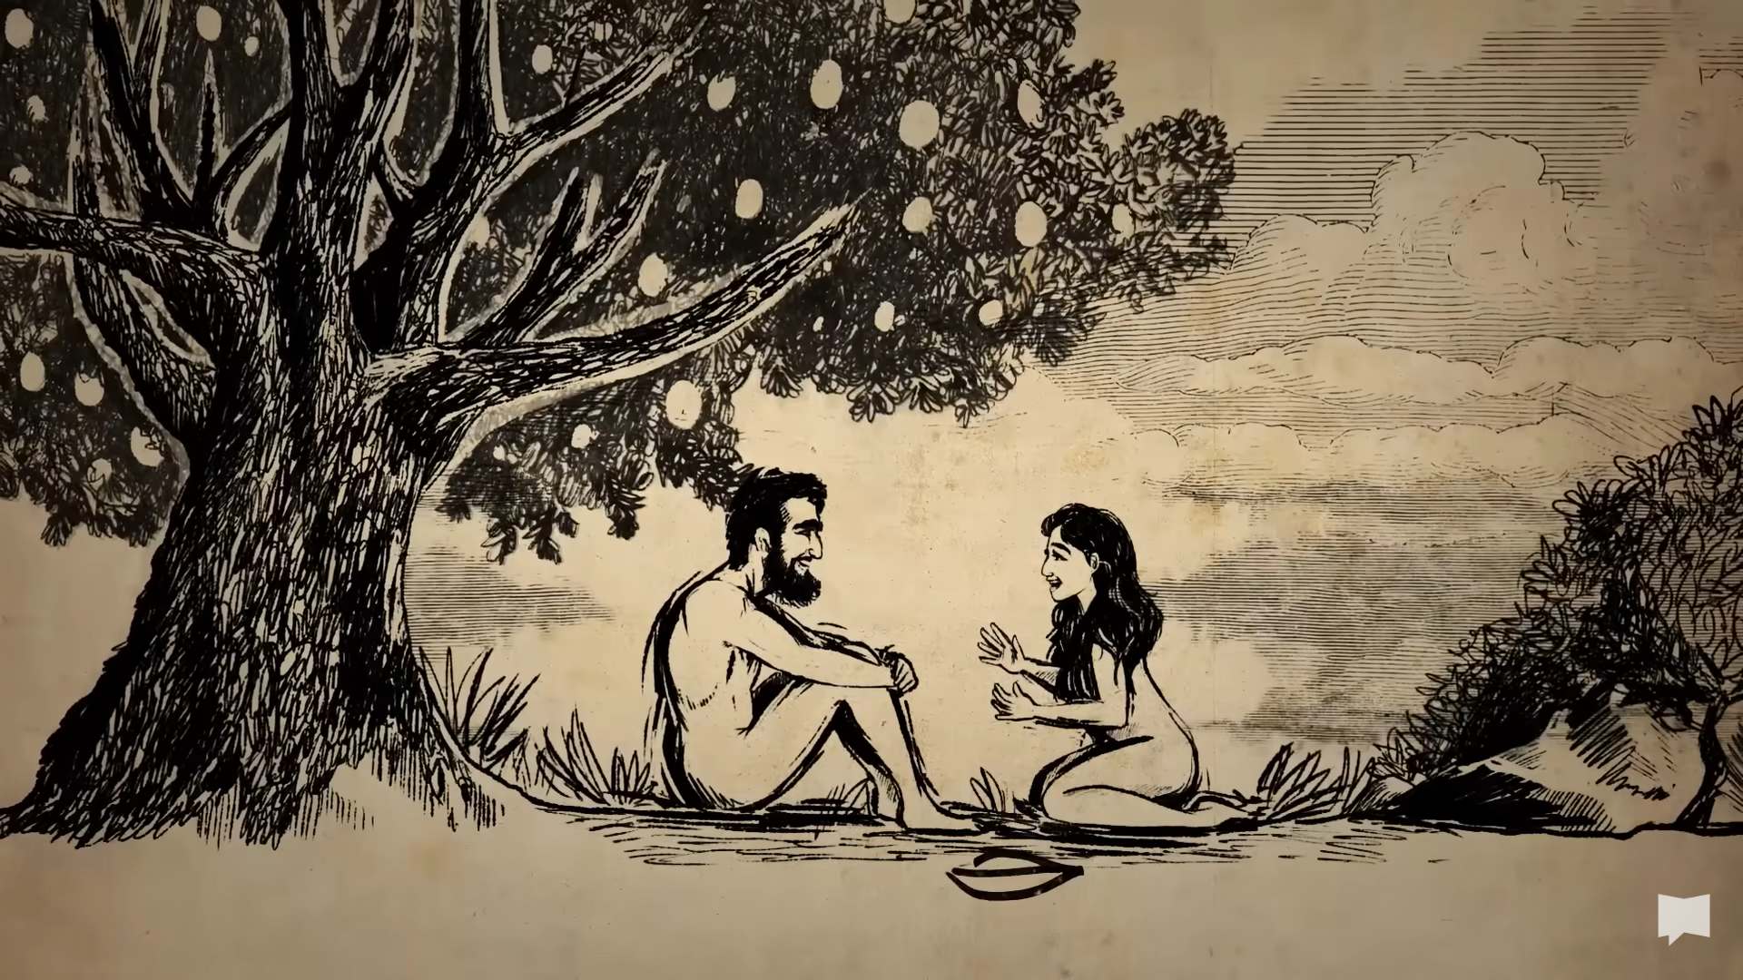

Slide 25
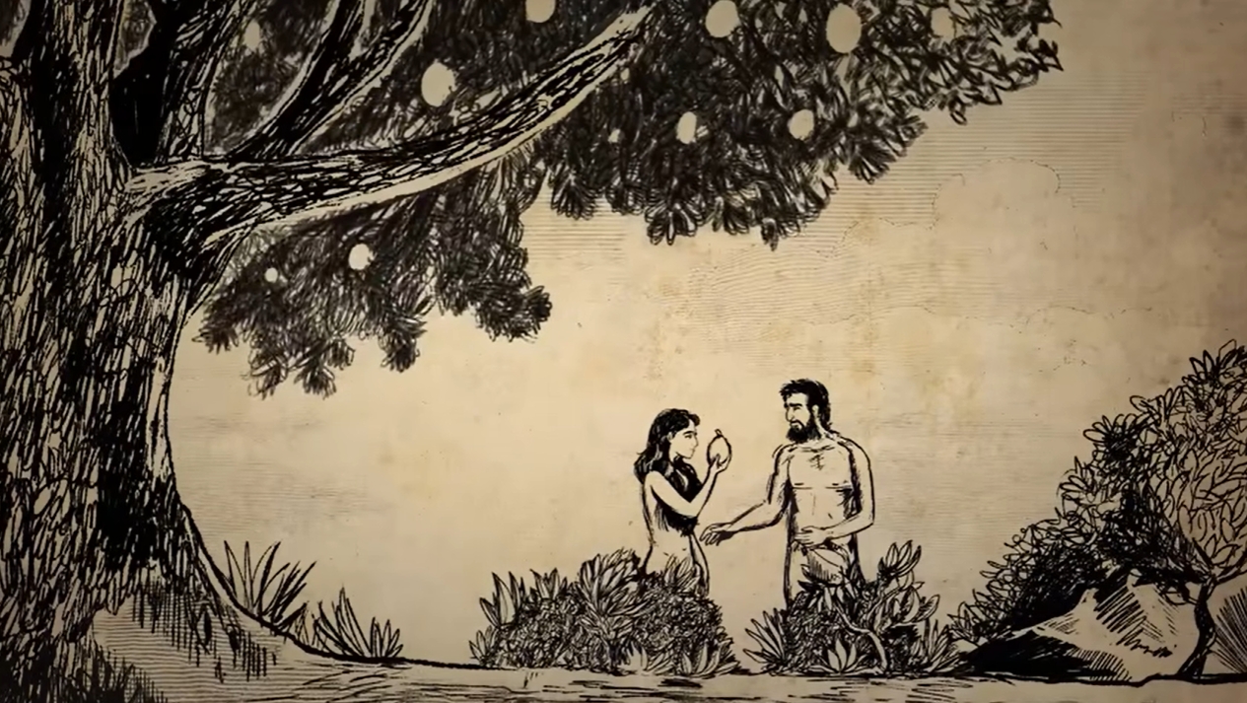

Slide 26
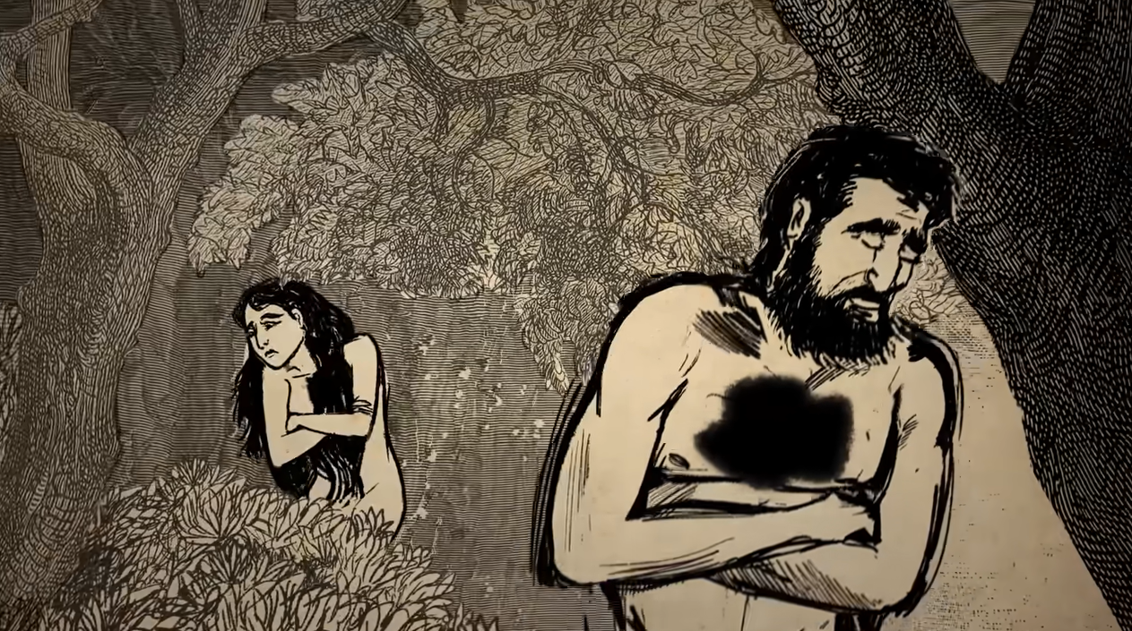

Slide 27
“When Christ walks on the water we have a miracle of the New Creation ... For a moment it looks as if it were going to spread. For a moment two men are living in that new world … Peter also walks on the water … then his trust fails him and he sinks … that momentary glimpse is a snowdrop of a miracle. The snowdrops show that we have turned the corner of the year. Summer is coming.”
– C. S. Lewis

Slide 28
“...be made new in the attitude of your minds; and to put on the new self, created to be like God in true righteousness and holiness.”
- Ephesians 3.23-24

Slide 29
“I counsel you to buy ... Salve to anoint your eyes, so that you may see...”
- Revelation 3.15-18

Slide 30
3. A life laid down...

Slide 31
“But whatever were gains to me I now consider loss for the sake of Christ. What is more, I consider everything a loss because of the surpassing worth of knowing Christ Jesus my Lord, for whose sake I have lost all things. I consider them garbage, that I may gain Christ and be found in him, not having a righteousness of my own that comes from the law, but that which is through faith in Christ...”
- Philippians 3.7-9

Slide 32
“There you will be told all that you have been assigned to do...”
- Acts 22.10

Slide 33
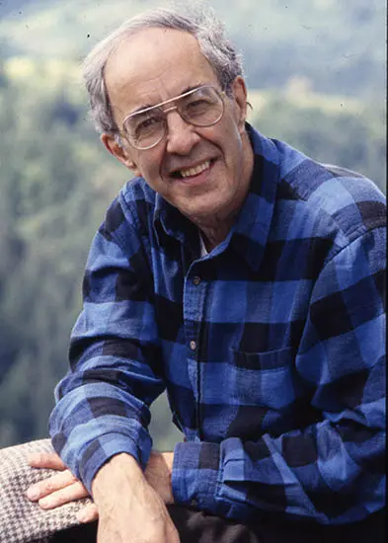
Henri Nouwen

Slide 34
“The way of the Christian ... Is not the way of upward mobility in which the world has invested so much, but the way of downward mobility ending in the cross. This might sound morbid ... But for those who have heard the voice of the first love and said “yes” to it, the downward-moving way of Jesus is the way to the joy and peace of God, a joy and peace that is not of this world.”
- Henri Nouwen

Slide 35
“I am ready not only to be imprisoned but even to die in Jerusalem for the name of the Lord Jesus.”
- Acts 21.13

Slide 36
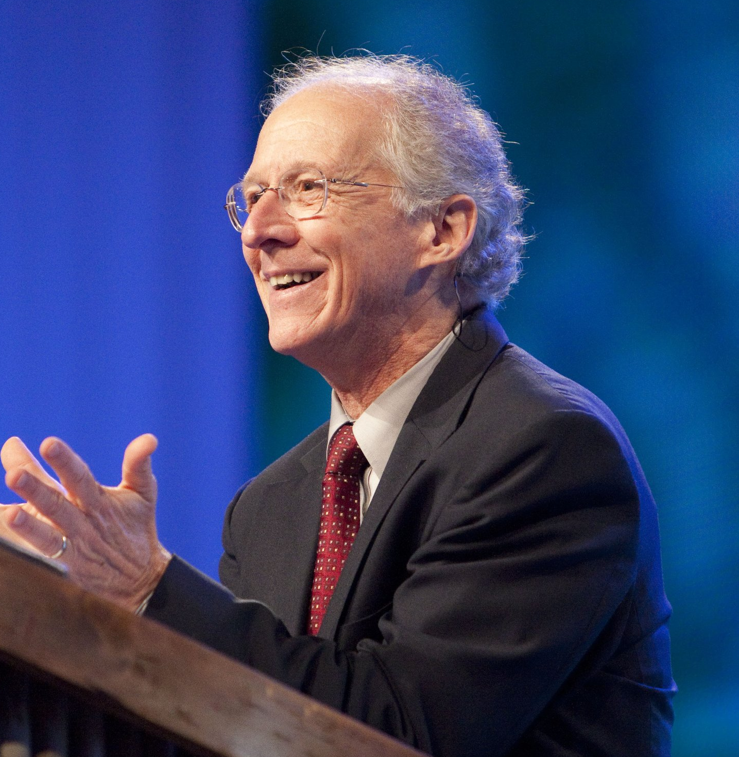
“And that’s what transformation means: When you are transformed in Christ you love to do what you ought to do. That’s freedom.”
– John Piper

Slide 37
Stand for truth in face of opposition
Empowers us as we participate in kingdom work
Lay down our desires, take up our cross

Slide 38
Make me a “crisis man...”
Open my eyes afresh with increased expectation for breaking in of your Kingdom...
May I taste and see the all-surpassing joy of knowing you...

