Slide 1

Acts 25-6
[You’ve just been promoted!]

Slide 2
What is God’s plan for work?

Slide 3
My mind 8 months ago…
Holy | Mundane
Speaking to colleagues about Jesus | Being consistent in rewarding and challenging their behaviour
Reading bible verses with my form class | Being available to stop and talk in the corridor
Praying for my students on my commute | Working hard on lesson resources

Slide 4
Genesis 2: 4-15
This is the account of the heavens and the earth when they were created, when the Lord God made the earth and the heavens.
Now no shrub had yet appeared on the earth and no plant had yet sprung up, for the Lord God had not sent rain on the earth and there was no one to work the ground, but streams came up from the earth and watered the whole surface of the ground. Then the Lord God formed a man from the dust of the ground and breathed into his nostrils the breath of life, and the man became a living being.
Now the Lord God had planted a garden in the east, in Eden; and there he put the man he had formed. The Lord God made all kinds of trees grow out of the ground—trees that were pleasing to the eye and good for food. In the middle of the garden were the tree of life and the tree of the knowledge of good and evil.
A river watering the garden flowed from Eden; from there it was separated into four headwaters. The name of the first is the Pishon; it winds through the entire land of Havilah, where there is gold. The name of the second river is the Gihon; it winds through the entire land of Cush. The name of the third river is the Tigris; it runs along the east side of Ashur. And the fourth river is the Euphrates.
The Lord God took the man and put him in the Garden of Eden to work it and take care of it.

Slide 5
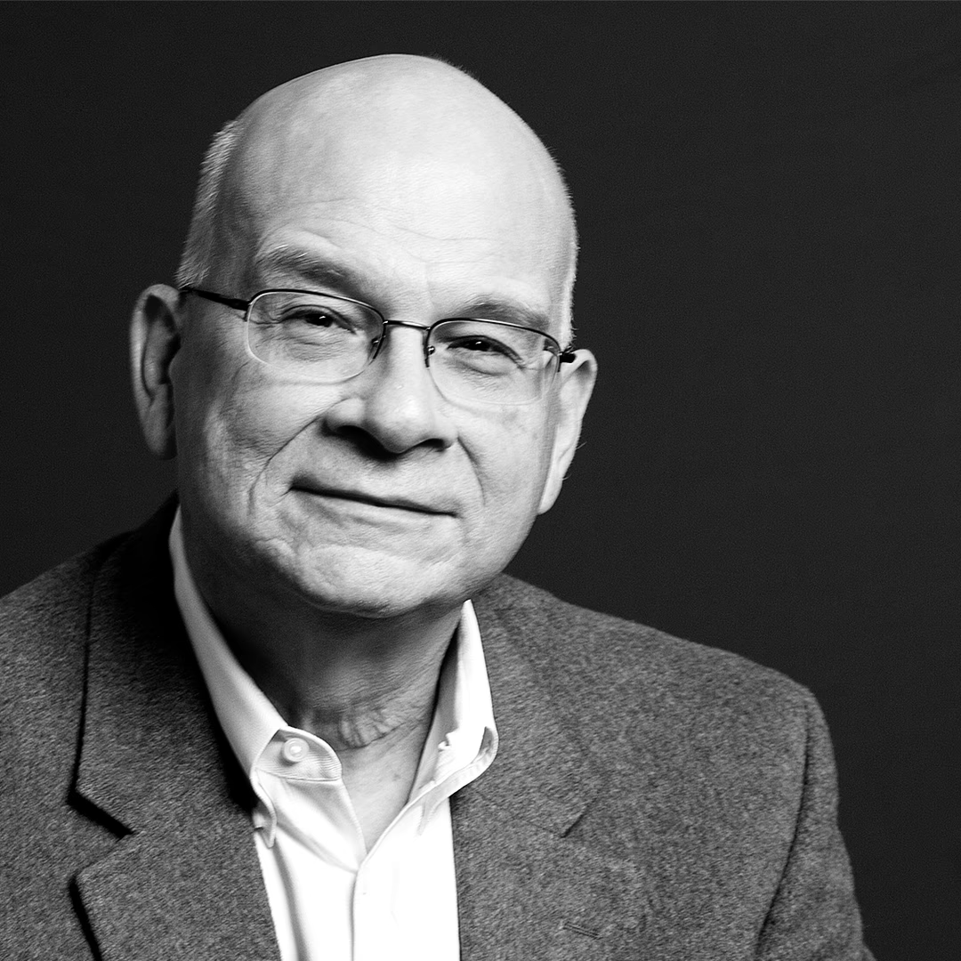
Tim Keller describes work as "rearranging the raw material of God's creation in such a way that it helps the world in general, and people in particular thrive and flourish"

Slide 6
Revelation 22:1-5
Then the angel showed me the river of the water of life, as clear as crystal, flowing from the throne of God and of the Lamb 2 down the middle of the great street of the city. On each side of the river stood the tree of life, bearing twelve crops of fruit, yielding its fruit every month. And the leaves of the tree are for the healing of the nations. 3 No longer will there be any curse. The throne of God and of the Lamb will be in the city, and his servants will serve him. 4 They will see his face, and his name will be on their foreheads. 5 There will be no more night. They will not need the light of a lamp or the light of the sun, for the Lord God will give them light. And they will reign for ever and ever.

Slide 7
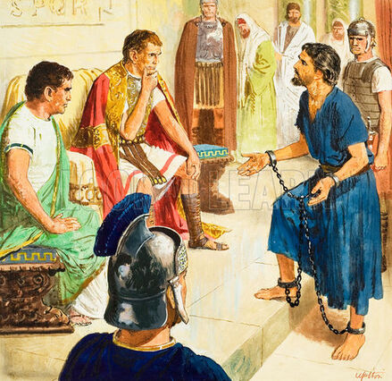
Acts 25
9 Festus, wishing to do the Jews a favor, said to Paul, “Are you willing to go up to Jerusalem and stand trial before me there on these charges?”
10 Paul answered: “I am now standing before Caesar’s court, where I ought to be tried. I have not done any wrong to the Jews, as you yourself know very well. 11 If, however, I am guilty of doing anything deserving death, I do not refuse to die. But if the charges brought against me by these Jews are not true, no one has the right to hand me over to them. I appeal to Caesar!”

Slide 8
Acts 26
30 The king rose, and with him the governor and Bernice and those sitting with them. 31 After they left the room, they began saying to one another, “This man is not doing anything that deserves death or imprisonment.”
32 Agrippa said to Festus, “This man could have been set free if he had not appealed to Caesar.”

Slide 9
Why does Paul hold him to account?

Slide 10

Redemption

Slide 11
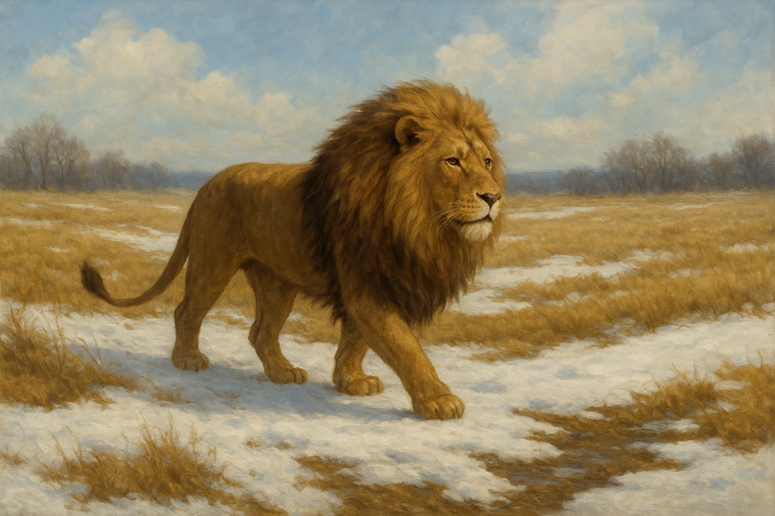
Aslan is on the move
― C.S. Lewis, The Lion, the Witch and the Wardrobe

Slide 12
Response:
Have you offered God your work?
Let Him give you vision for what your role can be used for
Remember the eternal importance of your work when things are difficult, and thank God that the battle is won!

