Slide 1

Acts 16
Nothing changes until the heart changes

Slide 2
Recap
Acts 7
Stephen killed
Persecution starts
Acts 10
Peter’s vison
Visits Cornelius (Gentile)
Acts 2
Holy Spirit comes
Acts 1
Jesus taken
up to heaven
Acts 4
Peter & John before Jewish
council and imprisoned
Acts 9
Saul’s conversion

Slide 3
Recap
Acts 13-14
Acts 15
Acts 16
Paul & Barnabas first missionary journey
Experience persecution
Return to Jerusalem – debate about Gentiles and law
Paul & Barnabas part company
Paul and Silas on second missionary journey – returning to churches visited in Acts 13-14
Paul joins with Silas

Slide 4
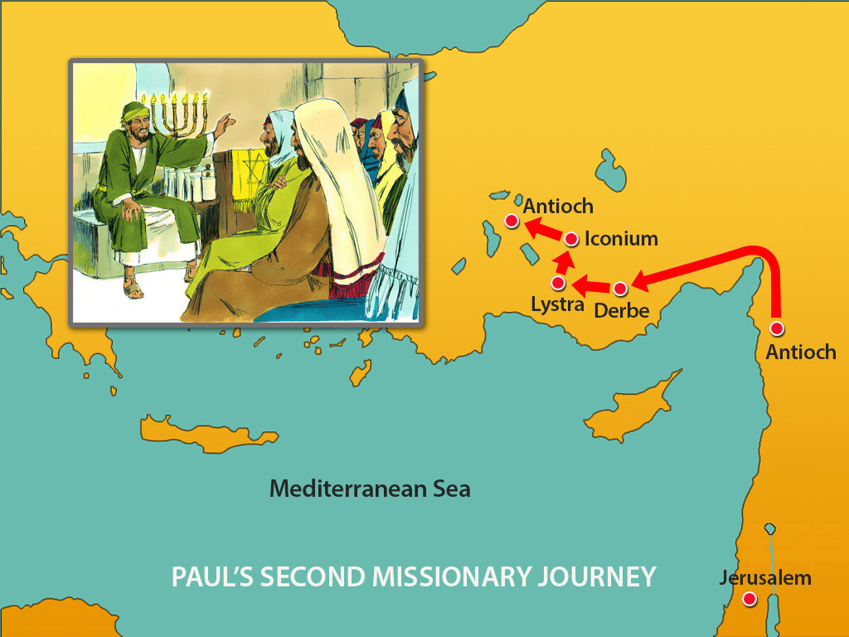

Slide 5
Acts 16 overview
Five parts
  Timothy Joins Paul and Silas
  Paul’s vision of the man of Macedonia
  Lydia’s conversion in Philippi
  Demon-possessed slave girl
  Paul and Silas in prison and release – next time!
God wants to do a new thing – and it requires heart change
  For others – recognise: I can’t help anyone to change, only God opens hearts
  For me – recognise: my ability to assess what I can and cannot do it so limited
Response: am I willing to invite God in to change my heart, to reorder my priorities?

Slide 6
Acts 16:1-5
Timothy Joins Paul and Silas
Paul came to Derbe and then to Lystra, where a disciple named Timothy lived, whose mother was Jewish and a believer but whose father was a Greek. 2 The believers at Lystra and Iconium spoke well of him. 3 Paul wanted to take him along on the journey, so he circumcised him because of the Jews who lived in that area, for they all knew that his father was a Greek. 4 As they traveled from town to town, they delivered the decisions reached by the apostles and elders in Jerusalem for the people to obey. 5 So the churches were strengthened in the faith and grew daily in numbers.

Slide 8
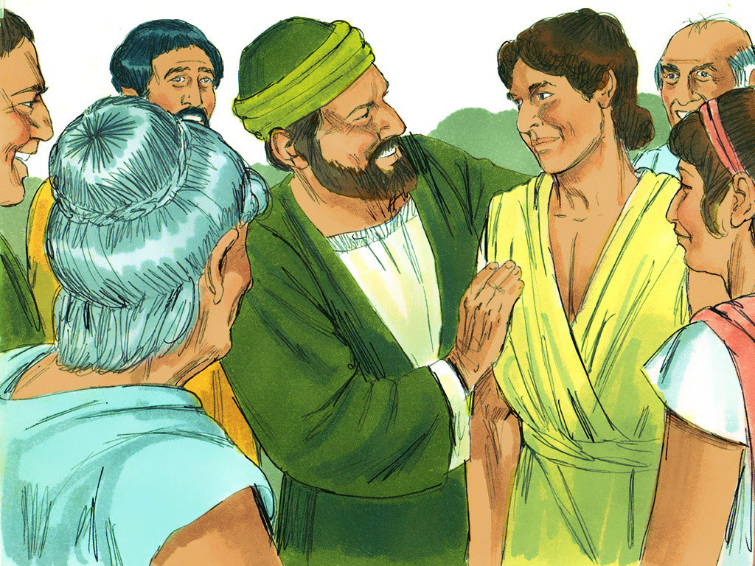
Who was timothy?
From Lystra
Half Jewish (“mother was Jewish and a believer”), half Greek (father)
Of good character (“believers spoke well of him”)
He was circumcised by Paul

Slide 9
timothy circumcised by paul?!

Slide 10
timothy circumcised by paul?!
Elsewhere Paul condemned circumcision..
Previous chapter (Acts 15) – Paul and Barnabas were in “sharp dispute” with the leaders who promoted circumcision for Gentiles.
Elsewhere in Paul’s teachings (Galatians 2) – Paul refused to let Titus be circumcised, “so that the truth of the gospel be preserved” – justified by faith not by the law

Slide 11
timothy circumcised by paul?!
Elsewhere Paul condemned circumcision..
..So why did Paul do this?
Previous chapter (Acts 15) – Paul and Barnabas were in “sharp dispute” with the leaders who promoted circumcision for Gentiles.
Elsewhere in Paul’s teachings (Galatians 2) – Paul refused to let Titus be circumcised, “so that the truth of the gospel be preserved” – justified by faith not by the law
Different opinions:
  Wisdom – not to put a stumbling block in way of Jewish folks
  Maybe he made a mistake?
  Timothy different from Titus – he was already Jewish by birth, and Paul wasn’t responding to pressure from community
The point: we need to be led by the Holy Spirit to access His wisdom and grace

Slide 12

Reflection questions (1)
xx

Slide 13
Acts 16:6-10
Paul’s vision of the man of Macedonia
6 Paul and his companions traveled throughout the region of Phrygia and Galatia, having been kept by the Holy Spirit from preaching the word in the province of Asia. 7 When they came to the border of Mysia, they tried to enter Bithynia, but the Spirit of Jesus would not allow them to. 8 So they passed by Mysia and went down to Troas. 9 During the night Paul had a vision of a man of Macedonia standing and begging him, “Come over to Macedonia and help us.” 10 After Paul had seen the vision, we got ready at once to leave for Macedonia, concluding that God had called us to preach the gospel to them.

Slide 14
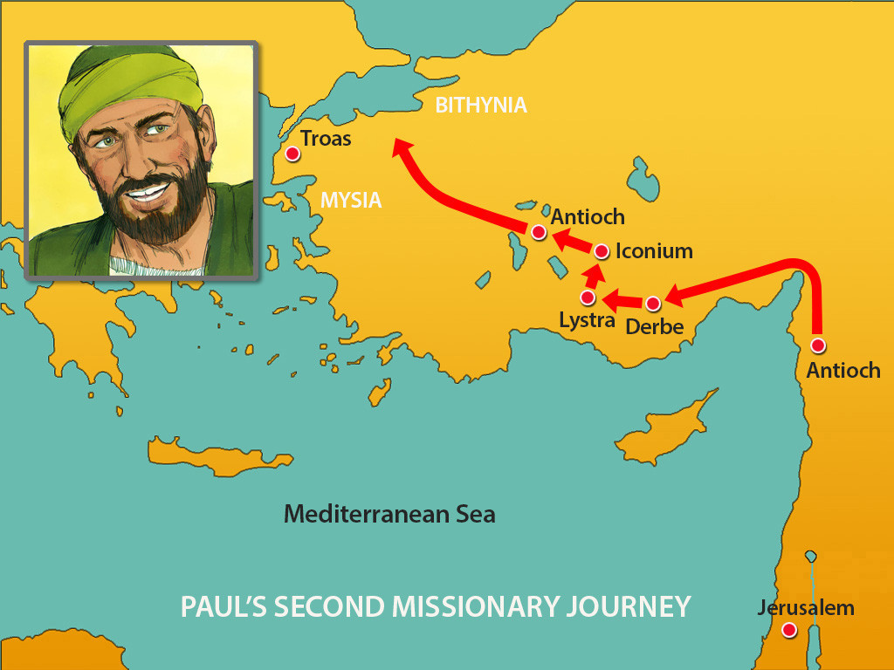

Slide 15
How do we follow God without a clear direction?
Responding to “nudges”
“Pushing on doors”
What is a “nudge”?
  The thought to message someone who “randomly” comes into your mind
  A “random” question that comes to mind to ask someone
  Prompting to change your schedule
What does it mean to “push on doors”?
  Green light, go
  Does this action I might take agree with scripture?
  Applying for a job
  Booking an appointment
In community: processing our decisions with those that care for us to share the burden and benefit from wisdom

Slide 16
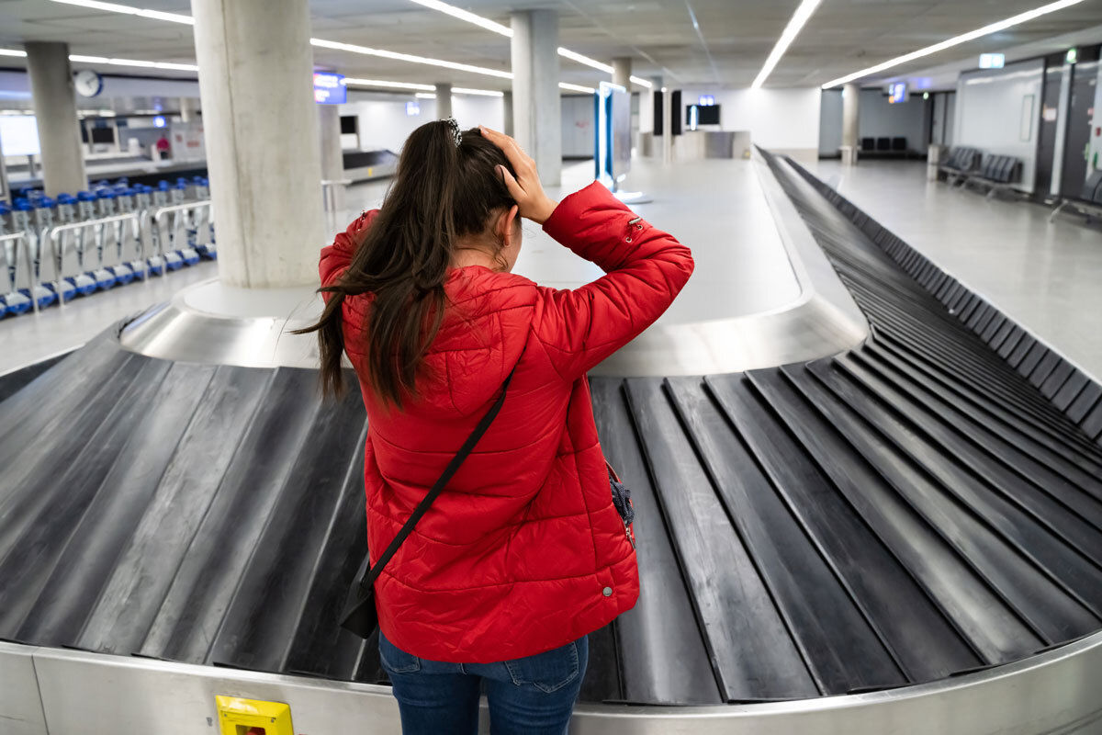
Mohamed nikoo

Slide 17
Reflection questions (1)
Talk to person next to you – can you think of a time where you were wanting to hear God:
You got a nudge, and you followed it. What happened?
You pushed on some doors and saw God close some and open others?

Slide 18
Acts 16:11-15
Lydia’s conversion in Philippi
11 From Troas we put out to sea and sailed straight for Samothrace, and the next day we went on to Neapolis. 12 From there we traveled to Philippi, a Roman colony and the leading city of that district of Macedonia. And we stayed there several days.
13 On the Sabbath we went outside the city gate to the river, where we expected to find a place of prayer. We sat down and began to speak to the women who had gathered there. 14 One of those listening was a woman from the city of Thyatira named Lydia, a dealer in purple cloth. She was a worshiper of God. The Lord opened her heart to respond to Paul’s message. 15 When she and the members of her household were baptised, she invited us to her home. “If you consider me a believer in the Lord,” she said, “come and stay at my house.” And she persuaded us.

Slide 19
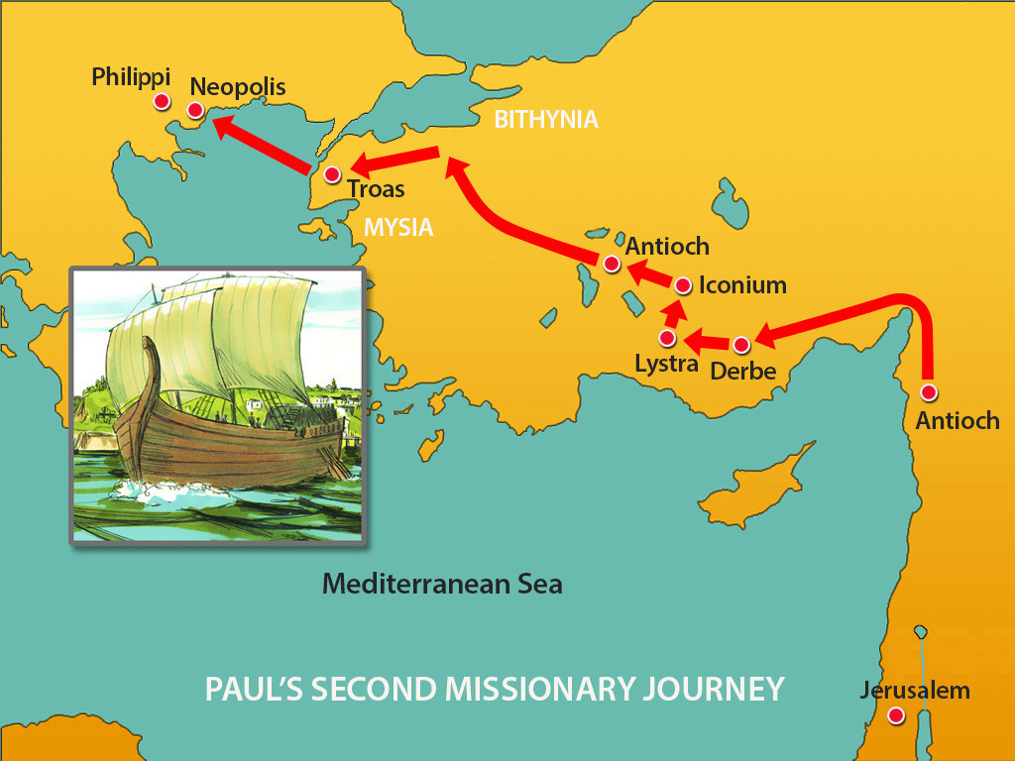

Slide 20
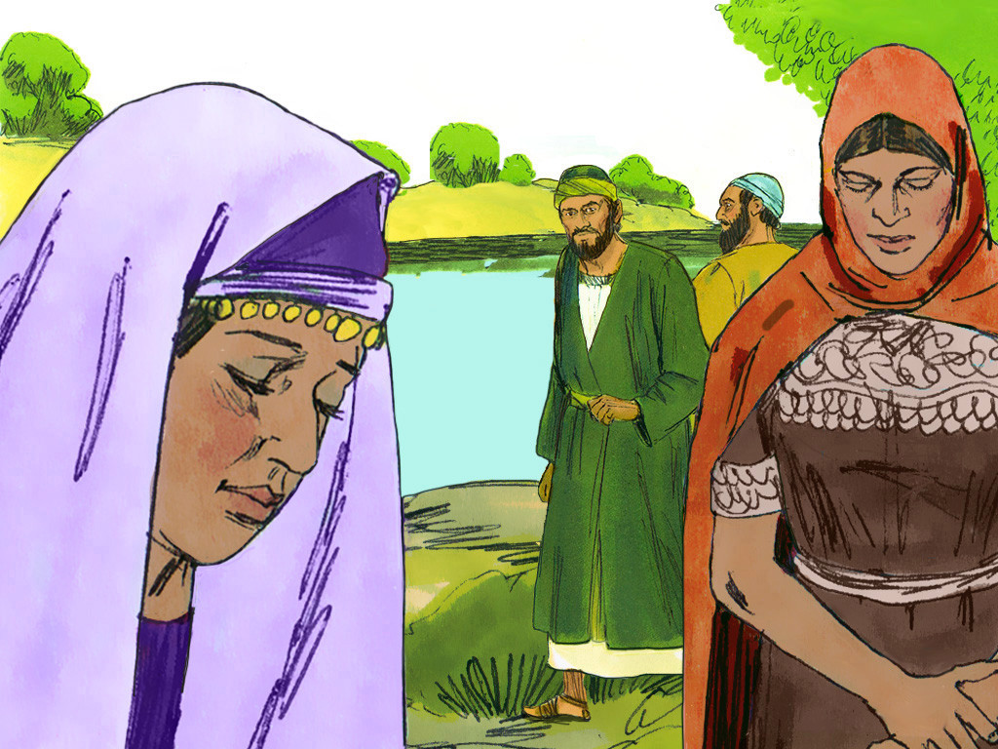
What do we know about Lydia?
A businesswoman
Dealer in purple cloth – only for the wealthy; selling beautiful clothes to beautiful people
A “worshipper of God” – or “God-fearer”
She found herself between paganism and Christianity + law

Slide 21
“God-fearers”
Exiting
Paganism (anti-religion)
Entering
Christianity plus law (religion)
Live for yourself
Do what makes you happy
Philosophical
Intellectual
Save yourself through good works
Still living by the Jewish law (circumcision, etc.)
Empty!
Burdensome!
Sound familiar?
The gospel message is attractive

Slide 22
Jesus: lived a perfect life according to law
Went to cross and died for sins
Earned the blessing the obedience to the law deserved
Took the curse that disobedience to law deserves
So when you believe in him the curse for your sin falls on him and means the blessing he earned falls on you, saved by grace

Slide 23
“God opened her heart”

Slide 24
Reflection questions (2)
Are there people in your life where God has prepared them to receive the gospel? Ask God to highlight these people now
Are there people in your life where you want to see breakthrough – salvation or release from bondage? Consider: have I taken it upon myself to be their saviour? Repent and ask God to be the one to open hearts

Slide 25
Acts 16:11-15
Demon-possessed slave girl
16 Once when we were going to the place of prayer, we were met by a female slave who had a spirit by which she predicted the future. She earned a great deal of money for her owners by fortune-telling. 17 She followed Paul and the rest of us, shouting, “These men are servants of the Most High God, who are telling you the way to be saved.” 18 She kept this up for many days. Finally Paul became so annoyed that he turned around and said to the spirit, “In the name of Jesus Christ I command you to come out of her!” At that moment the spirit left her.

Slide 26
What do we know about the female slave?
Greek translation suggests she was young – likely 10-14 years old
She could see the future, and her predictions were true
Troubled, spoke wildly, and spoke in different voices “ventriloquists”.
Today we might say “she’s mentally unwell”
Demon-possession

Slide 27
Paul became annoyed?

Slide 28
Contrasting two very different people
Lydia | Slave girl
Wealthy and affluent | Poor and destitute
Owner | Owned
Centre of society | Margins of society
Completely pulled together | Totally out of control
Both had perceptions about what they could and could not do
Both were powerless and needed an encounter with Jesus

Slide 29
Lydia and Slave girl – both had perceptions about what they could and could not do
Slave girl – powerless
Lydia – empowered (yet powerless to find a path to satisfaction and salvation)
We all measure our

Slide 30
God’s calling for expansion of our hearts
He’s doing a new thing

Slide 31
God’s calling for expansion of our hearts
Why? He wants to do a new thing amongst us. Hugh Osgood word.
New thing: different from what’s gone before. Requires change. We want to resist and push back change.
We think we understand what we can and cannot do – we compartmentalise our life – ring-fence areas and see only a small space for what new thing God might want to do
We look at opportunities and we tell God “I can’t do that”. God says, “I know, you can’t! But I can”. He knows we can’t do it on our own without him.
Why do we need our hearts expanded? Because when God works on our heart our desires change.
My challenge to children’s work leaders this week: are you willing to invite God in and touch your heart? Dangerous – if he comes in and takes residence, he may start to move the furniture. Reorder our priorities.
Are we willing to let God decide what we can and cannot do?

Slide 32
Heart change
“God’s in the business of giving heart transplants”
“Nothing changes until the heart changes”
How do I get a heart change? Come before him. Invite him to do the thing. Might not happen in one sitting. It’s not necessarily on tap, or on our time schedule. Why? He wants us to continually come before him. There’s more he wants to do in us. He misses us.
We say we can’t do this or that, we view it all through the lens of what we can do practically within our own construct
God wants to rearrange our priorities
Are we willing to say “yes” to him – to invite him in, to take residence in us. To rearrange the furniture. He wants to do a new thing.

Slide 33
How do we get heart change?
Ask Him
Infilling of Holy Spirit
Not one-time only
Sitting at his feet
Immersed in his presence

Slide 34
How might this apply?
God’s heart for children
Sharper witness
Households

Slide 35
Reflection questions (3)
What are you hearing?
How might God be calling you to respond?

Slide 36
Response
Do you feel a sense of unease about what embracing the new thing that God wants to do might mean for you?
Are you focused on the practical constraints in your life?
Are you willing to invite God to change your heart, to reorder our priorities?
Open the eyes of my heart, Lord

