Slide 1
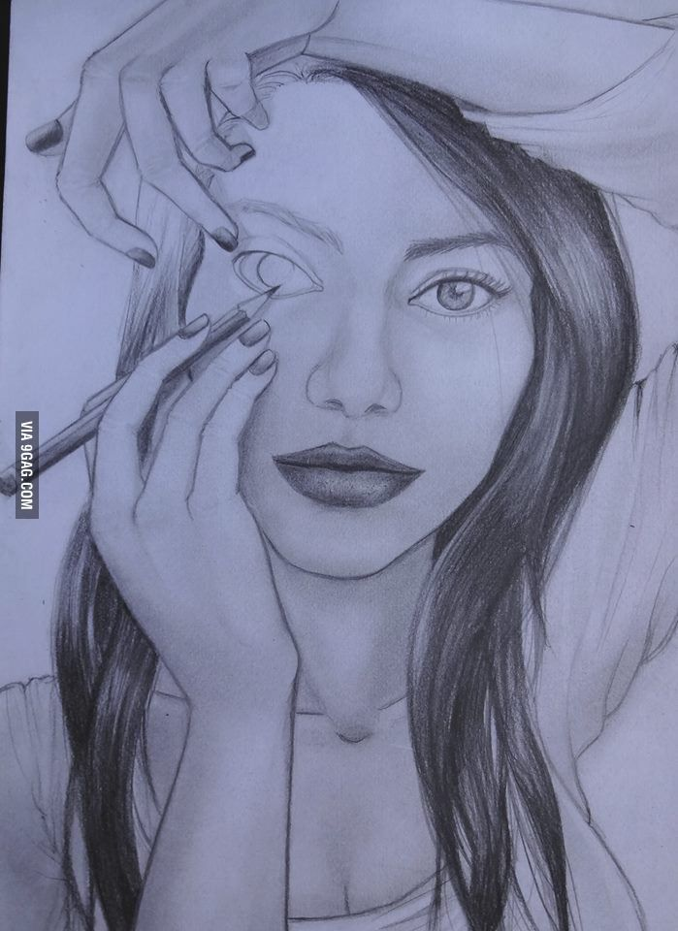
Acts Series
Episode 20: Chpt 16
19th Feb 2025

Slide 2
Acts 16:16-24
Once when we were going to the place of prayer, we were met by a female slave who had a spirit by which she predicted the future. She earned a great deal of money for her owners by fortune-telling. She followed Paul and the rest of us, shouting, “These men are servants of the Most High God, who are telling you the way to be saved.” She kept this up for many days. Finally Paul became so annoyed that he turned around and said to the spirit, “In the name of Jesus Christ I command you to come out of her!” At that moment the spirit left her.
When her owners realized that their hope of making money was gone, they seized Paul and Silas and dragged them into the marketplace to face the authorities. They brought them before the magistrates and said, “These men are Jews, and are throwing our city into an uproar by advocating customs unlawful for us Romans to accept or practice.”
Notes:
Slave girl – correct but aggravating
Was Paul correct to cast demon out? Know God’s mind and moment – perhaps he would have had more time if he didn’t lose his temper!
Power of God through Paul!
Motive – money generation. Presented – concern for peace of city and compliance with Rome – Magistrates not spot (fear makes us pliable)

Slide 3
Acts 16:16-24
The crowd joined in the attack against Paul and Silas, and the magistrates ordered them to be stripped and beaten with rods. After they had been severely flogged, they were thrown into prison, and the jailer was commanded to guard them carefully. When he received these orders, he put them in the inner cell and fastened their feet in the stocks.
Notes:
Whip up mob – Madness of Crowds
No trial – authenticity is about speed of reaction (vs angry letter best not sent) – wait for facts to emerge before casting verdict
Jailer particularly cruel – not wash wounds, only asked to guard them carefully but he puts in inner cell & stocks

Slide 4
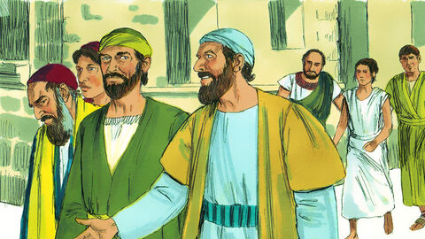
1. Power In Team
Notes:
¹⁶ Once when we were going to the place of prayer, we were met by a female slave who had a spirit by which she predicted the future. She earned a great deal of money for her owners by fortune-telling. ¹⁷ She followed Paul and the rest of us, shouting, “These men are servants of the Most High God, who are telling you the way to be saved.”
Luke joins Paul and Co in verse 10-11 = “we”
Power of team – who are you in team with?
Power In Team

Slide 5
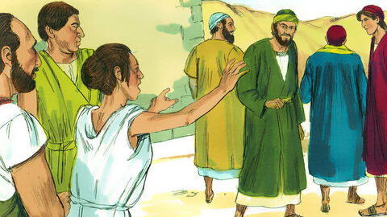
2. Power In the Name
Notes:
¹⁸ She kept this up for many days. Finally Paul became so annoyed that he turned around and said to the spirit, “In the name of Jesus Christ I command you to come out of her!” At that moment the spirit left her.
Power In the Name to set free!

Slide 6
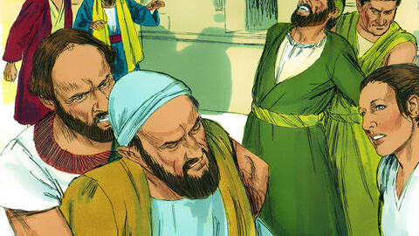
3. The Madness of Crowds
Notes:
¹⁹ When her owners realized that their hope of making money was gone, they seized Paul and Silas and dragged them into the marketplace to face the authorities. ²⁰ They brought them before the magistrates and said, “These men are Jews, and are throwing our city into an uproar ²¹ by advocating customs unlawful for us Romans to accept or practice.”
²² The crowd joined in the attack against Paul and Silas, and the magistrates ordered them to be stripped and beaten with rods.
The Madness of Crowds

Slide 7

The Madness of Crowds
James Thurber
‘The Day the Dam Broke’
Notes:
The Madness of Crowds – Douglas Murray
In 1933 James Thurber published ‘The Day the Dam Broke’, recalling his memories of 12 March 1913 when the whole of his town in Ohio went for a run. Thurber recalled how the rumour began that the dam had broken. Around noon ‘Suddenly somebody began to run. It may be that he had simply remembered, all of a moment, an engagement to meet his wife, for which he was now frightfully late.’ Soon somebody else began to run, ‘perhaps a newsboy in high spirits. Another man, a portly gentleman of affairs, broke into a trot’:
Inside of ten minutes, everybody on High Street, from the Union Depot to the Courthouse, was running. A loud mumble gradually crystallized into the dread word ‘dam’. ‘The dam has broke!’ The fear was put into words by a little old lady in an electric, or by a traffic cop, or by a small boy: nobody knows who, nor does it now really matter. Two thousand people were abruptly in full flight. ‘Go east!’ was the cry that arose – east away from the river, east to safety. ‘Go east! Go east! Go east!’
As the whole town stampedes to the east nobody stops to consider that the dam is so far away from their town that it could not cause a trickle of water to flow across the High Street. Nor does anybody notice the absence of water. The faster residents, who have put miles of distance between themselves and the town, eventually return home, as does everybody else. As Thurber says:
The next day the city went about its business as if nothing had happened, but there was no joking. It was two years or more before you dared treat the breaking of the dam lightly. And even now, twenty years after, there are a few persons . . . who will shut up like a clam if you mention the Afternoon of the Great Run.1

Slide 8
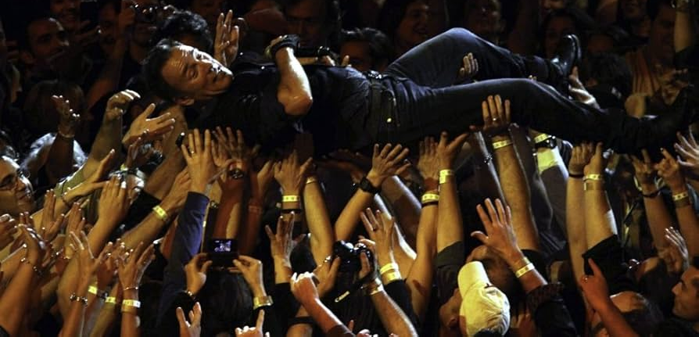
What makes you susceptible to the crowd?
Notes:
What makes you susceptible to the crowd?
Fear can make us malleable – covid compliance / magistrate
What others might think of us – try to keep under the radar
Not research facts for yourself - Silence is violence – immediate reaction is most authentic
Not bothering to come to own decision
None of these things are based on a desire to please God.

Slide 9
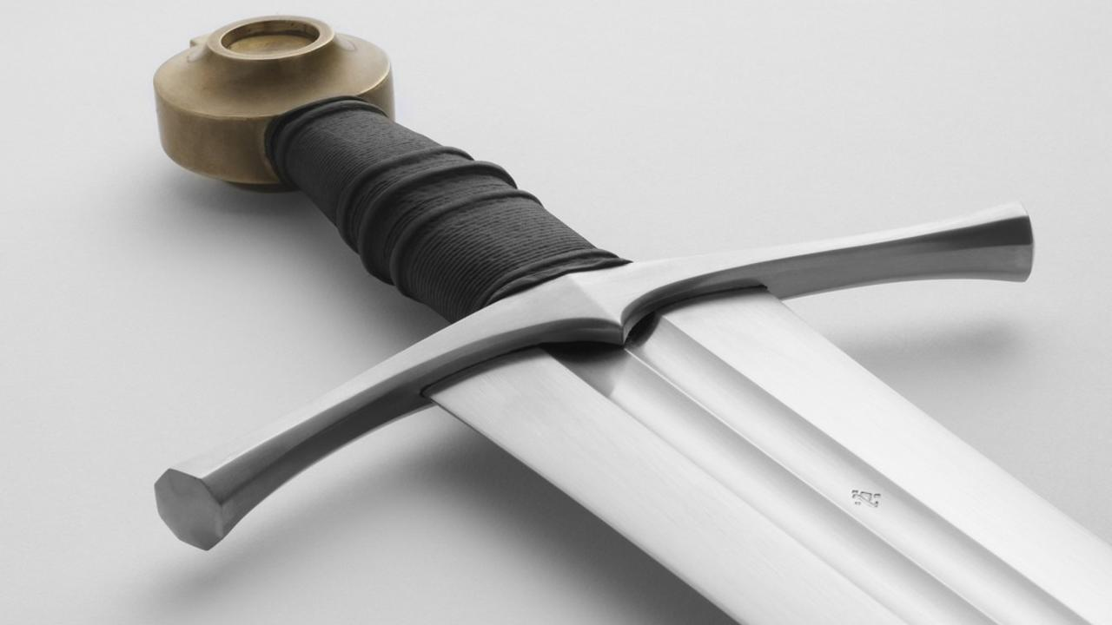
4. Necessity of Discernment
Notes:
Discernment
Motive – money generation. Presented – concern for peace of city and compliance with Rome – Magistrates not spot (fear makes us pliable)
Heb 4:12 For the word of God is alive and active. Sharper than any double-edged sword, it penetrates even to dividing soul and spirit, joints and marrow; it judges the thoughts and attitudes of the heart.

Slide 10
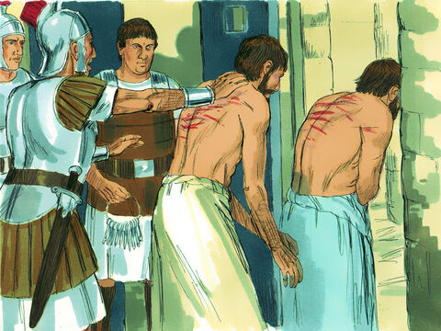
Notes:
²³ After they had been severely flogged, they were thrown into prison, and the jailer was commanded to guard them carefully.

Slide 11
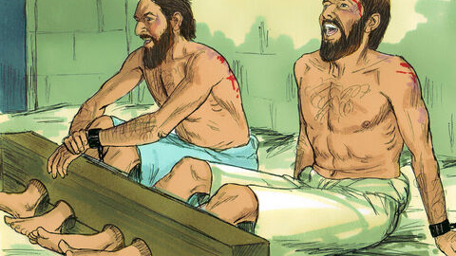
5. Shock of Singing in Stocks
Notes:
²⁴ When he received these orders, he put them in the inner cell and fastened their feet in the stocks.
²⁵ About midnight Paul and Silas were praying and singing hymns to God, and the other prisoners were listening to them.
Praying & singing – what has happened that this would be the response to the injustice they have faced from humans and the result of God’s orders
Body in chains but spirit free
Others listening when singing in stocks

Slide 12
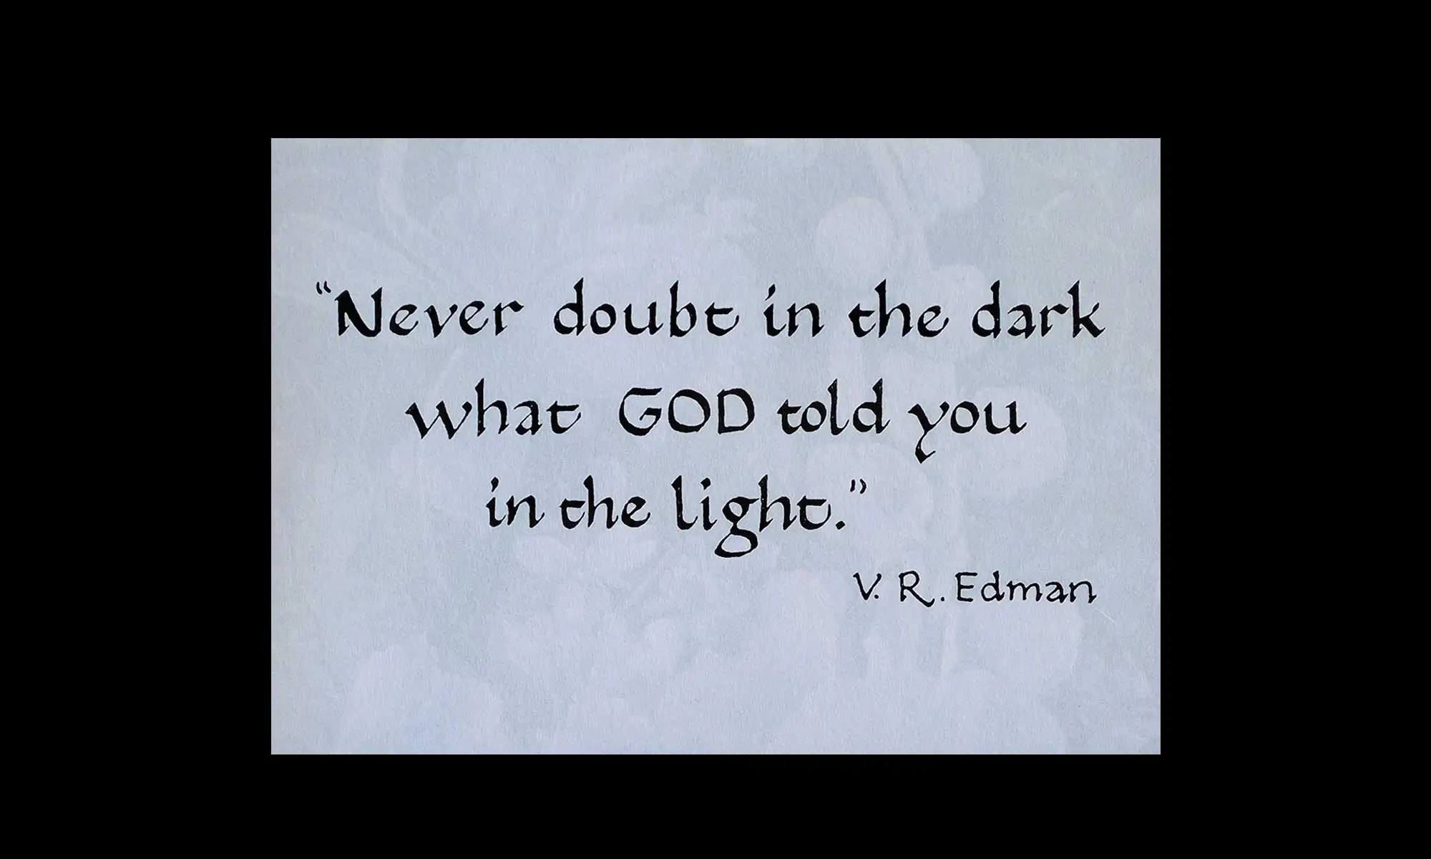

Slide 13
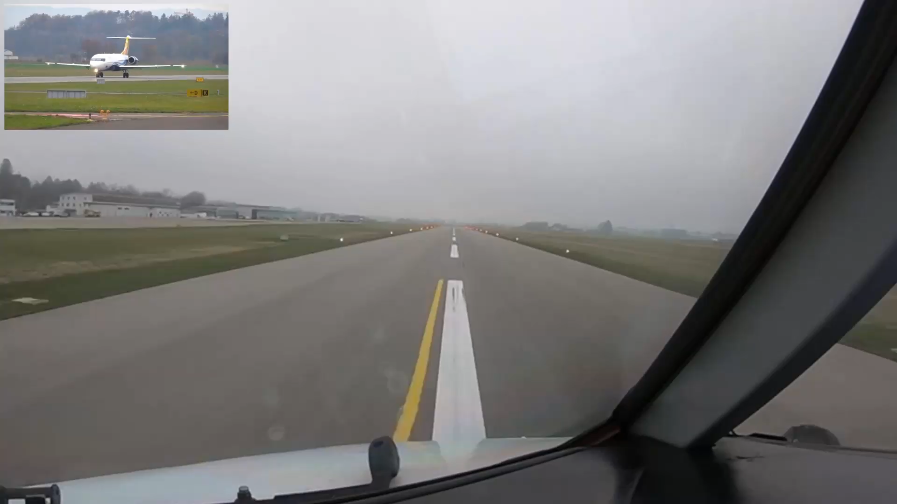
“Behind the cloud the sun is still shining.”
- Abraham Lincoln

Slide 14


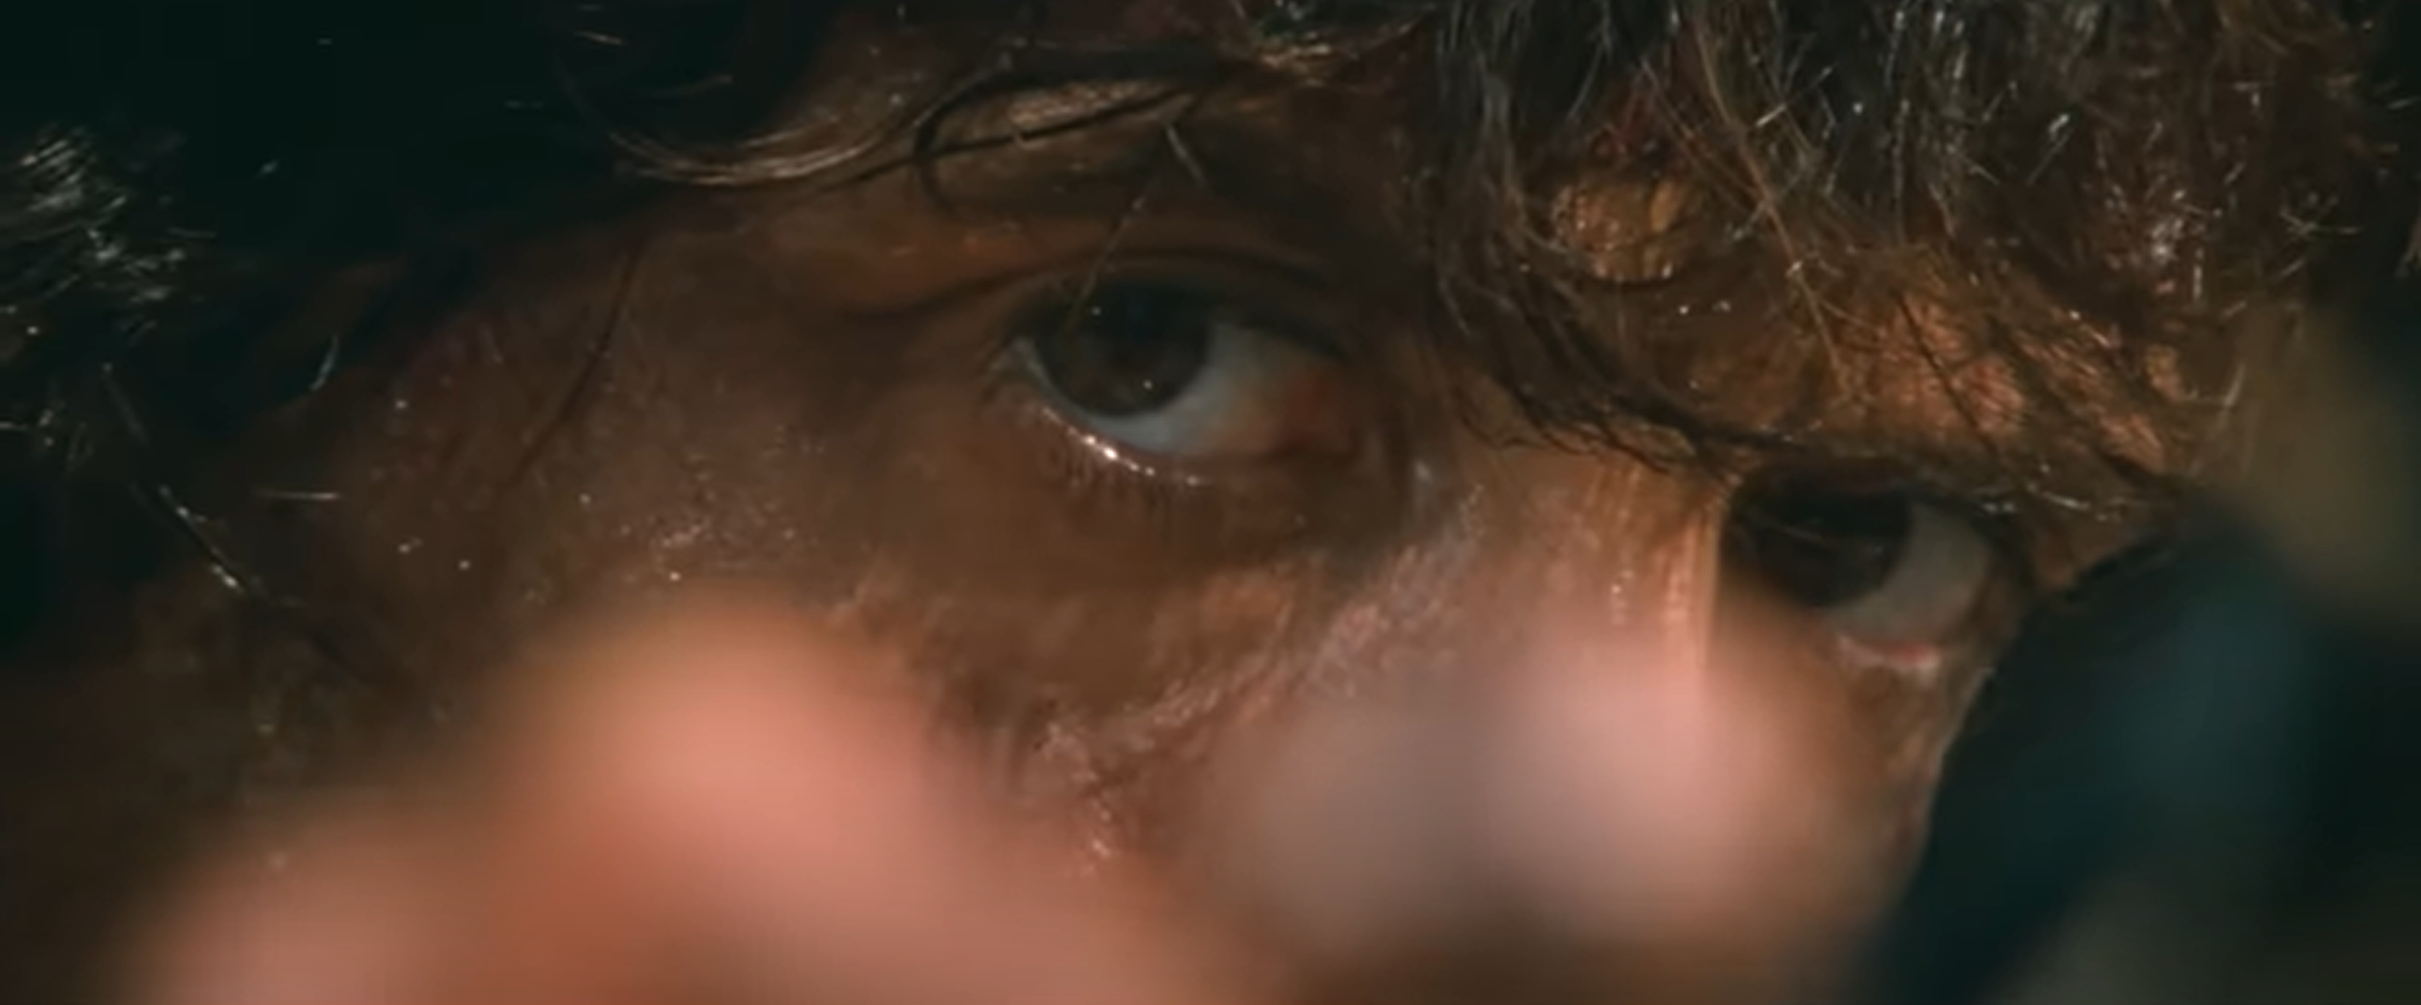

Slide 15
Acts 16:25-34
About midnight Paul and Silas were praying and singing hymns to God, and the other prisoners were listening to them. Suddenly there was such a violent earthquake that the foundations of the prison were shaken. At once all the prison doors flew open, and everyone’s chains came loose. The jailer woke up, and when he saw the prison doors open, he drew his sword and was about to kill himself because he thought the prisoners had escaped. But Paul shouted, “Don’t harm yourself! We are all here!”
The jailer called for lights, rushed in and fell trembling before Paul and Silas. He then brought them out and asked, “Sirs, what must I do to be saved?”
Notes:
Earthquake – God wanted to get involved
Punishment for failing in guarding – execution so suicide avoids public shame
Paul concerned for his well-being when jailer had been cruel
Paul command spirits and prisons – why would they obey Paul? Heard him singing?
What must we do to be saved? A vulnerable, open hearted position - it’s not the language of negotiation. - do nothing other than rely on what he has done

Slide 16
Acts 16:25-34
They replied, “Believe in the Lord Jesus, and you will be saved—you and your household.” Then they spoke the word of the Lord to him and to all the others in his house. At that hour of the night the jailer took them and washed their wounds; then immediately he and all his household were baptized. The jailer brought them into his house and set a meal before them; he was filled with joy because he had come to believe in God—he and his whole household.

Slide 17
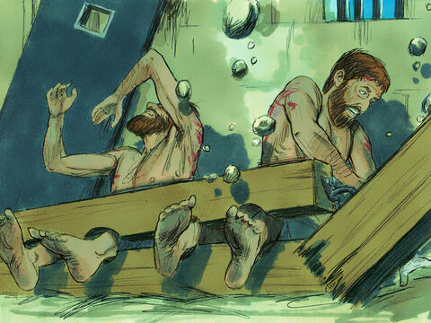
Notes:
²⁶ Suddenly there was such a violent earthquake that the foundations of the prison were shaken. At once all the prison doors flew open, and everyone’s chains came loose.

Slide 18
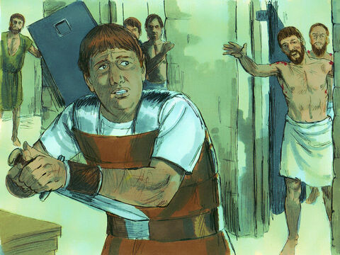
Notes:
²⁷ The jailer woke up, and when he saw the prison doors open, he drew his sword and was about to kill himself because he thought the prisoners had escaped. ²⁸ But Paul shouted, “Don’t harm yourself! We are all here!”
²⁹ The jailer called for lights, rushed in and fell trembling before Paul and Silas. ³⁰ He then brought them out and asked, “Sirs, what must I do to be saved?”
³¹ They replied, “Believe in the Lord Jesus, and you will be saved—you and your household.”

Slide 19
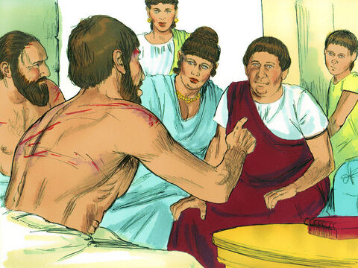
Notes:
³² Then they spoke the word of the Lord to him and to all the others in his house. ³³ At that hour of the night the jailer took them and washed their wounds;

Slide 20
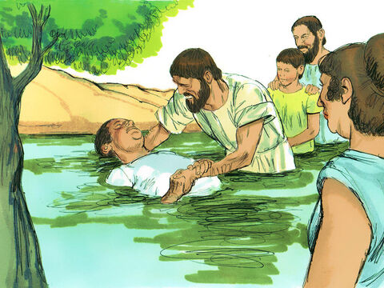
Notes:
then immediately he and all his household were baptized. ³⁴ The jailer brought them into his house and set a meal before them; he was filled with joy because he had come to believe in God—he and his whole household.

Slide 21
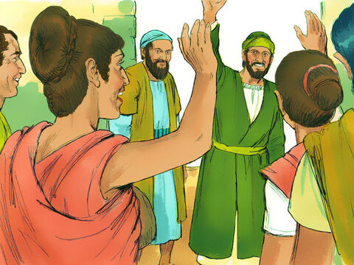

Slide 22

There they spoke so effectively that a great number of Jews and Greeks believed.
There was a plot afoot among both Gentiles and Jews, together with their leaders, to mistreat them and stone them.
Notes:
Preached effectively (saw fruit) yet still under threat
Opposition not necessarily result of poor presentation (Jesus was best representative of Himself and He was crucified)
Not just didn’t believe – ‘refused’ to believe – poisoned – no neutral positions to gospel
Messengers of Ultimate king have to flee…???

Slide 23
Acts 16:35-40
When it was daylight, the magistrates sent their officers to the jailer with the order: “Release those men.” The jailer told Paul, “The magistrates have ordered that you and Silas be released. Now you can leave. Go in peace.”
But Paul said to the officers: “They beat us publicly without a trial, even though we are Roman citizens, and threw us into prison. And now do they want to get rid of us quietly? No! Let them come themselves and escort us out.”
The officers reported this to the magistrates, and when they heard that Paul and Silas were Roman citizens, they were alarmed. They came to appease them and escorted them from the prison, requesting them to leave the city. After Paul and Silas came out of the prison, they went to Lydia’s house, where they met with the brothers and sisters and encouraged them. Then they left.
Notes:
Magistrate emotional reaction biting butt – wish they had done the research – they were the ones you violated the law
Doesn’t use his rights to protect self – chooses to identify (Phil 2) - Like Jesus renounced his status to suffer for us to afford us the status we couldn’t have afforded ourselves
Paul uses Roman citizenship & shift in power balance to protect the church
Met with the church – Lydia (who wanted to give her resources e.g. home to be used by kingdom), salve girl, jailer – when would they have interacted before – now they are “brothers and sisters”

Slide 24
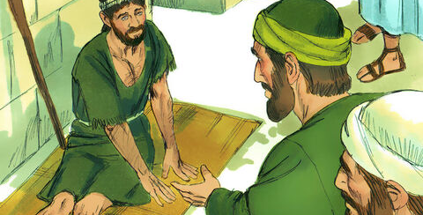
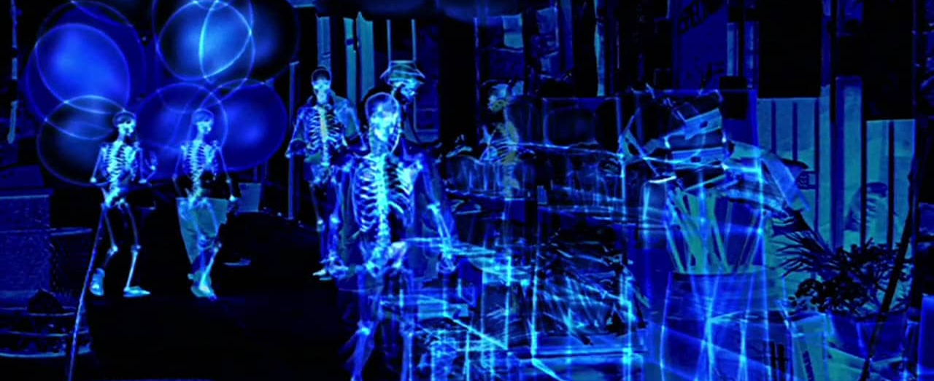
Paul looked directly at him, saw that he had faith…
Notes:
Paul’s words woke faith
Mirror Acts 3:4
To gaze intently, to look steadfastly, fixed gaze upon
Paul perceived the man had faith – I wonder what Paul saw
How do you perceive faith? Faith not the absence of facts, it’s the presence of conviction

Slide 25


Notes:
Ping pong ball pops back up
A proposed statement of faith – can’t be so delicate it can’t be exposed to facts or evidence – these should be poured on – not to extinguish but to stress test (not head in sand)
See if it pops back to the surface
Rom 4:19-20 Without weakening in his faith, he faced the fact that his body was as good as dead... ²⁰ Yet he did not waver through unbelief regarding the promise of God, but was strengthened in his faith …

Slide 26
Do you want to spot and nurture faith?
Notes:
Respect and Nurture faith in others
Look “directly” – what seeds of faith has been planted in others (what is God speaking to them about)
It might sound unconventional – test it, give it a go, get messy
- Maybe you are serving in some team – does your colleague have a new idea, a vision, an inspiration – draw it out, give space, interrupt the schedule

Slide 27
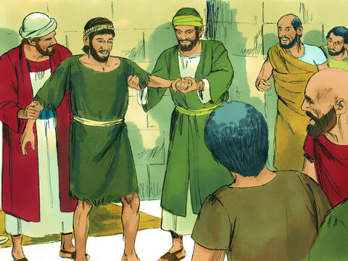
Do you want be a minister of the Spirit?
Notes:
Power evangelism – word and deed

Slide 28

Presenting the gospel to a pagan audience
Notes:
First time addressing a predominantly gentile crowd (not started at the synagogue)
In Acts 13, when speaking to Jews in diaspora, Paul talked about failure to live up to God’s law
Acts 13:38 “Therefore, my friends, I want you to know that through Jesus the forgiveness of sins is proclaimed to you. ³⁹ Through him everyone who believes is set free from every sin, a justification you were not able to obtain under the law of Moses.
But here they don’t believe in God’s law
How do you present the gospel in a culture that doesn’t believe scripture?
Doesn’t talk about sin and need for forgiveness

Slide 29
“You are worshiping idols, and you need a new master”
Profession/Situation | God
Soldier | God of war
Merchant | God of commerce
Farmer | God of agriculture
Artist | God of music & art
Politician | God of power
Lonely | God of romance
Notes:
You are worshiping idols and you need a new master
A polytheistic society is one that believes in multiple gods – you worship the god that gives you what you need
Not just doing commerce but worshipping it

Slide 30

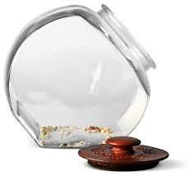
We are bringing you good news, telling you to turn from these worthless things to the living God
Notes:
Making highest allegiance to things which will ultimately leave them empty (deceptive, ineffective, promising fulfilment but falling short)
Worthless/empty – climb up for biscuit tin to discover nothing in it
These things take more than they give.
Now compare to God of all creation – He gives more than He requires – he has been giving you generously even though you haven’t acknowledged Him
You are controlled by what you live for
If you live for love you are controlled by the people who you want to love you
Power, career
False gods will enslave you but the real God will liberate you
This is what you say to relativists (don’t believe God, law of God, in sin/guilt, need for forgiveness, up to you to decide what is right)
You are living for something (you might not want to admit how important this something is for you)
This thing has mastered you – it’s the reason you always feel like an imposer, angry, disillusioned
The real God is the only one who can satisfy you (and if you fail Him, forgive you). If being a great parent is your god and you fail, it won’t die for you, it will punish you for the rest of your life
Christ is the only master who became a servant

Slide 31

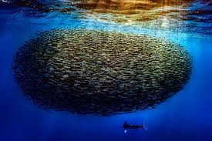
Identifying Idols
Imagination
Money
Disappointment
Uncontrollable emotions
Notes:
Identifying Idols
Imagination – where do my effortless thoughts go? What do you habitually think about?
Money – where does your money effortlessly flow toward heart’s greatest desire
Disappointment - How respond to unanswered prayer and frustrated hopes. What causes explosion of anger and despair.
Uncontrollable emotions – Fishermen know to look for fish where the water is roiling, look for your idols at bottom of most painful emotions, especially those that don’t seem to lift or drive you to do what you know to be wrong. I must have at all costs. Same with fear/despair/guilt

Slide 32
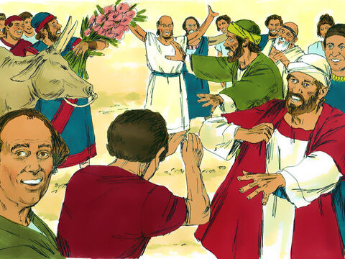
“The gods have come down to us in human form!”
Notes:
Fulfils longing
Acts 14:11 “The gods have come down to us in human form!”
They were wrong – but also right…
Thought Paul & Barn would fulfilling their fairytale
Why do fairytales grab out imagination?
Tolkein – 4 deep longings that realistic fiction can’t satisfy
Long to escape death (time travel)
Long to talk to non-human beings
Long for healing love (without parting)
Long for good to triumph over evil
Our time says not possible – when you die you rot
So why do these stories satisfy us – memory trace – Gen 1-3.
Even the pagans had ‘good dreams’ – something we can remember
There was a God who broke through into our world and promised to fulfil all these longings

Slide 33
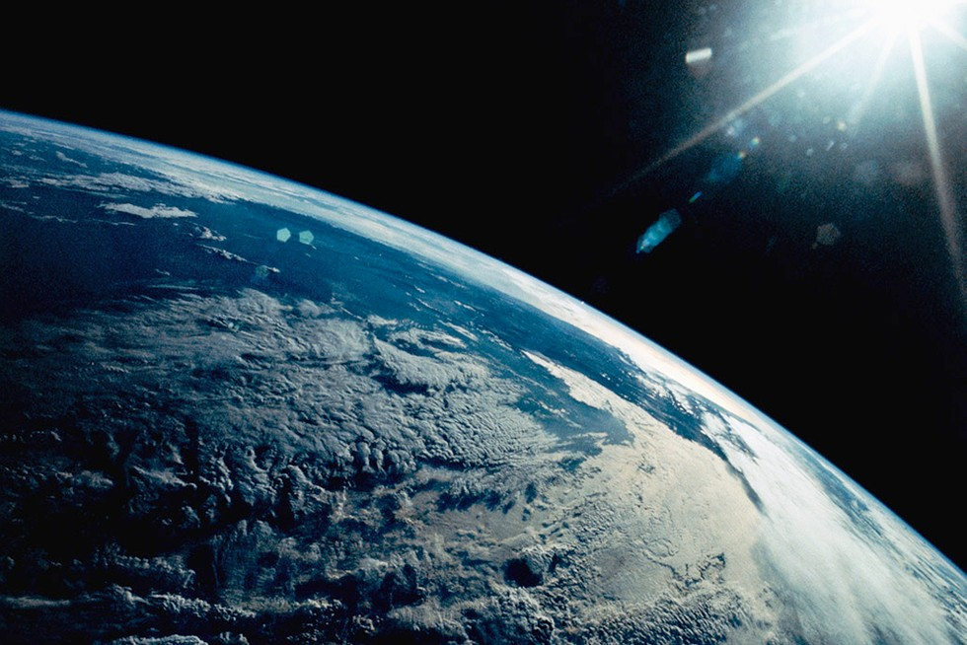
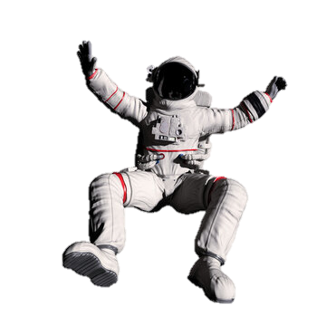
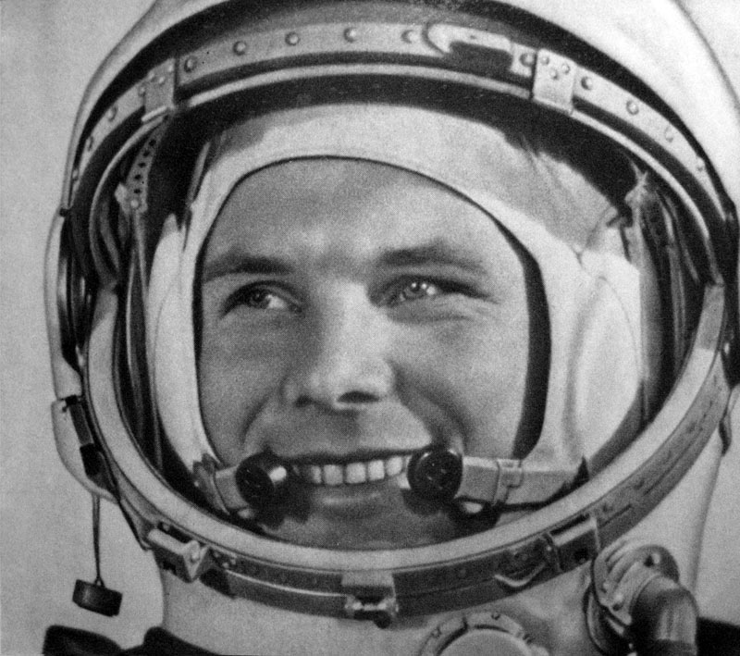
Notes:
When Yuri Gagarin became the first man to journey into outer space,

Slide 34
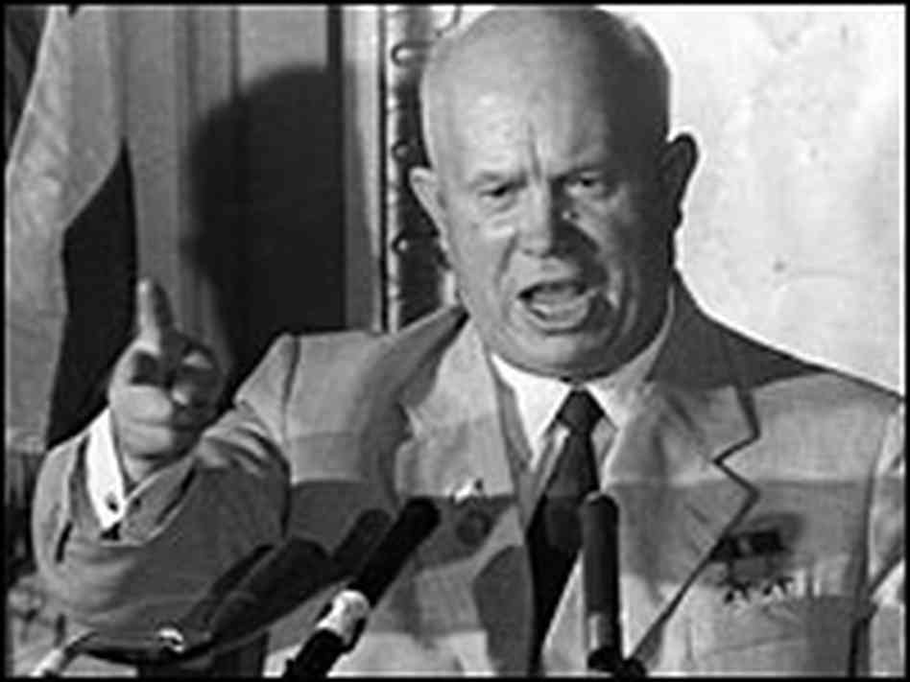
Notes:
Khrushchev declared “now we know there is no God because we have been to the heavens and not found him”.

Slide 35
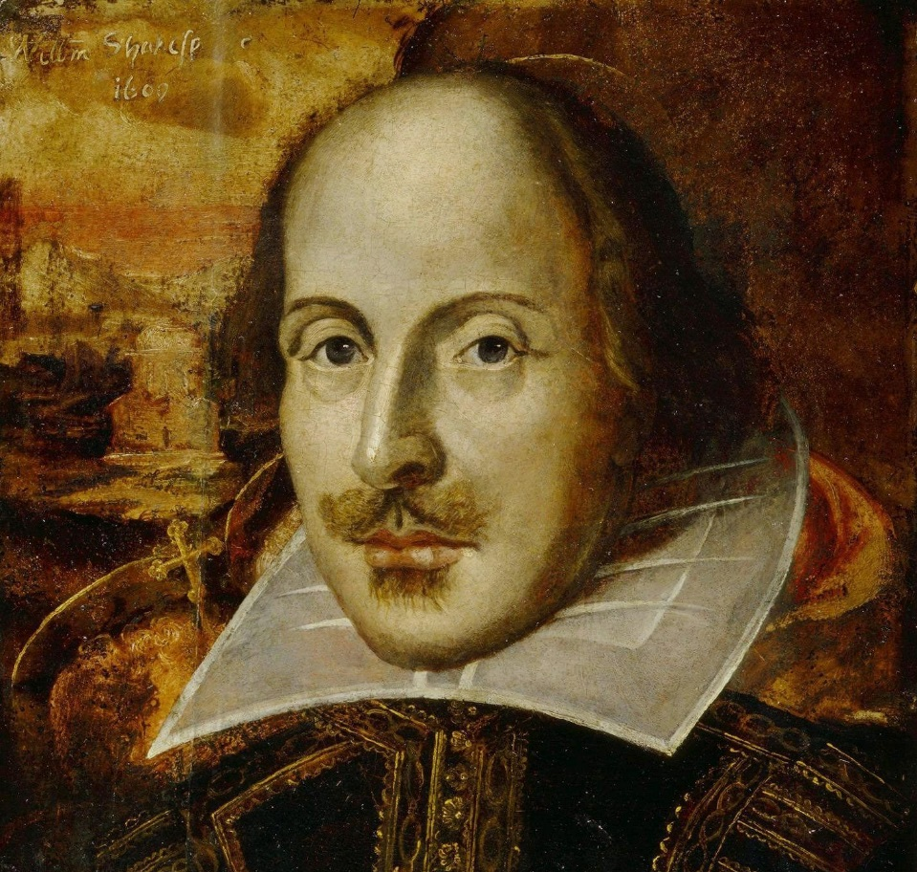
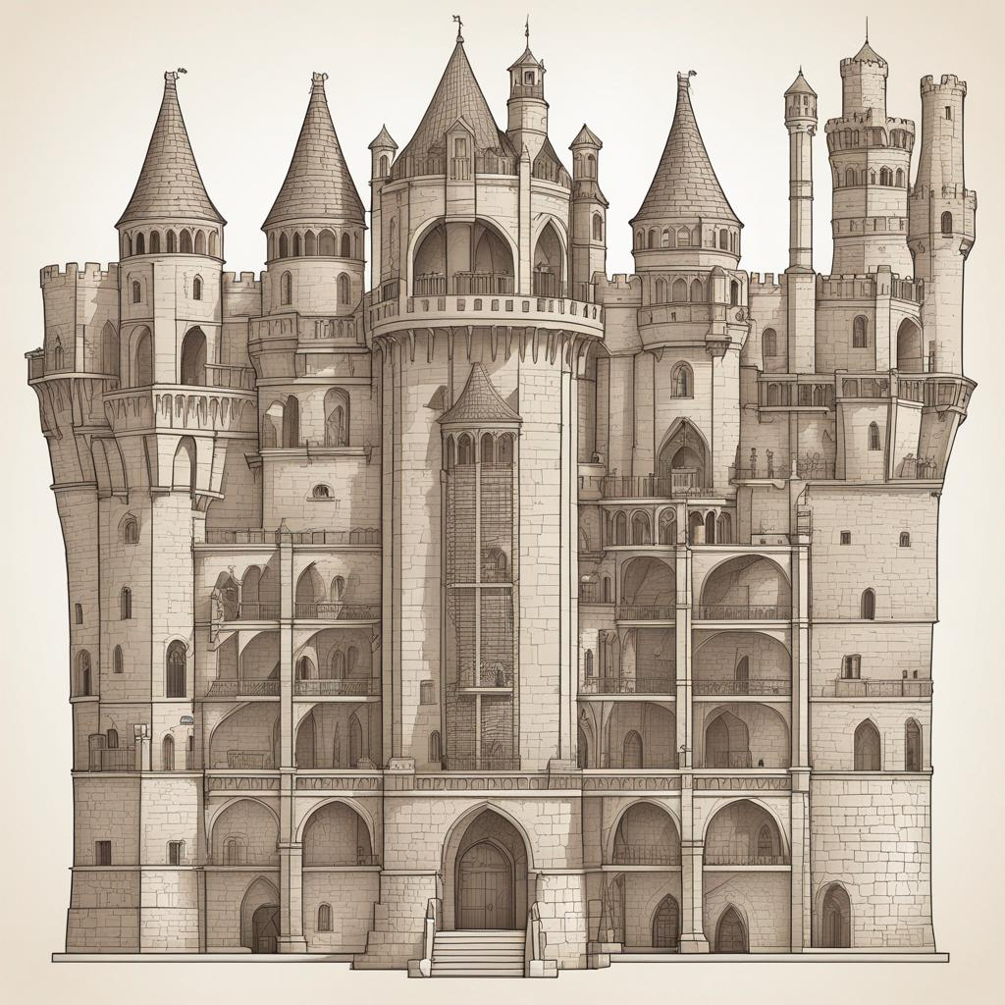

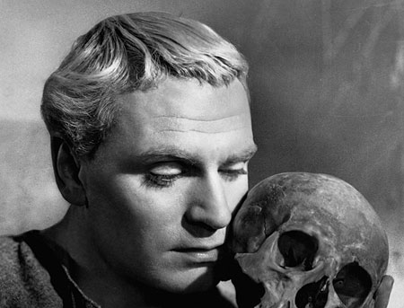
Notes:
CS Lewis remarked – it was like Hamlet trying to find Shakespeare by searching in the attic of his castle. It is a ridiculous idea. The only way the character of the story will become aware of the author is if the author writes Himself into His-story.

Slide 36
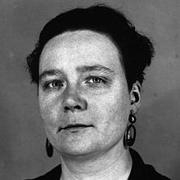
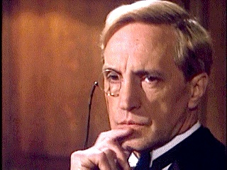
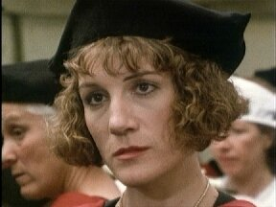
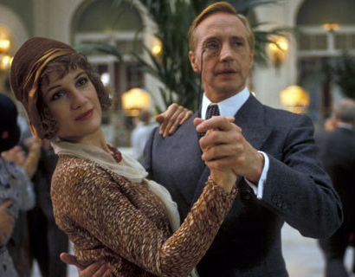
Would you like to be captured by the gospel anew?
Do you want to be a messenger of God?
Notes:
Dorothy L Sayers was one of the first women to graduate Oxford, she write crime fiction and was single. She created a sleuth called Lord Peter Wimsey, a brilliant detective but tortured and lonely. A new character arrives in the series, Harriet Vane. Harriet is one of the first women to graduate Oxford, is single and writes detective novels.
Dorothy L Sayers, saw that her creation (Wimsey) was lost and needed to be rescued so in love for him, she wrote herself into the story.
God wrote Himself into the story, in the form of Jesus, because he saw the creation he loved was lost and needed rescuing.
God did come down in human form to seek and save the lost (us)

Slide 37
Acts 14:19-22
Then some Jews came from Antioch and Iconium and won the crowd over. They stoned Paul and dragged him outside the city, thinking he was dead. But after the disciples had gathered around him, he got up and went back into the city. The next day he and Barnabas left for Derbe.
They preached the gospel in that city and won a large number of disciples. Then they returned to Lystra, Iconium and Antioch, strengthening the disciples and encouraging them to remain true to the faith. “We must go through many hardships to enter the kingdom of God,” they said.

Slide 38
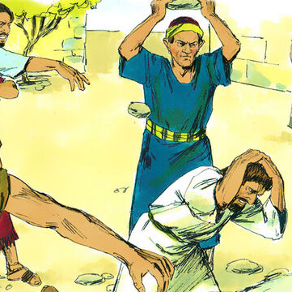
We must go through many hardships
Hardship used as purifying furnace
Nothing can separate us from His love
Testimony to the lost (especially in our culture)
Are you willing to take a new look at your suffering?
Notes:
Flees Iconium, stoned in Lystra – not good advert for messenger
Acts 9:16 I will show him how much he must suffer for my name.”
Hardships help us find the King and become like Him
Humility is a relief after hurt ego and trying desperately to save face
The purifying furnace
The way many Christians face hardship is a doorway to non-believers
Christians suffer and die better – not afraid of death and suffering
Cultural anthropologist Richard Shweder
Every culture gives you a story as to what life is about – western culture says its about (freedom to choose) happiness – gives us no resources to face suffering because it doesn’t help us achieve the story of life. Suffering an interruption not meaningful
Whiniest culture in history
[are you willing to take a new look at your suffering]

