Slide 1
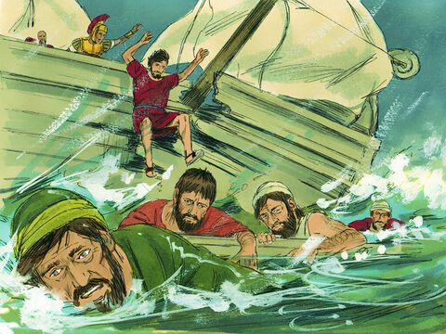
Acts Series
Episode 29: Chpt 27
14th Sept 2025
Notes:
Dramatic chapter
Reads like the narrative of a maritime log (could be at the Maritime Museum in Greenwich)
So much in this we could go in many directions
But we will focus on
The value of storms
No plan B
Lightening the load
Standing up in a storm

Slide 2
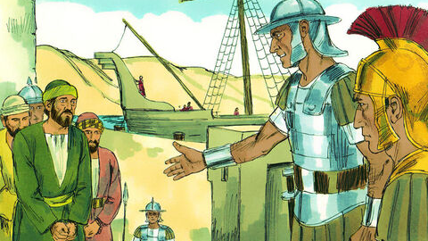
Notes:
1When it was decided that we would sail for Italy, Paul and some other prisoners were handed over to a centurion named Julius, who belonged to the Imperial Regiment. 2We boarded a ship from Adramyttium [Adra-mit-tium] about to sail for ports along the coast of the province of Asia, and we put out to sea. Aristarchus [Ari-star-cus], a Macedonian from Thessalonica, was with us.

Slide 3
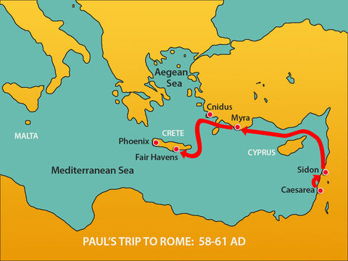
Notes:
3The next day we landed at Sidon; and Julius, in kindness to Paul, allowed him to go to his friends so they might provide for his needs. 4From there we put out to sea again and passed to the lee of Cyprus because the winds were against us. 5When we had sailed across the open sea off the coast of Cilicia [si-lis-ia] and Pamphylia, we landed at Myra in Lycia [lis-ia]. 6There the centurion found an Alexandrian ship sailing for Italy and put us on board. 7We made slow headway for many days and had difficulty arriving off Cnidus [Sni-dus]. When the wind did not allow us to hold our course, we sailed to the lee of Crete, opposite Salmone [Salmon-e]. 8We moved along the coast with difficulty and came to a place called Fair Havens, near the town of Lasea [La-sea].
wind did not allow us to hold our course
Premonition of storm to come
For all Rome’s power & determination – have to yield to will of the weather

Slide 4
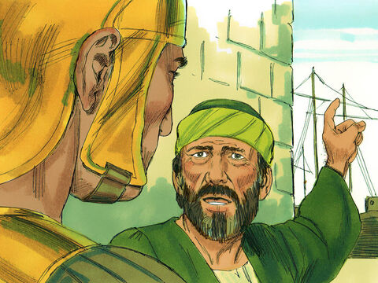
Acts 27:9-12
Much time had been lost, and sailing had already become dangerous because by now it was after the Day of Atonement. So Paul warned them, “Men, I can see that our voyage is going to be disastrous and bring great loss to ship and cargo, and to our own lives also.” But the centurion, instead of listening to what Paul said, followed the advice of the pilot and of the owner of the ship. Since the harbor was unsuitable to winter in, the majority decided that we should sail on, hoping to reach Phoenix and winter there. This was a harbor in Crete, facing both southwest and northwest.
Notes:
Much time had been lost – pressure to take risks leading to the failure of the mission (get goods to the location)
The Day of Atonement, or Yom Kippur, typically falls in late September or early October, coinciding with the beginning of the stormy season in the Mediterranean. This means the weather in the Mediterranean during the Day of Atonement can be unpredictable and potentially hazardous, especially for maritime travel.
instead of listening to what Paul said, followed the advice of
the pilot
owner of the ship.
majority decided (v12)
Trust expertise over anointing (not listening to incarcerated tent mending, iterant preacher)

Slide 5
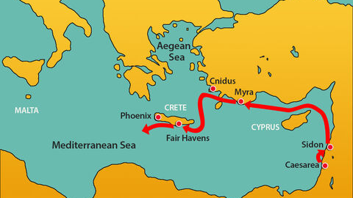
Notes:
13When a gentle south wind began to blow, they saw their opportunity; so they weighed anchor and sailed along the shore of Crete.
- [centurion scheming] Saw their opportunity – misread because determined to see a gap

Slide 6
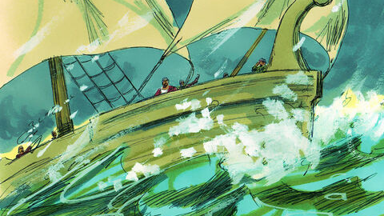
Notes:
14Before very long, a wind of hurricane force, called the Northeaster, swept down from the island. 15The ship was caught by the storm and could not head into the wind; so we gave way to it and were driven along. 16As we passed to the lee of a small island called Cauda [Cow-da], we were hardly able to make the lifeboat secure, 17so the men hoisted it aboard
- Out of control - gave way to it

Slide 7
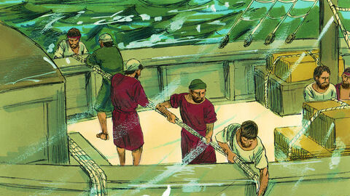
Notes:
Then they passed ropes under the ship itself to hold it together. Because they were afraid they would run aground on the sandbars of Syrtis [Sear-tis], they lowered the sea anchor ^{b} and let the ship be driven along.

Slide 8
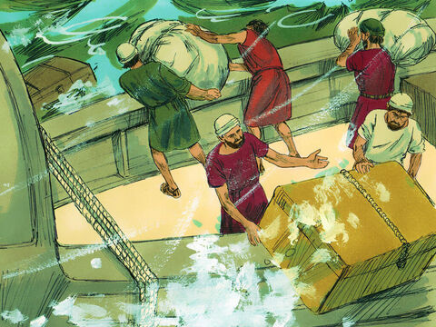
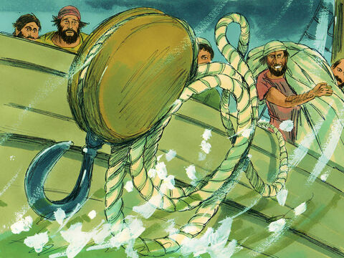
Notes:
18We took such a violent battering from the storm that the next day they began to throw the cargo overboard. 19On the third day, they threw the ship’s tackle overboard with their own hands.
- Tackle - everything that was not indispensable (beds, sails)
We threw…All hands on deck
Throwing over personal belongings and comforts – give lives to amass now willing to discard to save life
Might look good to discard at moment of peril but the ship wasn’t saved…

Slide 9
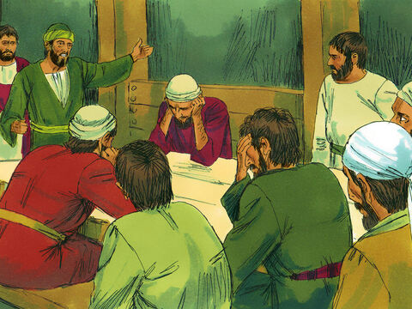
Acts 27:20
When neither sun nor stars appeared for many days and the storm continued raging, we finally gave up all hope of being saved.
Notes:
All hope of being saved – darkest moment
Run out of effort/options

Slide 10
Notes:
Acts 27:21-26
After they had gone a long time without food, Paul stood up before them and said: “Men, you should have taken my advice not to sail from Crete; then you would have spared yourselves this damage and loss. But now I urge you to keep up your courage, because not one of you will be lost; only the ship will be destroyed.
Paul stood up (turning point in the story)
Been mistreated, murder attempts, ignored, failed by justice system, now a prisoner – yet he stood up
What is Paul’s basis for standing up in the storm? (What’s yours)
Changes atmosphere & outcome
Jack Little – Pee Wee Hermen (spirit UPON) – Gideon, Saul
Toby Simmons / Myles / Joe – Steve / Diamond mines – lots of reasons to be intimidate & keep head down
Faced with truth (not popularity contest)
- consequence to our actions (The cargo and ship didn’t have to be lost) - Not about rubbing face in it – its to help them follow his next instructions better

Slide 11
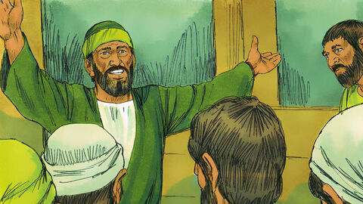
Notes:
Acts 27:23-26
Last night an angel of the God to whom I belong and whom I serve stood beside me and said, ‘Do not be afraid, Paul. You must stand trial before Caesar; and God has graciously given you the lives of all who sail with you.’ So keep up your courage, men, for I have faith in God that it will happen just as he told me. Nevertheless, we must run aground on some island.”
Stood beside me
Paul’s basis for standing
Similar to Acts 23:11 – stood beside
“the God whose I am and whom I serve …”
I am God's treasured possession
He knows he's loved. In other words, he knows in this storm he's being loved, not being rejected.
Intimacy
Empathy – in the boat with them
Nevertheless, we must run aground - Not going to be pretty

Slide 12
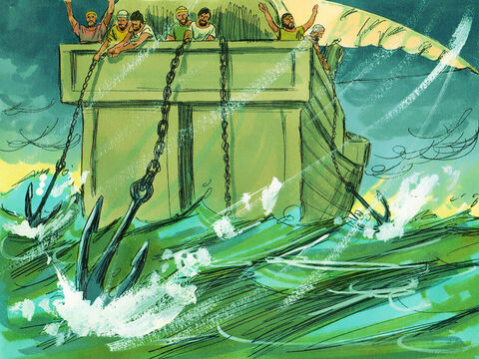
Notes:
27On the fourteenth night we were still being driven across the Adriatic ^{c} Sea, when about midnight the sailors sensed they were approaching land. 28They took soundings and found that the water was a hundred and twenty feet ^{d} deep. A short time later they took soundings again and found it was ninety feet ^{e} deep. 29Fearing that we would be dashed against the rocks, they dropped four anchors from the stern and prayed for daylight.

Slide 13
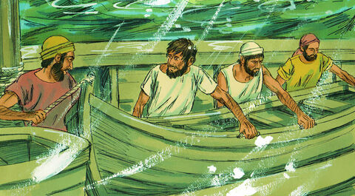
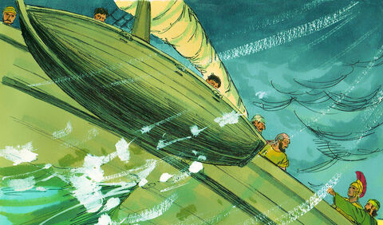
Notes:
30In an attempt to escape from the ship, the sailors let the lifeboat down into the sea, pretending they were going to lower some anchors from the bow. 31Then Paul said to the centurion and the soldiers, “Unless these men stay with the ship, you cannot be saved.” 32So the soldiers cut the ropes that held the lifeboat and let it drift away.
14th night!
[Sailors scheming] Deception, save themselves (that’s the ultimate deception – that we can save themselves)
Only saved if stay on ship?!
But God said all would survive…? – paradox of our role & God’s role
Counter intuitive – only save life if we lose it
Is God in charge, or are we?
Cut lifeboats – no plan b (what does it mean for you to cut your lifeboats?)

Slide 14
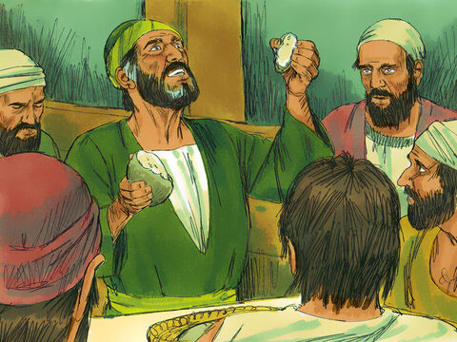
Notes:
33Just before dawn Paul urged them all to eat. “For the last fourteen days,” he said, “you have been in constant suspense and have gone without food—you haven’t eaten anything. 34Now I urge you to take some food. You need it to survive. Not one of you will lose a single hair from his head.” 35After he said this, he took some bread and gave thanks to God in front of them all. Then he broke it and began to eat. 36They were all encouraged and ate some food themselves. 37Altogether there were 276 of us on board. 38When they had eaten as much as they wanted, they lightened the ship by throwing the grain into the sea.
Communion
gave thanks & he broke it /eaten as much as they wanted
Feeding 5,000 language
Communion upon a ship heading to wreck
Non-Christians
Courage injected – eyes opened, hearts burned
See the one who was thrown into the ultimate storm for us, so we could be saved
lightened the ship
Threw overboard their perceived purpose/identity (if I’m not this identity I’m nothing / if I’m a grain ship without grain there’s no point in continuing) (held onto the grain to this point even though thrown other stuff earlier) – a deeper cleansing
For the purpose of lightening ship – to keep going – let Him strip everything away – I want to be light/nimble/responsive to him
- What do you need to toss overboard? (I have to have a plan or not at peace/I need to be the rescue ranger/when I’m a leader I feel I’m doing well)
- You will find you Lighten hearts as lighten ship

Slide 15
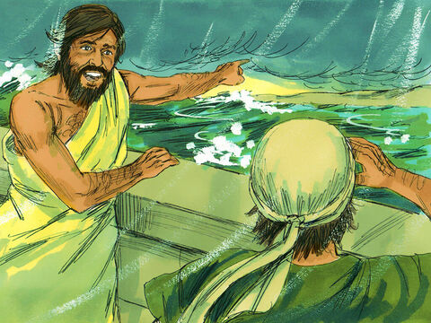
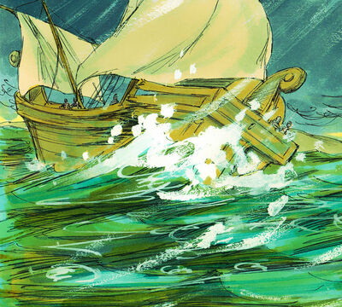
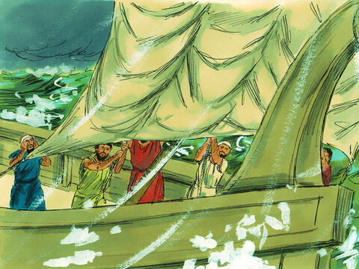
Notes:
39-41
When daylight came, they did not recognize the land, but they saw a bay with a sandy beach, where they decided to run the ship aground if they could.
Cutting loose the anchors, they left them in the sea and at the same time untied the ropes that held the rudders. Then they hoisted the foresail to the wind and made for the beach.
But the ship struck a sandbar and ran aground. The bow stuck fast and would not move, and the stern was broken to pieces by the pounding of the surf.
Place of safety unrecognisable - it is beyond our hopes and desires
Cut loose – let go of control
stern was broken to pieces by the pounding of the surf
dramatic
Shipwreck seems like the wrong move, but it was the route to safety
Being on the ship was keeping them alive – now it would kill them if they don’t evacuate – change as God changes

Slide 16
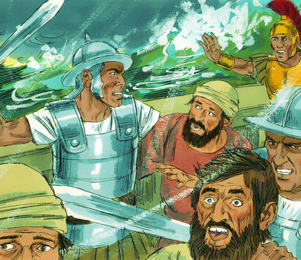
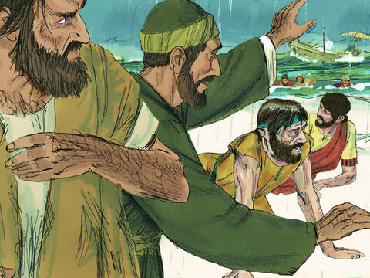
Notes:
42The soldiers planned to kill the prisoners to prevent any of them from swimming away and escaping. 43But the centurion wanted to spare Paul’s life and kept them from carrying out their plan. He ordered those who could swim to jump overboard first and get to land. 44The rest were to get there on planks or on other pieces of the ship. In this way everyone reached land safely.
[Soldiers scheming] their own protection – how sad to be deluded to think we are solely responsible for our future
How many different methods took place to ensure God’s word realised – i.e. not one will be lost
get there on planks – doesn’t matter how you get there (interestingly at one point holding ship together - now need to be broken up to help them now)
Some methods might lack dignity
Not calming the storm in this occasion
God’s hand at work the whole time (even in darkest moment) – [all man’s scheming yet God in control]
Proverbs 19:21 — “Many are the plans in a person’s heart, but it is the Lord’s purpose that prevails.”
Your name is the highest - Your name is the greatest - Your name stands above them all - All thrones and dominions - All powers and positions - Your name stands above them all

Slide 17
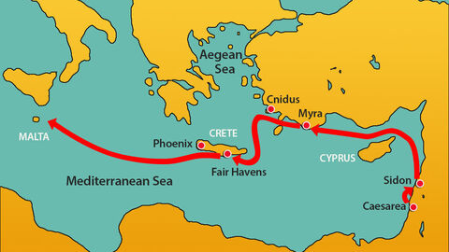
Notes:
The purpose of storms
Storms can drive you to your destination faster. If you can survive the storm you’ll be better off.
God’s purpose is Godliness
The storm gets Joseph to the palace (with the necessary character)
You meant for evil, God meant for good
God works from the vantage point of eternity
Embracing God’s plans in your storm
God loves you too much to leave you alone
Perhaps he wants you to stop scheming – let go of your plan b/escape plan
Perhaps he wants you to lighten the ship – get rid of those things you put your identity in so that you are more agile and responsive to what He has for you
Allow Him to set the course/agenda for your life
Receive the character development (long suffering/awareness of others) – Joseph needed to suffer to become worthy PM
Not always helpful to ask “what did I do wrong to end up here” - Paul had to be on the ship & the ship had to be in the storm to share

