Slide 1
Shaped up for Apprenticeship
Acts series
Daniel Singleton
Lifeline Church – 8th June 2025
Notes:
Song plays – mind worm
Ice storm story
Rachel read ODB
Journey with me today – this is another of those words that to the top - I want to say ‘not that I have achieved all this, but I press on towards the goal’ Phil 3 12-14

Slide 2
Love God, love each other
….and live like we mean it
Notes:
As we approached Christmas (before my dad passed away) I was chewing on this phrase - was there not a danger that it would lead to a holy huddle – ‘I’m aright’ ‘you do you’
I think I know what love each other means – but what about … our call to proclaim the kingdom – to make a difference in the world around
The key to it all is an unpacking Love God

Slide 3
“This is how we know that we know him if we keep his commands” (1John 2 v 3)
“This is how we know that we love God’s children: when we love God and obey his commands. (1John 5 v 2-3)
Notes:
Point to board (let them read)
In 1 john 2 v 3 says ³ This is how we know that we know him: if we keep his commands.
1John 5 v 2-3 This is how we know that we love God’s children: when we love God and obey^{[b]} his commands. ³ For this is what love for God is: to keep his commands.
In that little is wrapped up a lifeline of action --- so we find ourselves at Pentecost (in fact I was speaking here in 2020 during lockdown)

Slide 4
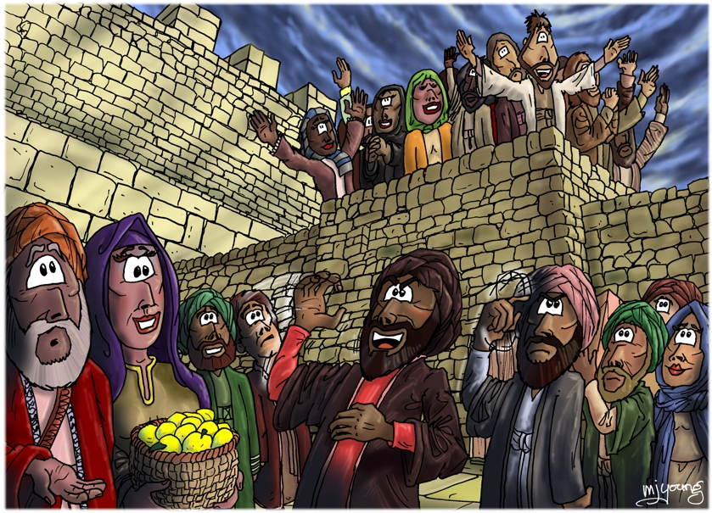
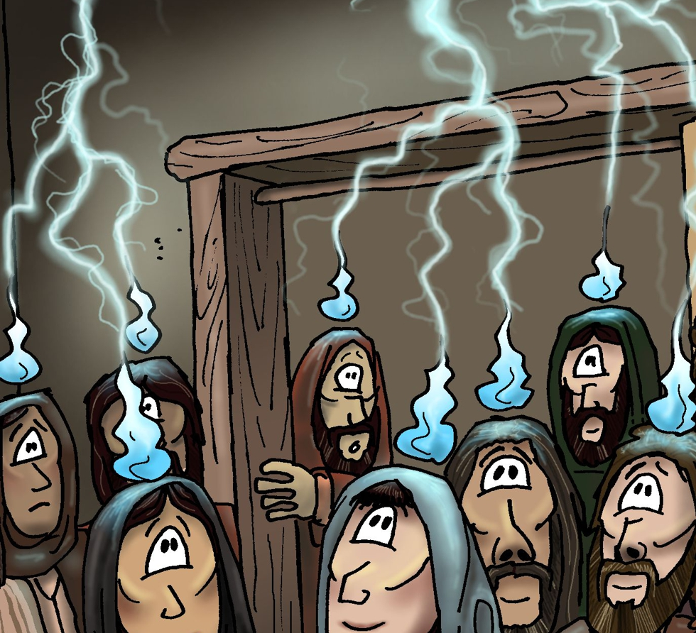
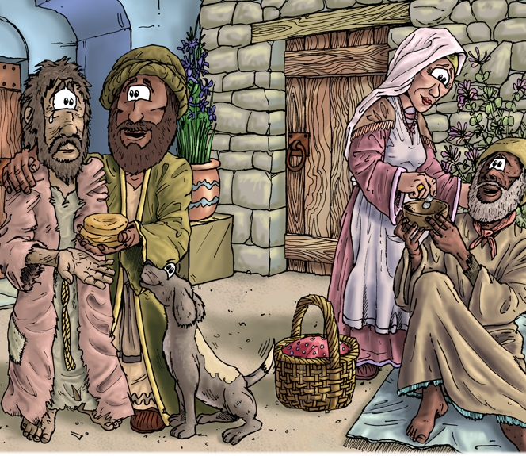
Jesus says(Acts 1) ….
…and at Pentecost (Acts 2)
Notes:
Acts 1 – Jesus says… “You will receive power when the Holy Spirit comes on you; and you will be my witnesses in Jerusalem, and in all Judea and Samaria, and to the ends of the earth” CLICK
Then we see –CLICKS 1)filled with power HOLY SPIRIT/ tongues of fire / 2) speaking other languages/ 3)healings, community, teaching & learning JS ways, sharing food and life
But lets go back a little Matt 28v16-19 context – end of gospel of Matt, JC died rose been around for about 40 days, final record before ascension (READ) CLICK

Slide 5
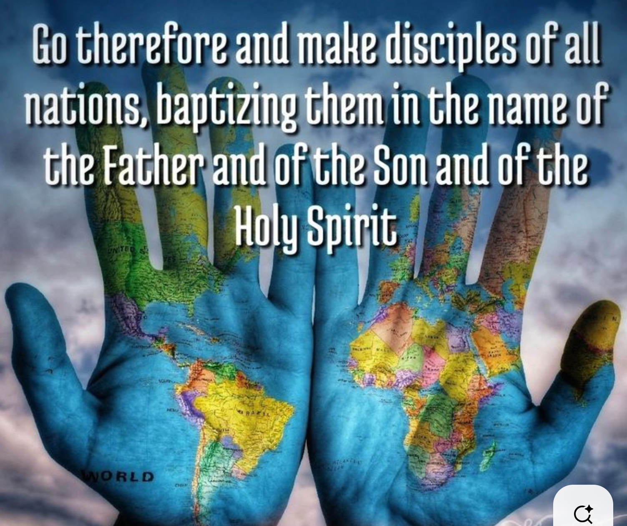
Go
Make Disciples
The Great Commission
Matt 28
Notes:
(Go and Disciple baptise and teach for another time)
Go – don’t stay … (no room for a holy huddle here) All nations / whole earth – I believe this ‘going’ (and sending) is not just geographic its thematic/ spheres (music, education, entertainment, business, charity etc) – I feel we have to re-find our corporate calling to shine light – proclaim the kingdom (and grapple with what that means again) we are called to be salt/ light and a city on a hill
Reminded of the Keith Green song ‘Jesus commands us to go’ --- and the power line ‘we’re his hands and his feet’ – what should that mean for our neighbours? communities and work colleagues (CSLewis – add your cell to his body)
Later on we see the story of the church – take a huge leap – Church persecuted - they have to go --- but I wonder if the Church in Jerusalem ever really embraced that going/ sending (to focused on preserving) – unlike the Antioch Church that sent Paul and Barnabas
How about this strange word disciple (note not converts)– - its true there is a need for disciplers (those who will show the ways of Jesus) but it is not easy to be a disciple – you have to have the right attitude

Slide 6
Disciple of Jesus
Christ- Apprentice
Follower of the Way
基督徒
ji du tu
Notes:
Apprentice – far better expresses what discipleship should look like – watch/ doing with / doing while being watched - Jesus lived life with his disciples, Paul joins Barnabus, Timothy apprentices to Paul, LIFE – DOING – ALONGSIDE --- (not only theoretical merely discussion)
Practicing the way of Jesus- there is a way (a relationship with God, a journey a way of being …. Not empty religion)
Paul challenges – imitate me as I imitate Christ 1 Cor 11 (the opposite is true also – only follow me in Godliness)
But to be an apprentice you have to recognise you have something to learn – i.e you need to humble yourself (not easy – when we are told we are a complete person, don’t submit to anyone)
To listen under (obedience) -(hupakoé)
To listen alongside (disobedience) - "Parakoe“ – parallel – where you position is key

Slide 7
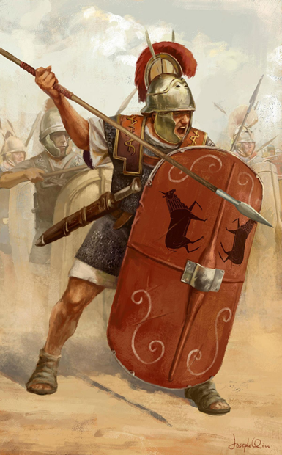
Apprenticeship - ‘Listening under’
The Triarri
Notes:
Recap – appreciating what experience you have –Old Roman saying saying res ad triarios venit meant "it comes down to the triarii" and referred to carrying on to the bitter end. – value in learning from maturity
Letting someone speak into you life is not easy – particularly in context of individualism – easier to ask google (than look silly)… look up online (AI mostly used for company and counselling) ‘ be submitted to one another (Eph 5 21)
…. teachable … humbling … getting discipled … against the way of this world ---You can to get apprentice if you don’t want to learn
Are you shaped up for apprenticeship? ---
to take someone under your wing (do you have something to give – to teach –an experience to share
Are you in a place to be apprenticed are you teachable – ready to learn
My examples; JP – enthusiasm Willie – bible reading McGrath – size the paddle DC – insightful timely encouragement Mike –to do / not to do/ list plans/ Dad – everything good
My best experience: Emily story – hungry for Christlike answers (I had revelation while explaining)

Slide 8
Go – but to who?
Notes:
But then the question is begging – where do we go?
Something seems to be happening
Latest research by bible society

Slide 9
Who’s in church?
 | 2018 | 2025
Over 65s | 14% | 19%
Middle-aged | 7% | 5%
Under 35s | 4% | 16%
Overall | 8% | 12%
Why this growth ?
Notes:
Bible society research
The question ‘Do you attend church at least once a month?’ was asked both in 2018 and 2024. The slide shows how church attendance has grown by 50%.
Click for each percentage figure. 2018 stats will appear first, 2024 stats next.
young men are now more likely to attend than young women.
Why is this? Of course we don’t know for sure – but we have some ideas

Slide 10
Nobody tells you the last time you get to make friends is at University !
30year old Software engineer (and church Treasurer) to his vicar.
Notes:
Why is church attracting young people? Borrowed from Nick spencer of Theos
Quote above online world– disfunction –– (HR worries/ remote working/ no safe spaces/ pubs to meet in) -
– Pandemic (people using AI for company and counselling)
our body life / shared life is dynamic and attractive to a world disconnected
/ Geopoitics / social disenfranchisement/
lack of relationships and fathers/
immigration & islam
masculinity(culture wars) family breakdown,
influencers fame folk speaking up for faith/
@Wedding May no-longer an odd conversations rebelling against underlying purposeless atheism (world aint getting better) (secularism is the norm)
The answer to 2008 – yes we can… in 2025 is – ‘seems we can’t’

Slide 11





Direct impact
Purpose
Hope
Community
Mental health
Acts of kindness
Notes:
[Click ‘Purpose’] Respondents who went to church were one and a half times as likely as non-churchgoers to say their lives felt meaningful.
[Click ‘Hope’] People who go to church are one and a half times as likely to feel hopeful about the future.
[Click ‘Community’] They’re twice as likely to feel connected to people in their local area.
[Click ‘Mental health’] Churchgoers are less likely to suffer from mental ill health than those who are not in church.
[Click ‘Acts of kindness’] Churchgoing respondents were noticeably more engaged in activities such as charitable giving, volunteering and community projects.

Slide 12


Ripe for harvest
One in three would go to church
One in four would open the Bible
Two in three would appreciate prayer
Notes:
[Click church symbol] According to the Bible Society research, a third of people who don’t go to church would be willing to give it a go if they were invited by a friend or family member.
[Click Bible symbol] One in four respondents said they’d consider giving the Bible a try. And when 18 to 24-year-olds were asked about the Bible, an impressive 37% said they were interested in finding out more.
[Click prayer symbol] Two thirds of respondents said they would be happy for a Christian friend to pray for them.
Evidently, we are witnessing a greater spiritual openness among the wider public. How will the Church respond?

Slide 13
Why we need Christ and His body (the church)
For years, I've run the fast lane
And my treads are wearin' thin
Left me on the shoulder, broken and pulled over
Alone in my skin
Some things weren't my choosin'
Sometimes, I led the charge
Chasin' dreams, or so it seemed
Down on Fool's Boulevard
I could use a little church right now
Love to have a little family around
I've been feelin' so overwhelmed
I could use a little church right now
I can almost hear the choir singin'
Back to when I was a child believin’
That nobody's too lost to get found
I could use a little church right now
My cup's about as empty
As this wilderness I'm in
I lost my way with the loss of love
That came to a bitter end
So far from runnin' over
So close to givin' in
It's gonna take the hands that made me
To make me whole again
It's not about the four walls
Or that steeple up on top
Ain't talkin' about them hard pews
Or that torn-up parkin' lot
It could happen on a dirt road
Or a crowded coffee shop
Yeah, the church I need is the hands and feet
Of a God who came to love
Notes:
The song seem like a summary of why people are searching for something
Life is wearing thin – circumstance and choices
Longing for family – community, a place of belonging
But not just the body – recognise the need of the hands of God ( Make for relationship with God and each other)
Not about place its about people and community
Again that duty on us ‘the hands and the feet’ of Jesus

Slide 14
Are you shaped up for Apprenticeship?
Are you ready to Go?
Are you prepared to be apprenticed?
Are you ready to apprentice someone?
Am I called to be a friend? To open your life/ home/ family?
Jerusalem or Antioch
Cosy club or a sent and sending people?
Notes:
Are we a sending place

Slide 16
Waiting in the Cold
Our city fell almost dark after a massive ice storm took down miles of power lines, leaving many of our friends without electricity to heat their homes in the dead of a frigid winter. Families longed to see repair teams in their neighbourhoods working to restore power. Later, I learned that a church car park served as a temporary command centre for the vehicles being sent out to assist those in need.
Hearing about the repair teams brought to mind Jesus’ command to His disciples in the book of Acts. For forty days after His resurrection, Christ appeared to His disciples to encourage and teach them about the kingdom of God (Acts 1:3). Before Jesus’ return to heaven, He gave them one last promise: “You will receive power when the Holy Spirit comes on you” (v. 8).
Christ promised that God’s incomparably great power would be available to the disciples through His Spirit. But the purpose of having power wasn’t to keep it to themselves. Instead, the disciples let God empower them in the mission of telling others how to experience once more the connection to God’s power and love that was broken by sin.
As we go out into our communities, we have the same power and calling. Empowered by God’s Spirit, we can care for those who are suffering and share how they too can have access to God’s power.
How have you experienced the power of God’s Spirit to help you? How might you share that message with others?
https://www.odbm.org/en-GB/devotional/devotional-category/gods-great-power
Notes:
READING
https://www.odbm.org/en-GB/devotional/devotional-category/gods-great-power

