Slide 1
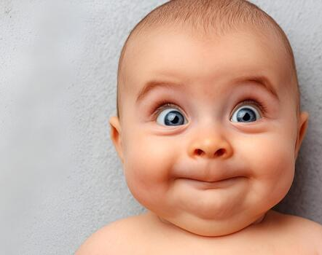
Baby Thanksgiving
06.09.26
Notes:
Since we are focusing on thanking God for these children thought we’d take some time to look at the bible’s view on children and parenting and briefly compare with our culture.
First, to humble ourselves and get in the right frame of mind – tell your neighbour a ‘parenting failure’ (committed by you or to you)

Slide 2
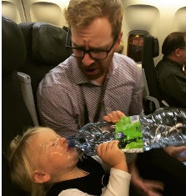
Parental Fails
Notes:
Ever water-boarded your own kid?
Ever found your lack of control has been outted in public?
Ever got so fed up trying to get them to stay still that you have just gaffer-ed them to the wall?

Slide 3
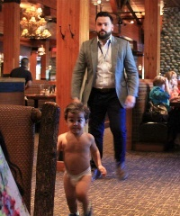
Parental Fails
Notes:
Ever water-boarded your own kid?
Ever found your lack of control has been outted in public?
Ever got so fed up trying to get them to stay still that you have just gaffer-ed them to the wall?

Slide 4
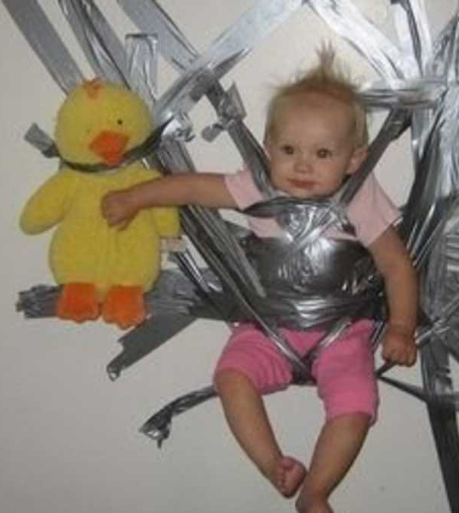
Parental Fails
Notes:
Ever water-boarded your own kid?
Ever found your lack of control has been outted in public?
Ever got so fed up trying to get them to stay still that you have just gaffer-ed them to the wall?

Slide 5
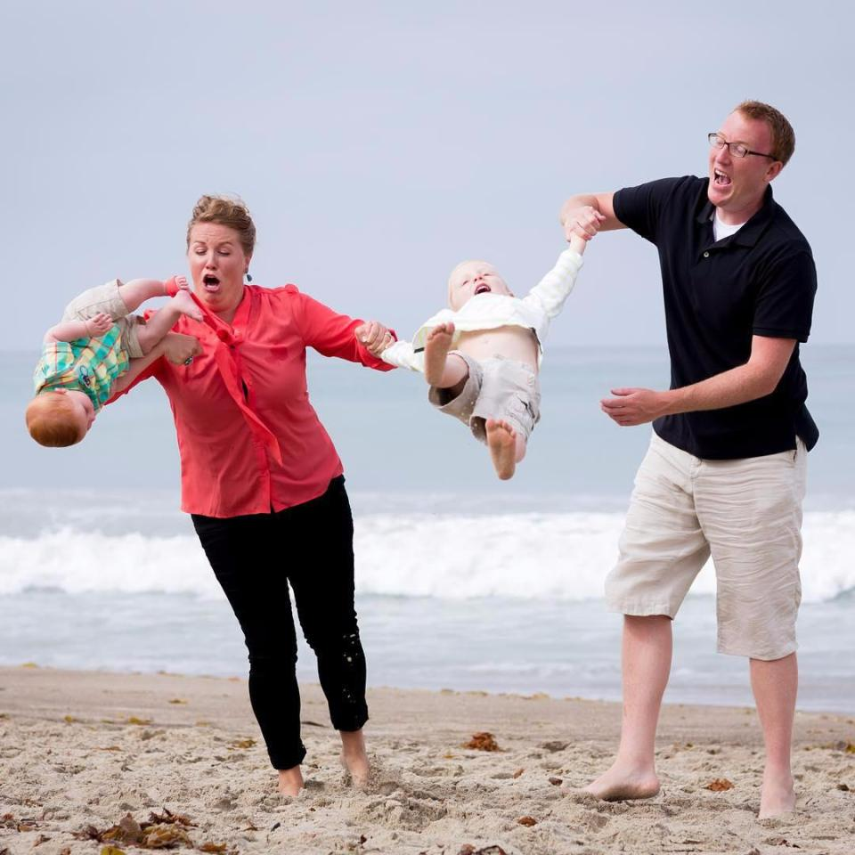
Parental Fails
Notes:
Ever struggled juggling two children?
Ever had to eat your lunch off your baby’s face?

Slide 6
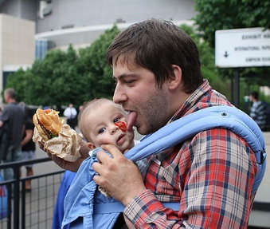
Parental Fails
Notes:
Ever struggled juggling two children?
Ever had to eat your lunch off your baby’s face?

Slide 7
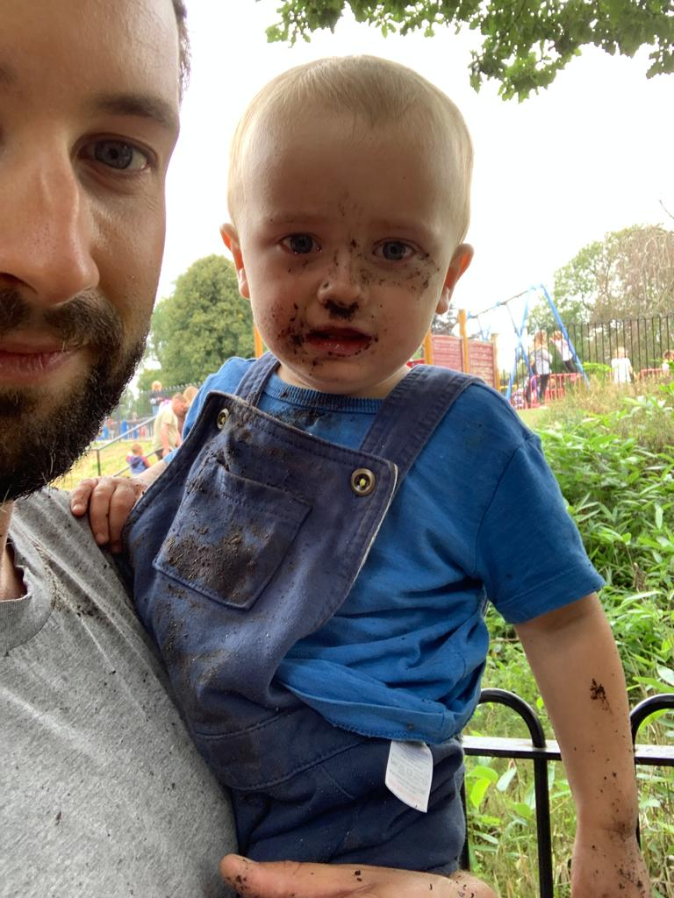

Slide 8
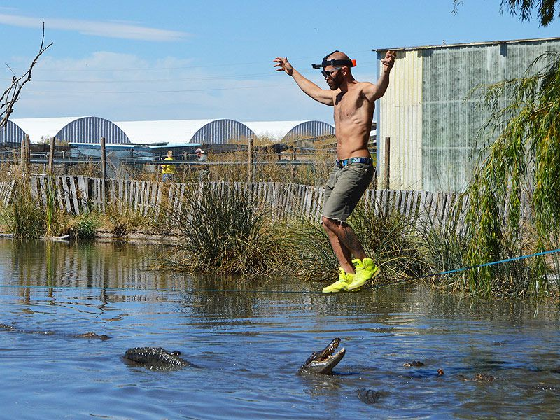
Notes:
I was quizzed more extensively when I wanted to buy a goldfish than when I became a father.
Guilt/shame/failure
A thousand decisions every day
A hundred questions – some of which you don’t care about but suddenly need to have an opinion on
You try to educate a kids on one thing then discover they are policing the whole playground
Your children will put you back into situation you could have avoided since you became independent
You will mix with people and have opportunity to demonstrate the compassion you have experienced from God
Marriage reveals how selfish you are
Parenting rubs your face in it
Jess and Chimeika are second children so Nick & Ella, John & Evelyn are experts now so will never feel like walking a tight rope
But I want you to feel encouraged & reassured
And for the church community – we have a role too

Slide 9
“Children are valuable because they are innocent”
- Our Culture
Notes:
They seem so pure – they could never do evil, they are a little blank canvas
Children are value not because they are innocent and pure (because they aren’t)
Genesis 8:21 declares, “. . . the intent of man’s heart is evil from his youth.”
Psalm 51:5 states that we all come into the world as sinners: “Behold, I was brought forth in iniquity, and in sin my mother conceived me.”
Ephesians 2:2 says that all people who are not in Christ are “sons of disobedience.”
Ephesians 2:3 also establishes this, saying that we are all “by nature children of wrath.”
but because they are image bearers and valued by God
If we were valued for our innocence, what happens when we break our first rule? This would be an unbearable pressure to place upon.
Sam Allberry explains this very well

Slide 10
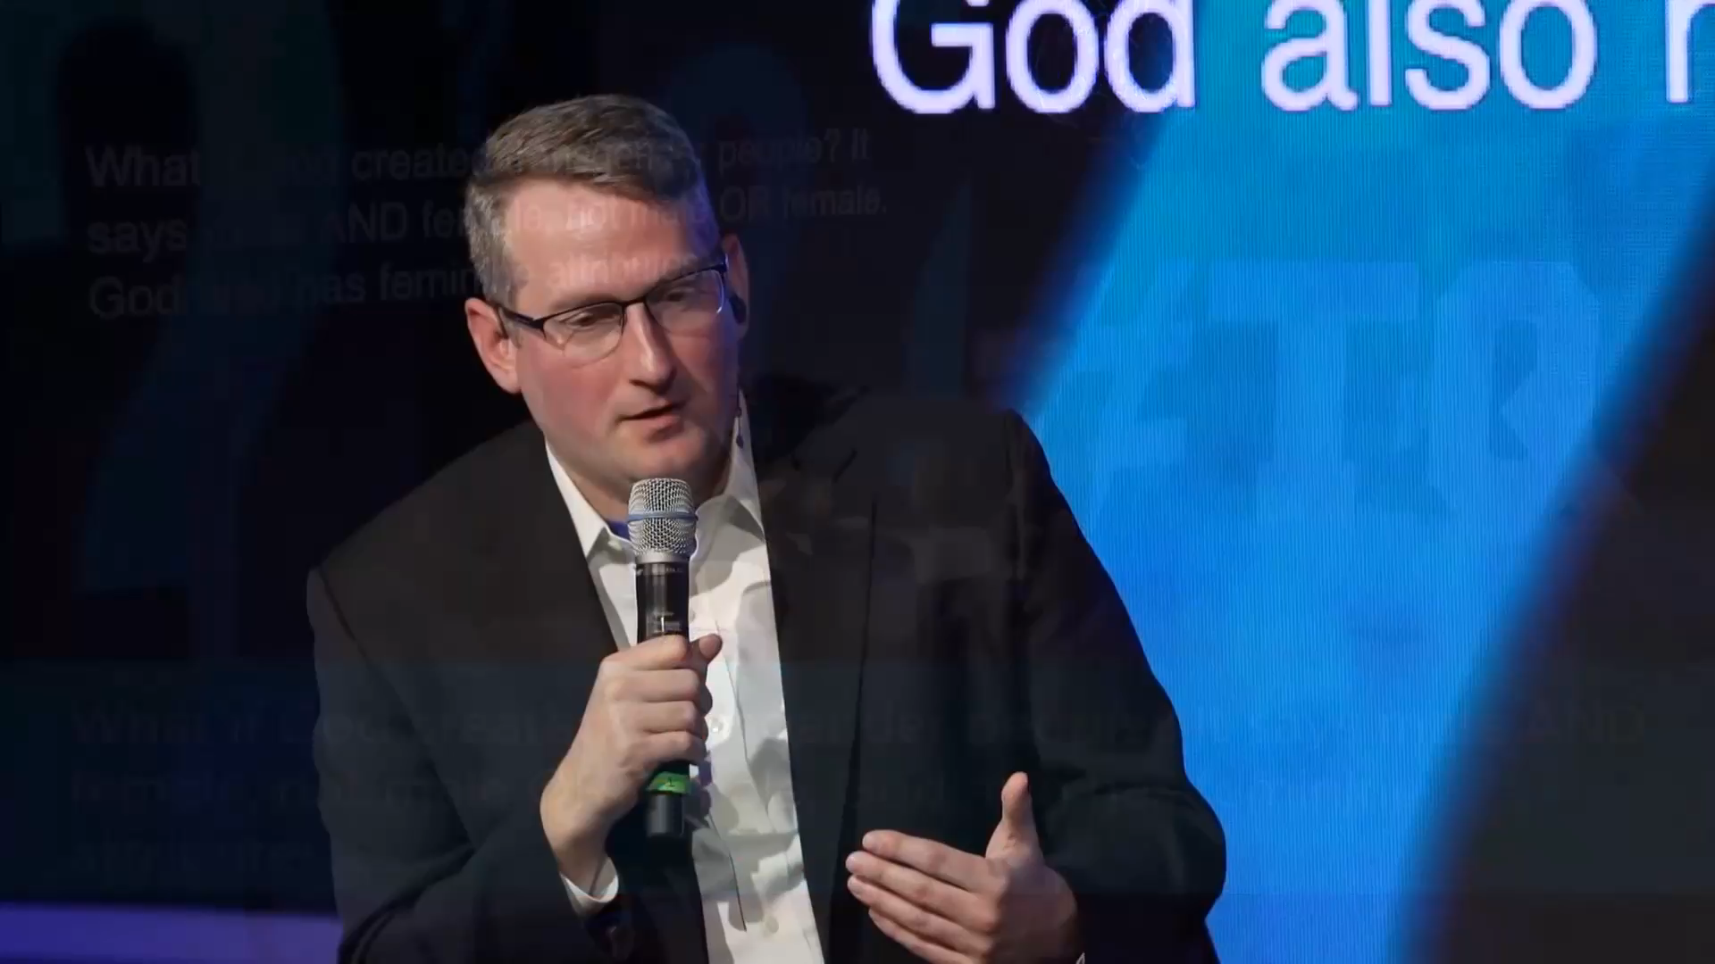
“God came up with the idea of you!”
“How you have been born is not quite right”
“‘must be born again’ is offensive”

Slide 11
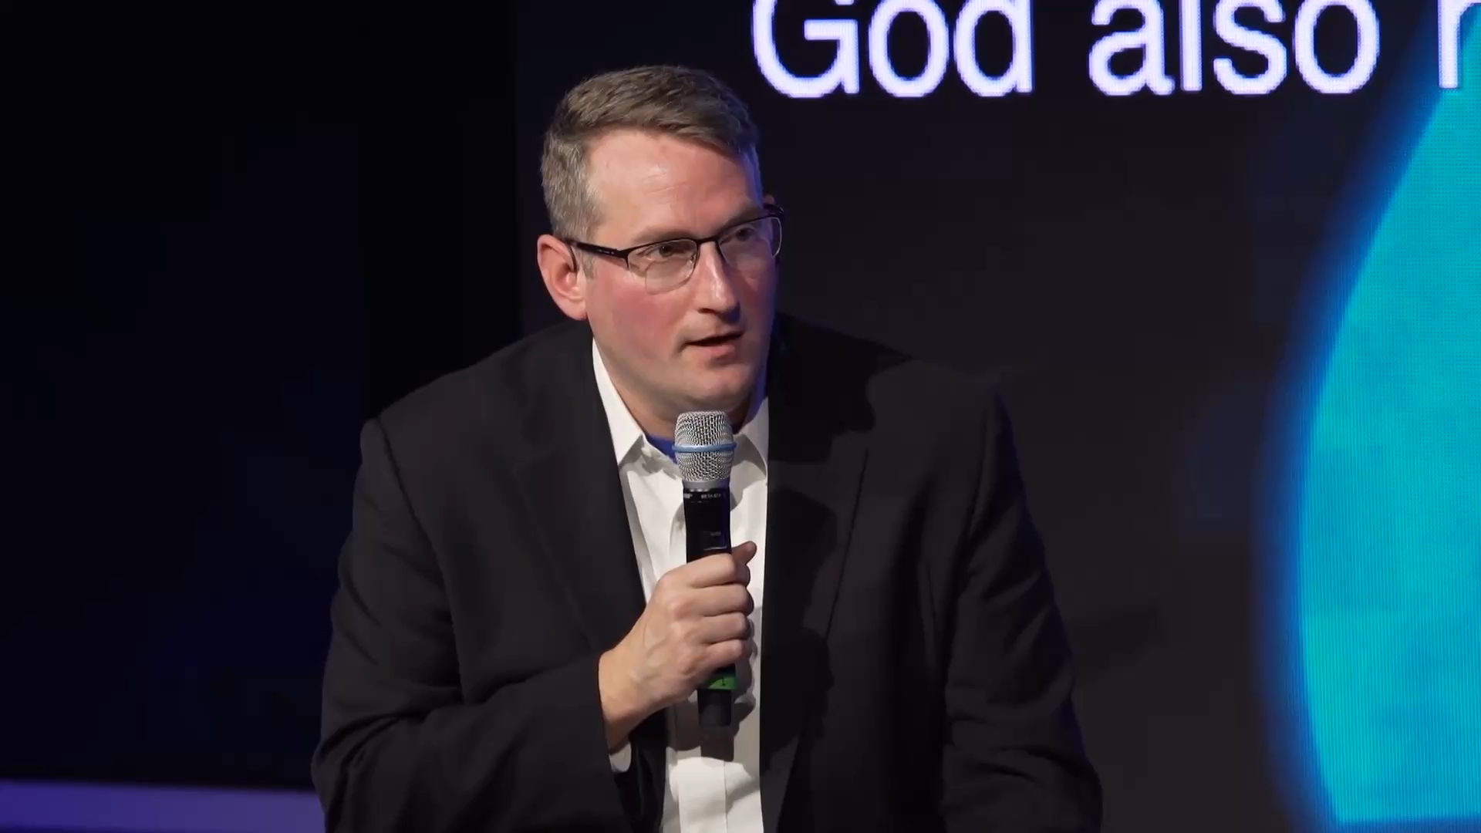
“We don’t do a good job of being us”
“Your ‘self’ needs to be denied”
“The self you were denying was your distorted self.”
“Become more like Jesus = more like real us”
Notes:
Counter-cultural position
“Not born quite right” sin corrupts – yet we are loved utterly
And God can work in us to bring us to fulfil our perfect design

Slide 12
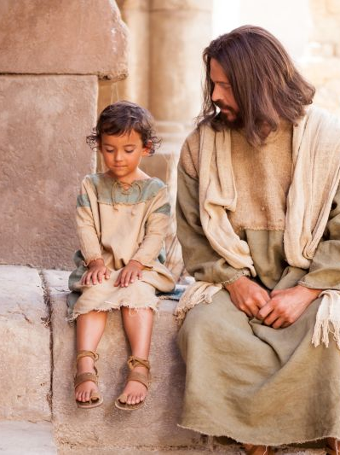
God loves our children
Jer 1:5
Before I formed you in the womb I knew you…
Ps 139:16
all the days ordained for me were written in your book before one of them came to be.
Matt 19:14
Jesus said, “Let the little children come to me, and do not hinder them, for the kingdom of heaven belongs to such as these.”
Notes:
God’s heart for children
Intimate knowledge
Love & enjoyment – refuses restrictions on children coming to him
Care, protection and provision
Invited into purpose – given role and power

Slide 13
“Let your children find their faith on their own”
- Our Culture
Notes:
Mustn’t force feed religion on kids
I understand – religion does a lot of damage – rituals/rules that we must follow to make us right before God
We can never make ourselves right with God – Jesus had to live the lives we should have lived and died the death we should have died in our place and then transferred this righteousness to us for us to be right with God.
No interest in force feeding religion – but to introduce my children to Jesus? Wow! What a privilege
Relationship not religion.

Slide 14
Charge to Parents
Delegate authority and responsibility to care and nurture children
Notes:
Charge of parents
Delegate authority and responsibility to care and nurture children
Traditionally, the child had to learn his place in the adult world. Increasingly in the West, adults have had to learn their place in the child's world.
Protection – understanding that safest place is to be in the will of God
Num 14:31
As for your children that you said would be taken as plunder, I will bring them in to enjoy the land you have rejected.
Might mean at times we trust God for our protection when feels out of our control e.g. Nov’s to Sierra Leone
Never want to protect FROM God

Slide 15
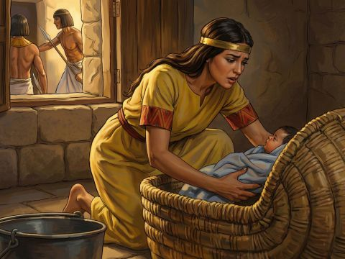
Charge to Parents
Delegate authority and responsibility to care and nurture children
Notes:
Charge of parents
Delegate authority and responsibility to care and nurture children
Traditionally, the child had to learn his place in the adult world. Increasingly in the West, adults have had to learn their place in the child's world.
Protection – understanding that safest place is to be in the will of God
Num 14:31
As for your children that you said would be taken as plunder, I will bring them in to enjoy the land you have rejected.
Might mean at times we trust God for our protection when feels out of our control e.g. Nov’s to Sierra Leone
Never want to protect FROM God

Slide 16
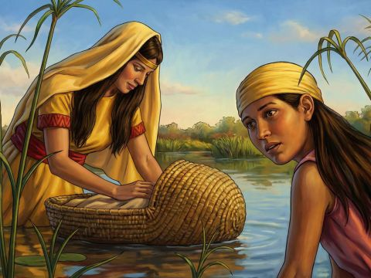
Charge to Parents
Delegate authority and responsibility to care and nurture children
Notes:
Charge of parents
Delegate authority and responsibility to care and nurture children
Traditionally, the child had to learn his place in the adult world. Increasingly in the West, adults have had to learn their place in the child's world.
Protection – understanding that safest place is to be in the will of God
Num 14:31
As for your children that you said would be taken as plunder, I will bring them in to enjoy the land you have rejected.
Might mean at times we trust God for our protection when feels out of our control e.g. Nov’s to Sierra Leone
Never want to protect FROM God

Slide 17
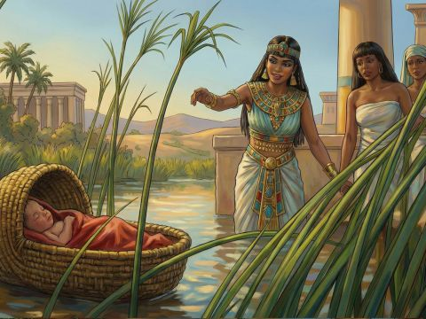
Charge to Parents
Delegate authority and responsibility to care and nurture children
Notes:
Charge of parents
Delegate authority and responsibility to care and nurture children
Traditionally, the child had to learn his place in the adult world. Increasingly in the West, adults have had to learn their place in the child's world.
Protection – understanding that safest place is to be in the will of God
Num 14:31
As for your children that you said would be taken as plunder, I will bring them in to enjoy the land you have rejected.
Might mean at times we trust God for our protection when feels out of our control e.g. Nov’s to Sierra Leone
Never want to protect FROM God
Sometimes protect from us - Need kids to be a credit to me

Slide 18
Charge to Parents
Delegate authority and responsibility to care and nurture children
Empowered (perfection not required)
Notes:
God places children in their families. No child is an accident.
You are the best person to parent your child. (Doesn’t mean you have it all together or don’t need lots of support. As you experience God’s parenting for yourself, you will be in better position to parent)

Slide 19
Charge to Parents
Delegate authority and responsibility to care and nurture children
Empowered (perfection not required)
Role of Sherpa (teach & model)
Notes:
Charge of parents
Delegate authority and responsibility to care and nurture children
Empowered – not perfection
Given exciting privilege to lead children into relationship with God
Hugh “I want them to have their own faith”
Sherpa – “come see a man”
We are instructed to teach children

Slide 20
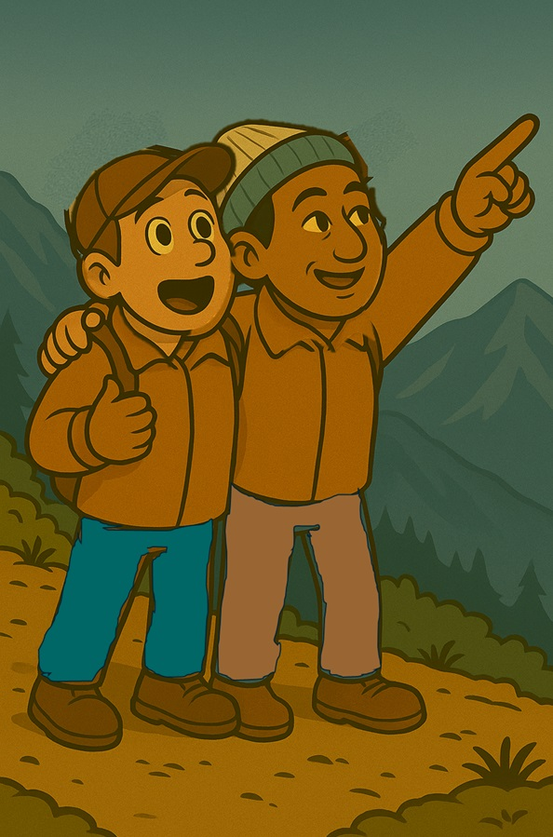
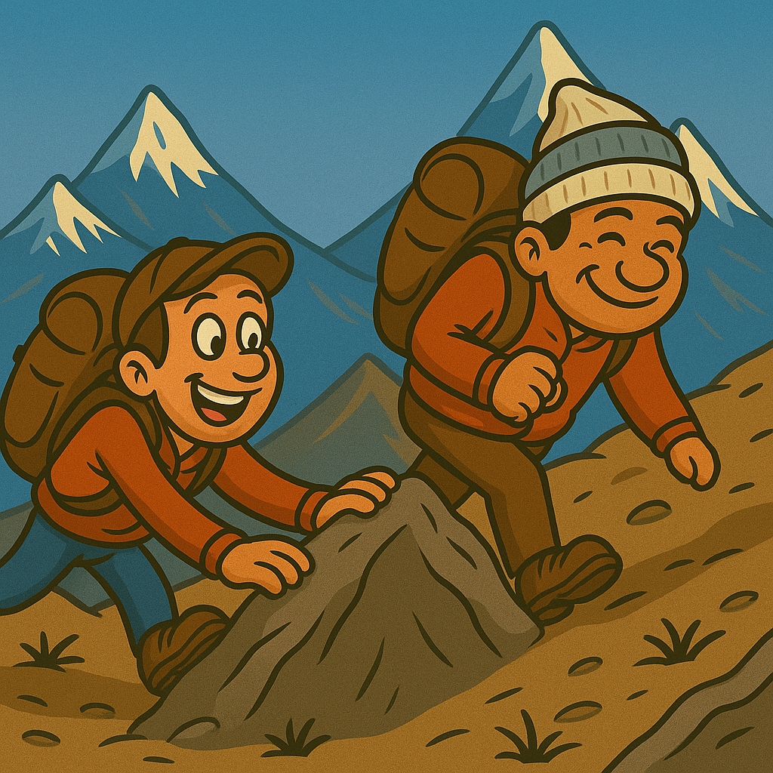
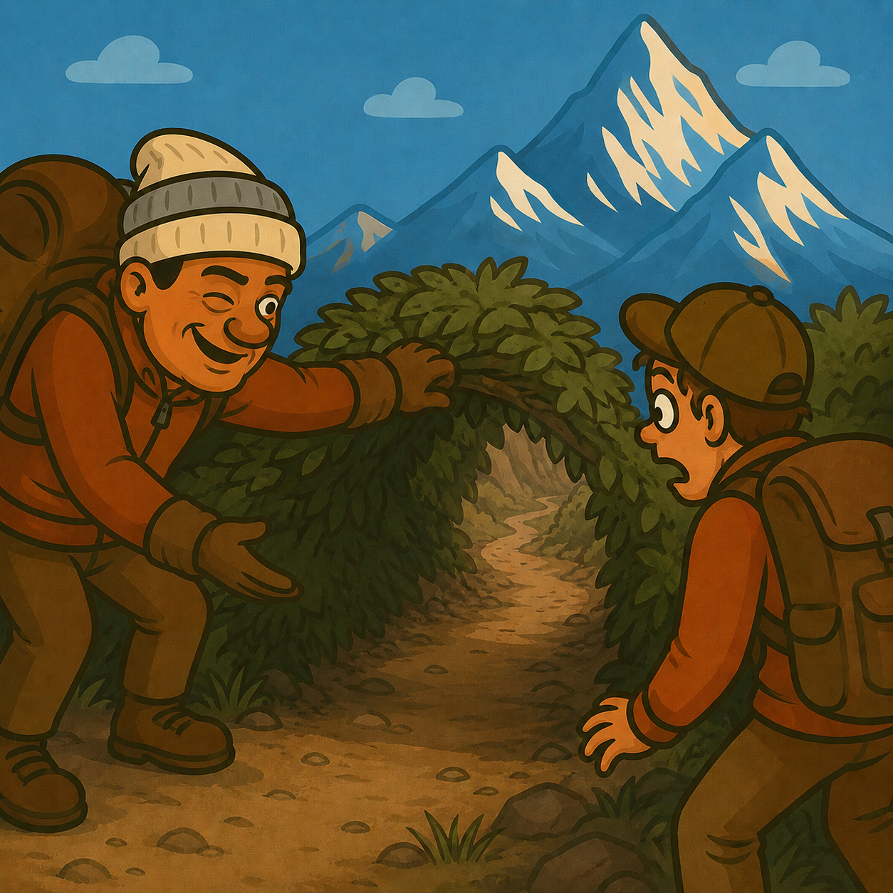
Notes:
Model – provide window into your relationship with God
I get to show His gentleness, patience, kindness, faithfulness etc… Thank goodness our children’s relationship doesn’t rest on this! But I can expect as I see Him, I become more like Him

Slide 21
Deu 6:1-7
1These are the commands, decrees and laws the Lord your God directed me to teach you to observe in the land that you are crossing the Jordan to possess, 2so that you, your children and their children after them may fear the Lord your God as long as you live by keeping all his decrees and commands that I give you, and so that you may enjoy long life. 3Hear, Israel, and be careful to obey so that it may go well with you and that you may increase greatly in a land flowing with milk and honey, just as the Lord, the God of your ancestors, promised you.
4Hear, O Israel: The Lord our God, the Lord is one. ª 5Love the Lord your God with all your heart and with all your soul and with all your strength. 6These commandments that I give you today are to be on your hearts. 7Impress them on your children. Talk about them when you sit at home and when you walk along the road, when you lie down and when you get up. 8Tie them as symbols on your hands and bind them on your foreheads. 9Write them on the doorframes of your houses and on your gates.

Slide 22
Deu 6:1-7
1These are the commands, decrees and laws the Lord your God directed me to teach you to observe in the land that you are crossing the Jordan to possess, 2so that you, your children and their children after them may fear the Lord your God as long as you live by keeping all his decrees and commands that I give you, and so that you may enjoy long life. 3Hear, Israel, and be careful to obey so that it may go well with you and that you may increase greatly in a land flowing with milk and honey, just as the Lord, the God of your ancestors, promised you.
4Hear, O Israel: The Lord our God, the Lord is one. ª 5Love the Lord your God with all your heart and with all your soul and with all your strength. 6These commandments that I give you today are to be on your hearts. 7Impress them on your children. Talk about them when you sit at home and when you walk along the road, when you lie down and when you get up. 8Tie them as symbols on your hands and bind them on your foreheads. 9Write them on the doorframes of your houses and on your gates.

Slide 23
Deu 6:1-7
1These are the commands, decrees and laws the Lord your God directed me to teach you to observe in the land that you are crossing the Jordan to possess, 2so that you, your children and their children after them may fear the Lord your God as long as you live by keeping all his decrees and commands that I give you, and so that you may enjoy long life. 3Hear, Israel, and be careful to obey so that it may go well with you and that you may increase greatly in a land flowing with milk and honey, just as the Lord, the God of your ancestors, promised you.
4Hear, O Israel: The Lord our God, the Lord is one. ª 5Love the Lord your God with all your heart and with all your soul and with all your strength. 6These commandments that I give you today are to be on your hearts. 7Impress them on your children. Talk about them when you sit at home and when you walk along the road, when you lie down and when you get up. 8Tie them as symbols on your hands and bind them on your foreheads. 9Write them on the doorframes of your houses and on your gates.
Notes:
Prov 22:6
Start children off on the way they should go,
and even when they are old they will not turn from it.
God tells us to teach our children His Word – because His Word explains how He has designed life to work
‘Freedom’ is prized in our culture but there are restrictions such as the child that wants to fly like superman
Or the boy that wants to give his pet goldfish more space

Slide 24
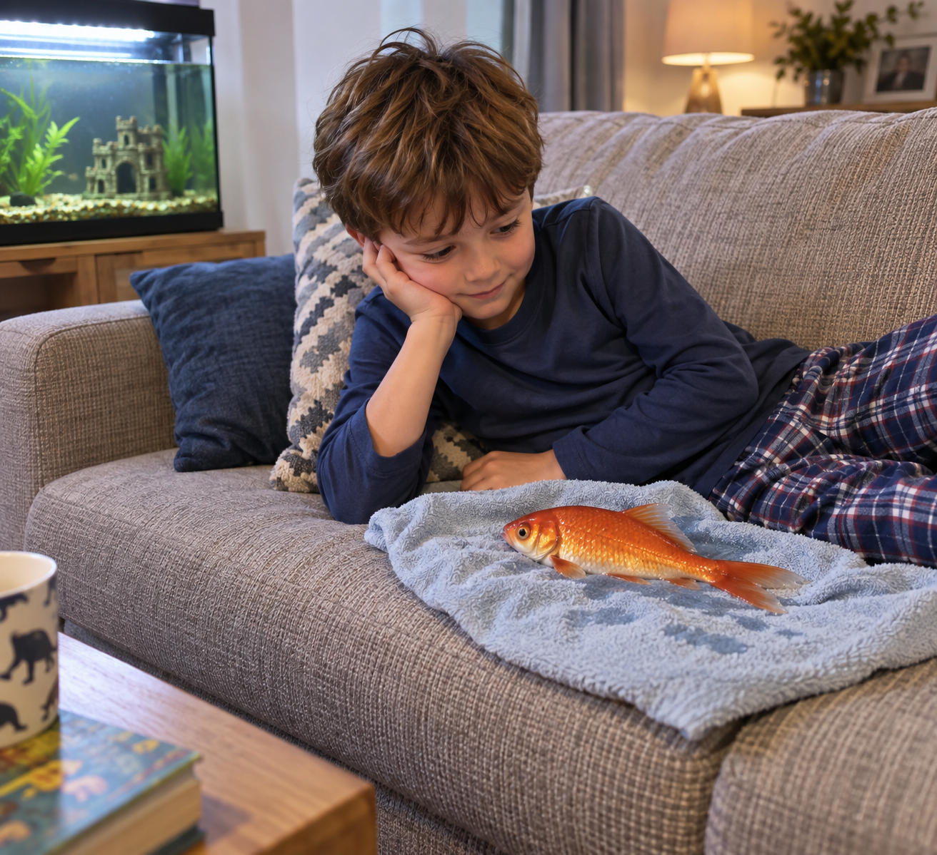
Notes:
Teaching children God’s Word is like explain why the fish needs to stay in the water
Otherwise we are in danger of neglect
Do we abandon our children like this in other ways? Find your own way across the road, go to school if you think it’s of interest, work out your bedtime etc
We share/train what we think will set children up with best chance of flourishing life
I don’t expect my mother to still help me cross the road now or check my bedtime but the principles I learned then have kept me until this time

Slide 25
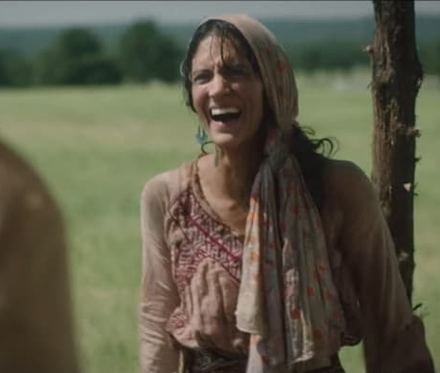
John 4:29-30, 42
“Come, see a man who told me everything I ever did. Could this be the Messiah?” They came out of the town and made their way toward him.
They said to the woman, “We no longer believe just because of what you said; now we have heard for ourselves, and we know that this man really is the Savior of the world.”
Notes:
Hugh Osgood when adopting his son. Council was concerned he would coerce his son. “Do you want your child to have your faith?”. Hugh replied “no, I want him to have his own”
expectation – God wants relationship with our children

Slide 26

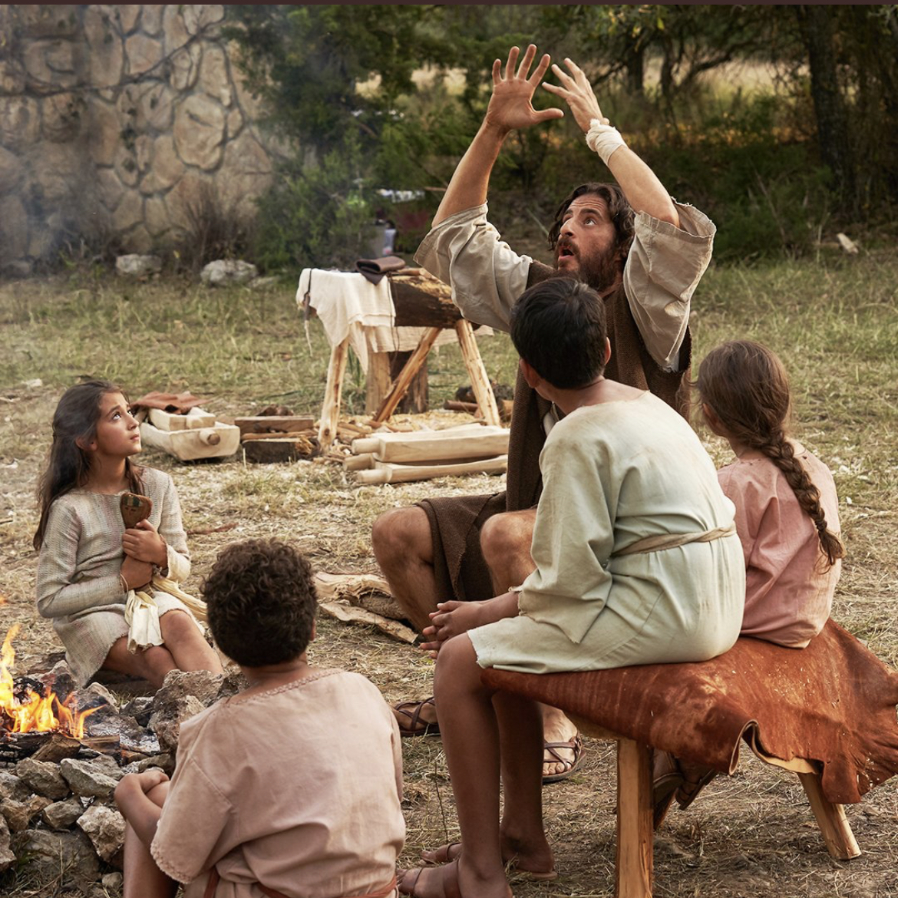









Notes:
Mark 10
¹³ People were bringing little children to Jesus for him to place his hands on them, but the disciples rebuked them. ¹⁴ When Jesus saw this, he was indignant. He said to them, “Let the little children come to me, and do not hinder them, for the kingdom of God belongs to such as these. ¹⁵ Truly I tell you, anyone who will not receive the kingdom of God like a little child will never enter it.” ¹⁶ And he took the children in his arms, placed his hands on them and blessed them.
Same then as He is now – each relationship unique as the child
“tell me more”
God-connected
Colin pg 75

Slide 27
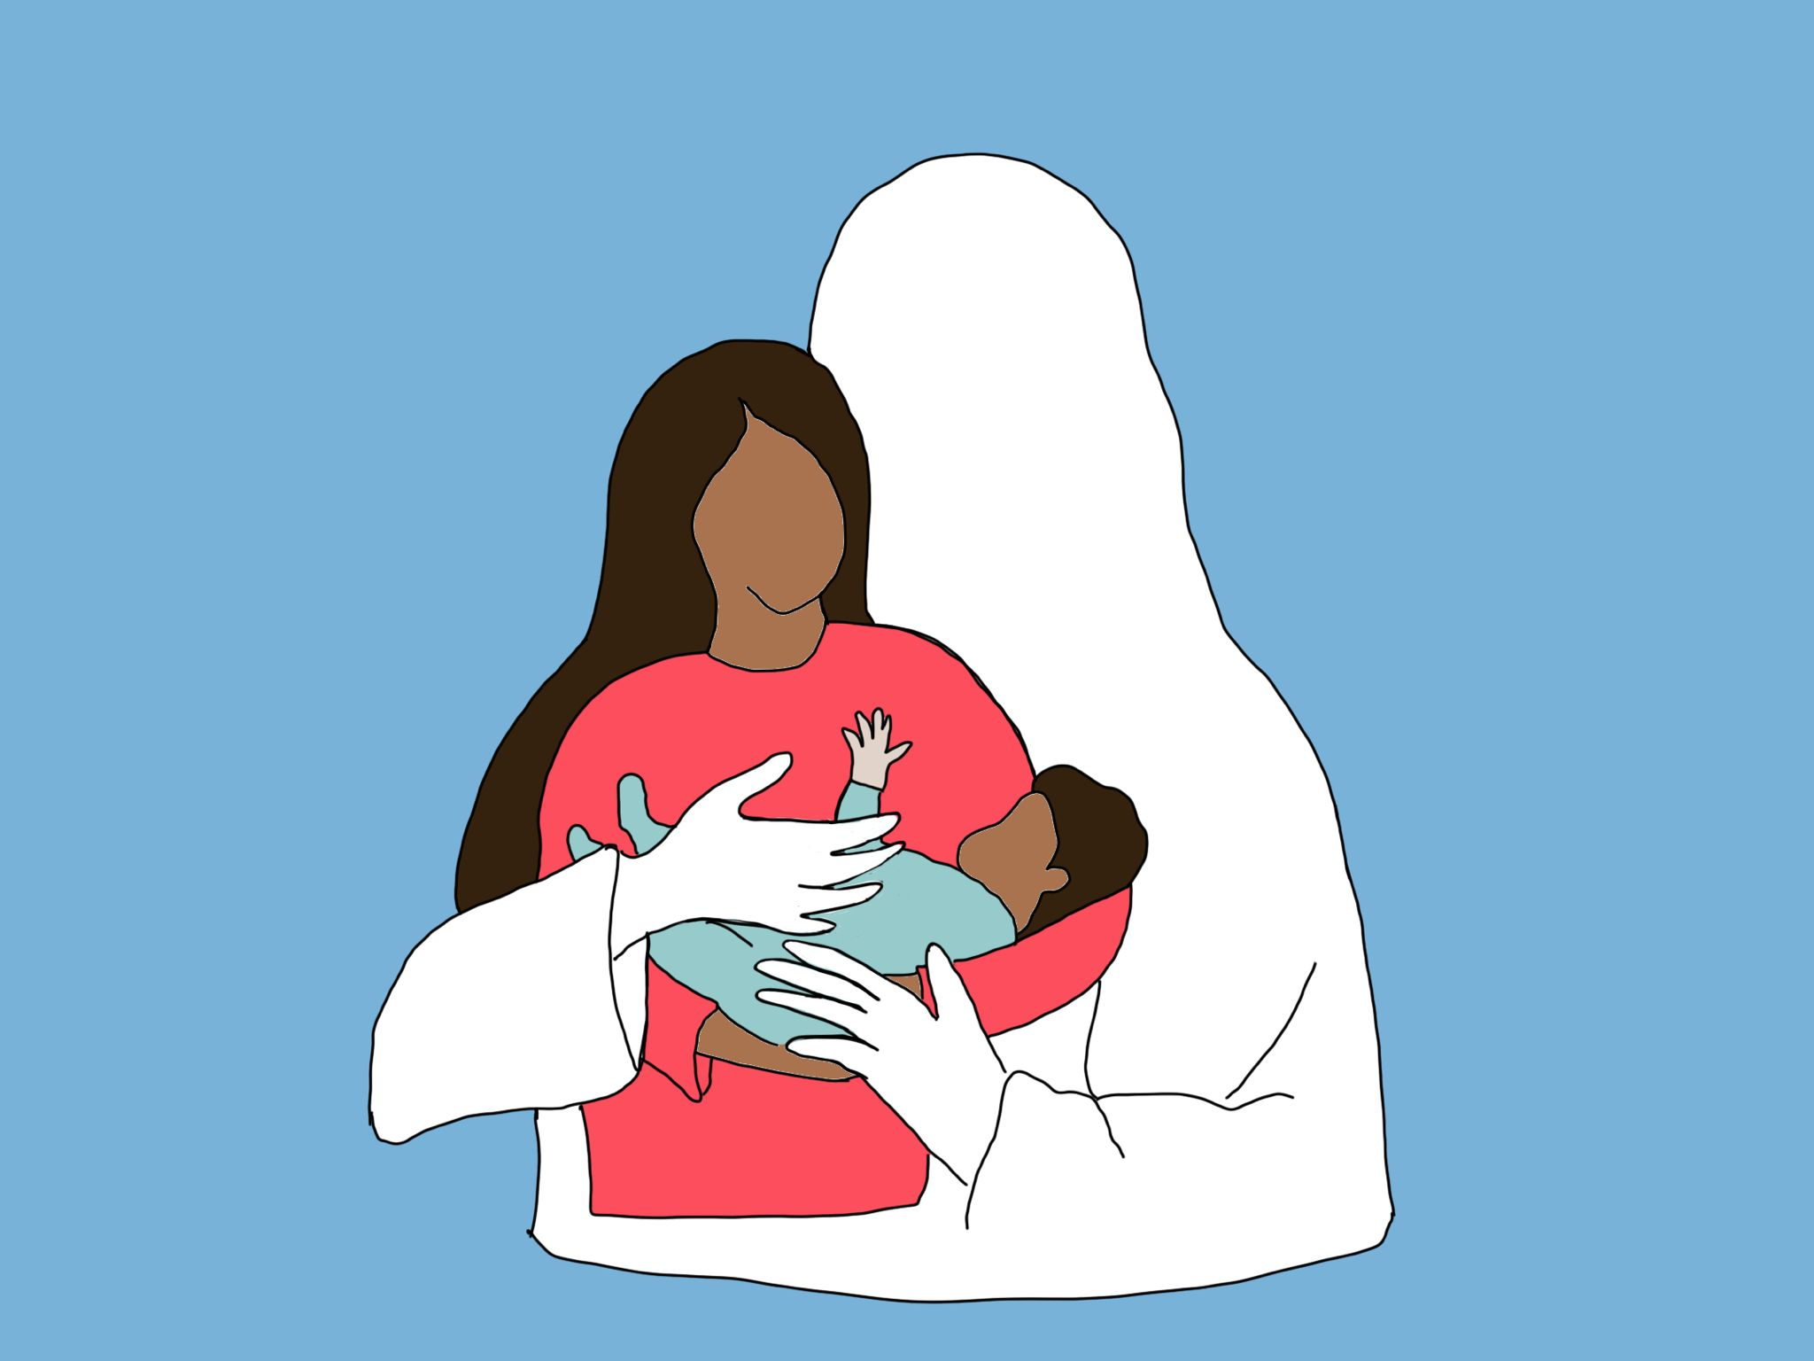
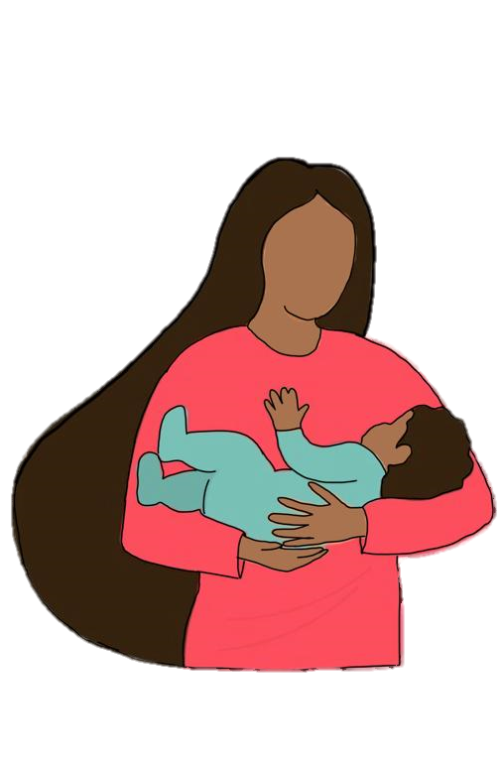
Notes:
He doesn’t leave us on our own with this responsibility
Remember, We are still his children

Slide 28
Ps 94:1-6
I will say of the Lord, “He is my refuge and my fortress,
my God, in whom I trust.”
Surely he will save you
from the fowler’s snare
and from the deadly pestilence.
He will cover you with his feathers,
and under his wings you will find refuge;
his faithfulness will be your shield and rampart.
You will not fear the terror of night,
nor the arrow that flies by day,
nor the pestilence that stalks in the darkness,
nor the plague that destroys at midday.
Notes:
Psalms 91:4 TPT
His massive arms are wrapped around you, protecting you. You can run under his covering of majesty and hide. His arms of faithfulness are a shield keeping you from harm.

Slide 29
Charge to the Church
Wrap around family
  Encouraging parents
  Aunt/Uncle to children
Notes:
Don’t judge from a distance come alongside lovingly and offer help

Slide 30
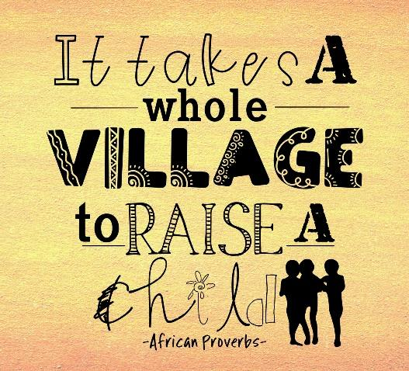

Slide 31
God-connected child
Notes:
To help our children to come into a relationship with Him He places them in a family, and that family in a church.
Today I want to briefly unpack how these roles are different but complementary

Slide 32
Parents
God-connected child
Notes:
Primary role

Slide 33
Extended family & Friends
Parents
God-connected child
Notes:
To help our children to come into a relationship with Him He places them in a family, and that family in a church.
Today I want to briefly unpack how these roles are different but complementary

Slide 34
Church
Extended family & Friends
Parents
God-connected child
Notes:
To help our children to come into a relationship with Him He places them in a family, and that family in a church.
these roles are complementary
Not expecting all 300 of us to have same level of involvement – but there will be a close-knit group that gathers around
Supporting children (Input at formative age)
Role model - small "insignificant" interactions or observations of behaviour and responses affect how children and young people view things. Might see a new way to look at something or respond to a situation just by seeing how a family friend reacts.
Can speak encouragement and insight into a child or young person's life "I see you like this"
Tim Holland – faithful aunty
Prince – grandmother
Sue Griffin called to speak to 11-year-old Daniel – perhaps the first phone call he ever received
come to play with the kids
Supporting Parents

Slide 35
Charge to the Church
Wrap around family
  Encouraging parents
  Aunt/Uncle to children
Watchman
  Miriam
  Eli

Slide 36
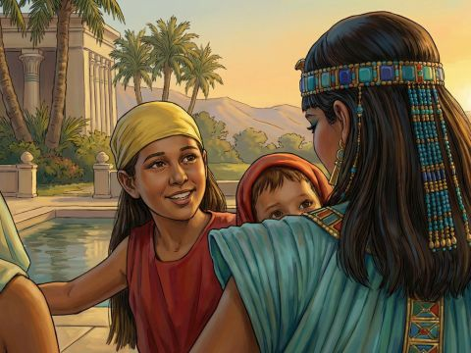
Notes:
Miriam
Exodus 2:4 His sister stood at a distance to see what would happen to him.
Not always possible to protect from all dangers (sometimes the child’s purpose is entangled within potential danger)
Have a watching role (praying and then act when released to do so)

Slide 37
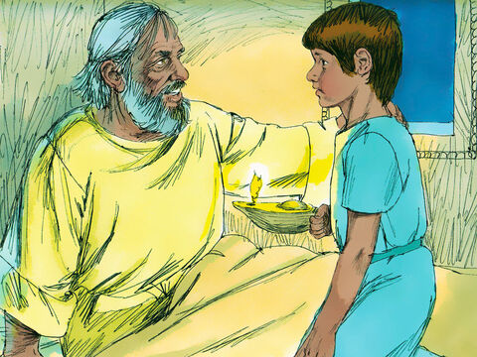
Notes:
The Eli Calling
1 Sam 3
Help child identify the voice of God
Guide them to interact
Help them unpack what they heard

Slide 38
Response
Notes:
Response
Parents – anoint
Aunts/uncles – sightedness
Those who would like to – see and embrace opportunity (takes time and resources)

