Slide 1
Continuing in the Faith

Slide 2
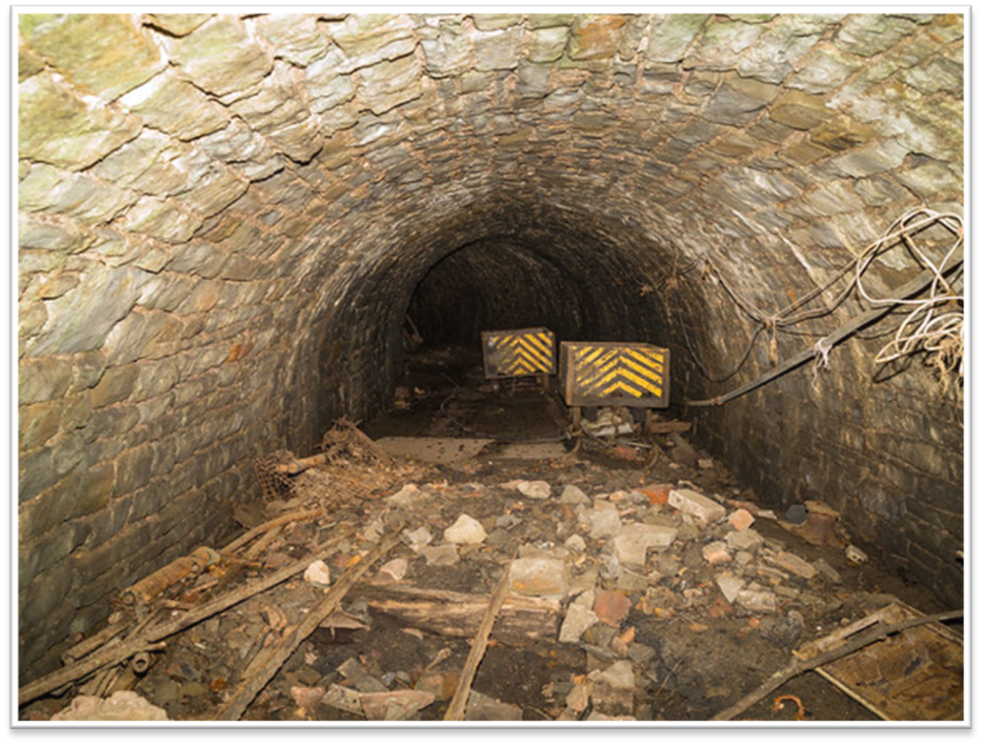
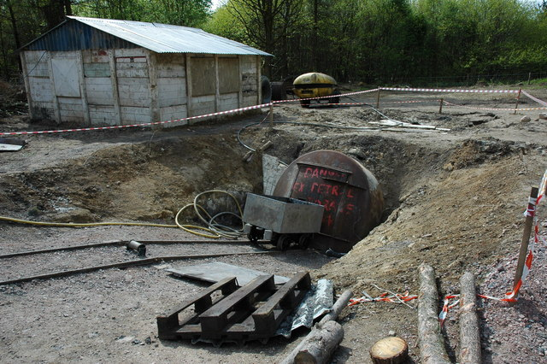
Mining in the Forest of Dean
Notes:
How presentation will benefit audience: Adult learners are more interested in a subject if they know how or why it is important to them.
Presenter’s level of expertise in the subject: Briefly state your credentials in this area, or explain why participants should listen to you.

Slide 3
¹ I waited patiently for the LORD; he turned to me and heard my cry.
² He lifted me out of the slimy pit, out of the mud and mire; he set my feet on a rock and gave me a firm place to stand.
3 He put a new song in my mouth, a hymn of praise to our God. Many will see and fear the LORD and put their trust in him.
Psalms 40: 1 -3

Slide 4
¹ I waited expectantly for the LORD; he turned to me and heard my cry.
² He lifted me out of the slimy pit, out of the mud and mire; he set my feet on a rock and gave me a firm place to stand.
³ He put a new song in my mouth, a hymn of praise to our God. Many will see and fear the LORD and put their trust in him.
Psalms 40: 1 -3
Notes:
Ephesians 2: 6,7

Slide 5
Colossians 1: 21-23
²¹ Once you were alienated from God and were enemies in your minds because of your evil behavior. ²² But now he has reconciled you by Christ’s physical body through death to present you holy in his sight, without blemish and free from accusation — ²³ if you continue in your faith, established and firm, and do not move from the hope held out in the gospel.
Notes:
Lesson descriptions should be brief.

Slide 6
No longer aliens or enemies
Reconciled
Holy in His Sight
Without Blemish
Free from Accusation

Slide 7
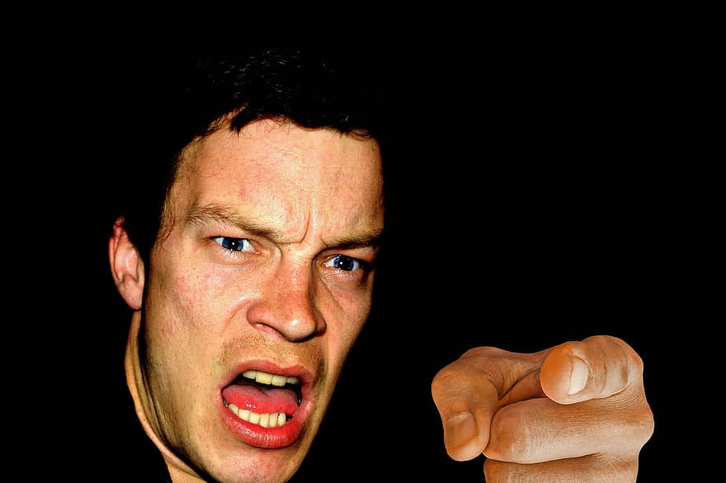
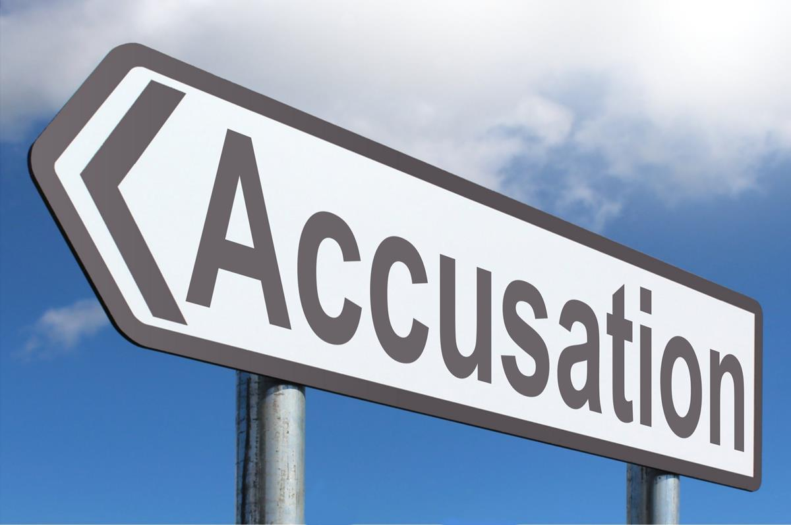
Source of accusation is the devil Rev 12:10
False Accusation is exposed
when we walk in the light 1 John 1:7
This Photo by Unknown Author is licensed under CC BY-SA
Notes:
Accusation – my story
Cf Hebrews 10:22 ²² let us go right into the presence of God with sincere hearts fully trusting him. For our guilty consciences have been sprinkled with Christ’s blood to make us clean, and our bodies have been washed with pure water. Hebrews 10:22
⁷ But if we are living in the light, as God is in the light, then we have fellowship with each other, and the blood of Jesus, his Son, cleanses us from all sin. 1 John 1:7

Slide 8
No longer aliens or enemies
Reconciled
Holy in His Sight
Without Blemish
Free from Accusation
…….if you continue in your faith

Slide 9
Colossians 1:23
²³ if you continue in your faith, established and firm, and do not move from the hope held out in the gospel.
Colossians 1:23
“he set my feet on a rock and gave me a firm place to stand”
Psalm 40:2
Notes:
Building on the right Foundation

Slide 10
Standing firm
⁴ Oh, the joys of those who trust the LORD,
who have no confidence in the proud
or in those who worship idols.
⁵ O LORD my God, you have performed many wonders for us.
Your plans for us are too numerous to list.
You have no equal.
If I tried to recite all your wonderful deeds,
I would never come to the end of them. Psalms 40:3-5
Notes:
Heb 11:6 – Without Faith it is impossible to please God
Putting our trust in God not worldy provision

Slide 11
Trust
Put our confidence in Him
Embrace His plans
Remember the wonderful things He has done
  A spirit and attitude of thankfulness

Slide 12
God’s Plan for my life
¹¹ Now these are the gifts Christ gave to the church: the apostles, the prophets, the evangelists, and the pastors and teachers. ¹² Their responsibility is to equip God’s people to do his work and build up the church, the body of Christ. ¹³ This will continue until we all come to such unity in our faith and knowledge of God’s Son that we will be mature in the Lord, measuring up to the full and complete standard of Christ. Ephesians 4:11-13

Slide 13
We need to keep Growing
You are like babies who need milk and cannot eat solid food. ¹³ For someone who lives on milk is still an infant and doesn’t know how to do what is right. ¹⁴ Solid food is for those who are mature, who through training have the skill to recognize the difference between right and wrong. Hebrews 5:12-14

Slide 14
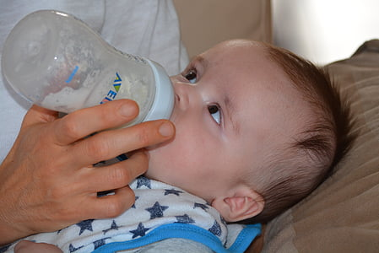
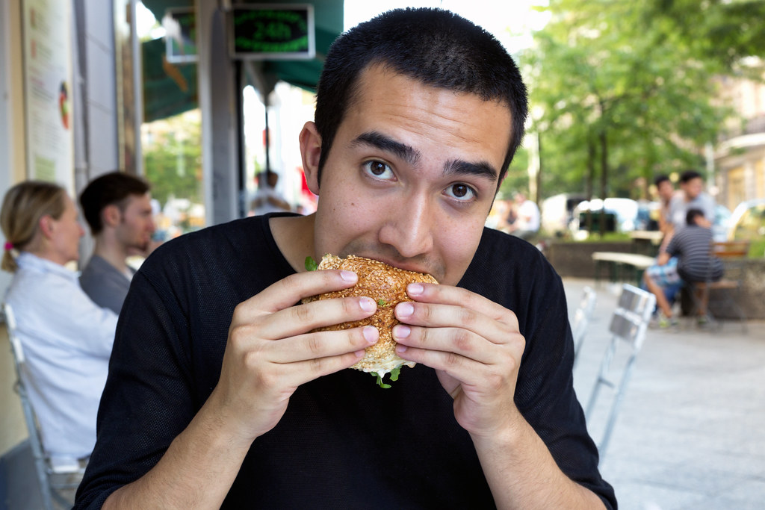
We have to keep growing
Hebrews 5:13-14
Let us go on instead and become mature in our understanding. Surely we don’t need to start again with the fundamental importance of repenting from evil deeds and placing our faith in God. Hebrews 6:1

Slide 15
The Psalmist’s response
⁶ You take no delight in sacrifices or offerings.
Now that you have made me listen, I finally understand—
you don’t require burnt offerings or sin offerings.
⁷ Then I said, “Look, I have come.
As is written about me in the Scriptures:
⁸ I take joy in doing your will, my God,
for your instructions are written on my heart.” Psalms 40:6-8
Notes:
Not a sacrifice but a joy
God has brought us into a loving caring relationship
Free from accusation
With his heart and desires written on our hearts
We just need to make ourselves available to him

Slide 16
A Response
God has reconciled us to Him; are you reconciled to God?
Are you available?
Do you need a new expectation of how God wants to use you?

