Slide 1


Corporate Prayer: Part 2
1st February 2026

Slide 2
Why this topic?
Notes:
Let’s get a little context by recapping from the Faith series

Slide 3


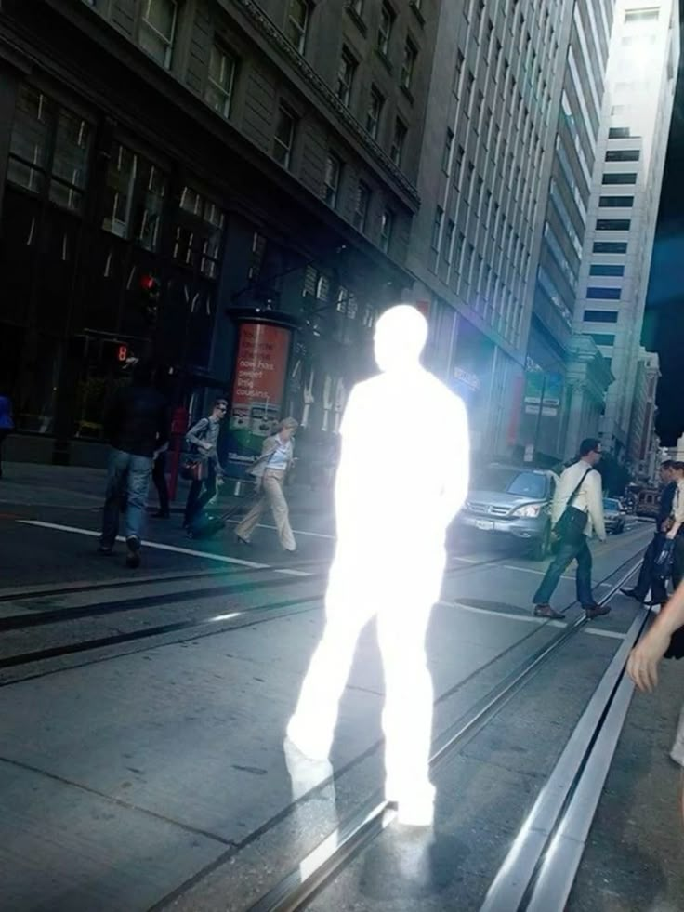
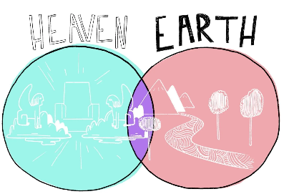
God’s Grand Plan
Completed through us
Notes:
God’s grand plan is to
fill earth with His glory (His attributes on display)
Unify heaven and earth
Bring rule of heaven onto earth (kingdom advance)

Slide 4
Preparing to Pray
“Sure Footing” - Knowing Him, Knowing you
According to His will
Notes:
“Sure Footing” - Knowing Him, Knowing you
According to His will
A true understanding of our identity puts us on solid ground when it comes to prayer
Knowing who He is and therefore who I am
Preparing to Pray - firm footing (identity) more important than smart words and aggressive tone.

Slide 5


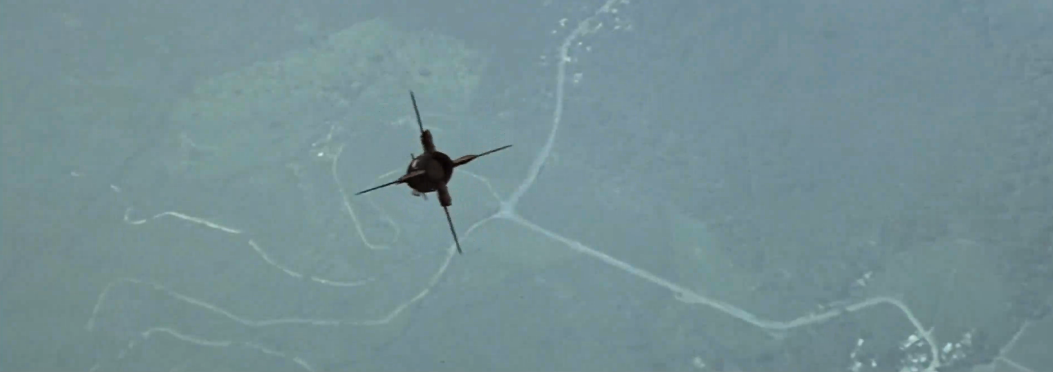
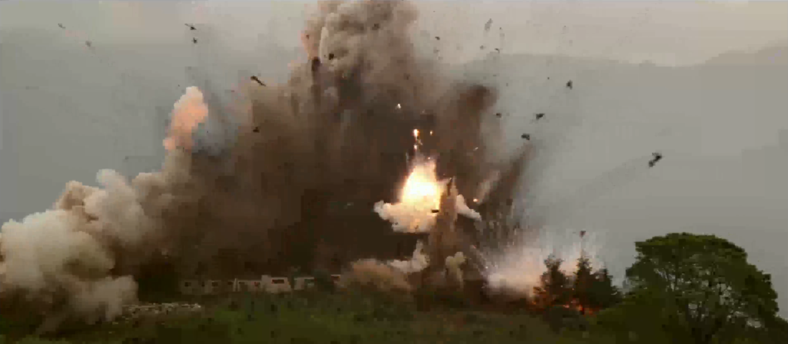

Slide 6
“See where God is working in your world – and join Him in that work.”
(Henry Blackaby)
Notes:
I’m here for Your glory
I choose to put down my preference and rediscover my joy and purpose in Your will

Slide 7
Young People Questions
1. What is the Spirit realm? How do we know there is a war going on in there?
2. If God knows what I need, why pray?
3. Can't I just pray on my own?
4. Can we make corp prayer more entertaining?
5. How do I make prayer items matter to me?
Notes:
Prayer questions
Now we have established God's grand plan, our role in it and our identity lets zoom in on prayer. (I especially want to focus on corporate prayer - when we come together to agree on something)
A bunch of young people helped me come up with the following (challenging questions) which if left unresolved it will undermine engagement in Corp Prayer.

Slide 8
6. Does prayer make a difference?
  Is God actually hearing our prayers?
  Why didn't we get what we prayed for?
  How do we deal with unanswered prayer?
7. Does my involvement make a difference?
8. How should we pray?
  Is there a point in praying for the same thing again and again?
  At what point do we stop?
  How long should a pray be and what should it consist of?

Slide 9
1. What is the Spirit realm? How do we know there is a war going on in there?

Slide 10


A Realm @ War
I have hold of evil, but evil also has hold of me
…abstain from sinful desires, which wage war against your soul. (1 Pet 2:11)
Within AND outside of
Notes:
There are spiritual forces at play
- Might not look like night of the living dead but if we aren’t possess by Holy Spirit we are vulnerable to be filled/highly influenced by evil spirit which supercharge our evil
Sin’s momentum
- “What was I thinking?” – I have hold of evil but evil has hold of me
- Stanford Experient – this picked up a momentum (https://www.youtube.com/watch?v=iXv91xFipLM)
- Liverpool parade driver
- I have hold of evil, but evil also has hold of me - It’s me and it’s not me
- It shows itself in exaggeration of resistance e.g. Sierra Leone – might be able to explain away each individual decision but when you zoom out it looks like there is a puppet master/a coordinator
- Eph 2:1-4

Slide 11
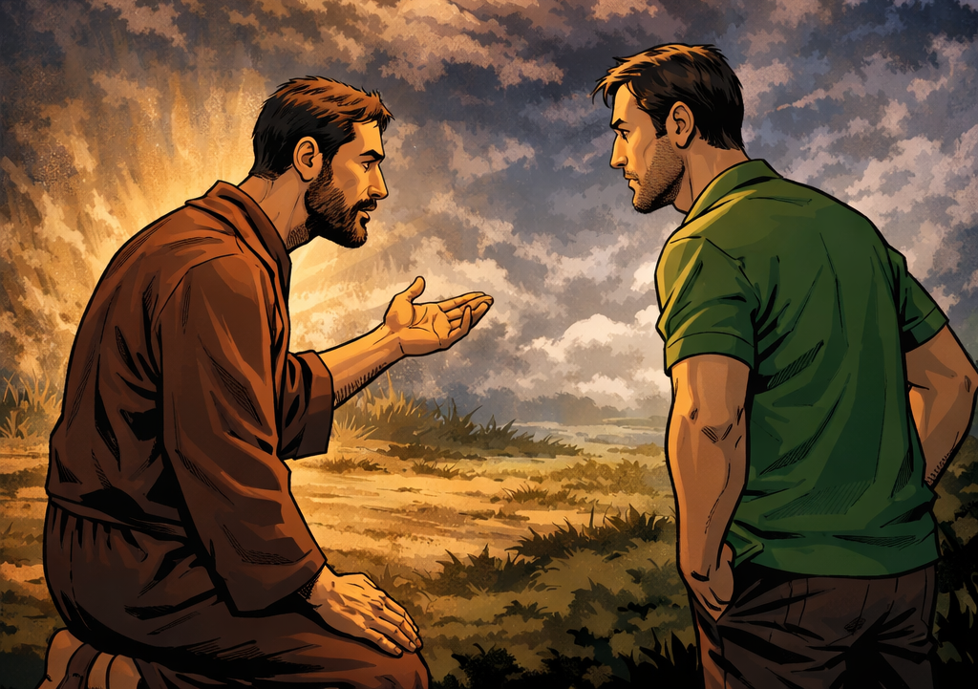
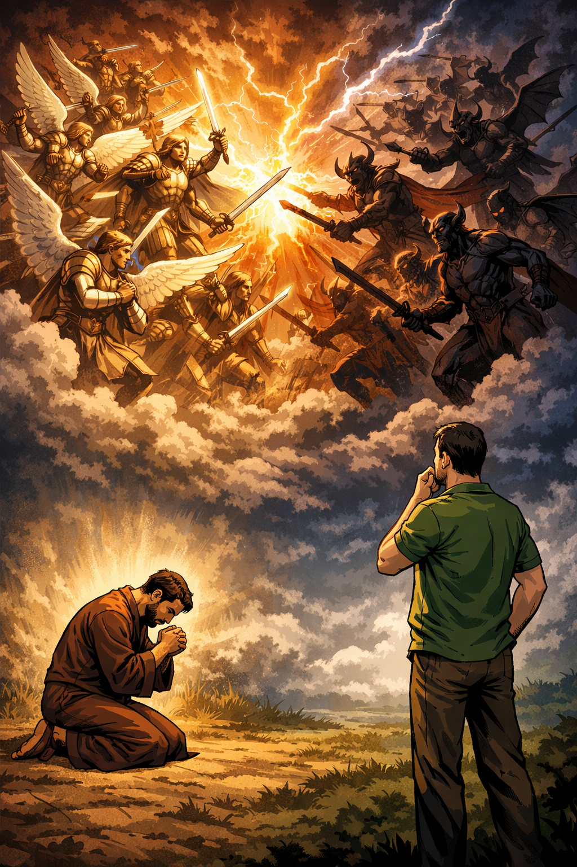
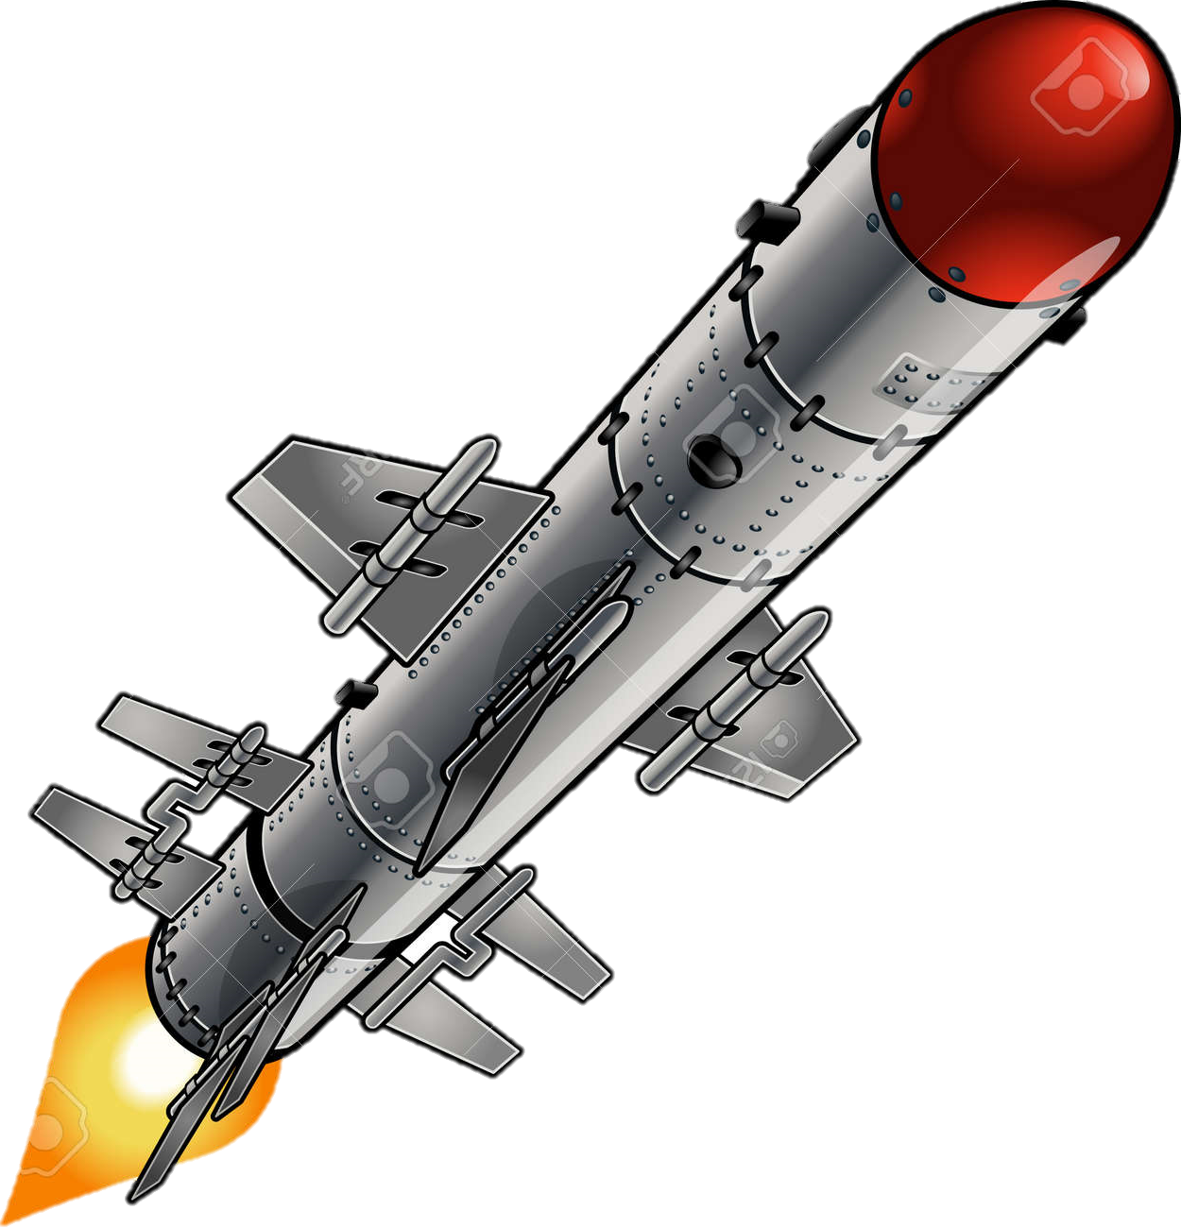
…The weapons we fight with are not the weapons of the world. On the contrary, they have divine power to demolish strongholds. We demolish arguments and every pretension that sets itself up against the knowledge of God…
(2 Cor 10:3-5)
Notes:
For though we live in the world, we do not wage war as the world does. The weapons we fight with are not the weapons of the world. On the contrary, they have divine power to demolish strongholds. We demolish arguments and every pretension that sets itself up against the knowledge of God, and we take captive every thought to make it obedient to Christ.
(2 Cor 10:3-5)

Slide 12
2. If God knows, why pray?

Slide 13
Do not be like them, for your Father knows what you need before you ask him.
(Matt 6:8)
If He knows the answer, why do I need to tell him?

Slide 14
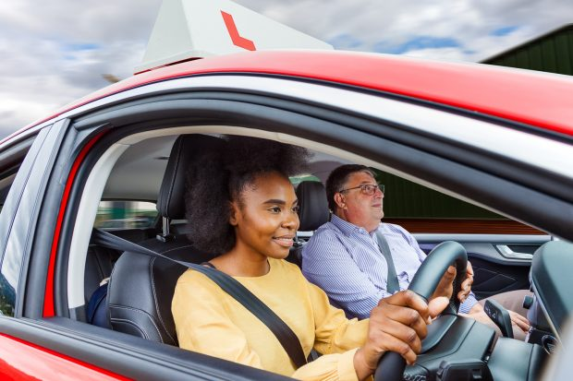
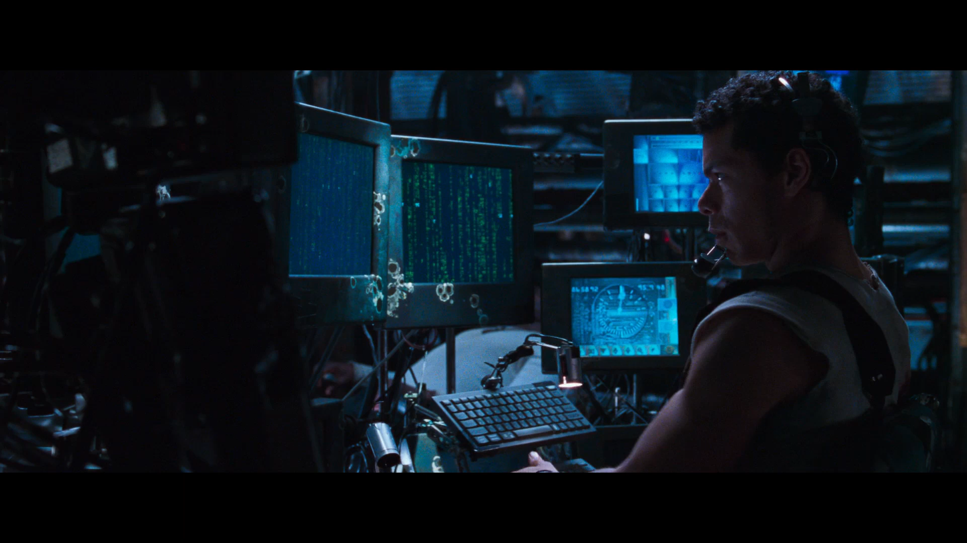
to get what you ask for
What’s the point of prayer?
To give Him permission to land – become more like Him
1. Communion with Him
2. ‘he knows what you need, SO ask him!”
3. Training us to rule
Notes:
What’s the point of prayer? (What’s the point of life?)
Prayer not just about moving God but allowing God to move me
When I come close to him I get so much more than what I went in for
E.g. Tell God my heart for my friends, then God tells me His heart for my friends!
1. Asking is essential to relationship – asking insists on vulnerability. When you ask anyone for anything, you risk rejection or at least disappointment. Until we ask God for something, he can’t disappoint or surprise us.
…You do not have because you do not ask God. James 4:2
…how much more will the heavenly Father give the Holy Spirit to those who ask him? Luke 11:13
2. He is a shop keeper who know what his customers need so he stocks ready for order – We need guns
3. If a driving instructor know how to drive why allow someone else to drive? - Learning to drive
He is teaching us how to rule with Him
Luke 10:17 - 17 “‘Well done, my good servant!’ his master replied. ‘Because you have been trustworthy in a very small matter, take charge of ten cities.’

Slide 15
3. Can’t I just pray on my own?

Slide 16
Power of Agreement
And the LORD said, “Behold, they are one people…now nothing which they plan to do will be impossible for them. (Gen 11:6)
If two of you agree on earth about anything they ask, it will be done for them by my Father in heaven. (Matt 18:19)
How could one chase a thousand, and two put ten thousand to flight…
(Deu 32:30)
“Two are better than one… If either of them falls, one can help the other up… A cord of three strands is not quickly broken.”
(Ecclesiastes 4:9–12)
How good and pleasant it is when God’s people live together in unity!...For there the Lord bestows his blessing… (Ps133:1-3)
Notes:
- exponential impact when people act together under God’s covenant.
It is possible to all attend the same corporate prayer meeting and yet not harness the power of agreement…
- If unresolved issues between, if not committed to same cause, not engaging with each others' contributions

Slide 17
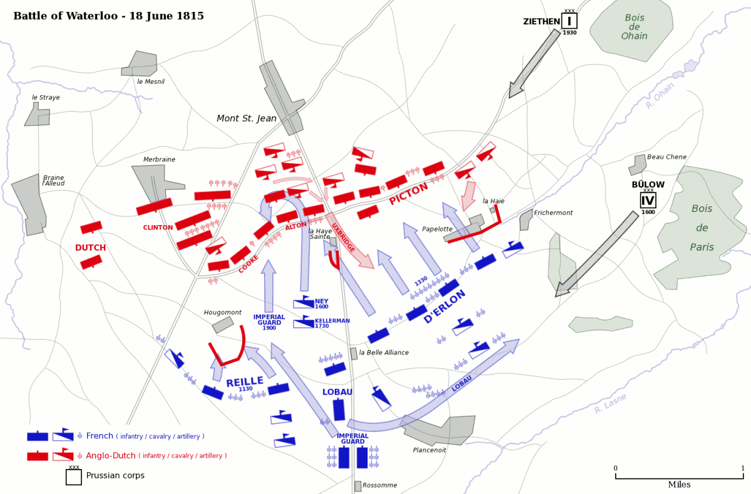

Slide 18
…But we have the mind of Christ. (1 Cor 2:16)

Slide 19


How does this work out in practice?
hope and strength
catch God’s will through your insight
Contagious faith
When the church prays…
Notes:
How does this work out in practice?
Contagious faith - I need to hear Prince’s faith-filled point of view to help me recalibrate
I need to know we are together - gives me hope and strength
I need to catch God’s will through your prophetic insight - build on and shapes prayer - prayer is evolving, living organism
for, “Who has known the mind of the Lord so as to instruct him?” But we have the mind of Christ. (1 Cor 2:16)
When the church prays - prisoners are released, chains are broken
Myles
Diamond field
Ebola
Crisis on compound/Prince arrest

Slide 20
4. Can we make corporate prayer more entertaining?
Notes:
I sympathise – prayers meetings can be boring (much easier to teach on prayer than actually praying)

Slide 21
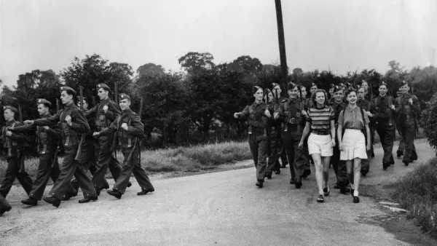
No one serving as a soldier gets entangled in civilian affairs, but rather tries to please his commanding officer. (2 Tim 2:4)
Notes:
I’m not here for my entertainment; I’m here for his glory.
Set your joy in knowing Him and being part of His will.
So what do I do with my boredom?
Tell Him how you feel and make a decision what is most important
Ask Him to change you

