Slide 1

Words for now…
Transition
Acceleration
Entering in
Going deeper
Taking new ground
“You prepare a table in the presence of my enemy”
Notes:
Time to accelerate
I was listening to the Bible in one year on my way to work and this was a thing that Nicky Gumbel was talking about it being time to accelerate. I started getting excited. God was speaking to me. It’s time to leave the slow lane. We are entering into a new phase..
I was driving along, I reached about 10 minutes from school when the traffic stopped. I waited for 15 mins, but the only way I could get through, was to turn about and go back the way I had come. as soon as the word accelerate into my head the world around me stopped. sometimes our prayers can be a bit like that,

Slide 2
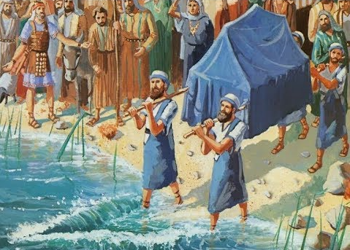
Crossing the Jordan
God has spoken to us about doing impossible things.
About setting out in obedience, before you know you are going to make it.
What does it mean to you?
What will it look like on the other side of the river?

Slide 3

Dealing with intimidation
8th March 2026

Slide 4
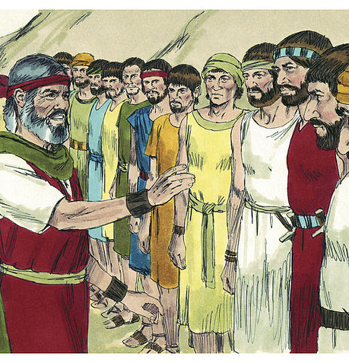
Numbers 13
The Lord said to Moses, ² “Send some men to explore the land of Canaan, which I am giving to the Israelites. From each ancestral tribe send one of its leaders.”
¹⁷ When Moses sent them to explore Canaan, he said, “Go up through the Negev and on into the hill country. ¹⁸ See what the land is like and whether the people who live there are strong or weak, few or many.
¹⁹ What kind of land do they live in? Is it good or bad?
What kind of towns do they live in? Are they unwalled or fortified?
²⁰ How is the soil? Is it fertile or poor? Are there trees in it or not? Do your best to bring back some of the fruit of the land.” (It was the season for the first ripe grapes.)
Notes:
Spies Sent Out
Deut 1:19Then, as the Lord our God commanded us, we set out from Horeb and went toward the hill country of the Amorites through all that vast and dreadful wilderness that you have seen, and so we reached Kadesh Barnea. 20Then I said to you, “You have reached the hill country of the Amorites, which the Lord our God is giving us. 21See, the Lord your God has given you the land. Go up and take possession of it as the Lord, the God of your ancestors, told you. Do not be afraid; do not be discouraged.”
22Then all of you came to me and said, “Let us send men ahead to spy out the land for us and bring back a report about the route we are to take and the towns we will come to.”
23The idea seemed good to me; so I selected twelve of you, one man from each tribe. 24They left and went up into the hill country, and came to the Valley of Eshkol and explored it. 25Taking with them some of the fruit of the land, they brought it down to us and reported, “It is a good land that the Lord our God is giving us.”

Slide 5
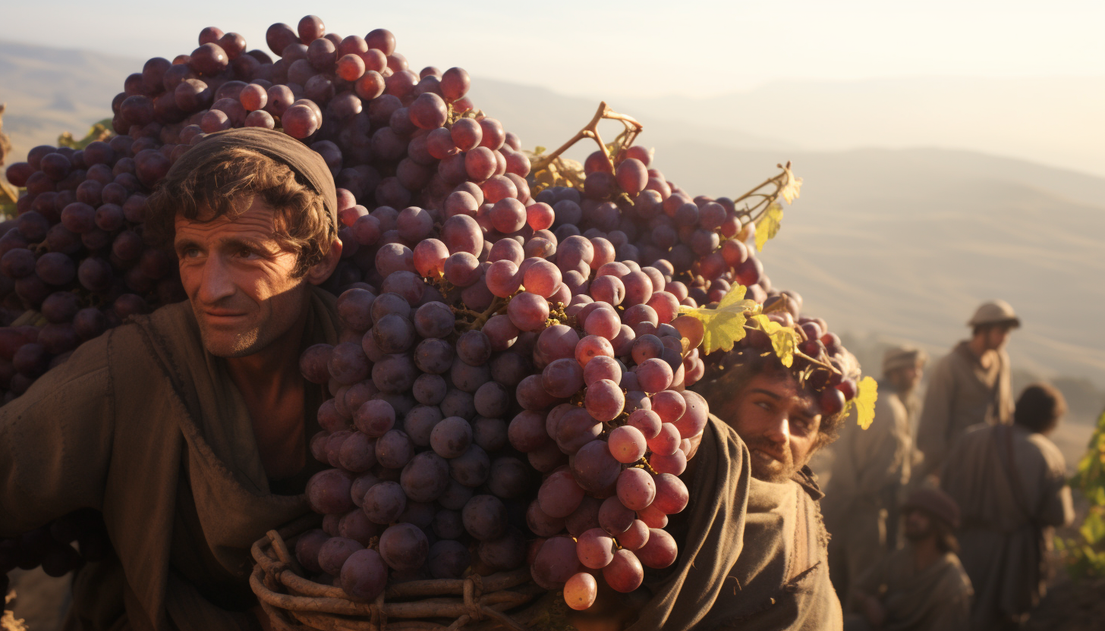
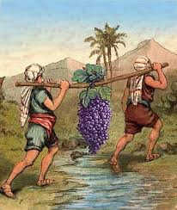
²¹ So they went up and explored the land from the Desert of Zin as far as Rehob, toward Lebo Hamath. ²² They went up through the Negev and came to Hebron, where Ahiman, Sheshai and Talmai, the descendants of Anak, lived. (Hebron had been built seven years before Zoan in Egypt.)
²³ When they reached the Valley of Eshkol,^{[a]} they cut off a branch bearing a single cluster of grapes. Two of them carried it on a pole between them, along with some pomegranates and figs.
²⁴ That place was called the Valley of Eshkol because of the cluster of grapes the Israelites cut off there.
²⁵ At the end of forty days they returned from exploring the land.
Notes:
So they went up and spied out the land: As these spies toured the land, they saw some of the people and the produce of the land. This spectacular produce included clusters of grapes so big that they had to be carried between two men on a pole. This was a good land.
And came to Hebron: God promised all the land of Canaan to Abraham, but the only piece he owned (in the eyes of the Canaanites) was the burial cave in Hebron. They came to Hebron, but no mention is made of the tombs of Abraham, Sarah, Isaac, Rebekah, Jacob, and Leah.
c. The descendants of Anak, were there: This is the first Biblical mention of these people. They were a people of great stature (Numbers 13:33) and thought to be fierce warriors (Deuteronomy 9:2).
i. They saw the descendants of Anak in Hebron. “Instead of looking to the patriarchs and the promises, the spies noticed sizes of buildings and statures of persons…. they averted their glance from the tombs of the fathers, and they neglected the promise of God; they were too preoccupied with the sandal sizes of three huge men who lived in Hebron.” (Allen)
d. And they returned from spying out the land after forty days: The discovery tour covered some 250 miles (400 kilometers) and took forty days. In the Bible, a period of forty (such as forty days or forty years) is often associated with testing.

Slide 6
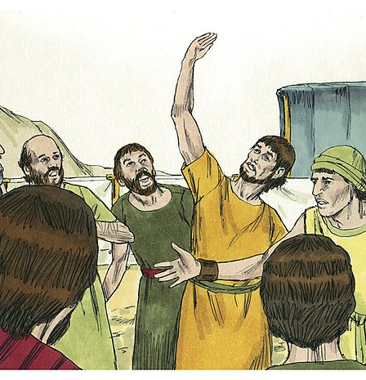
Reporting back (good news / bad news)
²⁶ They came back to Moses and Aaron and the whole Israelite community at Kadesh in the Desert of Paran. There they reported to them and to the whole assembly and showed them the fruit of the land. ²⁷ They gave Moses this account: “We went into the land to which you sent us, and it does flow with milk and honey! Here is its fruit.
²⁸But the people who live there are powerful, and the cities are fortified and very large. We even saw descendants of Anak there. ²⁹ The Amalekites live in the Negev; the Hittites, Jebusites and Amorites live in the hill country; and the Canaanites live near the sea and along the Jordan.”
Notes:
a. They brought back word to them and to all the congregation, and showed them the fruit of the land: The returning spies both spoke and showed all Israel what they saw in the land. This included the huge cluster of grapes mentioned in Numbers 13:23.
b. We went to the land where you sent us: The spies seemed to sense they were more on a mission from Israel than on a mission from God.
c. It truly flows with milk and honey: What God had promised about the land was indeed true. The fruit they brought back – grapes, pomegranates, and figs – showed how fruitful and blessed Canaan was agriculturally.
Symbolism: The phrase represents more than just food; it symbolizes a land of ultimate abundance, a "full pantry" that provides for all needs after the barren wilderness.
Meaning of "Milk": This refers to the abundance of milk from livestock (goats, sheep, cattle), indicating rich pastures
Meaning of "Honey": While it can refer to bee honey, in the context of the land of Israel, it often refers to date or fig syrup—a thick, sweet syrup used as a sweetener and preservative.
Context: Used in the Bible to describe Canaan, which God promised to the descendants of Abraham as a place of rest and blessing.
Cultural Significance: The phrase emphasizes a, land where both shepherds and farmers could thrive.
d. BUT: The word () is a strong way to make a contradictory statement. BUT means “despite all of that.” The message from most of the spies was, “The land is as wonderful as God promised, but we can’t conquer it.”
· Despite God’s faithful promise, the people who dwell in the land are strong.
· Despite God’s faithful promise, the cities are fortified and very large.
· Despite God’s faithful promise, we saw the descendants of Anak there.
· Despite God’s faithful promise, the Amalekites dwell…the Hittites, the Jebusites, and the Amorites dwell…and the Canaanites dwell in the land, and there isn’t any room for the people of Israel.

Slide 7
Reporting back (good news / bad news)
“We can’ ³⁰ Then Caleb silenced the people before Moses and said, “We should go up and take possession of the land, for we can certainly do it.”
³¹ But the men who had gone up with him said, t attack those people; they are stronger than we are.” ³² And they spread among the Israelites a bad report about the land they had explored. They said, “The land we explored devours those living in it. All the people we saw there are of great size. ³³ We saw the Nephilim there (the descendants of Anak come from the Nephilim). We seemed like grasshoppers in our own eyes, and we looked the same to them.”
Notes:
a. Then Caleb quieted the people: Caleb commanded the people to immediately (at once) trust God, obey God, and take the land. He understood that in the LORD they were well able to overcome it.
When the enemy lies to us, we need to confront it straight away
b. Let us go up at once and take possession: It took great courage for this man to stand against the tide of unbelief and doubt. Caleb had the spirit of Romans 3:4: Let God be true but every man a liar.
a. But the men who had gone up with him said: Their unbelieving response was a strong combination of truth, lies, and exaggeration.
· It was true from a human perspective that they are stronger than we – but to say, we are not able to go up against the people was a lie.
· It was true that they had gone through the land – but to say, a land that devours its inhabitants was a lie.
· Each of the statements, All the people whom we saw in it are men of great stature or the giants and we were like grasshoppers were all terrible exaggerations – meaning they were lies.
The land through which we have gone as spies: The unbelieving spies appealed to their authority as those who had seen the strong cities and people of Canaan themselves. They thought and said that the facts and practical realities were on their side. Yet the most fact-based and practical thing the believer can do is to trust the promises of the living God. Ultimately, their unbelief was not according to the facts, but despite the facts.
Two groups of men could see the same things – the same grapes, the same Canaanites, the same land, and the same cities. One group (Caleb and Joshua) came away strong in faith, and the other ten spies had a sense of certain doom. Ultimately, faith or unbelief is not rooted in circumstances or environment. Faith is rooted in a heart that trusts God and His promises.

Slide 8
What’s happened?
The reports of the new land from the spies are contradictory and confused
The people sent out were experienced leaders of each tribe – they should have known better!
What impacted them that didn’t impact Joshua and Caleb?
Joshua and Caleb, see exactly the same sights as the rest; yet their perspective is totally different.
When trying to hear God, how we process what we see is as important as what we see.
Notes:
The tribes of Israel were confronted with two reports regarding the Promised Land.
Two of the twelve spies (Caleb and Joshua) said, Let us go up at once and take possession, for we are well able to overcome it (Numbers 13:30).
The message of the other ten spies was, “What God promised about the land is true; nevertheless, the natives of the land are too mighty, and we cannot overcome them, despite what God has promised” (as in Numbers 13:31-33).
These were no minor or young inexperienced spies
These were leaders from each tribe they were experienced they were appointed they’ve been prayed into their place they had the status in the tribes and they were sent into this new land to see what they could find.
They saw the same things they came to completely different conclusions
How’s their status made them comfortable? are there a point in life where they no longer wish to take risk?
How are you seeing what lies ahead for us?

Slide 9
Numbers 14
14 That night all the members of the community raised their voices and wept aloud. ² All the Israelites grumbled against Moses and Aaron, and the whole assembly said to them, “If only we had died in Egypt! Or in this wilderness! ³ Why is the Lord bringing us to this land only to let us fall by the sword? Our wives and children will be taken as plunder. Wouldn’t it be better for us to go back to Egypt?” ⁴ And they said to each other, “We should choose a leader and go back to Egypt.”
⁵ Then Moses and Aaron fell facedown in front of the whole Israelite assembly gathered there. ⁶ Joshua son of Nun and Caleb son of Jephunneh, who were among those who had explored the land, tore their clothes ⁷ and said to the entire Israelite assembly, “The land we passed through and explored is exceedingly good. ⁸ If the Lord is pleased with us, he will lead us into that land, a land flowing with milk and honey, and will give it to us. ⁹ Only do not rebel against the Lord. And do not be afraid of the people of the land, because we will devour them. Their protection is gone, but the Lord is with us. Do not be afraid of them.”
Notes:
A land flowing with milk and honey" is a biblical idiom (appearing over 20 times, e.g., Exodus 3:8) describing the promised land of Israel as exceptionally fertile, prosperous, and abundant. It symbolizes a, land capable of supporting life through both pastoral grazing (milk) and agriculture (honey), representing divine provision, sustenance, and richness.

Slide 10
That night all the people wept aloud
They mourned because God would not make it all “easy.”
They mourned with resentment against God, putting the blame on Him.
They mourned and gave in to the feeling of unbelief and fear.
They mourned over a loss.
Unbelief made them think that God’s good for them (the gift of the Promised Land) was an evil thing.
Less than two years out of Egypt, Israel here stood on the threshold of the Promised Land. But unbelief prevented this otherwise prepared people from receiving God’s promises.
Notes:
What were they crying about?
The unbelief of the ten spies accurately represented the unbelieving heart of the nation. Israel wept that night when they heard that the enemies in Canaan were strong.
i. They mourned because God would not make it all “easy.” We often expect this of God and therefore we often resent adversity. This is to forget the example of Jesus, who faced great difficulty in life and ministry. We may forget that we, as disciples, are not above Jesus our Master.
ii. They mourned with resentment against God, putting the blame on Him. In doing this, they denied that the LORD is a loving Father who cares for His children.
iii. They mourned and gave in to the feeling of unbelief and fear. This sorrow allowed their feelings to overwhelm their thinking and actions, instead of being directed by a thinking faith in the living God. This was a sinful and unbelieving trust in the feelings of fear and sorrow.
iv. They mourned over a loss. We often mourn because something has died. They felt the promise of Canaan had died, becoming impossible. Instead, God wanted them to “die” to their unbelief and their trust in self.
c. And the people wept that night: As God invited Israel to take the land of Canaan, they rebelled against Him through their mourning. Unbelief made them think that God’s good for them (the gift of the Promised Land) was an evil thing.
i. This shows the great tragedy of unbelief. Less than two years out of Egypt, Israel here stood on the threshold of the Promised Land. Over the first ten chapters of Numbers Israel was fully prepared to live and go forward as people suited for God’s Promised Land.
They had been ordered and organized;
cleansed and purified;
set apart and blessed; taught how to give and how to function as priests.
In that period, Israel was made to remember judgment spared and deliverance brought; they were given God’s presence as a guide, and the tools needed to lead the people.
Yet, unbelief prevented this otherwise prepared people from receiving God’s promises.

Slide 11
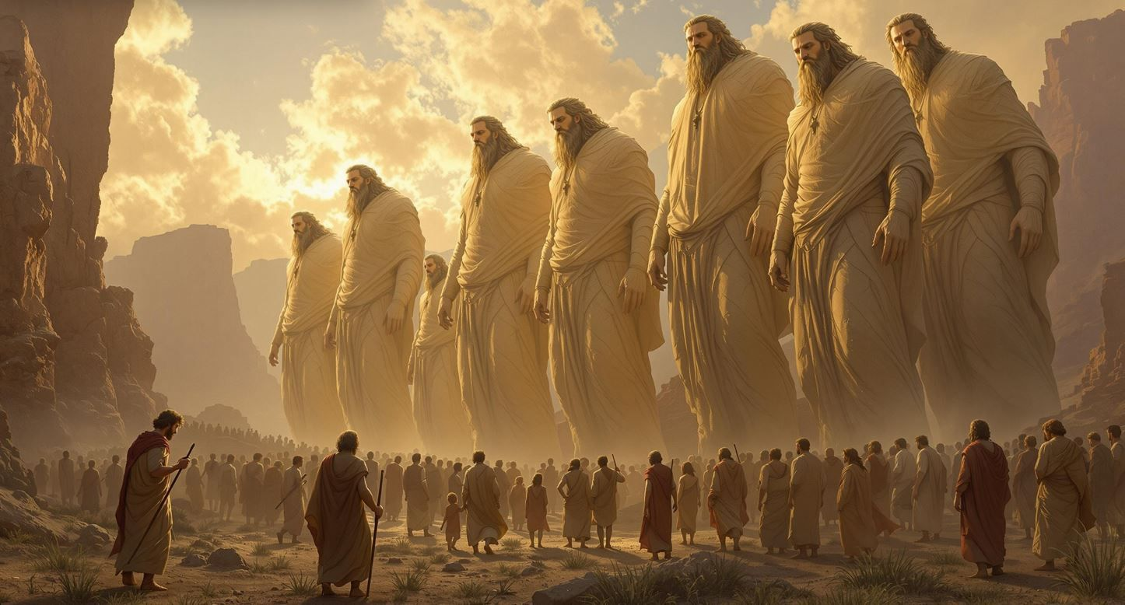
Grapes or giants ahead?
OR

Slide 12
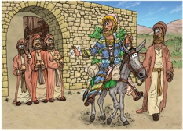
Matthew 25
¹⁴ “For it will be like a man going on a journey, who called his servants^{[a]} and entrusted to them his property. ¹⁵ To one he gave five talents,^{[b]} to another two, to another one, to each according to his ability. Then he went away. ¹⁶ He who had received the five talents went at once and traded with them, and he made five talents more. ¹⁷ So also he who had the two talents made two talents more. ¹⁸ But he who had received the one talent went and dug in the ground and hid his master's money.
Notes:
In the application of this parable it is appropriate to see these talents as life resources – such as time, money, abilities, and authority.
ITS NOT FAIR
“the most spiritually healthy [thing anyone] can do is to simply stop paying attention to what others have.”** There will always be someone better looking, smarter, kinder, wealthier, more popular and successful than me. So instead of finding my self-worth in competition, I choose to root it in contemplation. Contemplation of the God I cannot impress, who set aside his power and status to show me just how deeply he loves me (Philippians 2:5–11).
Since this is the kind of life we have chosen, the life of the Spirit, let us make sure that we do not just hold it as an idea in our heads or a sentiment in our hearts, but work out its implications in every detail of our lives. That means we will not compare ourselves with each other as if one of us were better and another worse. We have far more interesting things to do with our lives. Each of us is an original
Gal 5 25-26

Slide 13
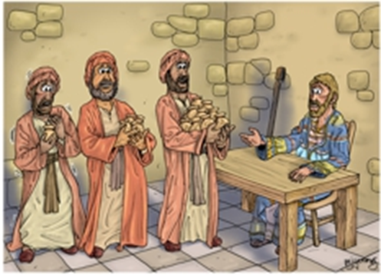
Matthew 25
¹⁹ Now after a long time the master of those servants came and settled accounts with them. ²⁰ And he who had received the five talents came forward, bringing five talents more, saying, ‘Master, you delivered to me five talents; here, I have made five talents more.’
²¹ His master said to him, ‘Well done, good and faithful servant.^{[c]} You have been faithful over a little; I will set you over much. Enter into the joy of your master.’ ²² And he also who had the two talents came forward, saying, ‘Master, you delivered to me two talents; here, I have made two talents more.’ ²³ His master said to him, ‘Well done, good and faithful servant. You have been faithful over a little; I will set you over much. Enter into the joy of your master.

Slide 14
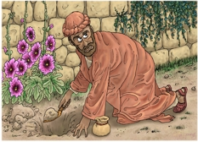
²⁴ He also who had received the one talent came forward, saying, ‘Master, I knew you to be a hard man, reaping where you did not sow, and gathering where you scattered no seed, ²⁵ so I was afraid, and I went and hid your talent in the ground. Here, you have what is yours.’
²⁶ But his master answered him, ‘You wicked and slothful servant! You knew that I reap where I have not sown and gather where I scattered no seed? ²⁷ Then you ought to have invested my money with the bankers, and at my coming I should have received what was my own with interest.
²⁸ So take the talent from him and give it to him who has the ten talents. ²⁹ For to everyone who has will more be given, and he will have an abundance. But from the one who has not, even what he has will be taken away. ³⁰ And cast the worthless servant into the outer darkness. In that place there will be weeping and gnashing of teeth.’

Slide 15
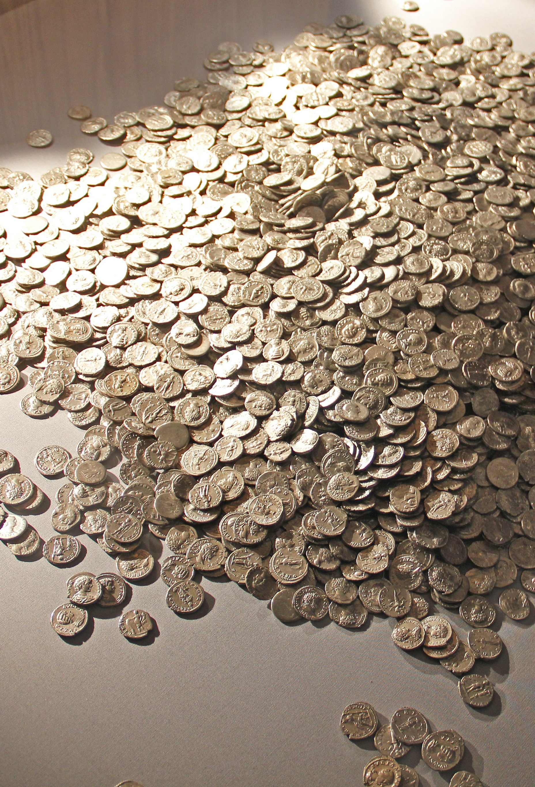
Key points
When more is given, more is expected – Eph 4:1 live a life worthy of the calling you have received
Comparison kills - stop paying attention to what others have
Everyone in this story receives a lot! A talent would be 16 years of wages
We are expected to invest what God gives us
Fear leads to a lack of faith and false perspectives
Notes:
Parable of the talents lesson 1: When more is given, more is expected
In the parable, the rich man’s goods were divided between three servants.
The first servant was given five talents.
The second was given two talents.
The third was given one talent.
What is a talent?
In the ancient world, a talent was a unit of weight, in this case, a weight of silver.
According to Vine’s Expository Dictionary of New Testament Words, a talent was equivalent to 6,000 denarii. Since one denarius was the wage for a day’s work in the fields, as mentioned in Matthew 20:2, that’s roughly equivalent to what would be earned over 6,000 work days—a little over 16 years of wages! So, the rich man entrusted a large sum of money to these three servants.
But the lesson is not about money.
In this parable, the talents represent strengths, skills and abilities God gives to people. Some abilities we’re born with, while others are learned and developed over time. It was because of this parable that the word talent became associated with abilities in the Middle Ages.
ITS NOT FAIR
“the most spiritually healthy [thing anyone] can do is to simply stop paying attention to what others have.”** There will always be someone better looking, smarter, kinder, wealthier, more popular and successful than me. So instead of finding my self-worth in competition, I choose to root it in contemplation. Contemplation of the God I cannot impress, who set aside his power and status to show me just how deeply he loves me (Philippians 2:5–11).
Since this is the kind of life we have chosen, the life of the Spirit, let us make sure that we do not just hold it as an idea in our heads or a sentiment in our hearts, but work out its implications in every detail of our lives. That means we will not compare ourselves with each other as if one of us were better and another worse. We have far more interesting things to do with our lives. Each of us is an original
Gal 5 25-26

Slide 16

What “talents” has God given you to invest in the Kingdom?
Strengths, skills and abilities
Position, influence, following
No one else is like you. No one else can make your contribution.
Don’t bury them!

Slide 17

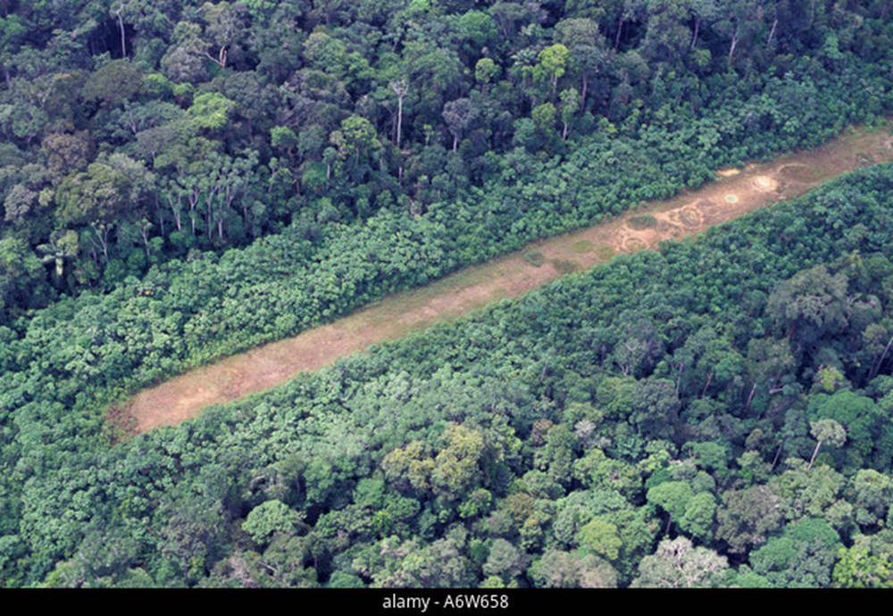
“Don’t give the enemy a landing strip”

Slide 18
We are on the move!
So we have seen that giving the enemy hold over our lives has dramatic consequences
The enemy looks for opportunity (Job 1:7)
What things give him a landing strip?
  Anger gives the enemy a foothold (Eph 4:26)
  A lack of open, key relationships (1 John 1:7)
  Unconfessed sin (1 John 1: 9)
  Comparison with others (Gal 5:26)
  all of these things can lead to dark places where the enemy thrives
Must keep focussed on what God has said – and don’t give in to the enemy’s agenda. Be patient, persistent and purposeful.
Notes:
⁷ The Lord said to Satan, “Where have you come from?”
Satan answered the Lord, “From roaming throughout the earth, going back and forth on it.”
1 John 1: 7,9 ⁷ But if we walk in the light, as he is in the light, we have fellowship with one another, and the blood of Jesus, his Son, purifies us from all^{[b]} sin.⁹ If we confess our sins, he is faithful and just and will forgive us our sins and purify us from all unrighteousness.
Since this is the kind of life we have chosen, the life of the Spirit, let us make sure that we do not just hold it as an idea in our heads or a sentiment in our hearts, but work out its implications in every detail of our lives. That means we will not compare ourselves with each other as if one of us were better and another worse. We have far more interesting things to do with our lives. Each of us is an original
Gal 5 25-26
Numbers 14
“The land we passed through and explored is exceedingly good. ⁸ If the Lord is pleased with us, he will lead us into that land, a land flowing with milk and honey, and will give it to us. ⁹ Only do not rebel against the Lord. And do not be afraid of the people of the land, because we will devour them. Their protection is gone, but the Lord is with us. Do not be afraid of them.”
Deut 1:21See, the Lord your God has given you the land. Go up and take possession of it as the Lord, the God of your ancestors, told you. Do not be afraid; do not be discouraged.”
Wrestling Against Darkness: Rooted in New Testament teaching, it involves engaging in spiritual warfare against evil forces that seek to destroy God's purposes.
Persistence and Intensity: It is not a casual prayer but a "strenuous, labored effort," similar to an athlete competing or someone knocking on a door until it opens.
Declaring Scripture: It involves praying with authority, often speaking God's promises out loud to enforce His will in situations.
Using Authority: Believers use their delegated authority, not their own strength, to stand against obstacles.
Intercession: It is frequently used when fighting for others, for healing, or against impossible situations, sometimes described as standing in the gap.
YouTube +6
It is important to remember that contending in prayer is not about convincing God, but joining Him in his, or actively bringing his, kingdom purposes. It is a form of prayer that, while sometimes long and difficult, is designed to lead to victory.

Slide 19
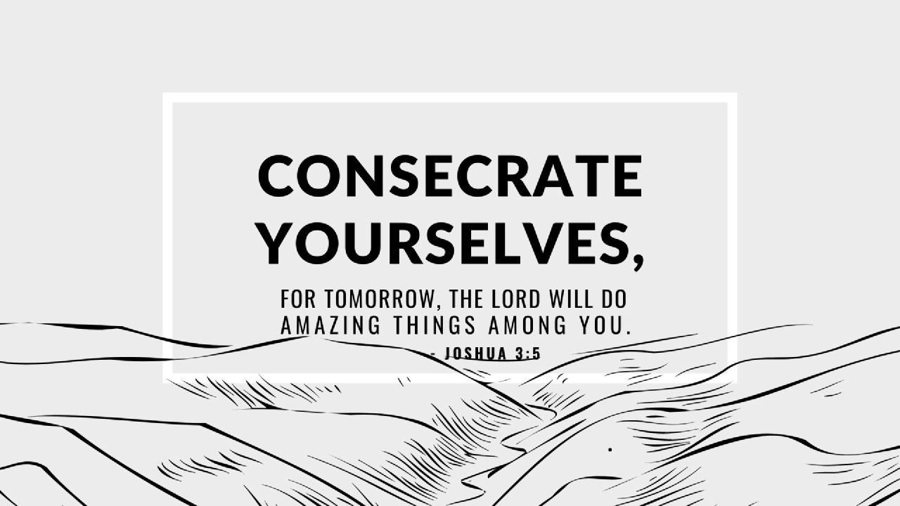

Slide 20
Consecration (Eph 4:17-32)
Put off your old self - Be made new in the attitude of your minds
Put on the new self - Created to be like God in true righteousness and holiness
Put off falsehood and speak truthfully
Do not let the sun go down while you are still angry
Watch what you say and how you say it.
Get rid of all bitterness, rage and anger, brawling and slander, along with every form of malice.
Be kind and compassionate to one another, forgiving each other, just as in Christ God forgave you.
Notes:
Instructions for Christian Living
¹⁷ So I tell you this, and insist on it in the Lord, that you must no longer live as the Gentiles do, in the futility of their thinking. ¹⁸ They are darkened in their understanding and separated from the life of God because of the ignorance that is in them due to the hardening of their hearts. ¹⁹ Having lost all sensitivity, they have given themselves over to sensuality so as to indulge in every kind of impurity, and they are full of greed.
²⁰ That, however, is not the way of life you learned ²¹ when you heard about Christ and were taught in him in accordance with the truth that is in Jesus.
²² You were taught, with regard to your former way of life, to put off your old self, which is being corrupted by its deceitful desires; ²³ to be made new in the attitude of your minds; ²⁴ and to put on the new self, created to be like God in true righteousness and holiness.
²⁵ Therefore each of you must put off falsehood and speak truthfully to your neighbor, for we are all members of one body. ²⁶ “In your anger do not sin”^{[d]}: Do not let the sun go down while you are still angry, ²⁷ and do not give the devil a foothold. ²⁸ Anyone who has been stealing must steal no longer, but must work, doing something useful with their own hands, that they may have something to share with those in need.
²⁹ Do not let any unwholesome talk come out of your mouths, but only what is helpful for building others up according to their needs, that it may benefit those who listen. ³⁰ And do not grieve the Holy Spirit of God, with whom you were sealed for the day of redemption. ³¹ Get rid of all bitterness, rage and anger, brawling and slander, along with every form of malice. ³² Be kind and compassionate to one another, forgiving each other, just as in Christ God forgave you.

