Slide 1

Easter is good news!

Slide 2
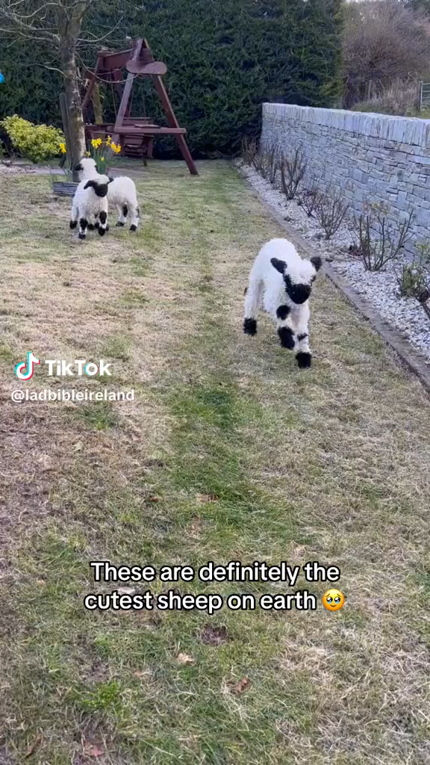
Notes:
Growing up on a farm – always wanted lambs to look after. But we didn’t have sheep – except for one year when I ended up with 20 orphaned lambs that needed bottle feeding. One of them was especially enthusiastic and when I appeared with a bottle would leap into my arms – which was fine when it was this age but not when it was a half grown sheep and still tried to do it!

Slide 3
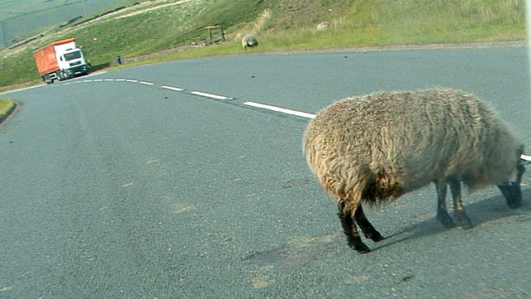
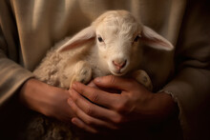
We all, like sheep, have gone astray, each of us has turned to our own way; Isaiah 53:6
…get into trouble
…need rescuing

Slide 4
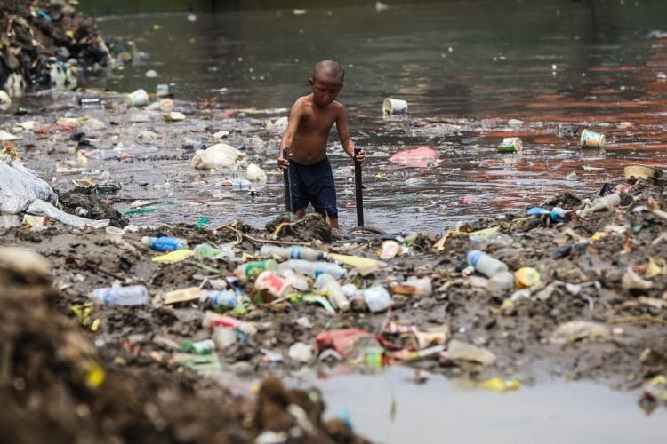

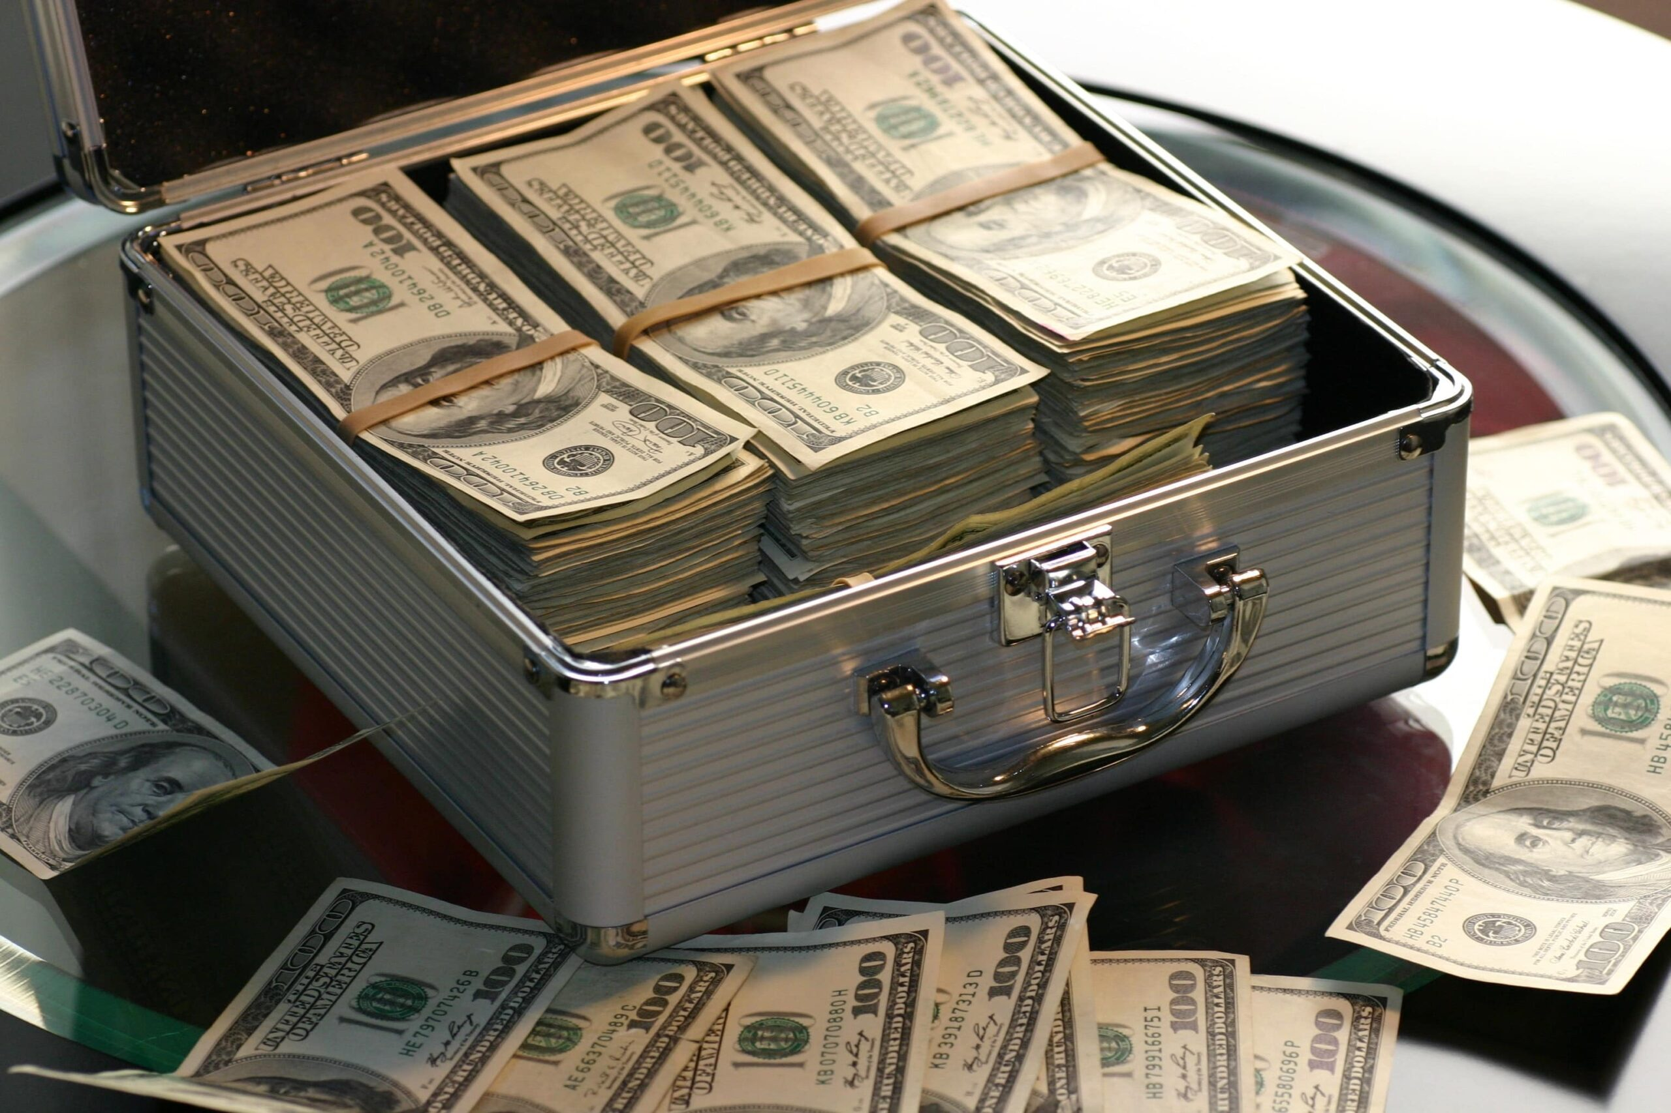
Sacrifice: a reminder and a ransom

Slide 5
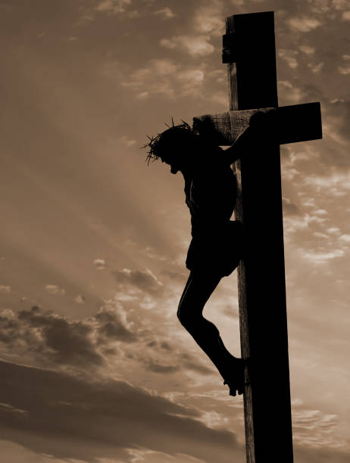
Look, the Lamb of God, who takes away the sin of the world! John 1:29
He was oppressed and afflicted, yet he did not open his mouth; he was led like a lamb to the slaughter, and as a sheep before its shearers is silent, so he did not open his mouth.
Isaiah 53:7

Slide 6
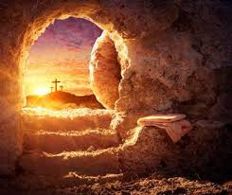
So why is this Good News?
Christ suffered for our sins once for all time. He never sinned, but he died for sinners to bring you safely home to God. He suffered physical death, but he was raised to life in the Spirit. 1 Peter 3:18

Slide 7
Our response?
For God so loved the world that he gave his one and only Son, that whoever believes in him shall not perish but have eternal life. John 3:16
Admit that you’ve gone astray
Accept that Jesus has paid the ransom
Ask Jesus to come and take charge of your life

