Slide 1
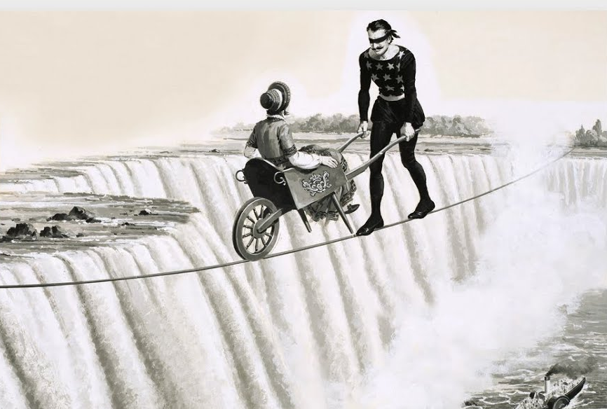

You gotta have faith
Episode 2: What is Faith? Part 2

Slide 2


Slide 3
Faith Equation
1.
What God says about Himself (scripture)
2.
track record
personal conviction (witness)
3.
My decision to live as if this is true
FAITH
Consider
Action
Notes:
Considering the evidence available and choosing to live as if this is reality
Faith in God = adding up all that God claims about Himself through the scripture, and how he has expressed His nature through his track record in my life (and those I trust) and choosing an attitude, mindset and actions in line with this.

Slide 4
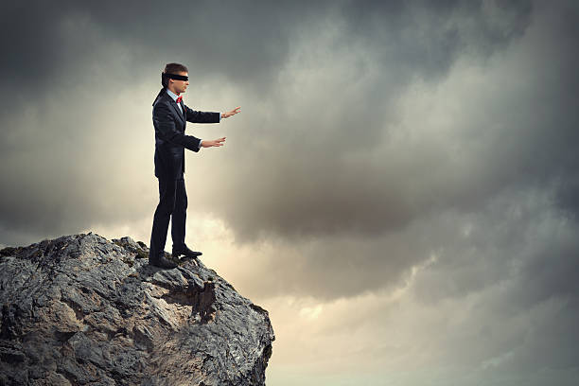

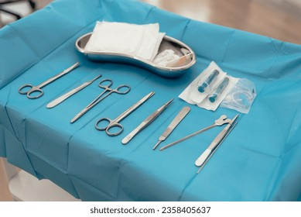
Consider
Scientific Materialism
sight
For we live by faith, not by reason
(2 Cor 5:7)
Notes:
I think we greatly underestimate our role in considering/thinking/reasoning/adding up
Culture puts faith against reason - Blind faith = failure to consider
Tom Holland said to believe he would have to “cut himself off from reason”
But the bible doesn’t want us to switch off our brain Paul didn’t say cut yourself off from reason
Paul says “we live by faith and not by sight” – contrasting faith and sight. Not faith and reason. Sight is one sense we have for receiving evidence (its not the only)
Our faith is reasonable - Jesus – look at the birds, see the flowers – consider the evidence in front of you
Faith is about thinking through – not suspending our intellect.
Justin Brierley (Christian apologist/radio host/surprising rebirth) challenges Holland
Enlightenment made evidence to be only material – but this is a narrow definition of evidence. If its real it can be recreated in laboratory
But we don’t live like this – love isn’t material but we live as if it is real
e.g. surgery – not new info, but now having to figure out what to do with sight

Slide 5
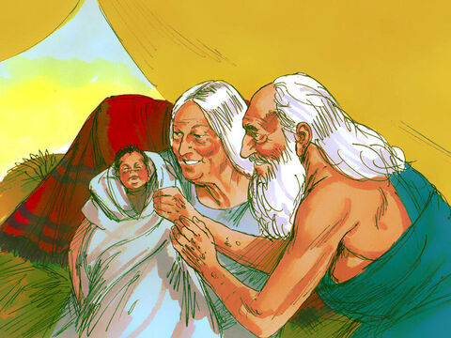
Consider
And by faith even Sarah, who was past childbearing age, was enabled to bear children because she considered him faithful who had made the promise.
(Heb 11:11)
Notes:
Added it up, collected the evidence, did the sums
God has protected her as they moved to unknown lands, protected her during danger in Egypt
Is the one making this promise is trust/faith-worthy?

Slide 6
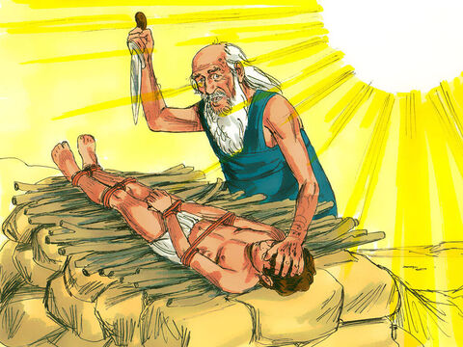
Consider
Abraham reasoned that God could even raise the dead, and so in a manner of speaking he did receive Isaac back from death.
(Heb 11:19)
Notes:
Evidence to lay out in decision making
God miraculously gave us child at 100 as He promised = God is powerful and trustworthy
If he can bring forth life from a body that was as good as dead, he can bring forth life from a dead body
did he have certainty (that Isaac would be risen from the dead)? No
did he have a pretty good grasp of God’s nature? Yes. He had a good reason.

Slide 7
Faith Equation
1.
What God says about Himself (scripture)
2.
track record
personal conviction (witness)
3.
My decision to live as if this is true
FAITH
Consider
Action

Slide 8
Creator
(Gen 1:1)
Patient
(Exo 34:6)
Holy
(1 Sam 2:2)
Compassionate
(Exo 34:6)
Forgiver
(Col 1:14)
Gracious
(Exo 34:6)
Trustworthy
(Num 23:19)
Powerful
(Ps 147:5)
Omnipresent
(Ps139:7-8)
1. What God says about Himself (scripture)
Energetic
(Isa 40:28)
Wise
(1 Cor 1:25)
Righteous
(Ps111:3)
Love
(1 John 4:8)
Near
(Ps 145:18)
Doer of the impossible
(Luke 1:37)
Sees all
(Heb 4:13)
Impartial
(Acts 10:34)
Saviour
(Ps 27:1)
Merciful
(Deu 4:31)
King
(Jer 10:10)
Redeemer
(Job 19:25)
Shepherd
(Ps 23:1)
Unchanging
(Mal 3:6)
Notes:
How many adjectives can you think of?
What God says about Himself become the basis for our faith in Him
e.g. Shepherd – he protects, leads us, take care of all needs (checks what's in the pastures), knows we would be lost without him
Some of these characteristics of God you might not have identifiable first-hand experience of – but this is about what He says not your experience

Slide 9
Revelation He is jealous for me
First encounter with God
Just as I was with Moses, so I will be with you.
Wade out into the river
He knows best
Secured identity
Hope in Me
2.
(witness)
personal conviction
track record
Myles
Share message with stranger
Head not the tail
Protection of LNP
Miraculous provision
Sharper witness
Ministering Spirit
HH together
Marriages restored
Jeremy
Notes:
You don’t need to know the story behind all this (ask me about it) – example of homework
Track record – where have I witnessed actions of God (date, place, time) [Light blue = direct involvement]
I might be witness of how He has acted in someone else’s life but it is still on my track record [darker blue = church/indirect]
Personal conviction (conviction not negative – firmly held belief)
Now words – what I have a conviction for
Not heard audible voice but a ‘settling’ – compulsion (not always happiness)
Won’t find these directions in scripture specifically (but won’t contradict the arch)
Wade out (Josh 3) – could have used Jesus’ illustration – you don’t start building unless you have the money (Luke 14:28)
Like certain scriptures come to life
Might not have track record + now word or might have just 1
a) Conviction but no track record
- John Wimber - Teach My Word not your experience
- More than Able
Just 'cause I haven't seen it in my lifetime
That doesn't mean He can't do it”
Gideon – never seen victory over Midian but fleece
b) Track record but no now word
- Tithe / obey scripture

Slide 10
What is on your track record?
What are your personal convictions?
Notes:
Just looked at personal conviction – lets look how this kicks in…

Slide 11
"Faith is not less than thinking, but it is more.” - Tim Keller
1. God’s nature
2. God’s track record
2. Personal Conviction
3. Action
Can I murder my boss?
God has enabled me to forgive before
God is merciful
Don’t commit murder
N/A
Neither decision contradicts God’s word
Do I come off medication?
Mrs Smith came off and has been fine
God is a healer
What is He saying now?
Come off meds
Notes:
Faith is not less than thinking, but it is much more (not just intellectual)
E.g. on medication – Healing in God’s nature, other’s with same condition healed – do I act in same way?
If the question was should I steal/commit adultery/murder – bible has made it clear

Slide 12
What does a personal conviction feel like?
Notes:
How do you know you’ve ‘heard’ from God?

Slide 13
"And when He [the Holy Spirit] comes, He will convict the world concerning sin and righteousness and judgment."
— John 16:8
personal conviction
"Now when they heard this, they were cut to the heart..."
— Acts 2:37
Includes feelings
but not dependent on them
“Each of them should be fully convinced in their own mind.”
— Rom 14:5
“It seemed good to the Holy Spirit and to us…”
— Acts 15:28
“Conviction you’ll die for, everything else is preference”
- Terry King
Whether you turn to the right or to the left, your ears will hear a voice behind you, saying, “This is the way; walk in it.”
— Isa 30:21
Notes:
Nuance of conviction
Not just if you are ‘feeling it’
E.g. TK terrified about moving to NY but conviction
Jesus embrace the cross but was sweating blood, pleaded for alternative
Power of personal experience/specific word
Dawn – pregnancy
Act 23:11 – Jesus stood beside Paul
Conviction pressed upon through experience
(Includes feeling but not dependent on it)
This is how the bible describes conviction
Awakening/make aware (when previously unaware)
Remorse. Compulsion to respond – “What must we do?!”
scripturally ambiguous – personally settle what is right for me
Settling (in peace but not necessarily ‘happiness’)
Leading of the holy spirit
Sometimes the ‘settling’ is comes after the decision
Conviction you’ll die for, everything else is preference

Slide 14
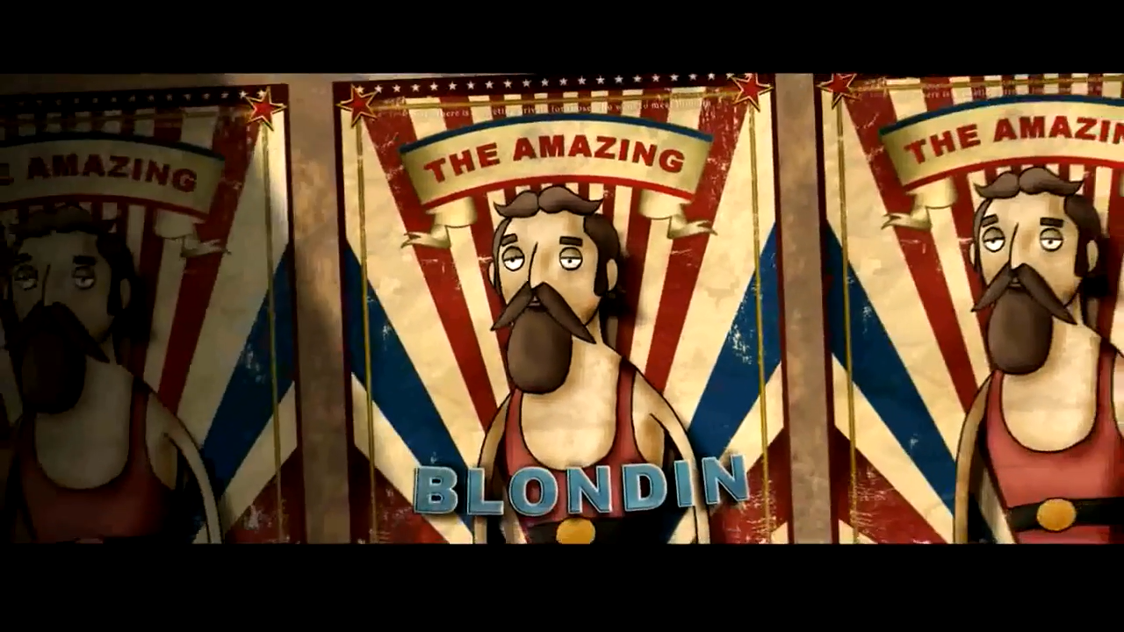
Action
You believe that God is one; you do well. Even the demons believe—and shudder!
(James 2:19)
3. My decision to live as if this is true
By faith Abraham, when called … obeyed and went, even though he did not know where he was going
(Heb 11:8)
Notes:
If we stopped at Consider we have not come to faith. It only truly becomes faith when we bank on it
e.g. Blondin – claim you believe, now prove it by getting into the wheelbarrow
– would be like demons
Even demons believe and tremble
believe in heart AND Confess with mouth
Heb 11:8
By faith Abraham, when called to go to a place he would later receive as his inheritance, obeyed and went, even though he did not know where he was going

Slide 15
Scenario
Nature
Track Record/
Action
Conviction
Abraham told to sacrifice
Isaac
God is boss
God protected
Sacrifice son
God enabled to become
Faithful
Action
father
Therefore, could bring boy
back to life
Heard God’s command
“Should you be revising
Is your teacher
Has your teacher given you
Don’t revise
for your exam?”
corrupt/unjust?
generous grades you didn’t
Wishful
Action
“I have faith that I’ll
deserve in the past?
pass”
Church holiday camping
God is boss
He has led me well
Don’t go
Faithless
Action
(I don’t like camping)
Don’t bother asking God
Notes:
His Nature: God is Lord of all
Track record: He has track record of leading me well
(But I don’t like camping) – I don’t seek His will, in the context of His nature and track record, but on my preference/feeling
Action: Don’t go
(If you ask God and God says ‘no’ would be faithful – let us be careful in using God’s name)

Slide 16
Conclusion
“Faith is making decisions based on who God is, what He has done/said and is saying”
You have a role to play in your faith
- Collect & consider the evidence
- Act on the evidence
Notes:
Faith is making decisions based on who God is, what He has done & said and is currently saying
Not view life through my limitations
Response: You have a role to play in your faith
What opportunities can you anticipate this coming week where you can ACT on the evidence?

