Slide 1
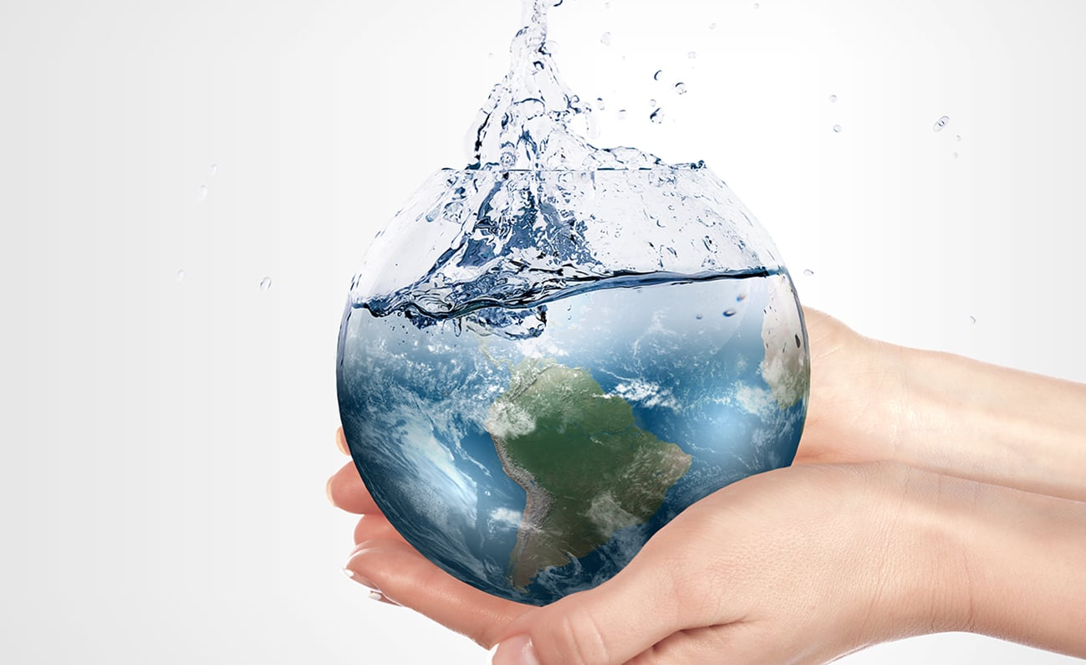

You gotta have faith
Episode 5: Glory
Notes:
We interrupt this faith series to bring you this urgent message
“like water the sea…as it rises on us”

Slide 2


Slide 3
Why did God make you?

Slide 4
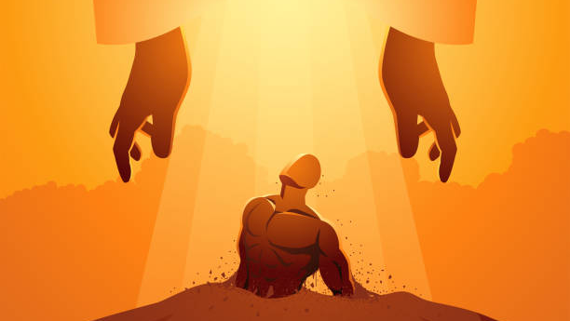
everyone who is called by my name, whom
I created for my glory,
whom I formed and made.”
(Isa 43:7)
Notes:
everyone who is called by my name, whom I created for my glory, whom I formed and made.”
(Isa 43:7)

Slide 5
God’s Grand Plan

Slide 6
What do you think God’s Grand Plan is?

Slide 7
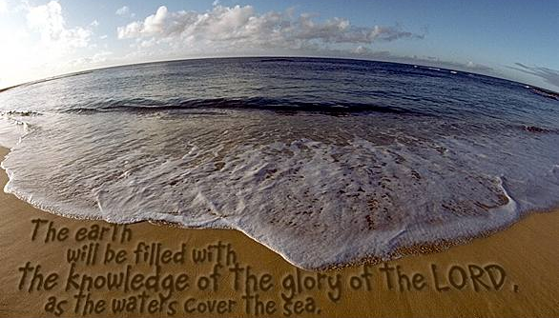
(Hab 2:14)
Notes:
(Hab 2:14)

Slide 8
God’s Grand Plan
=
Fill the earth with His glory
Notes:
So, what does glory mean?
He wants His space (heaven) to completely overlap with our space (earth)

Slide 9
What do you think ‘glory’ means?

Slide 10
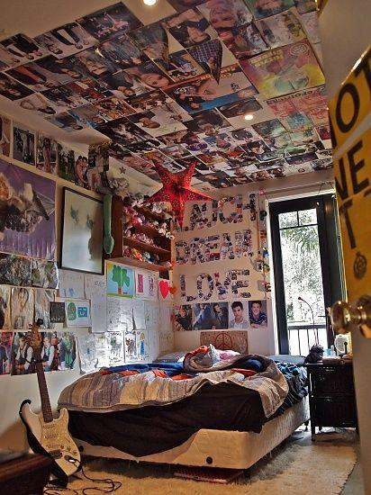
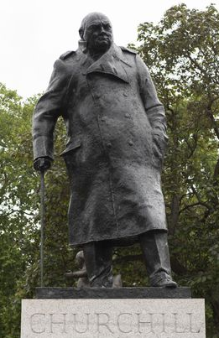
Glory
Glory of God = God’s attributes on display
To glorify is to be an accurate representation
Notes:
You can tell who this room belongs to because their personality/attributes are expressed
Glory of God = God’s attributes on display
Q: What are some attributes of God?
To glorify is to be an accurate representation – does the representation bear the image? Do you see this statue is meant to make you think of Churchill?

Slide 11

for the earth will be full of the knowledge of the LORD as the sea is full of water. (Isa 11:9)
as surely as the whole earth is filled with the glory of the LORD (Num 14:21)
may all the earth be filled with His glory. (Ps 72:19)
And they were calling out to one another: “Holy, holy, holy is the LORD of Hosts; all the earth is full of His glory.” (Isa 6:3)
And the glory of the LORD will be revealed, and all people will see it together. (Isa 40:5)

Slide 12
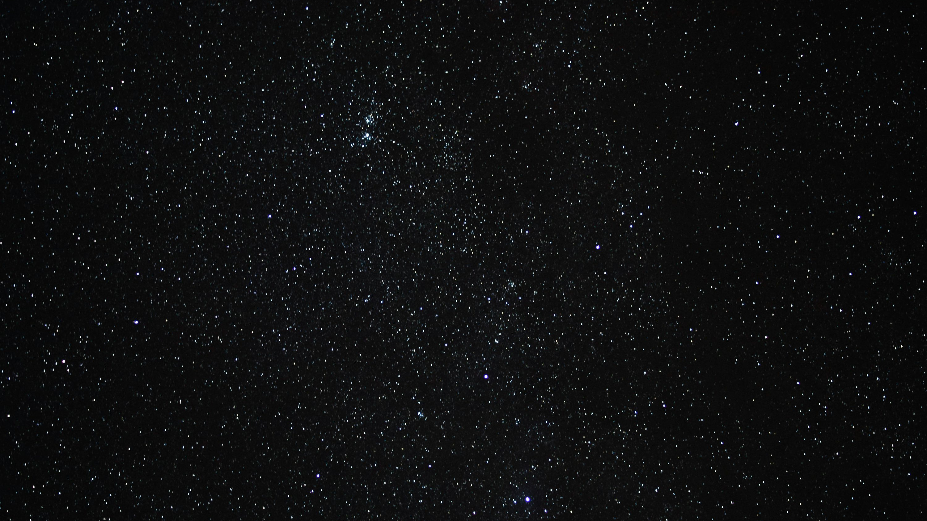



Slide 13
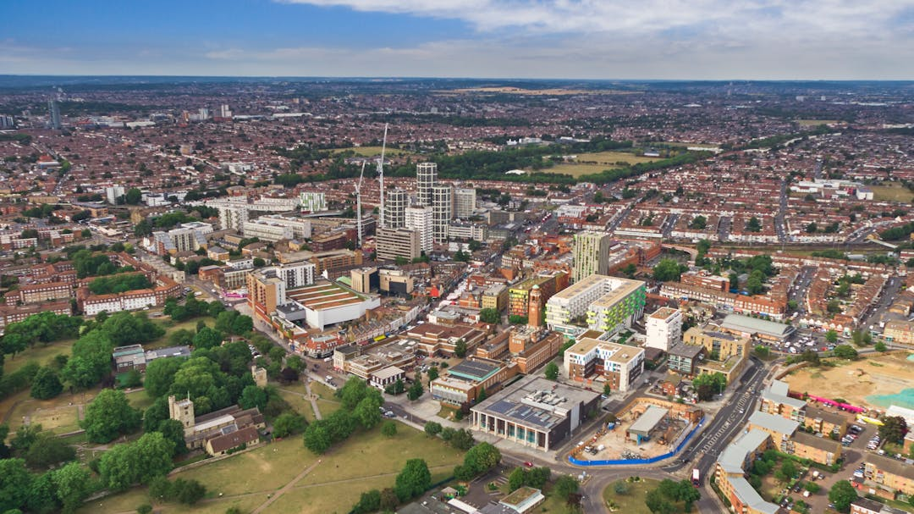
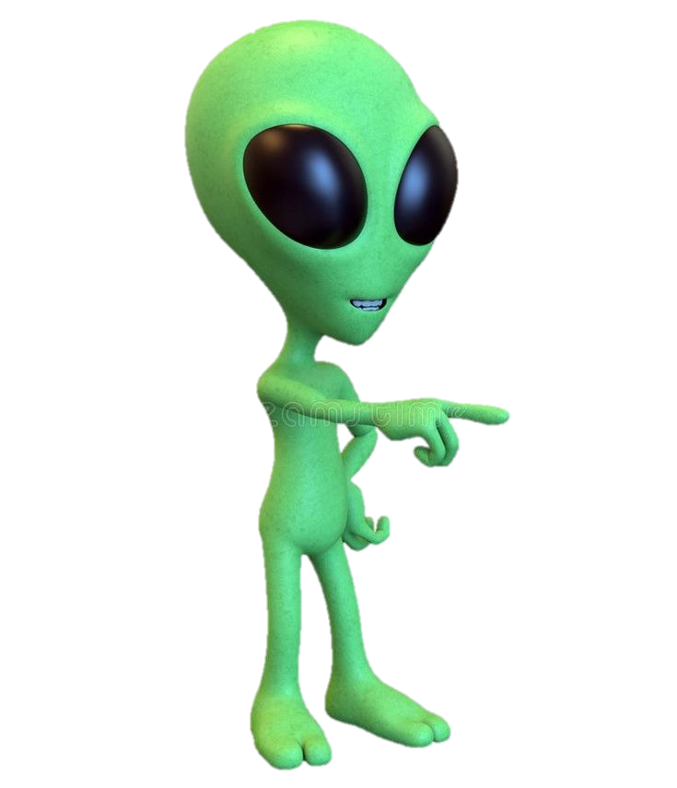

Where am I?!
I see love
I see kindness
I see justice
I see hope
I see joy
I see ……….

Slide 14
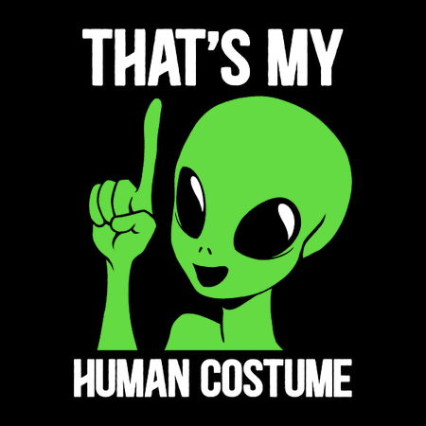
Aha!...This must be earth!!!
Notes:
Obviously, this isn’t the reality right now
An alien wouldn’t be able to spot this is earth because it accurately displays God’s nature
So how is God going to deliver His Grand Plan?

Slide 15
How is God going to deliver His Grand Plan?

Slide 16
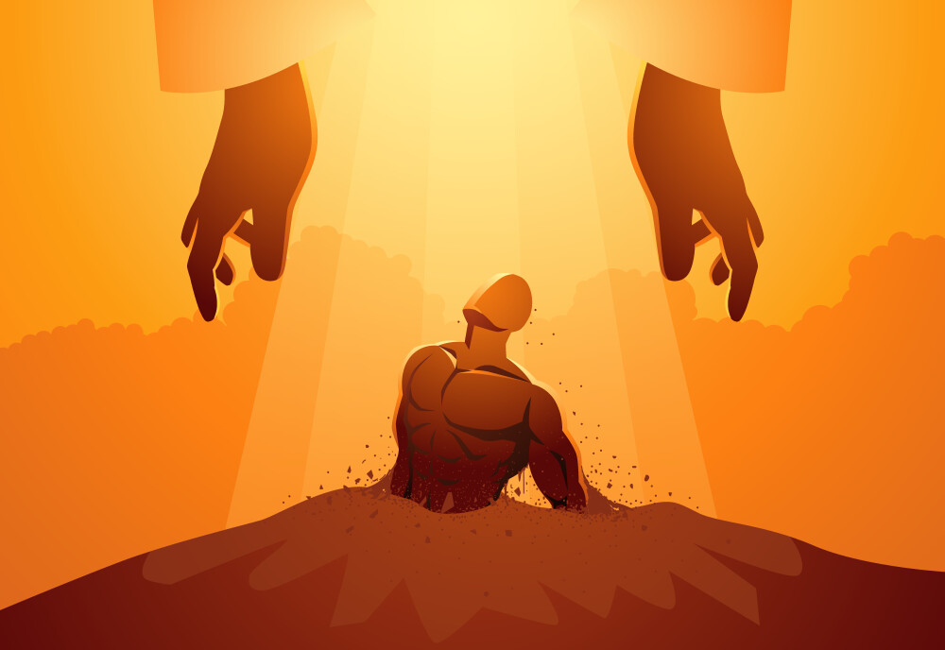
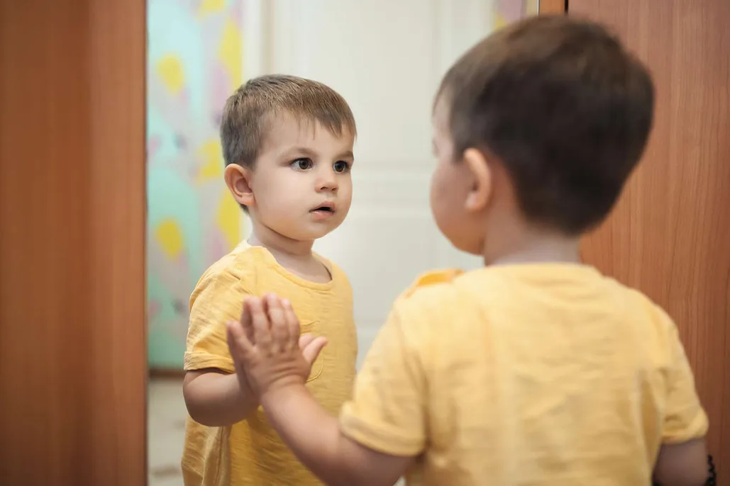
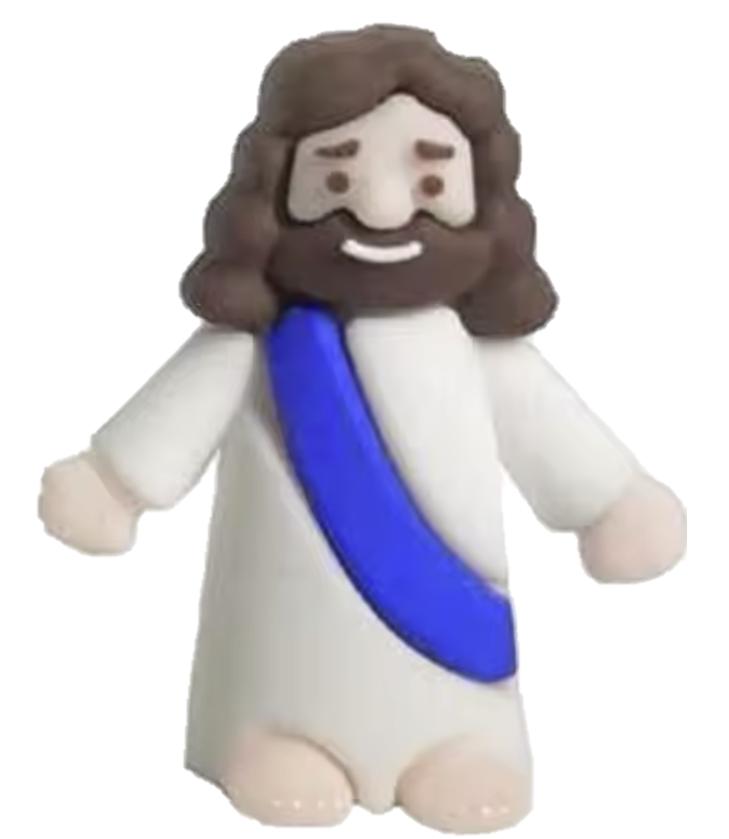
Notes:
So God created mankind in his own image, in the image of God he created them;… (Gen 1:27)
…I created you for my glory. (Isa 43:7)

Slide 17
Notes:
God blessed them and said to them, “Be fruitful and increase in number; fill the earth and subdue it… (Gen 1:28)
His image is everywhere – covering the whole earth
BUT…

Slide 18

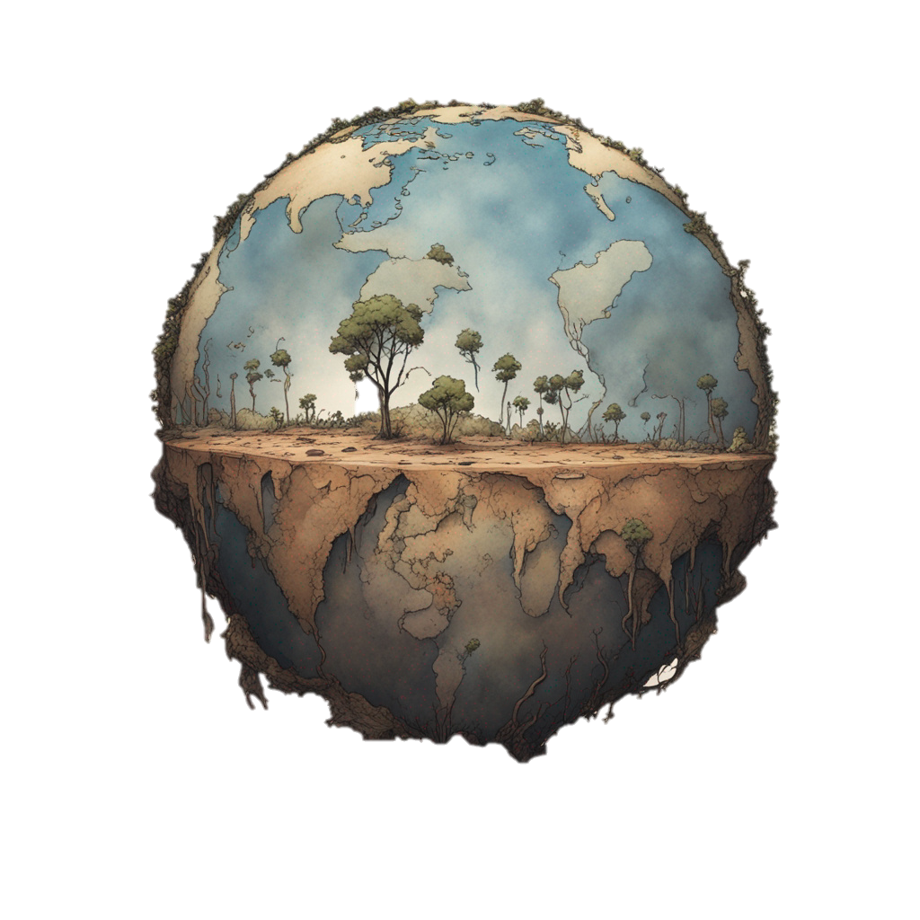
for all have sinned and fall short of the glory of God,
Rom 3:23
Notes:
Our maker (in whose image we were made) is no longer recognisable in us
Because we decided to glorify ourselves – to promote/serve ourselves
Leaves the world in a mess – not full of His glory
But God wasn’t willing to leave it this way

Slide 19

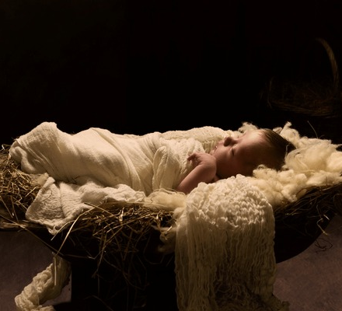
Notes:
God parachuted behind enemy lines, into hostile territory to get his children back
Set us free from our abusive master of sin/death
Set us free to reflect His image once more (He has no plan B – it is us He wants to use to fill this earth with his glory)

Slide 20
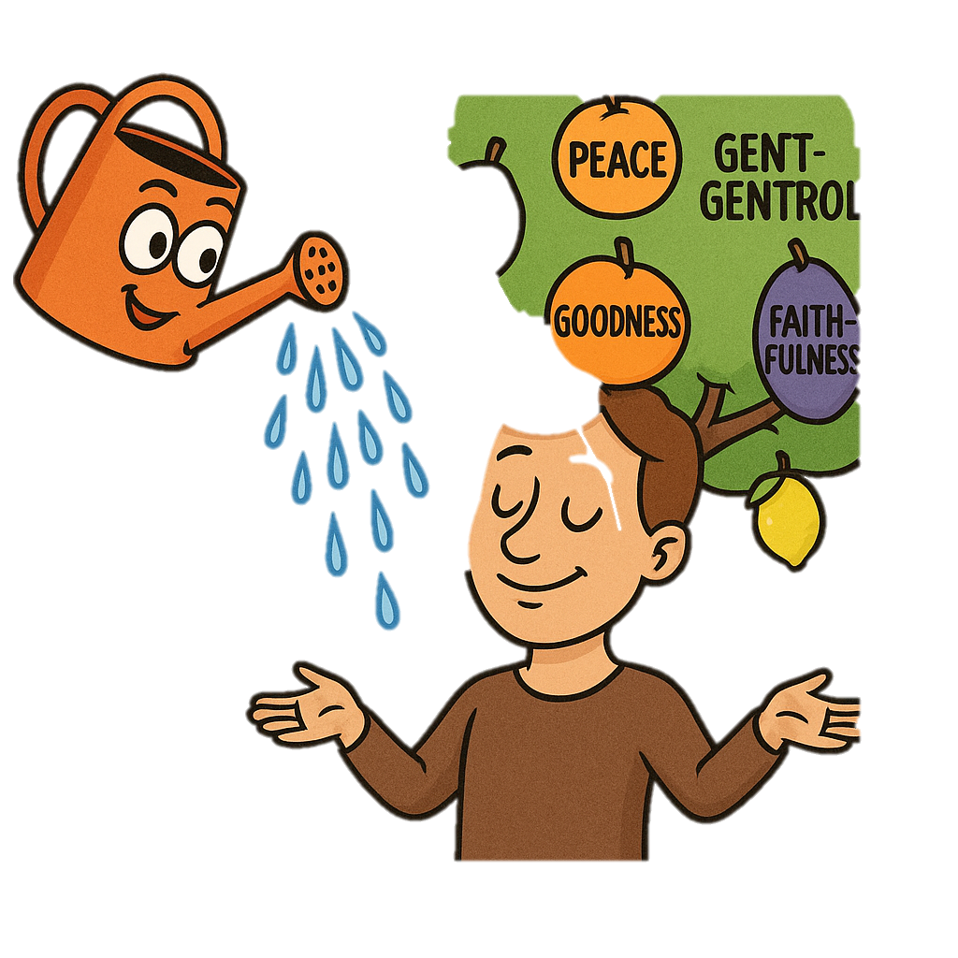
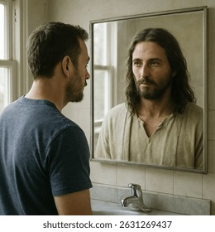
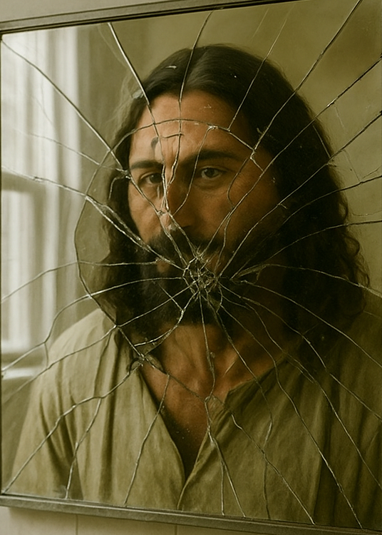





Holy Spirit
PATIENCE
…put on the new self, which is being renewed in knowledge in the image of its Creator. (Col 3:10)
Notes:
We are filled with the Spirit – which produce in us the Fruit = God’s attributes
Restores us back into being accurate image bearers
So all of us who have had that veil removed can see and reflect the glory of the Lord. And the Lord—who is the Spirit—makes us more and more like him as we are changed into his glorious image. (2 Cor 3:18)
Send out into the whole earth
1 John 3:2
Beloved, we are now children of God, and what we will be has not yet been revealed. We know that when Christ appears, we will be like Him, for we will see Him as He is.
Philippians 3:21
who, by the power that enables Him to subject all things to Himself, will transform our lowly bodies to be like His glorious body.
John 17:22
I have given them the glory You gave Me, so that they may be one as We are one—

Slide 21
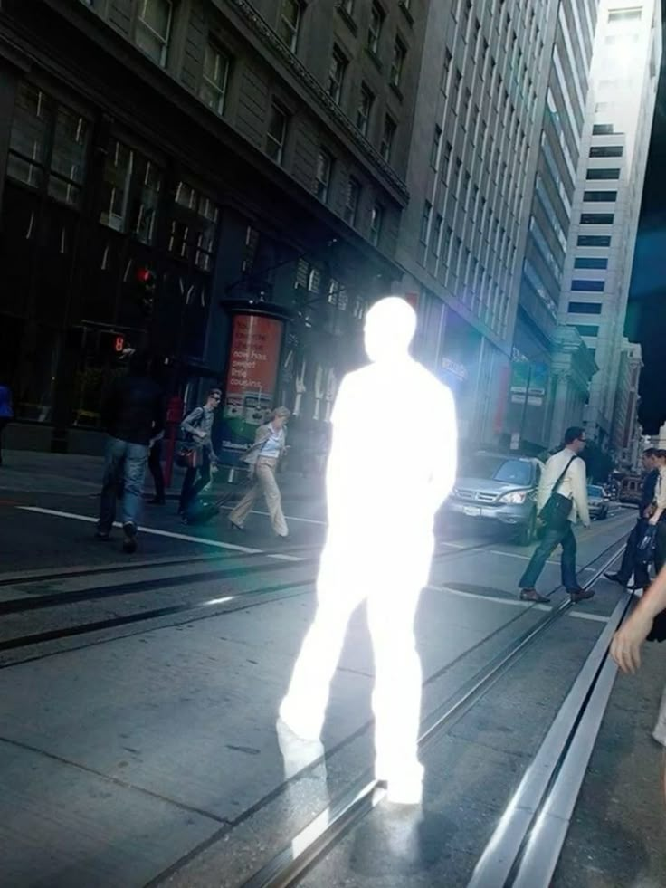
“You are the light of the world... let your light shine before others, that they may see your good deeds and glorify your Father in heaven.” (Matt 5:14-16)
“No one has ever seen God; but if we love one another, God lives in us and his love is made complete in us.” (1 John 4:12)
“A new command I give you: Love one another. As I have loved you, so you must love one another. By this everyone will know that you are my disciples...” (John 13:34-35)
God is glorified (made famous) by the way you shine
Notes:
I used to think we glorify God by singing songs
God is glorified when we bear fruit
To bear fruit we need to remain connected to Him
If you abide in me…By this my father is glorified, that you bear much fruit and so prove to be my disciples. (John 15)

Slide 22

Notes:
This video is really dense, but don’t worry, I will highlight the key parts afterwards

Slide 23
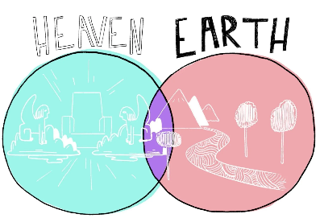
The Union of Heaven & Earth
=
God’s Glory filling the earth
‘Your kingdom come. Your will be done, On earth as it is in heaven.
(Matt 6:10)
“Then I saw a new heaven and a new earth... And I saw the holy city, new Jerusalem, coming down out of heaven from God... And I heard a loud voice from the throne saying, ‘Behold, the dwelling place of God is with man. He will dwell with them.’”
(Rev 21:1-3)
Notes:
The union of Heaven & Earth (what the bible is all about) = God’s Glory filling the earth
Overlapping his space with our space
Being close with his children, dispelling sin and death
Rev – God wants to be completely who He is, with us

Slide 24
How do we glorify God?

Slide 25
“God is most glorified in us when we are most satisfied in Him”
- John Piper
So all of us who have had that veil removed can see and reflect the glory of the Lord. And the Lord—who is the Spirit—makes us more and more like him as we are changed into his glorious image.
(2 Cor 3:18)
Notes:
When we see Him – we desire Him – to be with Him, like Him to obey Him – all this makes Him famous
We lose ourselves in Him

Slide 26
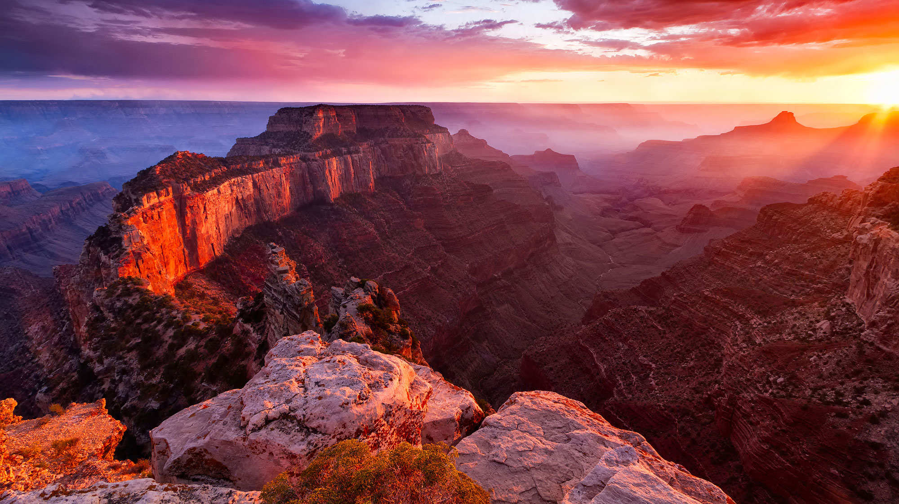
Notes:
No one goes to Grand Canyon to feel better about themselves – they go to lose themselves in awe and wonder
John Baptist – I must decrease so He can increase
Paul – I consider all garbage in comparison to God
God invites us to become besotted with who He is [we realise He is everything we are looking for]
As we see Him for who He is, our lives become more about Him and less about us
We better reflect Him in our lives – we fill our part of the earth with His attributes

Slide 27

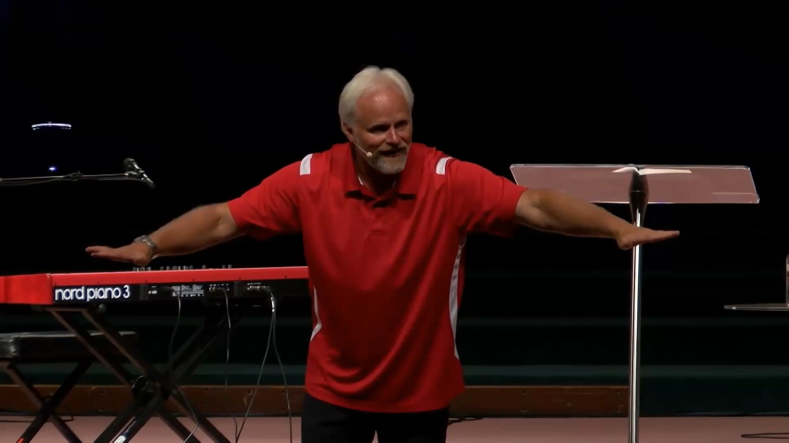
Did you know…
…that God cares more about making us like Him than about making us happy?
happiness
God
Notes:
God is more glorified when we see him not as the means to the end, but the end in Himself
Dan Mohler
Looking for circumstances to prove God loves me - ducks in a row – feel happy
But God already proved it, we have evidence to believe
He made us in His image to show what He is like, to bring heaven to earth and we can miss this by focusing on getting our ducks lined up
We don’t need others to treat us right to be ok, to shine, we don’t need to be healthy, to have right relationship/job/house/exam results
Then Jesus said to his disciples, “Whoever wants to be my disciple must deny themselves and take up their cross and follow me. (Matt 16:24)
But seek first his kingdom and his righteousness, and all these things will be given to you as well. (Matt 6:33)
“If anyone comes to me and does not hate father and mother, wife and children, brothers and sisters—yes, even their own life—such a person cannot be my disciple. (Luke 14:26)
Don’t make anything on your ‘list’ more important than him
Dan Mohler “be honest how many people are Christians for the sake of that list”
We want to avoid pain & suffering
(US Declaration of Independence) = pursuit of happiness
Maximise pleasure & minimise pain
Difficult to pursue happiness and God if they go in different directions
Pain & suffering an interruption to purpose of life (happiness)
Pain & suffering can be a channel to purpose of life (imaging God)

Slide 28
Are you using God to help you pursue happiness?

Slide 29
Conclusion
“God’s Grand Plan is to fill the earth with His glory (His attributes), and He plans to do this through you”
- Is there something on your priority list which you need to bump down so God can take top spot?
Notes:
Have you been using God to achieve your list? Make your life better? Have you been pursuing your own glory?
Accept why He made you
Make His glory your goal

