Slide 1
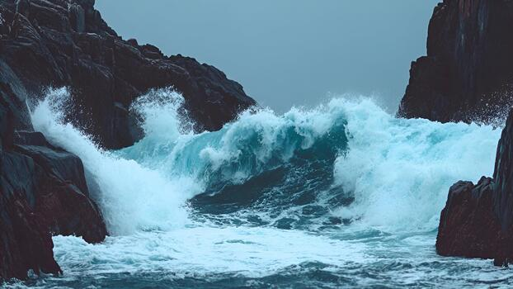
Fear of the Lord
12th April 2006

Slide 2
What do you think about when you hear the phrase ‘Fear of the Lord’?

Slide 3
Why this topic?

Slide 4
What is the Fear of God?
Fear of God is not…
  Fear of hell
  Fear of punishment
Notes:
Isaiah 53:5
But he was pierced for our transgressions,
he was crushed for our iniquities;
the punishment that brought us peace was on him,
and by his wounds we are healed.
1 John 4:18
There is no fear in love. But perfect love drives out fear, because fear has to do with punishment. The one who fears is not made perfect in love.
Fear of the Lord is not being scared of God
Deu 10:12 And now, Israel, what does the LORD your God ask of you but to fear the LORD your God, to walk in obedience to him, to love him, to serve the LORD your God with all your heart and with all your soul, - Not fear or love, fear & love
Ps 130:4 But with you there is forgiveness, that you may be feared. – More forgive, more I fear

Slide 5
What is the Fear of God?
Fear of God is…
  Treasuring God for who He is
    Holiness
    Awesome
    Ruthless (in pursuit)
  Valuing our relationship

Slide 6
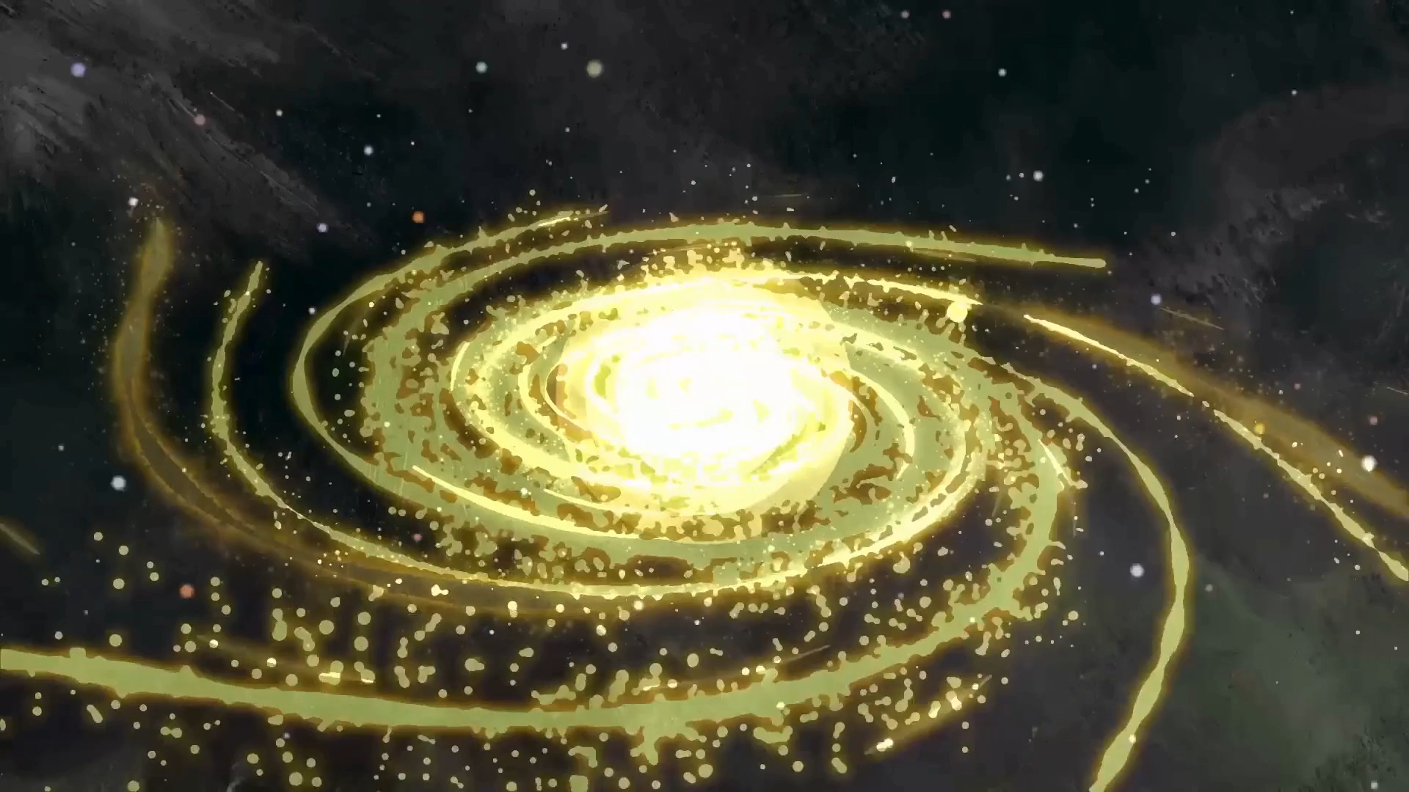
Holiness
Notes:
His presence is dangerous to you, not because its bad but because it is so good

Slide 7
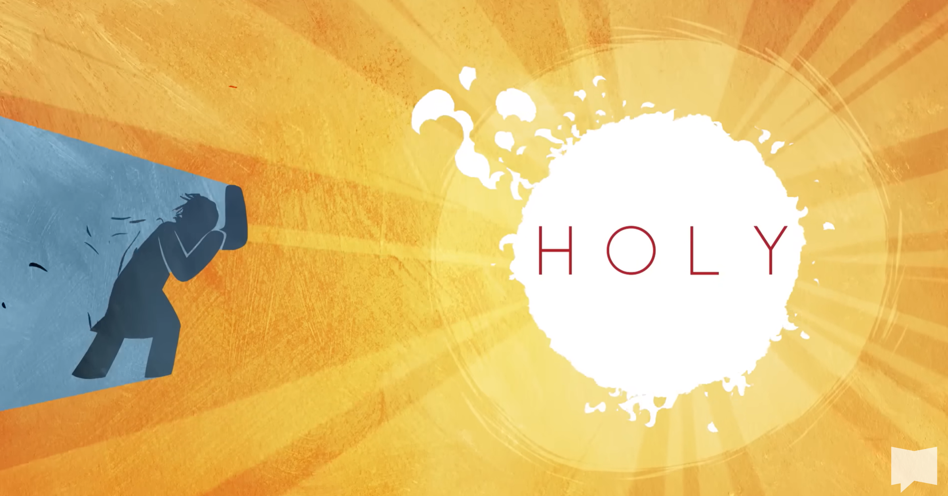
Holiness

Slide 8
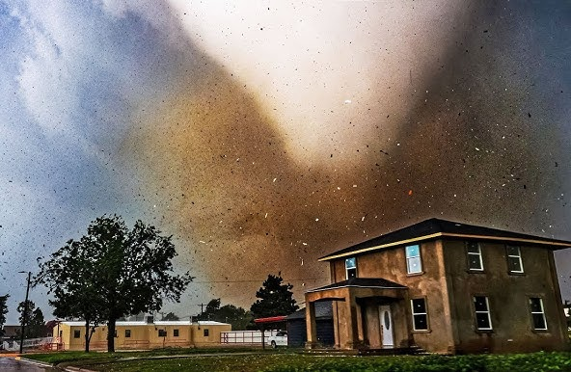
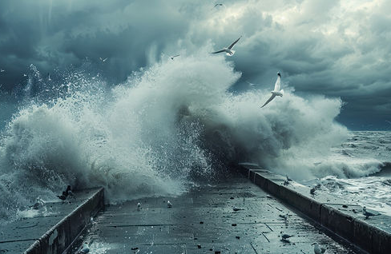
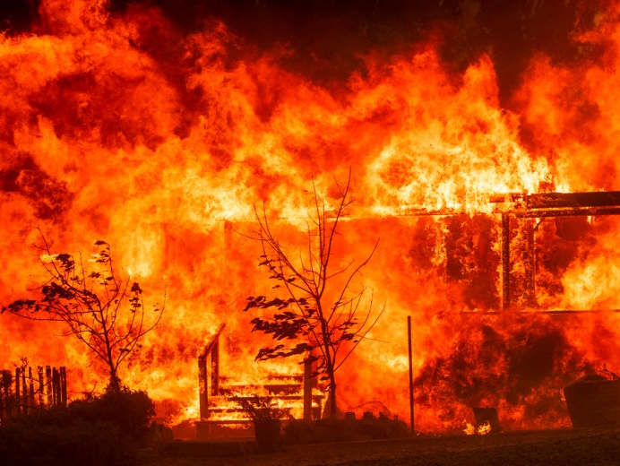
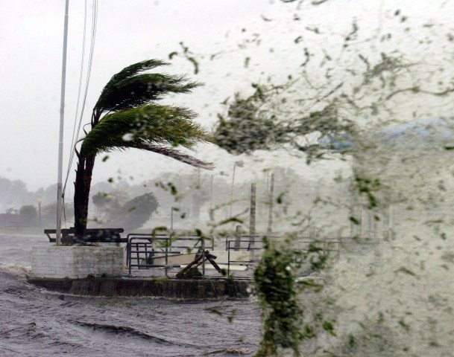
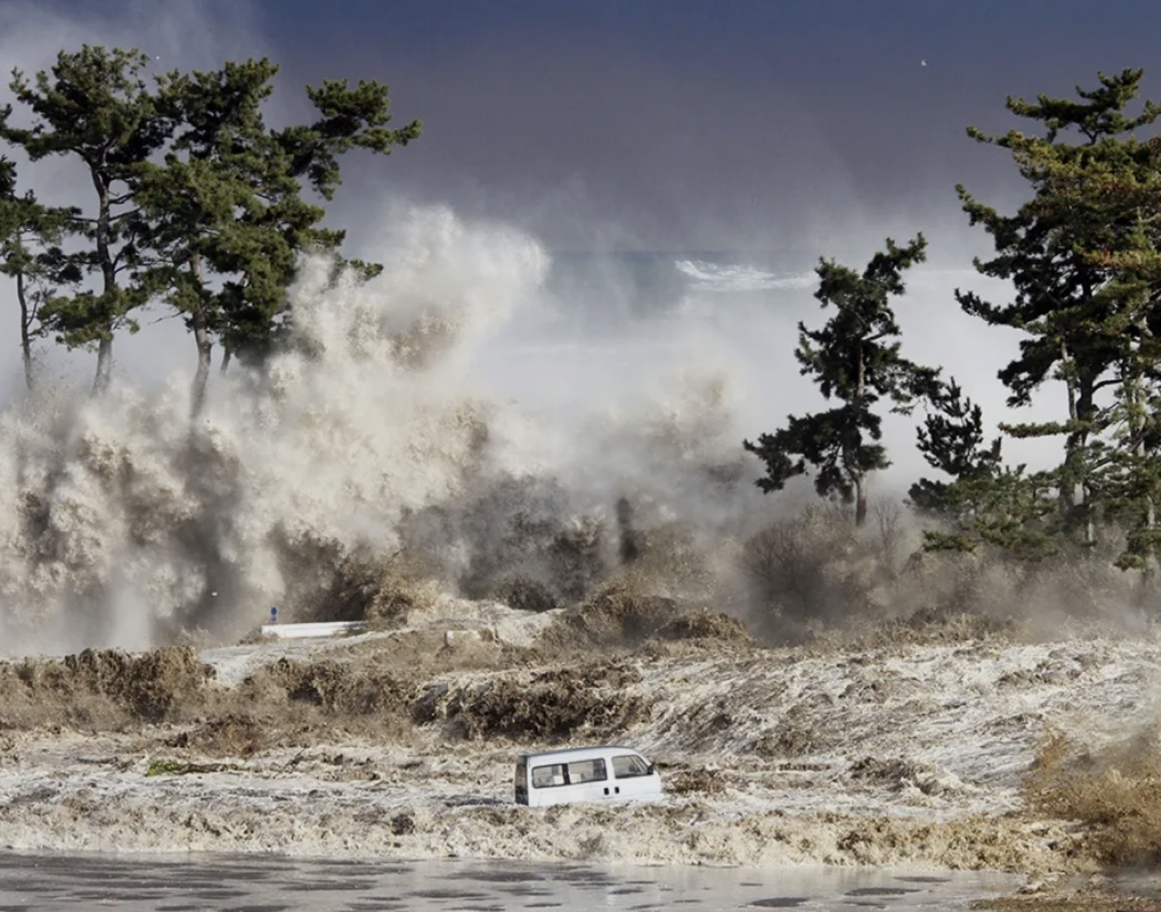
Awesome
Notes:
Fear of God is a befitting treasuring of who He is
Appropriate appreciation
Relevant reverence
Grasping of His grandeur
This is bigger than me. I couldn’t stop it even if I tried. It’s only by mercy I am not destroyed by this force.
Respect, awe and wonder – not approach casually

Slide 9
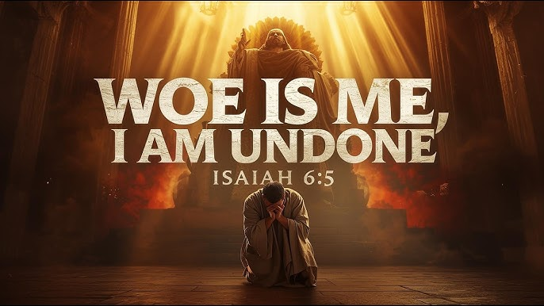
Awesome
Notes:
Job said “My ears had heard of You, but now my eyes have seen You. / Therefore I despise myself, and I repent in dust and ashes.” (Job 42:5-6)
- God confronts friends & restores Job’s losses
Peter fell at Jesus’ knees. “Go away from me, Lord,” he said, “for I am a sinful man.” (Luke 5:8)
Then Jesus said to Simon, “Don’t be afraid; from now on you will fish for people.”
John describes “When I saw Him, I fell at His feet like a dead man. But He placed His right hand on me (Revelation 1:17)
and said, “Do not be afraid. I am the First and the Last,
At transfiguration 5While he was still speaking, a bright cloud covered them, and a voice from the cloud said, “This is my Son, whom I love; with him I am well pleased. Listen to him!”
When the disciples heard this, they fell facedown to the ground, terrified.
But Jesus came and touched them. “Get up,” he said. “Don’t be afraid.”

Slide 10
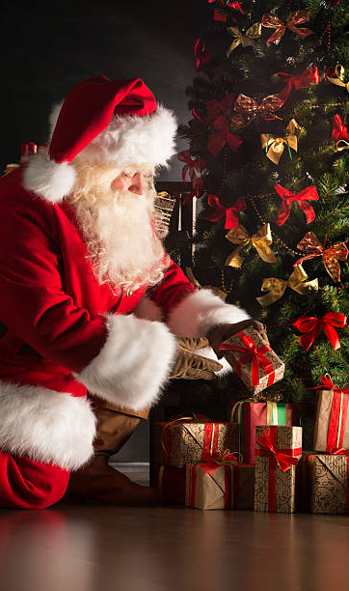
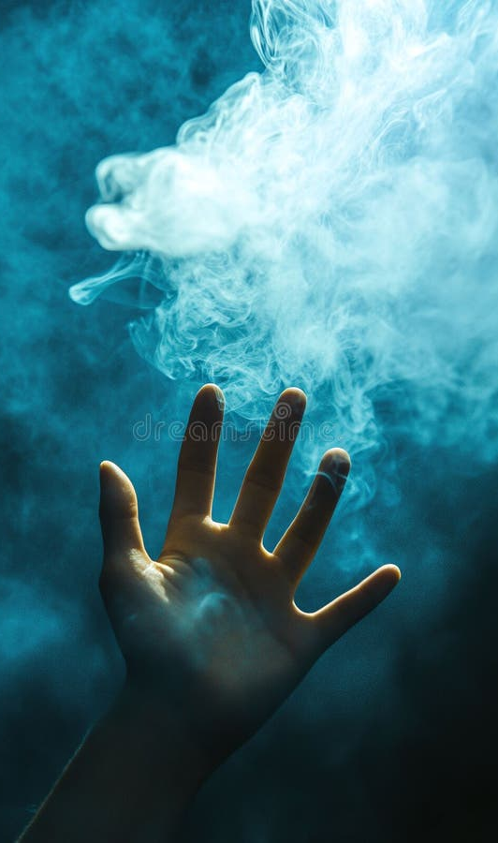
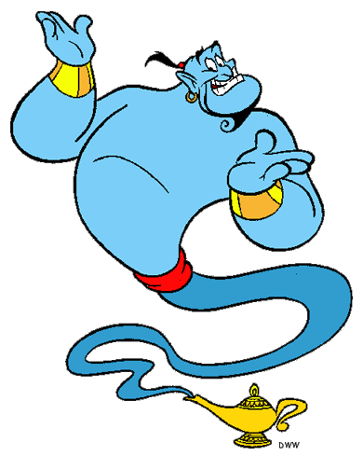
Awesome
Notes:
Fear of God means seeing Him not as genie granting wishes, father Christmas delivering gifts or concept you grasp at but has no substance
He is real, He is here, He is awesome

Slide 11
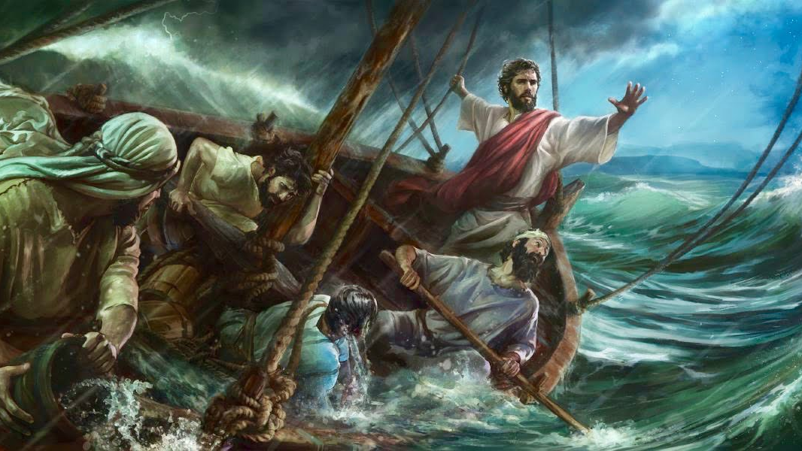
Awesome
Notes:
Mark 4
⁴⁰ He said to his disciples, “Why are you so afraid? Do you still have no faith?”
⁴¹ They were terrified and asked each other, “Who is this? Even the wind and the waves obey him!”
Jesus is less controllable than the storm
(Now I’m in the presence of Almighty God!) Woe is me

Slide 12
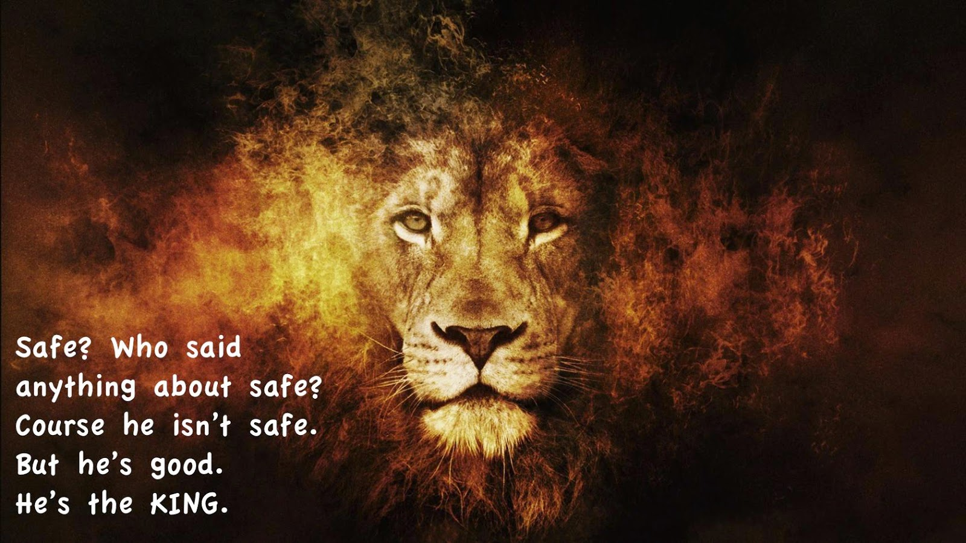
Awesome
He isn’t a tame lion
Notes:
Uncontrollable

Slide 13
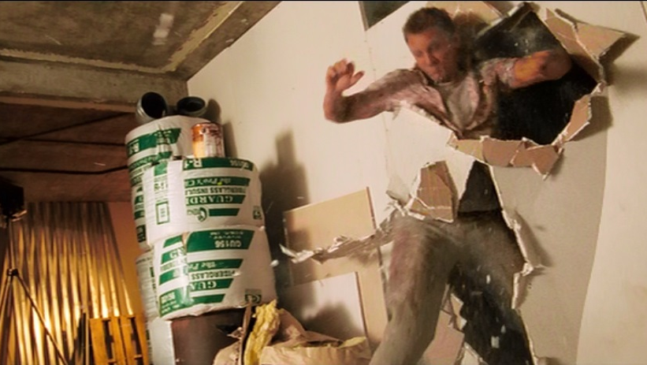
Ruthless
Notes:
There is no wall He won’t kick down
Lie you won’t tear down, coming after me
“There is no one like the God of Jeshurun,
who rides across the heavens to help you
and on the clouds in his majesty.
Deu 33:26

Slide 14
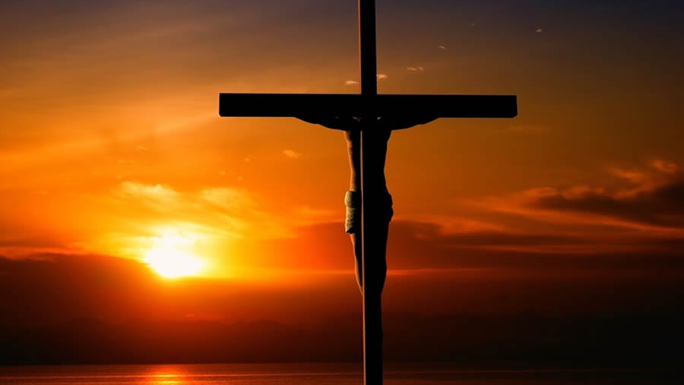
Ruthless
Notes:
The ultimate images of relentless, ruthless pursuit

Slide 15
Ruthless
Psalm 18:6-19
Notes:
Psalm 18:6-16

Slide 16
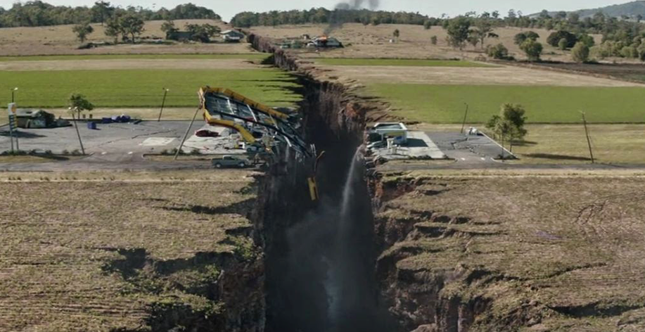
Notes:
Ps 18:6-15
In my distress I called to the Lord;
I cried to my God for help.
From his temple he heard my voice;
my cry came before him, into his ears.
⁷ The earth trembled and quaked,
and the foundations of the mountains shook;
they trembled because he was angry.

Slide 17
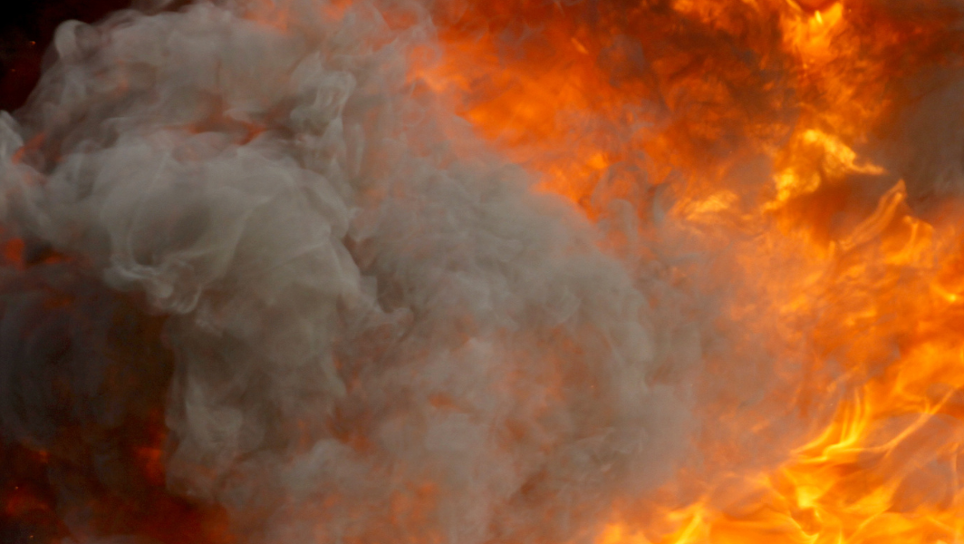
Notes:
⁸ Smoke rose from his nostrils;
consuming fire came from his mouth,
burning coals blazed out of it.
⁹ He parted the heavens and came down;
dark clouds were under his feet.
¹⁰ He mounted the cherubim and flew;
he soared on the wings of the wind.

Slide 18
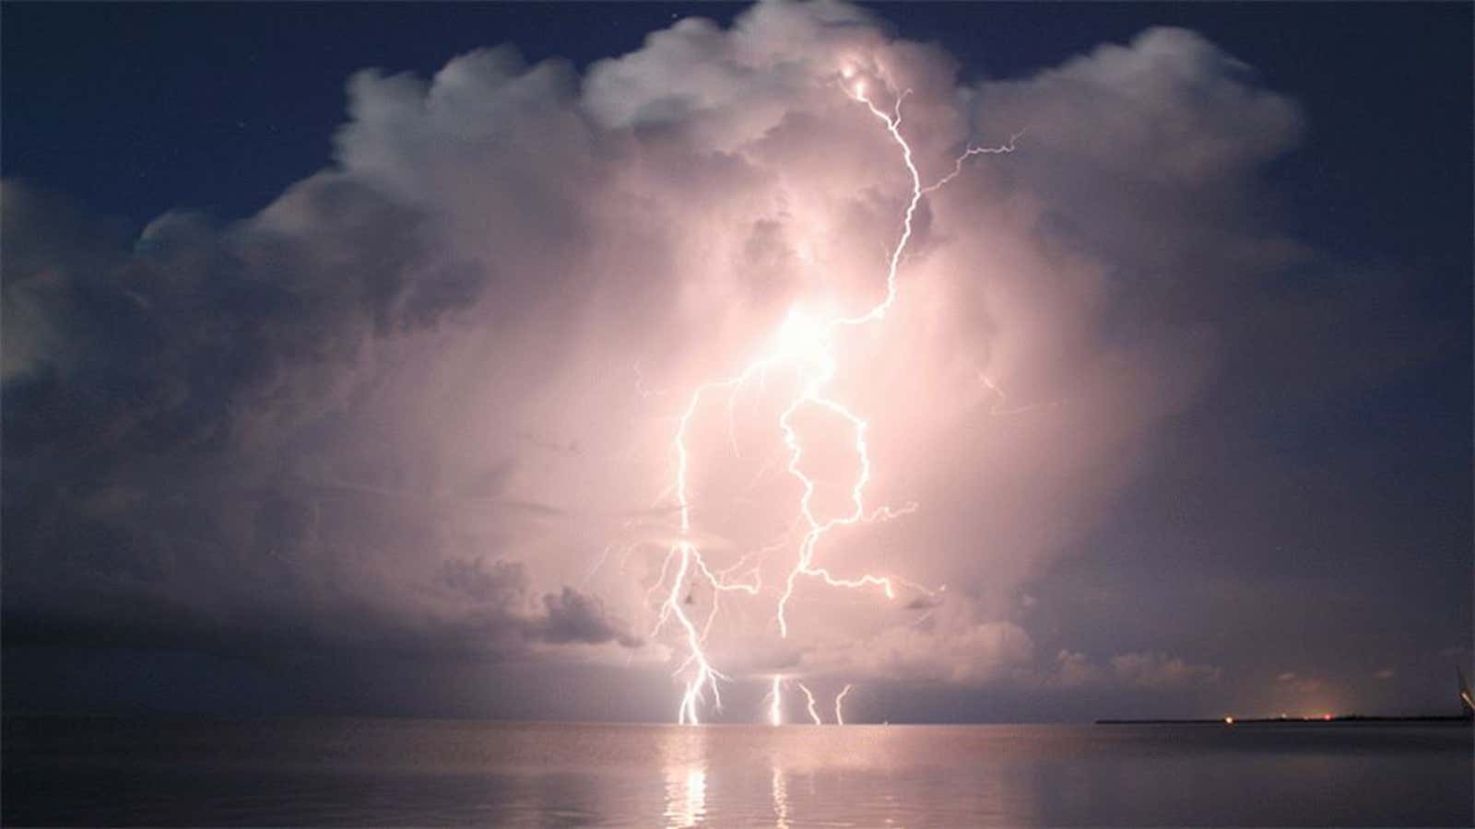
Notes:
¹¹ He made darkness his covering, his canopy around him—
the dark rain clouds of the sky.
¹² Out of the brightness of his presence clouds advanced,
with hailstones and bolts of lightning.
¹³ The Lord thundered from heaven;
the voice of the Most High resounded.^{[d]}
¹⁴ He shot his arrows and scattered the enemy,
with great bolts of lightning he routed them.

Slide 19
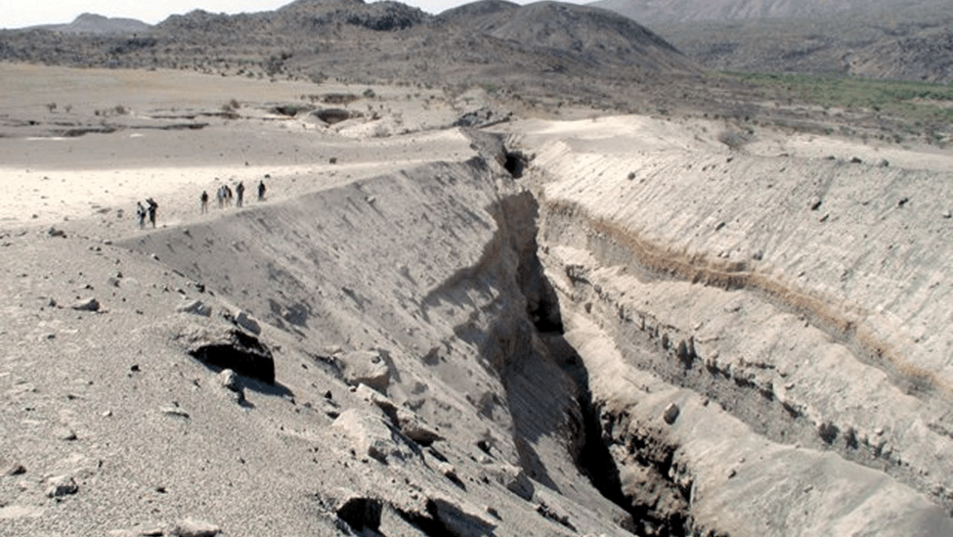
Notes:
¹⁵ The valleys of the sea were exposed
and the foundations of the earth laid bare
at your rebuke, Lord,
at the blast of breath from your nostrils.

Slide 20
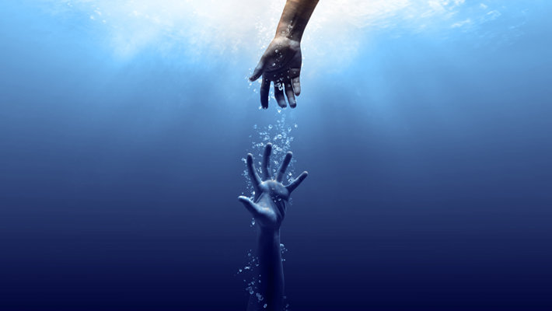
Notes:
¹⁶ He reached down from on high and took hold of me;
he drew me out of deep waters.
¹⁷ He rescued me from my powerful enemy,
from my foes, who were too strong for me.
¹⁸ They confronted me in the day of my disaster,
but the Lord was my support.
¹⁹ He brought me out into a spacious place;
he rescued me because he delighted in me.

Slide 21
…he rescued me because he delighted in me.
Notes:
He is jealous for me!

Slide 22
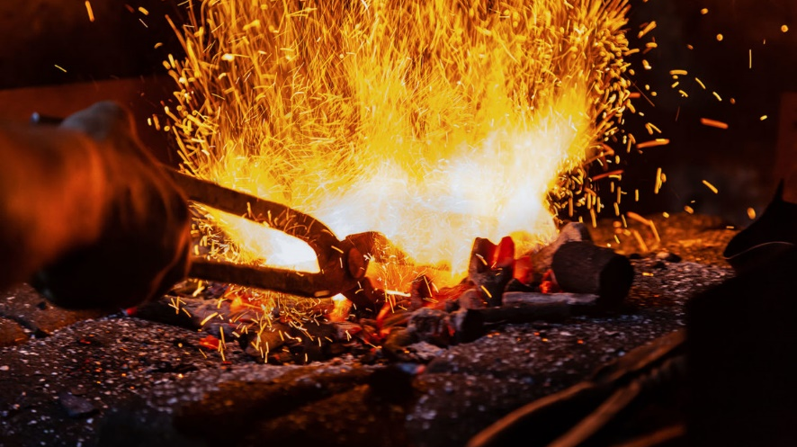
Ruthless
Notes:
Isa 48:10
See, I have refined you, though not as silver; I have tested you in the furnace of affliction.
He is loves me too much to leave me as I am – He is willing to put me in the hottest part of the fire to purify me, so I can reflect Him – because this is my purpose, it is what I most need for my fulfilment
He is not under my control
He doesn’t seamlessly slip into my life – He smashes me into smithereens and then puts me back together in a mosaic with Him in the centre

Slide 23
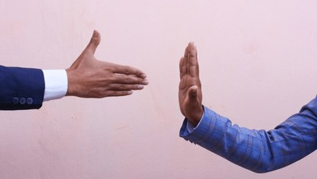
Notes:
Fear of breaking relationship
JWS – fear displeasing God

Slide 24
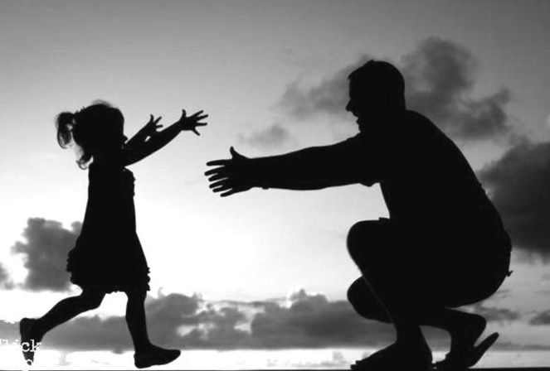
Notes:
Run towards / embrace
Stallard vs Torn

Slide 25
How will the Fear of God effect the way I live?
  Reorders priorities
  Focuses our perspective of God
  Preserves

Slide 26
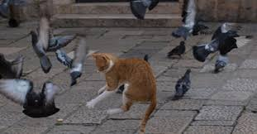
Reorders my Priorities
the fear of the Lord is a life rearranging, joyful, awe, and wonder before the greatness of who God is and what He's done.
- Tim Keller
Notes:
The Fear of God Reorders my Priorities
the fear of the Lord is a life rearranging, joyful, awe, and wonder before the greatness of who God is and what He's done.
Tim Keller
You're living in mortal fear of something, the loss of which would render life meaningless and by understanding your fear, what is your greatest fear? You'll see your greatest love. The thing you most fear losing.
Encountering Jesus brings a shaking
Who you thought you were
What you think matters

Slide 27
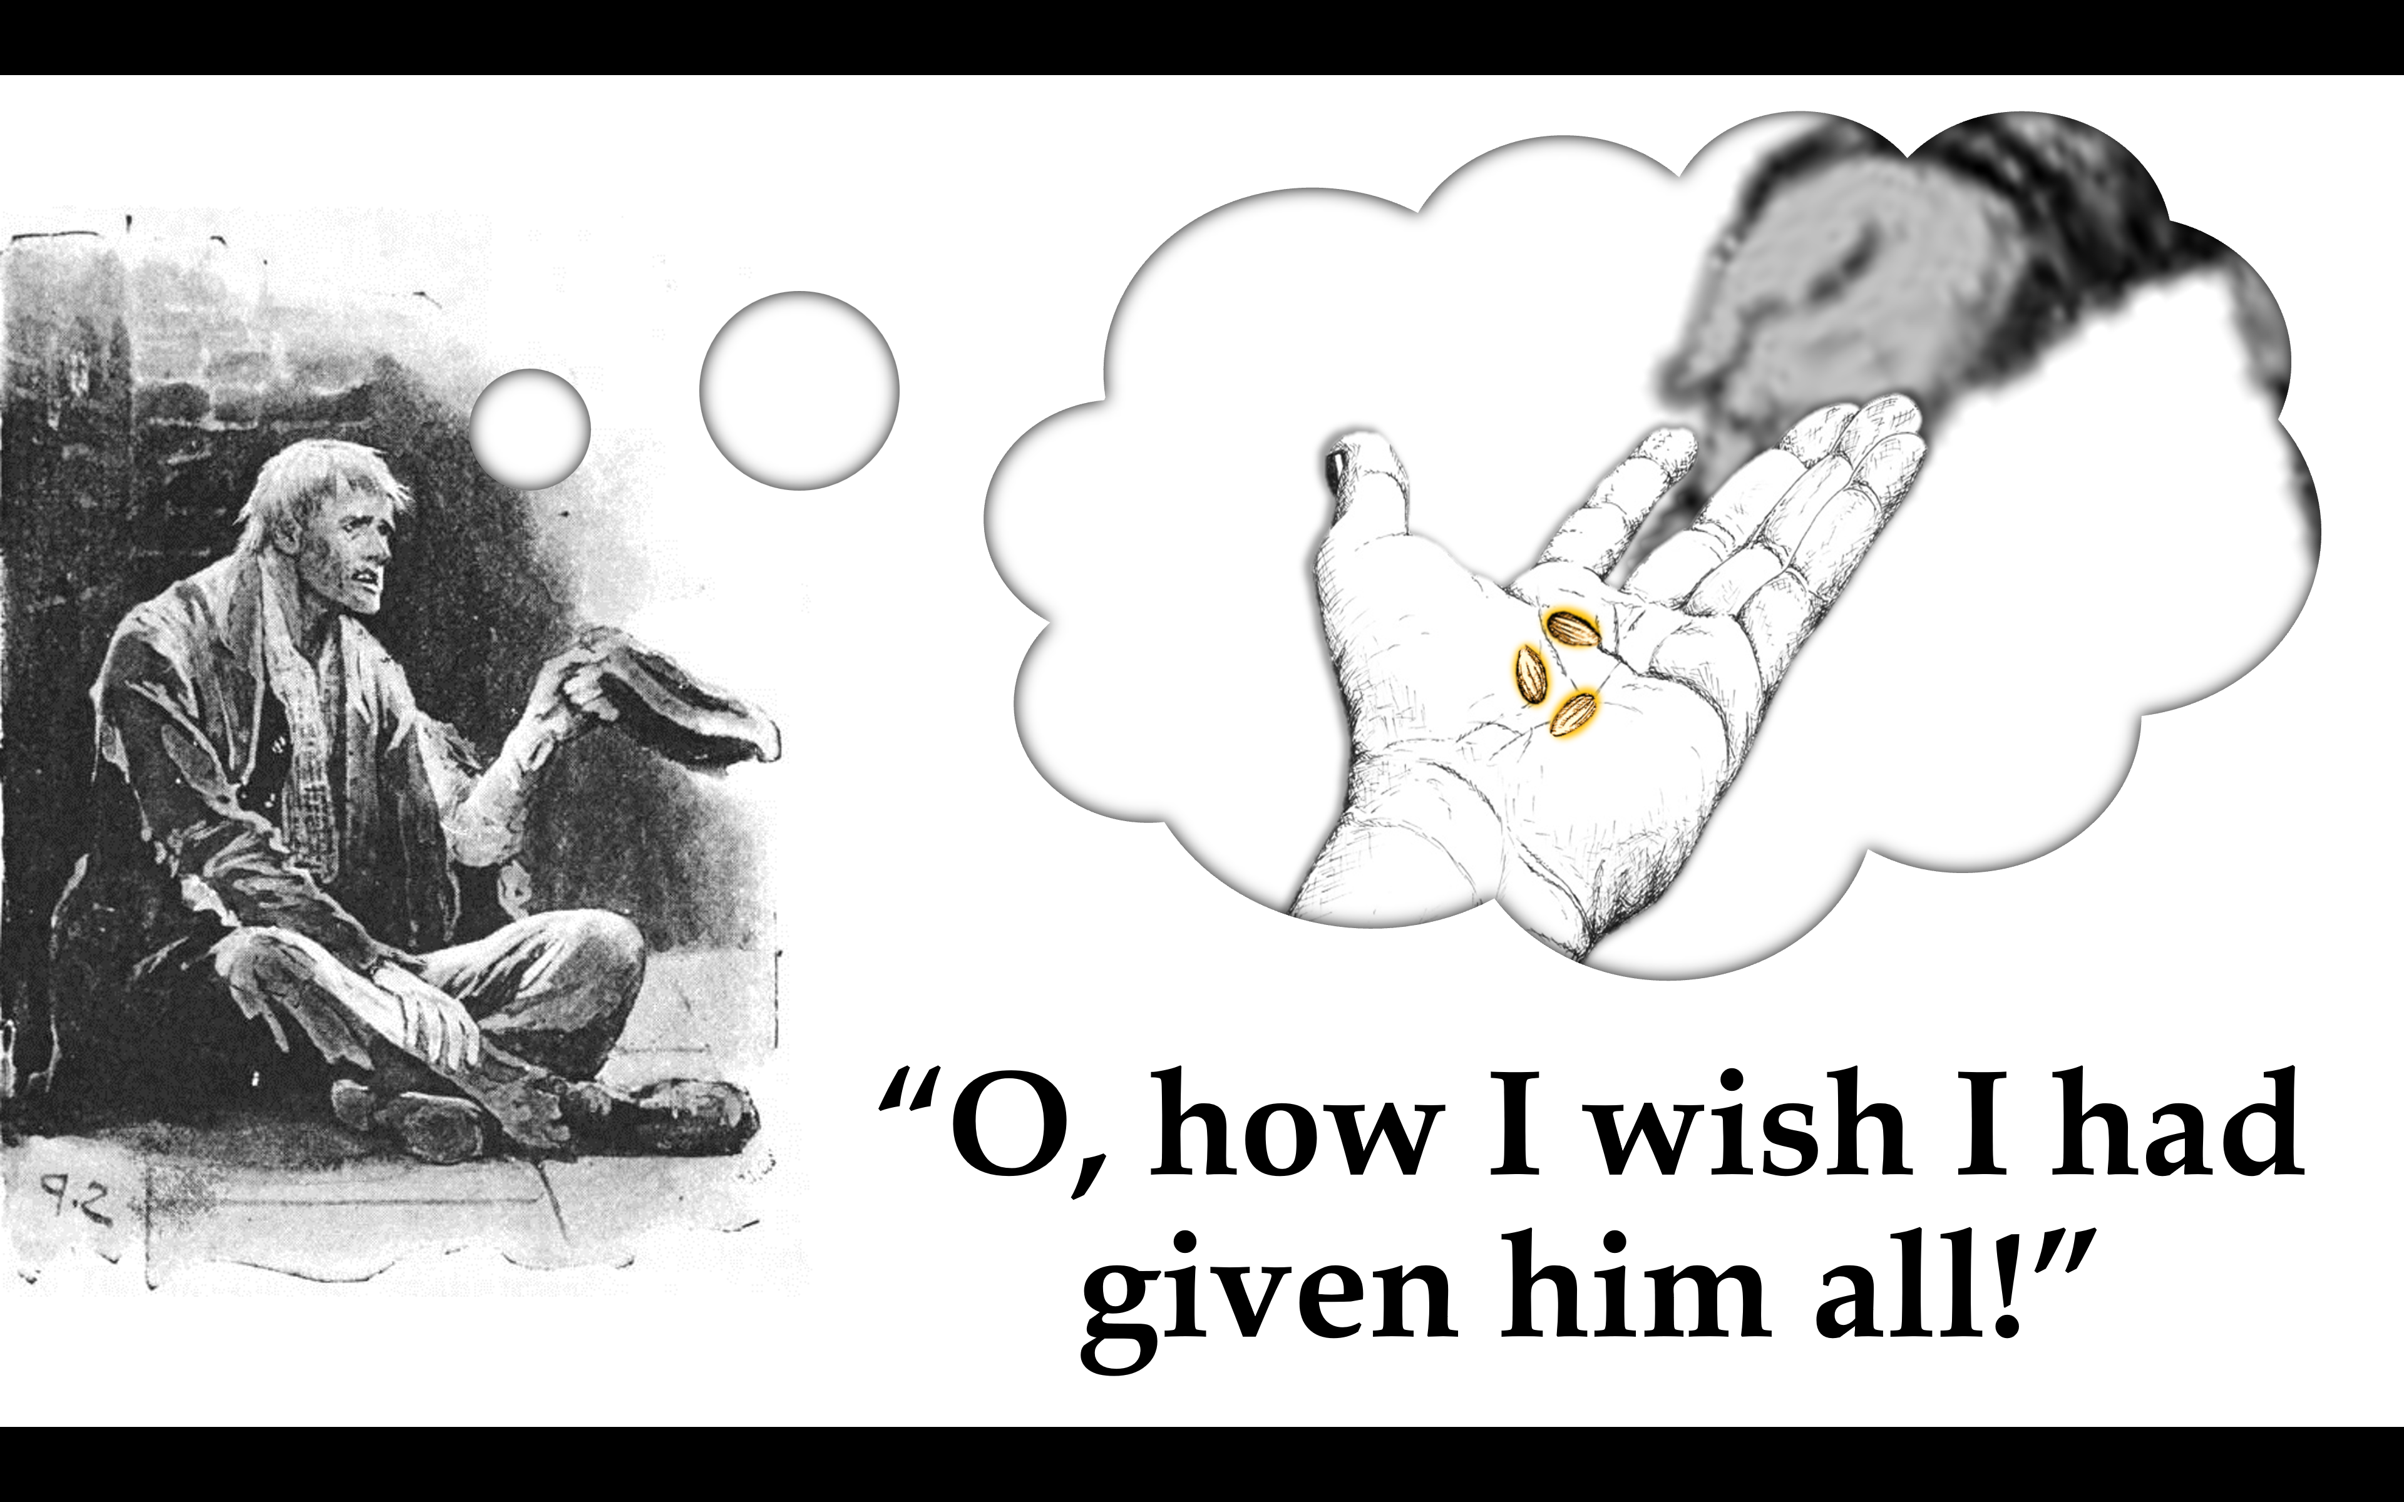
Notes:
In the light of what/Who I have discovered the decisions I make require rethinking

Slide 28
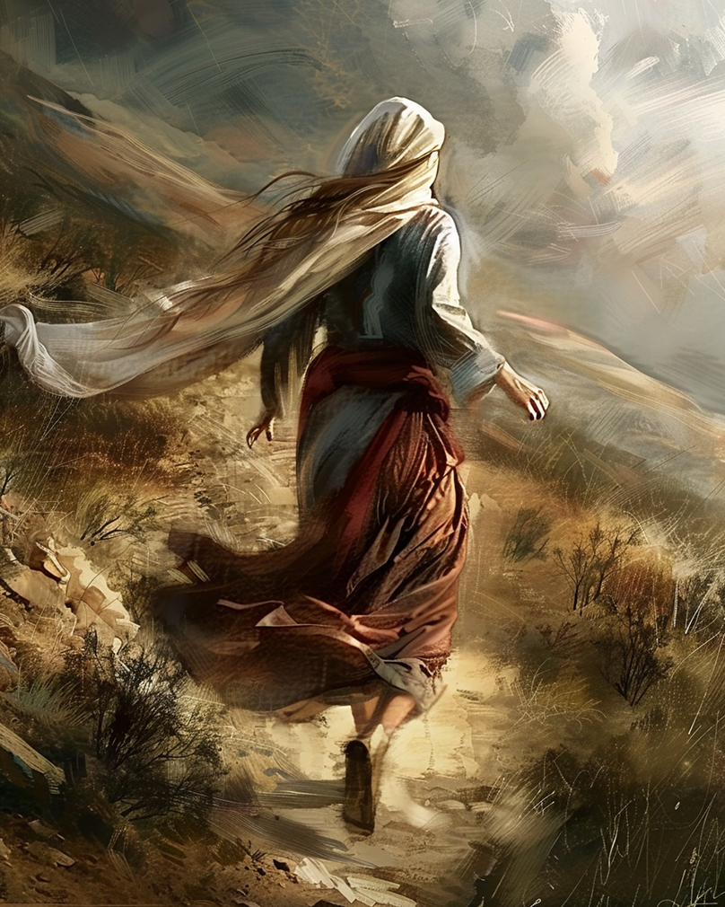
So the women hurried away from the tomb, afraid yet filled with joy, and ran to tell his disciples.
- Matt 28:8
Notes:
28 After the Sabbath, at dawn on the first day of the week, Mary Magdalene and the other Mary went to look at the tomb.
² There was a violent earthquake, for an angel of the Lord came down from heaven and, going to the tomb, rolled back the stone and sat on it. ³ His appearance was like lightning, and his clothes were white as snow. ⁴ The guards were so afraid of him that they shook and became like dead men.
⁵ The angel said to the women, “Do not be afraid, for I know that you are looking for Jesus, who was crucified. ⁶ He is not here; he has risen, just as he said. Come and see the place where he lay. ⁷ Then go quickly and tell his disciples: ‘He has risen from the dead and is going ahead of you into Galilee. There you will see him.’ Now I have told you.”
⁸ So the women hurried away from the tomb, afraid yet filled with joy, and ran to tell his disciples.
Becoming a father – suddenly my priorities changed
Enjoying hanging out late into the night exchange for sleep when you can
West Ham position in the table
Safety equipment
Nappy brands
Snot suckers
What makes Him comfortable? What pleases Him?
My deference to His preference

Slide 29
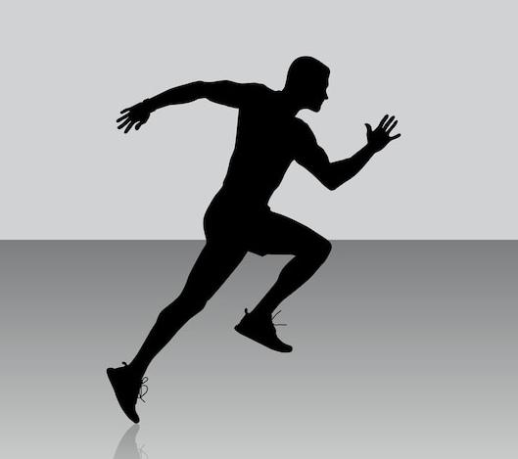
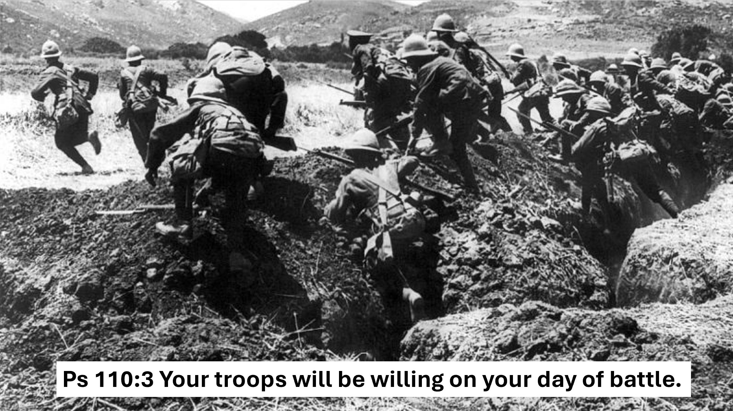

Slide 30
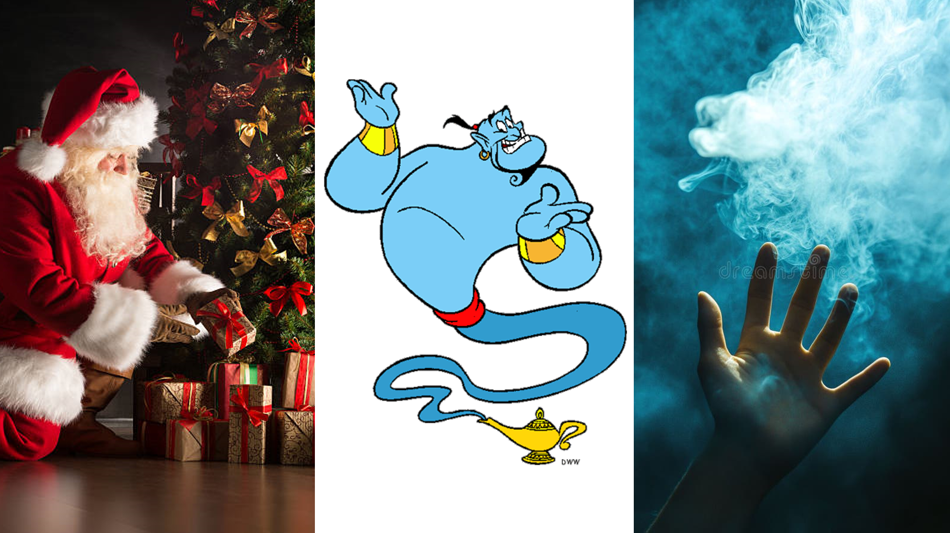
Focuses our perceptive of God
Notes:
He will do whatever necessary
He is real
TK dare not turn around
JWS dare not reach out hand
Now I’m in the presence of almighty God

Slide 31
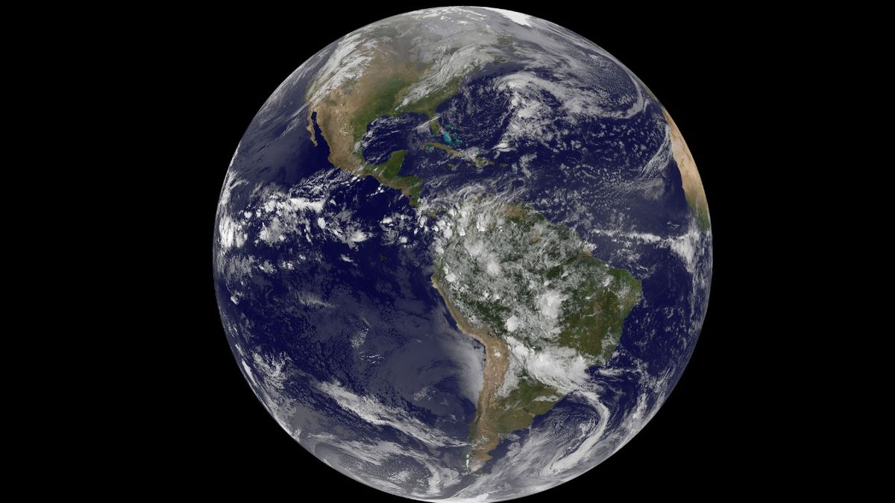
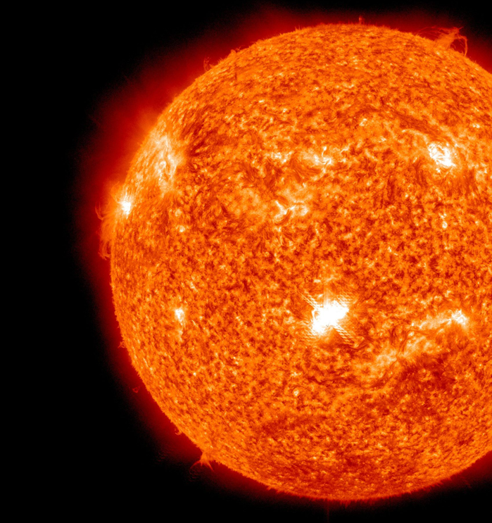
Notes:
Distance from Earth to Sun (149.6 million kilometers (92.96 million miles))
Thickness of 1 sheet of paper

Slide 32
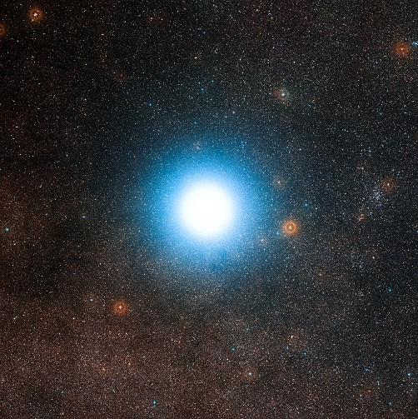
Notes:
Distance from Earth to nearest star (other than Sun) ((about 40 trillion km or 25 trillion miles)
Stack of paper 70 feet high

Slide 33
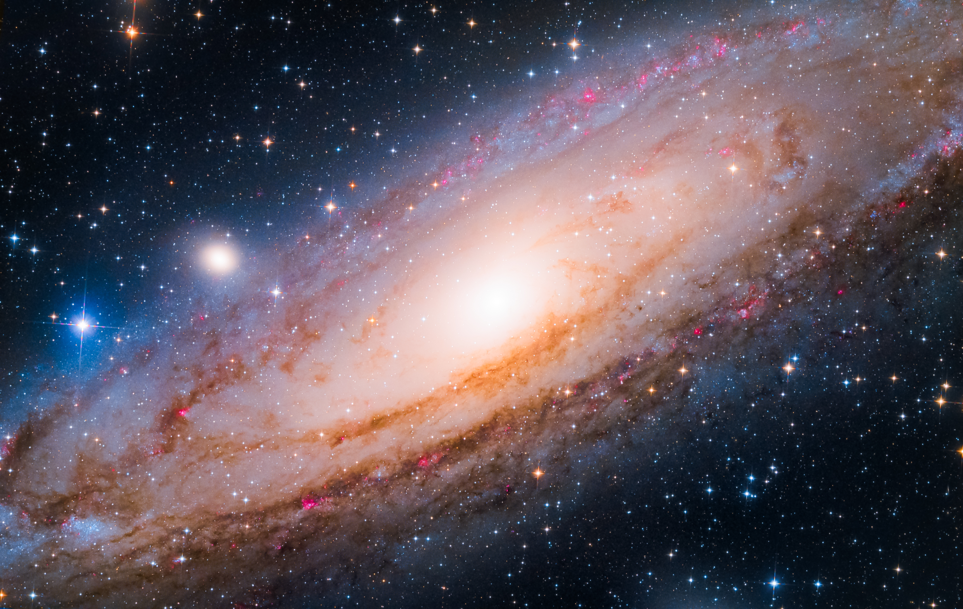
Notes:
Diameter of Galaxy (588 quadrillion miles)
Stack of paper 310 miles high
Estimates suggest there are between 200 billion and 2 trillion galaxies in the observable universe.

Slide 34
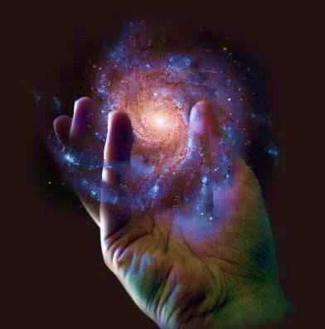
He upholds the universe by the word of his power.
Hebrews 1:3
Notes:
Not the type of person you invite into your life to be your PA
I exist to serve Him
Is God useful or is He beautiful? (Means to an end or an end in Himself?)
When I see His majesty I don’t approach Him casually

Slide 35
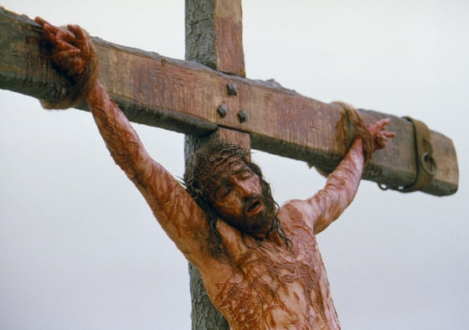
Preserves
Notes:
Take sin seriously
I have tendency towards my previous husband…!
Forgiven free to me but cost Jesus His life
When I see how God treats my sin and what He went through to bring me back to Him – I don’t approach causally
I wouldn’t want to hurt One so wonderful (vs what can I get away with)
Preservative
Fear God rather than man (Rick Warren)
If only I’d known, I would have given him everything
Don’t neglect such an invitation

Slide 36
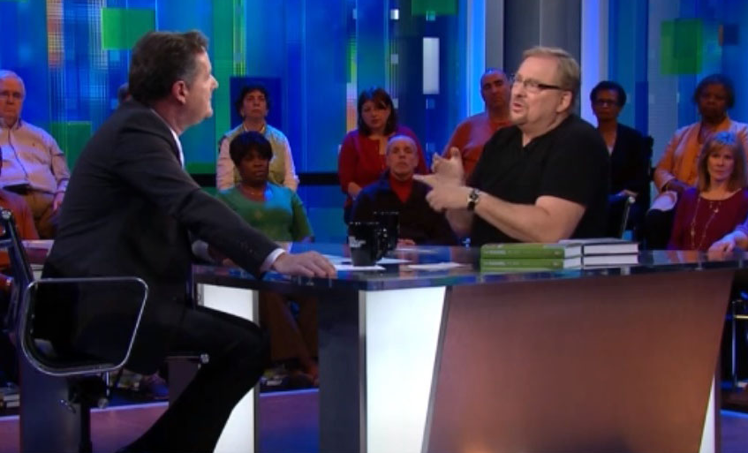
The fear of the Lord is the beginning of wisdom, and the knowledge of the Holy One is insight.
(Proverbs 9:10)
“I fear the disapproval of God more than I fear your disapproval or the disapproval of society”
Moses said to the people, “Do not be afraid. God has come to test you, so that the fear of God will be with you to keep you from sinning.” (Exo 20:20)
how shall we escape if we ignore so great a salvation?..
(Heb 2:3)
Notes:
Piers Morgan – can you see a time when you will change your views to better fit in with society?
Fear of God saves us from making mistakes
John – I fear displeasing God.
Treat Him with the seriousness He deserves

Slide 37
Do you want the fear of God?
Notes:
Response
the fear of the Lord is a life rearranging, joyful, awe, and wonder before the greatness of who God is and what He's done.
- Tim Keller
Fear of lord leads to unconditional trust because he is the thing you most fear losing
“All the vain things that charm me most, I sacrifice them through his blood.” (When I Survey)
Story of Biggerman who discovered there was a Bigger Man – shook him to the core
In the presence of almighty God
Humbling, Serious, Shaking
When commanding in chief says charges, I charge (I don’t weigh my options)
When He says “jump”, I ask “How high?” on the way up

