Slide 1
God’s workmanship

Slide 2
God is Revealed in all his made
For we are His workmanship, created in Christ Jesus for good works, which God prepared beforehand that we should walk in them. Ephesians 2:10
For since the creation of the world God’s invisible qualities—his eternal power and divine nature—have been clearly seen, being understood from what has been made, so that people are without excuse. Rom 1:20
‘Workmanship’ = ‘made’ = ‘poiema’

Slide 3
God is pleased with his workmanship
Then God looked over all he had made, and he saw that it was very good! Genesis 1:31
Your new name will be “The City of God’s Delight” and “The Bride of God,”
for the LORD delights in you Isaiah 62:4

Slide 4
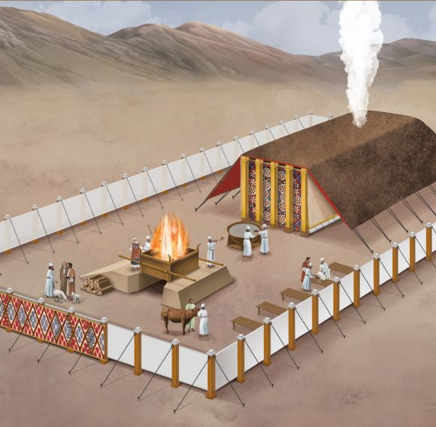
MAde BY THE HAND OF MAN
God Lived in a Tent
“My home has always been a tent, moving from one place to another in a Tabernacle”
1 Chronicles 17:5
A tent made by men to God’s specification Exodus 35
God uses us in what He is making, but His standards do not change – it has to be good and pleasing to Him

Slide 5
A Tent built by MEN Under GOD’s ANOINTING
⁴ Then Moses said to the whole community of Israel, “This is what the LORD has commanded: ⁵ Take a sacred offering for the LORD. Let those with generous hearts present the following gifts to the LORD: gold, silver, and bronze; ⁶ blue, purple, and scarlet thread ; fine linen and goat hair for cloth; ⁷tanned ram skins and fine goatskin leather ; acacia wood;,⁸ olive oil for the lamps; spices for the anointing oil and the fragrant incense;
⁹ onyx stones, and other gemstones to be set in the ephod and the priest’s chest piece.
¹⁰ “Come, all of you who are gifted craftsmen. Construct everything that the LORD has commanded:
²¹ All whose hearts were stirred and whose spirits were moved came and brought their sacred offerings to the Lord
²² Both men and women came, all whose hearts were willing.
. Exodus 35 : 4 – 10, 21 - 22

Slide 6
A Tent built by MEN Under GOD’s ANOINTING
²⁵ All the women who were skilled in sewing and spinning prepared blue, purple, and scarlet thread, and fine linen cloth. ²⁹ So the people of Israel—every man and woman who was eager to help in the work the LORD had given them through Moses—brought their gifts and gave them freely to the LORD. Exodus 35: 25,29
³⁰ Then Moses told the people of Israel, “The LORD has specifically chosen Bezalel son of Uri, grandson of Hur, of the tribe of Judah. ³¹ The LORD has filled Bezalel with the Spirit of God, giving him great wisdom, ability, and expertise in all kinds of crafts. ³² He is a master craftsman, expert in working with gold, silver, and bronze. ³³ He is skilled in engraving and mounting gemstones and in carving wood. He is a master at every craft. ³⁴ And the LORD has given both him and Oholiab son of Ahisamach, of the tribe of Dan, the ability to teach their skills to others. ³⁵ The LORD has given them special skills as engravers, designers, embroiderers in blue, purple, and scarlet thread on fine linen cloth, and weavers. They excel as craftsmen and as designers. Exodus 35:30-35

Slide 7
IT WAS A Sacred TASK
“Take a sacred offering for the LORD” - v4
⁴ Soldiers don’t get tied up in the affairs of civilian life, for then they cannot please the officer who enlisted them. ⁵ And athletes cannot win the prize unless they follow the rules 2 Timothy 2:4-5

Slide 8
qUALITIES OF those building for the lord
They had generous hearts v5
They were obedient to His command v4
Their hearts were stirred – they had a passion for what they were building v21
They were all volunteers – they were willing v22
They were eager v 29
They gave their time and possessions freely v29
They were anointed by God to :-
  Complete the tasks skilfully and wisely v31 ,35
  To teach others v34
  To learn v34

Slide 9
WE are God’s WORKERS
‘For we are both God’s workers …….. You are God’s building.’ 1 Corinthians 3:9
God no longer lives in a tent; He lives in us individually and corporately - ‘We are His temple’ 2 Cor 6: 16, 1 Pet 2:5
His plan is to involve us in the building of this spiritual temple as we align ourselves with His plan for our individual lives
To stay involved we need the same qualities as the Israelites who were building the tent and tabernacle in Exodus 35

Slide 10
WE are God's BUILDING - 1 Cor 3:9
Generous
Obedient
Hearts stirred for and by what we are building
A willingness to volunteer
Eagerness
Ready to sacrifice our time and possessions
Ready to share our skills and experience
A readiness to learn
An openness to receive equipping from the Holy Spirit

Slide 11
IT was VOLUNTARY – but not really
For we are His workmanship, created in Christ Jesus for good works, which God prepared beforehand that we should walk in them. Ephesians 2:10

Slide 12
Response
Is your heart stirred towards God’s purpose for your life and your place in this community?
If it is are you ready to pass on the skills God has for you to teach others?
Are you willing to allow the Holy Spirit to take you out of your comfort zone, anoint you and teach you to serve in new ways?

