Slide 1
God’s view of marriage

Slide 2
Why teach about marriage on a Sunday morning?
The Bible talks about marriage – it’s God’s idea, his plan from the beginning.
Marriage is a picture of Christ and the Church – so there are applications for all of us whether married or not
We are all called to honour marriage (Heb 13:4), so we need to have an accurate understanding of it
If we are hoping to be married in the future, we need to understand what marriage is – and what it’s not!
Some of us need fresh vision and hope for our marriages

Slide 3
1. Marriage is God’s idea from the beginning
The Lord God said, “It is not good for the man to be alone. I will make a helper suitable for him.”
Now the Lord God had formed out of the ground all the wild animals and all the birds in the sky. He brought them to the man to see what he would name them; and whatever the man called each living creature, that was its name. So the man gave names to all the livestock, the birds in the sky and all the wild animals.
But for Adam no suitable helper was found. So the Lord God caused the man to fall into a deep sleep; and while he was sleeping, he took one of the man’s ribs and then closed up the place with flesh. Then the Lord God made a woman from the rib he had taken out of the man, and he brought her to the man.
The man said,
“This is now bone of my bones
and flesh of my flesh;
she shall be called ‘woman,’
for she was taken out of man.”
That is why a man leaves his father and mother and is united to his wife, and they become one flesh.
Adam and his wife were both naked, and they felt no shame. Gen 2:18-25

Slide 4
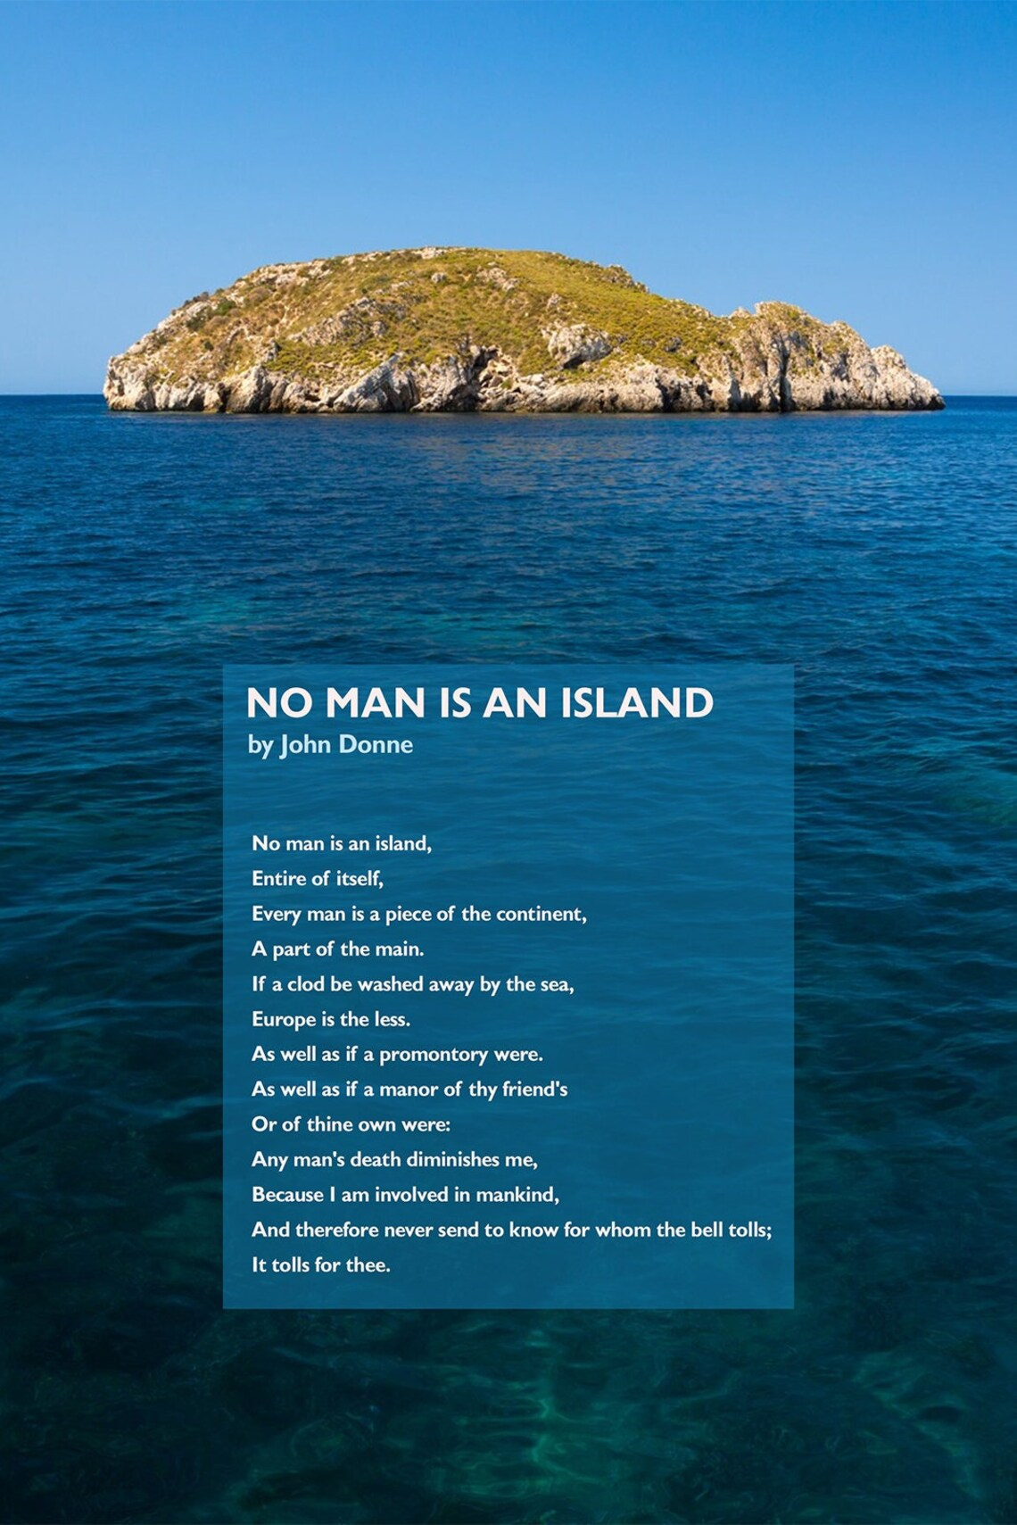
We’re made for community
The Lord God said, “It is not good for the man to be alone. I will make a helper suitable for him.”
Gen2:18
Now you are the body of Christ, and each one of you is a part of it.
1 Corinthians 12v27
Because there is one loaf, we, who are many, are one body, for we all share the one loaf
1 Corinthians 10 v17
Notes:
Even if unmarried we are not designed to be alone but in community. Paul writes about us all being one body with many parts inextricably linked 1 Corinthians 12v12

Slide 5
Help!
‘ezer kenegdo
‘ezer
help, one who plays a mutual role of the “indispensable other”, a strong and wise guide, without whom the intended good cannot happen.
assistance at a point of real need, whether by God or by a fellow human being…effective strength supplied from outside oneself, meeting difficult circumstances that require immediate action, rather than merely offering sympathy.
military reinforcement.
kenegdo = idea of mirroring
‘It is not good for the human to be solitary. I will make one who can deliver him from his inability to fulfil the divine commission alone, one who mirrors him.’ Gen 2:18 (paraphrase)
Notes:
Nicks example

Slide 6
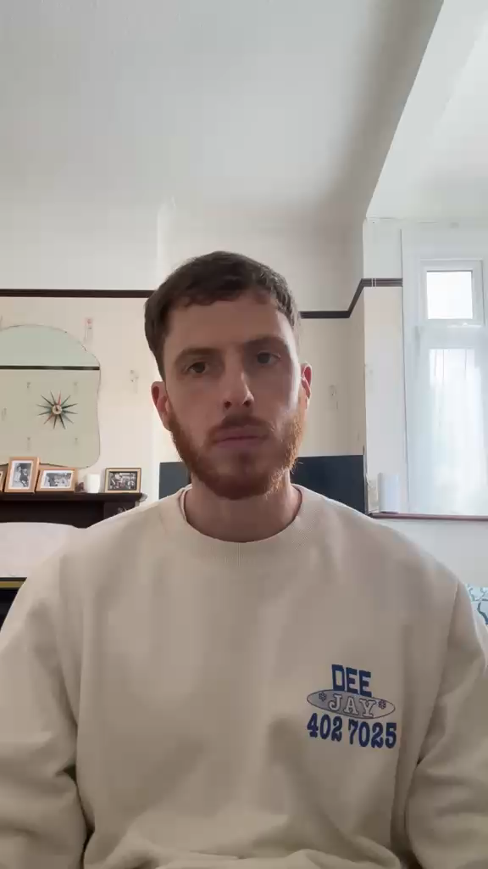
Nick Brewer

Slide 7
Eve is formed from Adam’s rib
Not from the dust like all the other animals but from his side, his own substance. They are each other’s complements.
Deep relational intimacy between man and woman:
‘Bone of my bone and flesh of my flesh’
‘That is why a man leaves his father and mother and is united to his wife, and they become one flesh.’
As they become one it’s as if the gap in Adam’s side is restored to him in a beautiful way
Notes:
Taken from side rather than head or feet widely is felt to symbolize equality. Moreover the rib protects the heart. In Hebrew the word translated as rib, tsela, generally means side

Slide 8
‘One flesh’
No longer living for self, not doing it my way but putting aside my way of doing things for the good of the other person and our relationship together
Becoming one flesh is another way of saying that Adam and Eve now have a covenantal relationship, not contract - 100% each, not 50/50
‘She is your partner, the wife of your marriage covenant’ Malachi 2 v14
Leaving and cleaving (becoming one flesh)
“Haven’t you read,” he replied, “that at the beginning the Creator ‘made them male and female,’ and said, ‘For this reason a man will leave his father and mother and be united to his wife, and the two will become one flesh’ ? So they are no longer two, but one flesh. Therefore, what God has joined together, let no one separate. Matthew 19:4-6
Notes:
– leave family and be united with spouse. Setting up a new family unit, old family no longer has same influence, although we still honour our parents.

Slide 9
2. Marriage is a picture of Christ and the Church
‘The Bible opens with a wedding and it ends with a wedding. It opens with a marriage and it ends with a marriage. Your bible is essentially a love story.’
Frank Viola
The wedding feast of the lamb …
‘I saw the Holy City, the new Jerusalem, coming down out of heaven from God, prepared as a bride beautifully dressed for her husband.’
Rev 21:2
Notes:
The wedding feast of the lamb is described in Revelation at the end of the world when Jesus returns. Jesus is the bridegroom , and we , the Church are his bride. .

Slide 10
Jesus the perfect bridegroom: our model
Husbands, love your wives, just as Christ loved the church and gave himself up for her to make her holy, cleansing her by the washing with water through the word, and to present her to himself as a radiant church, without stain or wrinkle or any other blemish, but holy and blameless. In this same way, husbands ought to love their wives as their own bodies. He who loves his wife loves himself. After all, no one ever hated their own body, but they feed and care for their body, just as Christ does the church— for we are members of his body. “For this reason a man will leave his father and mother and be united to his wife, and the two will become one flesh.” This is a profound mystery—but I am talking about Christ and the church. However, each one of you also must love his wife as he loves himself, and the wife must respect her husband.
Ephesians 5:21-33

Slide 11
Marriage as a picture of the gospel
‘So, what do you need to make marriage work? You need to know the secret, the gospel, and how it gives you both the power and pattern for your marriage. On the one hand, the experience of marriage will unveil the beauty and depths of the gospel to you. It will drive you further into reliance on it. On the other hand, a greater understanding of the gospel will help you experience deeper and deeper union with each other as the years go by.’
The Meaning of Marriage Tim Keller
Notes:
So the whole of the gospel is like a marriage – a loving covenant

Slide 12
Giving ourselves up for one another as Christ gave himself up for us
Within this Christian vision for marriage, here’s what it means to fall in love. It is to look at another person and get a glimpse of the person God is creating, and to say, “I see who God is making you, and it excites me! I want to be part of that. I want to partner with you and God in the journey you are taking to His throne. And when we get there, I will look at your magnificence and say, ‘I got glimpses of it on earth, but now look at you!’” Each spouse should see the great thing that Jesus is doing in the life of their mate through the Word, the gospel. Each spouse then should give him or herself to be a vehicle for that work and envision the day you will stand together before God, seeing each other presented in spotless beauty and grace.
Tim Keller The Meaning of Marriage
Actively looking for ways to serve – laying down our life in preference for the other, putting the other first
Being honest - transparent and open
Being vulnerable
Being prepared to challenge and confront – in love
Not giving up on the other person
Taking responsibility
Being reliable
Being quick to repent and forgive
We need the Holy Spirit to help us

Slide 13

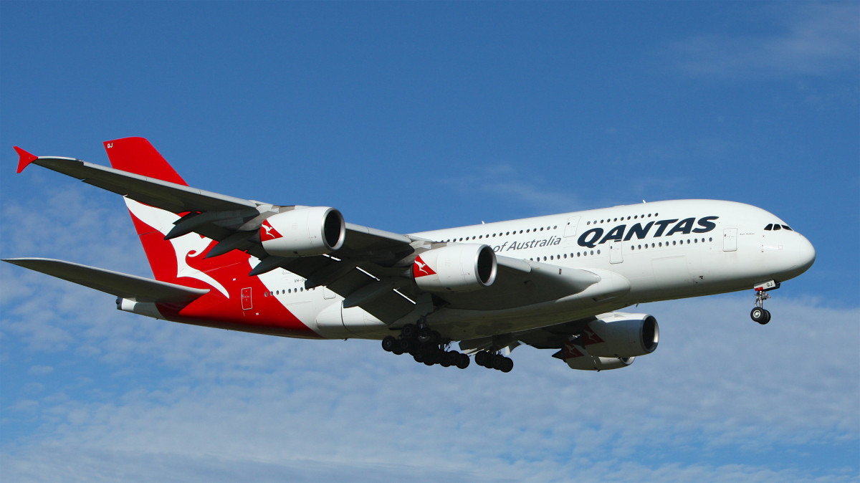

Slide 14
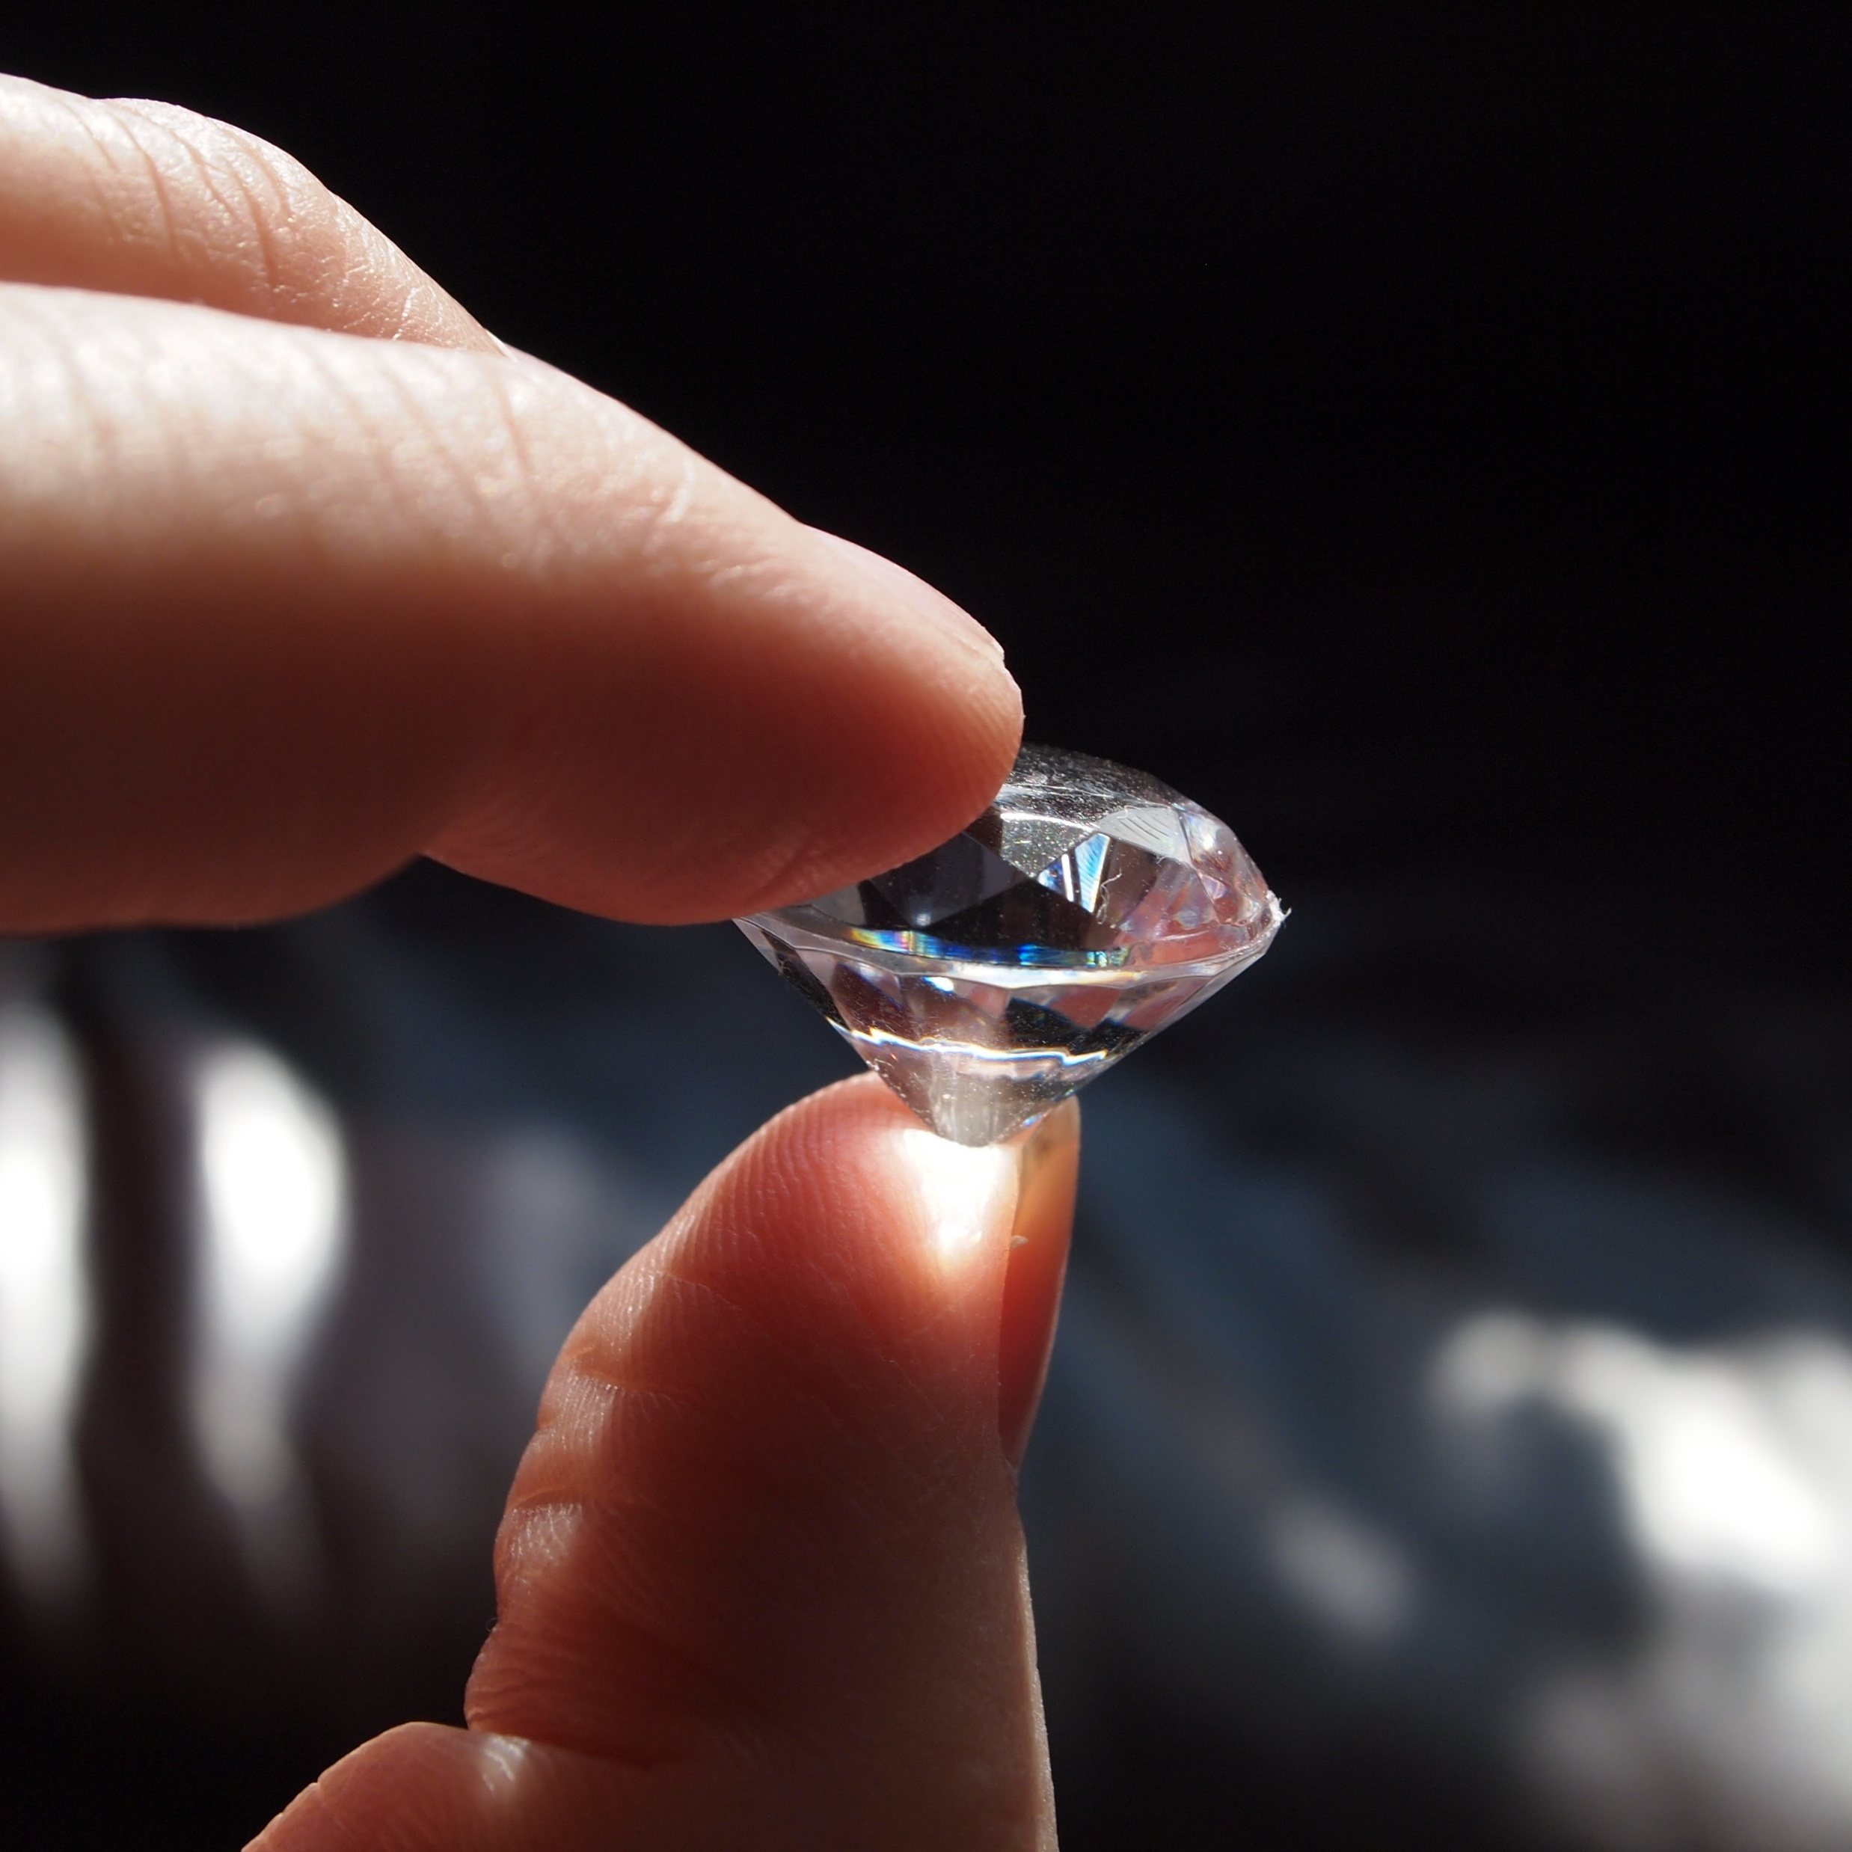
3. Marriage is something we are called to honour
‘Marriage should be honoured by all’ Hebrews 13:4
Honour = of great price, sacred, God-ordained

Slide 15
Under attack
Declining marriage rate
Same-sex marriage: marriage has been re-defined by society
Civil partnerships – no vows, no covenant
High divorce rate
Sex before/outside marriage is seen as normal (e.g. side-chicks/guys/pieces, one-sided monogamy)
Media message – do what you feel
All undermine the sanctity of marriage

Slide 16
How do we honour marriage?
If married – commit to it, work hard at it, ask for help
Whether married or single – during the wedding ceremony we promise to help!
‘Will you, the families and friends of N and N, support and uphold them in their marriage now and in the years to come?’
‘We will!’
Encourage couples to get help, bring challenge and confront. Don’t assume you have no part to play in helping friends, both inside and outside the church.
Notes:
Ask for help – recommend referee couple. Talk about how J&D helped us, we gave permission etc

Slide 17
4. What marriage is … and what it’s not
Marriage is not … | Marriage is …
A fairy tale | An adventure – with bumps and obstacles, as well as joy, along the way A committed relationship to be worked at, even in difficult times. Not always smooth sailing
A contract (I will if you will) | A covenant – a solemn vow before God where each gives 100%
To fill the God-shaped hole in my life. That must be filled by Jesus | To point each other towards Jesus and have a vision for each other
Having my needs met | A real, servant-hearted friendship, each laying down their lives for the other

Slide 18
Our message is becoming increasingly counter-cultural
1 in 5 Americans have chatted with an AI romantic companion
Why does AI love make sense?
Loneliness is at epidemic levels. Relationships require risk. AI companions offer affection without requiring much, and engagement entirely on your own terms.
AI companions offer a competing vision:
disincarnation (ie separating the spirit/soul from the physical body)
intimacy without vulnerability
comfort without genuine encounter
The church has more to offer than warnings. Christianity brings a rich theology of the body’s dignity and a vision of communion deep enough to withstand modern loneliness. The gospel is not trying to make us want less. It is teaching us how to want well. Jay Stringer, Christianity Today

Slide 19
God’s grace is available
Do you need fresh hope and vision for your marriage?
Do you need to experience a fresh touch of God for whatever circumstances you find yourself in?
Notes:
(Gem tumbler illustration)
Speak to whoever you look to pastorally, or to a leader.

