Slide 1
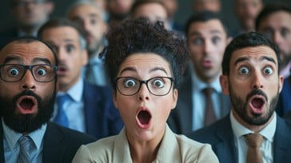
Gospel of Mark
Episode 2
28/06/26
Notes:
Nail in coffin

Slide 2
Mark 1:16-20
As Jesus walked beside the Sea of Galilee, he saw Simon and his brother Andrew casting a net into the lake, for they were fishermen. “Come, follow me,” Jesus said, “and I will send you out to fish for people.” At once they left their nets and followed him.
When he had gone a little farther, he saw James son of Zebedee and his brother John in a boat, preparing their nets. Without delay he called them, and they left their father Zebedee in the boat with the hired men and followed him.
Notes:
Immediate & dramatic response

Slide 3
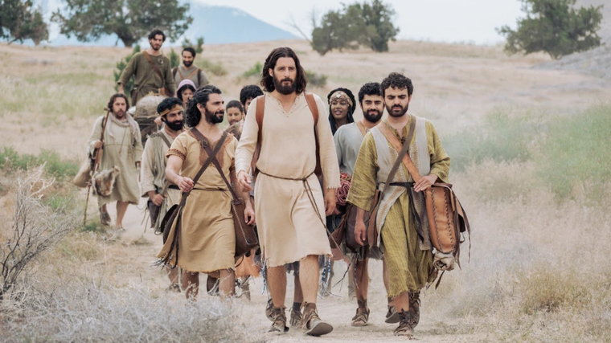
Notes:
“Follow me” – uni applied to be accepted by the student
What did they see that caused them to drop their nets & father?
He was amazing (and still is)

Slide 4
The Amazing Jesus
Notes:
In next passaged twice people are amazed by jesus – though same word in niv different in greek
Amazed
1605 ekplḗssō (from 1537 /ek, "wholly out," intensifying 4141 /plḗssō, "to strike") – properly, "strike out of one's senses" (BAGD), i.e. with the outcome of being utterly amazed (dumbfounded) or left "at a loss" from witnessing the incredible (causing the viewer to gape in astonishment).
struck with astonishment – slap or cold water tipped down back
not how we use it – when someone brings us the coffee we ordered “amazing! Thanks”
Amazed
Cognate: 2284 thambéō – to astonish, amaze (passive, dumbfounded) to the point of becoming emotionally "stalled" ("shutting down") – also implying a sense of wonder or terror
stupefy is to make someone unable to think clearly, usually by stunning, shocking, or exhausting them
Interrupt, invade, displace

Slide 5
Mark 1:21-28
They went to Capernaum, and when the Sabbath came, Jesus went into the synagogue and began to teach. The people were amazed at his teaching, because he taught them as one who had authority, not as the teachers of the law. Just then a man in their synagogue who was possessed by an impure spirit cried out, “What do you want with us, Jesus of Nazareth? Have you come to destroy us? I know who you are—the Holy One of God!”
“Be quiet!” said Jesus sternly. “Come out of him!” The impure spirit shook the man violently and came out of him with a shriek.
The people were all so amazed that they asked each other, “What is this? A new teaching—and with authority! He even gives orders to impure spirits and they obey him.” News about him spread quickly over the whole region of Galilee.

Slide 6
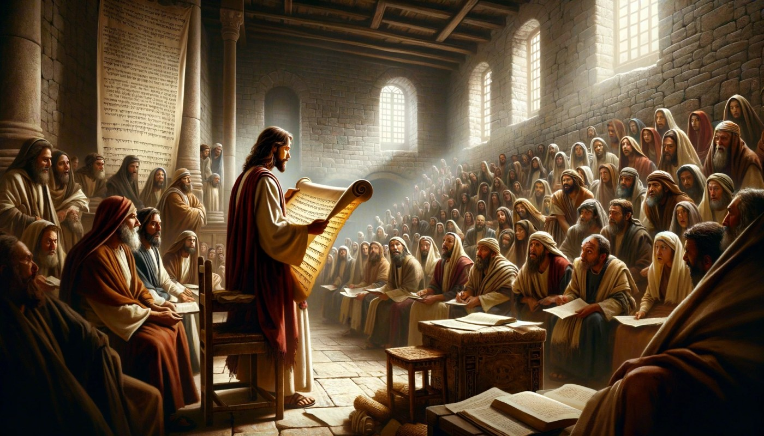
Notes:
Firstly amazed at his authority in teaching

Slide 7

Notes:
Authority
Teaching
Book club – we say opinion, author explains intension
Never find out what he teaches
This is Jesus!

Slide 8
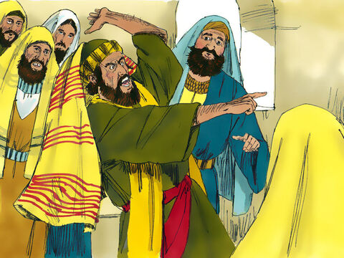
Notes:
Next amazed at his authority over spirit
Major part of ministry – start popping up all over the place because territory getting squeezed
First featured miracle
Authority over
Demon knew Jesus
Secrecy
Similarities with stopping storm

Slide 9
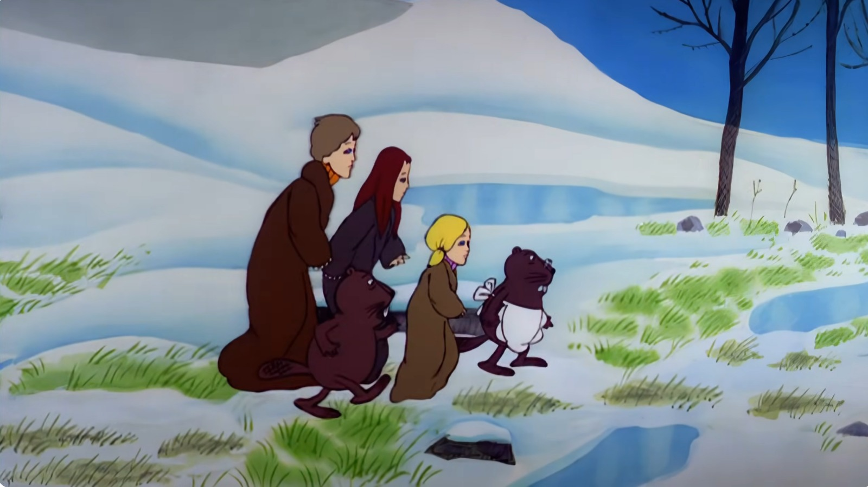
Notes:
“Every moment the patches of green grew bigger and the patches of snow grew smaller. Every moment more and more of the trees shook off their robes of snow. Soon, wherever you looked, instead of white shapes you saw the dark green of firs or the black prickly branches of bare oaks and beeches and elms. Then the mist turned from white to gold and presently cleared away altogether. Shafts of delicious sunlight struck down on to the forest floor and overhead you could see a blue sky between the tree tops.
Soon there were more wonderful things happening. Coming suddenly round a corner into a glade of silver birch trees Edmund saw the ground covered in all directions with little yellow flowers- celandines. The noise of water grew louder. Presently they actually crossed a stream. Beyond it they found snowdrops growing.” ― C.S. Lewis, The Lion, the Witch and the Wardrobe
Aslan is on the move – the curse holding the land is breaking
Jesus moved out into the world making little pockets of heaven
Fixing this world matters – God is glorified, made known when it is repaired
Disfunction perpetuates a lie e.g. Sierra Leone
Order speaks of God’s nature
Refuge collection
Justice system
Education
Can demand our ‘rights’ and just want the material or can see a God whose very nature is expressed and a universe that is attuned to its Source
This is Jesus!

Slide 10
Mark 1:29-34
As soon as they left the synagogue, they went with James and John to the home of Simon and Andrew. Simon’s mother-in-law was in bed with a fever, and they immediately told Jesus about her. So he went to her, took her hand and helped her up. The fever left her and she began to wait on them.
That evening after sunset the people brought to Jesus all the sick and demon-possessed. The whole town gathered at the door, and Jesus healed many who had various diseases. He also drove out many demons, but he would not let the demons speak because they knew who he was.

Slide 11
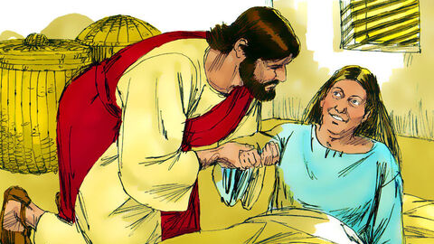
Notes:
Healed so she can serve
More diseases heal and demons cast out

Slide 12
Mark 1:40-45
A man with leprosy came to him and begged him on his knees, “If you are willing, you can make me clean.”
Jesus was indignant. He reached out his hand and touched the man. “I am willing,” he said. “Be clean!” Immediately the leprosy left him and he was cleansed.
Jesus sent him away at once with a strong warning: “See that you don’t tell this to anyone. But go, show yourself to the priest and offer the sacrifices that Moses commanded for your cleansing, as a testimony to them.” Instead he went out and began to talk freely, spreading the news. As a result, Jesus could no longer enter a town openly but stayed outside in lonely places. Yet the people still came to him from everywhere.

Slide 13
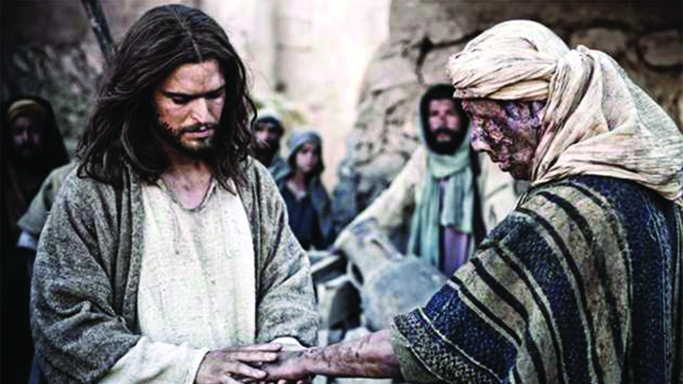
Notes:
[healing leper]
A man with leprosy came to him and begged him on his knees, “If you are willing, you can make me clean.”
Risk to come to Jesus – complete disease – believed result of sin, contagious, isolated, incurable
If you are willing – doubted will, not power
I am willing
Heaven torn open, for God so loved the world, coming to rescue his children
Jesus was indignant.
A physic reaction
Moved with compassion
Highly emotive
Jesus touches Him (didn’t need to touch – can heal with word or thought) – “I’m with you”
Now jesus has to live in the lonely places

Slide 14
Trading Places

Slide 15
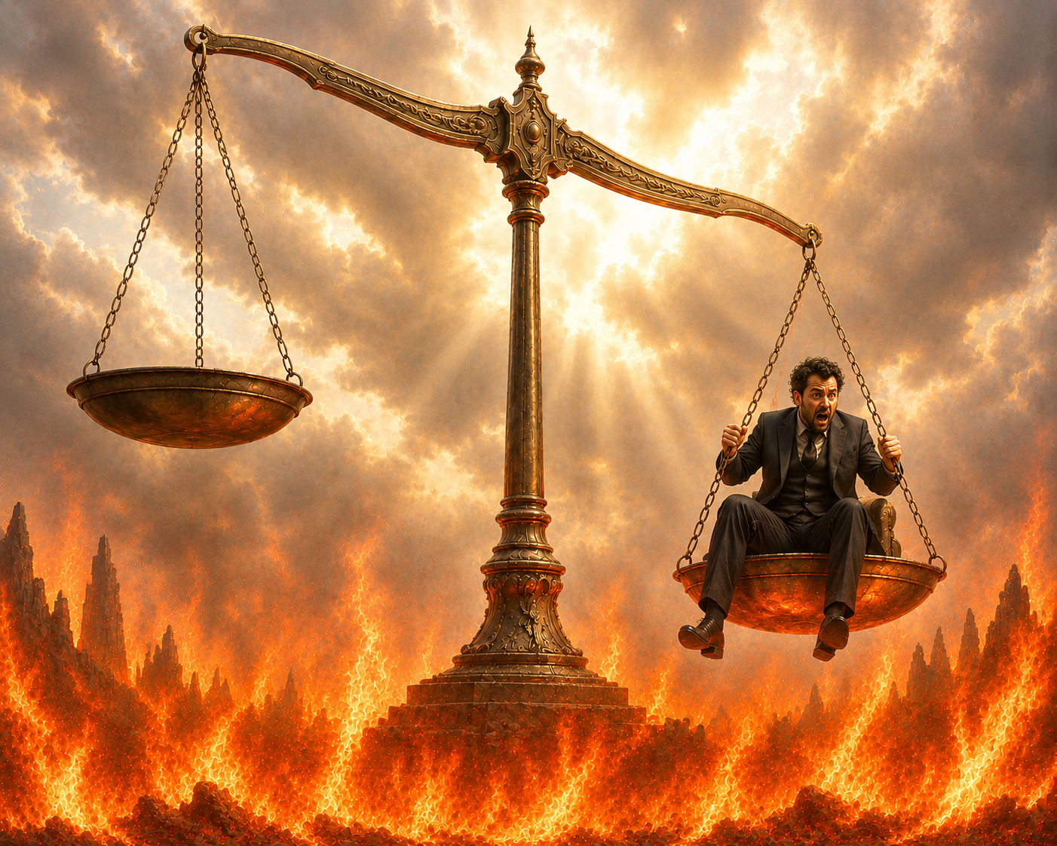
Notes:
Theme in gospels
Every time he raises others, he is lowering himself into the grave. he is trading places.
Mother-in-law raised up
Brings leprous man out of isolation at cost of his own isolation
Raises Lazarus, leaders want to put him in a tomb
Every healing in another nail in His coffin

Slide 16
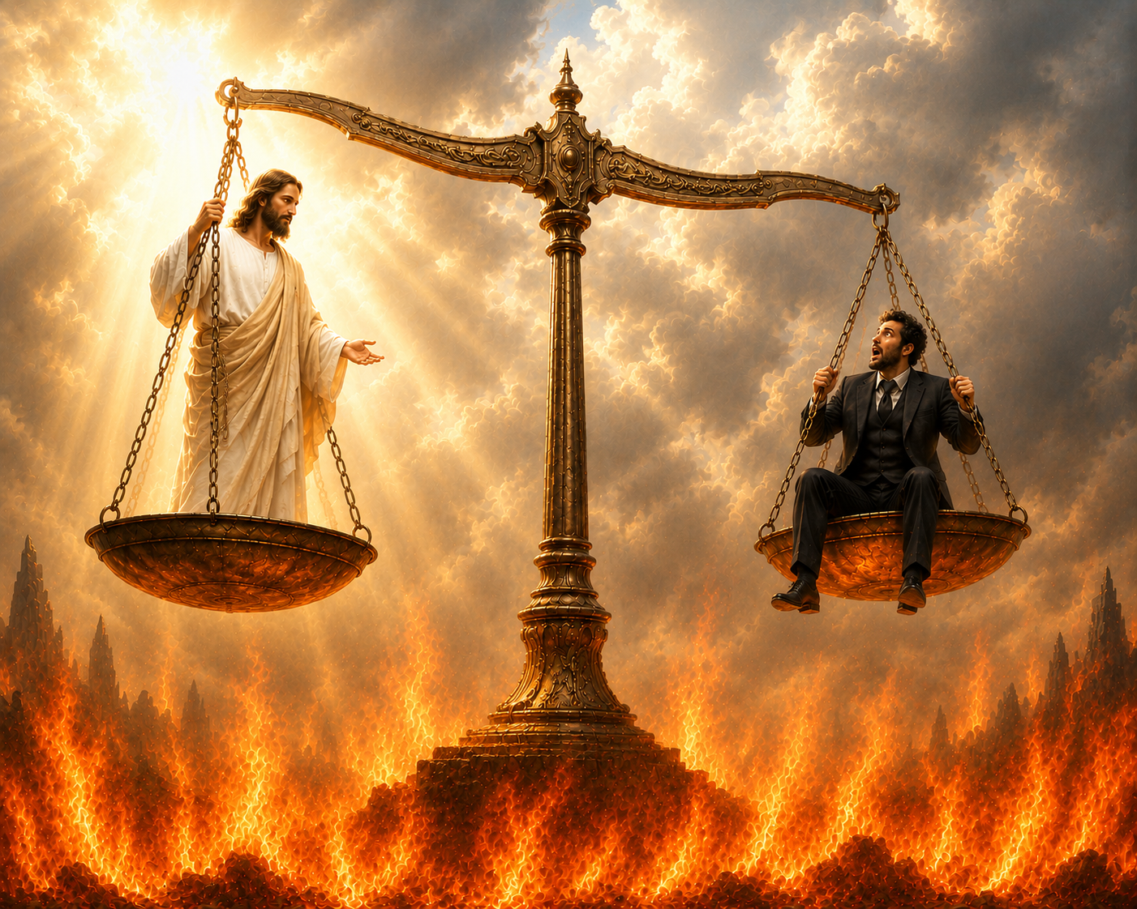

Slide 17
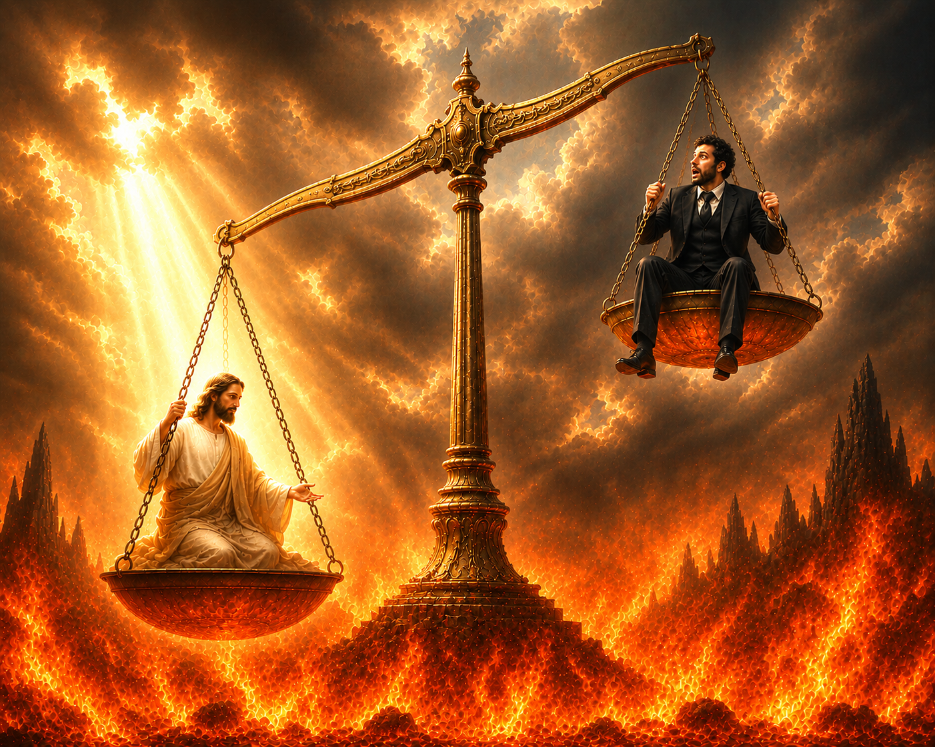
Notes:
Every healing, act of justice is another nail in his coffin
He takes this sin upon him to free us from it
2 Cor 5:21 God made him who had no sin to be sin for us, so that in him we might become the righteousness of God.
1 Peter 2:24 “He himself bore our sins” in his body on the cross, so that we might die to sins and live for righteousness; “by his wounds you have been healed.”
Trading places (free for us, costly for Him)
Thank you for saving me, what can I say?

Slide 18
Mark 1:35-37
Very early in the morning, while it was still dark, Jesus got up, left the house and went off to a solitary place, where he prayed. Simon and his companions went to look for him, and when they found him, they exclaimed: “Everyone is looking for you!”

Slide 19
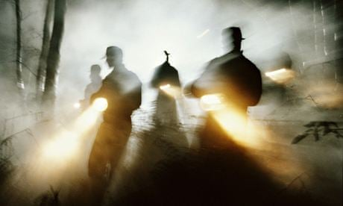
Notes:
Everyone is looking for you!
True and false on different levels
They are looking for miracle maker (means to an end)
They aren’t looking for a king/rescuer
We are all looking for completion – choose all type of idols to fill the void
Saint Augustine: "You have made us for yourself, and our hearts are restless until they rest in you.
Are you looking for this amazing Jesus – perhaps you know of Him, or to a limited extent but to truly know Him (end in Himself)

Slide 20
He is knowable
Notes:
That’s the Jesus I know!
Do you know Him?
He has made Himself know about
Col 1:15 The Son is the image of the invisible God, the firstborn over all creation.
Col 2:9 For in Christ all the fullness of the Deity lives in bodily form
Phil 3:10 I want to know Christ

Slide 21
Does He Amaze You?
Notes:
in jesus christ we see virtues combined that never anywhere else are combined
We see
Tenderness without weakness
Strength without a milligram of harshness
Humility without a ounce of uncertainty
Unbending convictions yet complete and utter approachability
Power without insensitivity
Passion without slightest prejudice
Total integrity without ridgity
Never a misstep
Looking at God through a human nature
(wait to you see other facets of the diamond later)
He knows you. Do you want to know Him? He has purposely made Himself knowable.

Slide 22


Slide 23

My boat of life sails on a troubled sea
Whenever there's a wind in my sails
But I have a friend who watches over me
When the breeze turns into a gale
I know the Master of the wind
I know the Maker of the rain
He can calm a storm,
Make the sun shine again
I know the Master of the wind
Sometimes I soar
Like an eagle through the sky
Among the peaks my soul can be found
But an unexpected storm
May drive me from the heights
It may bring me low,
But cannot bring me down

