Slide 1

Notes:
https://create.kahoot.it/share/marks-gospel-origins-audience-and-christology/9e973584-40fc-4fd2-bd6f-33ace0613e11

Slide 2

Gospel of Mark
Episode 3
12/07/26

Slide 3
Mark 2:1-12
A few days later, when Jesus again entered Capernaum, the people heard that he had come home. They gathered in such large numbers that there was no room left, not even outside the door, and he preached the word to them. Some men came, bringing to him a paralyzed man, carried by four of them. Since they could not get him to Jesus because of the crowd, they made an opening in the roof above Jesus by digging through it and then lowered the mat the man was lying on. When Jesus saw their faith, he said to the paralyzed man, “Son, your sins are forgiven.”
Now some teachers of the law were sitting there, thinking to themselves, “Why does this fellow talk like that? He’s blaspheming! Who can forgive sins but God alone?”

Slide 4
Mark 2:1-12
Immediately Jesus knew in his spirit that this was what they were thinking in their hearts, and he said to them, “Why are you thinking these things? Which is easier: to say to this paralyzed man, ‘Your sins are forgiven,’ or to say, ‘Get up, take your mat and walk’? But I want you to know that the Son of Man has authority on earth to forgive sins.” So he said to the man, “I tell you, get up, take your mat and go home.” He got up, took his mat and walked out in full view of them all. This amazed everyone and they praised God, saying, “We have never seen anything like this!”

Slide 5
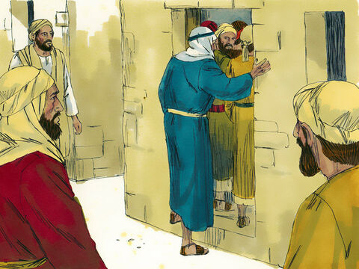
A few days later, when Jesus again entered Capernaum…
Notes:
Few days later…after
Healing Simon mother-in-law
Casting out impure spirit(s)
Healing leper
Entered Capernaum
Had to be in lonely placed outside the town to avoid being mobbed

Slide 6
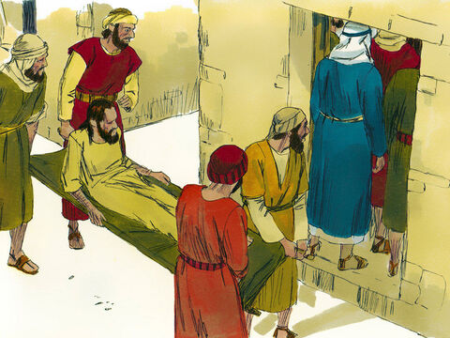
Since they could not get him to Jesus because of the crowd…
Notes:
Could not get to Jesus
How desperate would you feel
Imagine if Jesus was inaccessible
No torn heaven open or veil
If he had only died and not risen again
If he wasn’t calling you for relationship

Slide 7
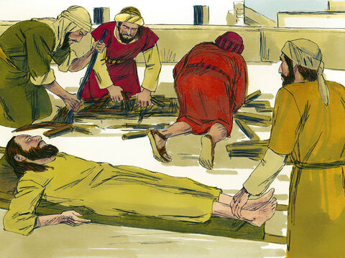
they made an opening in the roof above Jesus by digging through it and then lowered the mat the man was lying on.
Notes:
The friends
Commitment – you need Jesus and I will carry you there
Ruthless – vandalism
Are your friends seeking to bring you into presence of Jesus?
Are you putting the right expectation on this relationship?
How do you carry a friend to Jesus?
Orchestra of God
Rachel – Maths
Leonie – mountain rescue
Dixons – Xray
Martin – school lifts/fishing/Duxford
Chris – lemon grass
Elliott – paddle
JWS for NS – just want you to be happier
Clare – cry, finance, tell me I was wrong
I don’t know if I saw Jesus through this at the time, I probably wouldn’t have articulated such, but as I look back on these acts I see Jesus and I see a culture cultivated which brought me into His presence. Thank you.
Lay down life to ensure you lay down yours
Fun – restorative
We are giving thanks to the set up team etc – have you considered you a lowering your friends into the presence of Jesus? If you did how would you think differently about this task?
We are welcome people into our community – this is a special commitment to stand with and support. Not going to have the same depth with all 200+ people but expect to find depth with particular
Matt 25:31-40
34“Then the King will say to those on his right, ‘Come, you who are blessed by my Father; take your inheritance, the kingdom prepared for you since the creation of the world. 35For I was hungry and you gave me something to eat, I was thirsty and you gave me something to drink, I was a stranger and you invited me in, 36I needed clothes and you clothed me, I was sick and you looked after me, I was in prison and you came to visit me.’
40“The King will reply, ‘Truly I tell you, whatever you did for one of the least of these brothers and sisters of mine, you did for me.’

Slide 8
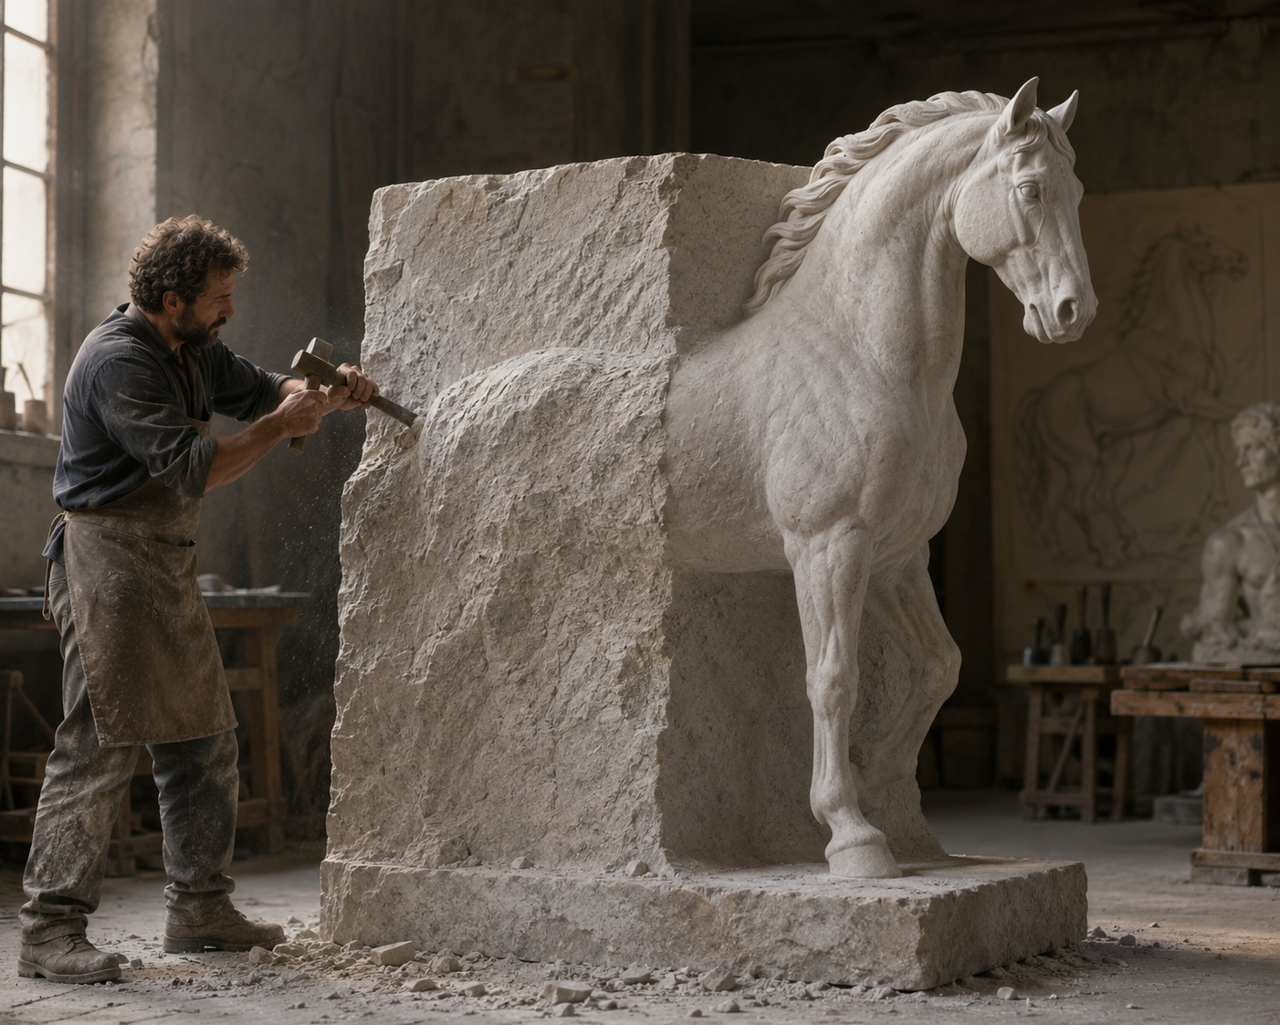
Notes:
“The sculpture is already complete within the marble block, before I start my work. It is already there, I just have to chisel away the superfluous material.”
― Michelangelo
…look at another person and get a glimpse of what God is creating, and to say, "I see who God is making you, and it excites me! I want to be part of that. I want to partner with you and God in the journey you are taking to his throne. And when we get there, I will look at your magnificence and say, 'I always knew you could be like this. I got glimpses of it on earth, but now look at you!”
Tim Keller
Present each other mature in Christ
Encourage – celebrate to friend what you see
Lead to Jesus – come see a man – I’ve seen Jesus and it has messed me up for good, it would rock your world too
The load, or weight, or burden of my neighbour’s glory should be laid daily on my back, a load so heavy that only humility can carry it, and the backs of the
proud will be broken. It is a serious thing to live in a society of possible gods and goddesses, to remember that the dullest and most uninteresting person you talk to may one day be a creature which, if you saw it now, you would be strongly tempted to worship, or else a horror and a corruption such as you now meet, if at all, only in a nightmare. All day long we are, in some degree, helping each other to one or other of these destinations. It is in the light of these overwhelming possibilities, it is with the awe and the circumspection proper to them, that we should conduct all our dealings with one another, all friendships, all loves, all play, all politics. There are no ordinary people. You have never talked to a mere mortal.
- CS Lewis, Weight of Glory

Slide 9
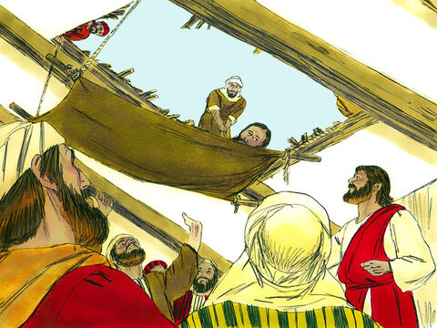
When Jesus saw their faith…
Notes:
Jesus saw their faith
Saw – what did he see?
Their – faith of friends. Forgave on this basis?

Slide 10
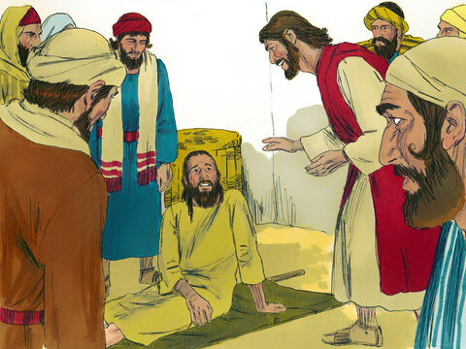
Son, your sins are forgiven.
Notes:
Ummm…I came here because I’m paralysed…???
Biggest issue is not our suffering but our sin
Don’t always get what you want, but sometimes you get what you need
Jesus goes deeper than we were prepared for

Slide 11
Son, your sins are forgiven.
Ummm… I came because I can’t walk …
Notes:
Ummm…I came here because I’m paralysed…???
Biggest issue is not our suffering but our sin
Don’t always get what you want, but sometimes you get what you need
Jesus goes deeper than we were prepared for

Slide 12
Sin
For all have sinned and fall short of the glory of God (Rom 3:23)
our righteous acts are like filthy rags
(Isa 64:6)
…Although I want to do good, evil is right there with me... What a wretched man I am! Who will rescue me (Rom 7:21, 24)
It’s your sins that have cut you
off from God…(Isa 59:2)
Once you were alienated from God and
were enemies in your minds because of your evil behaviour. (Col 1:21)
Defend: Deny, Distract, Deflect, Discharge
Notes:
Defend –
deny (I did nothing wrong),
distract (this isn’t really a big issue),
deflect (it’s the fault of other people/circumstance)…when none of these work
Discharge (I will attempt to pay my debt).

Slide 13
Sin
Salvation
For all have sinned and fall short of the glory of God (Rom 3:23)
our righteous acts are like filthy rags
(Isa 64:6)
…Although I want to do good, evil is right there with me... What a wretched man I am! Who will rescue me (Rom 7:21, 24)
It’s your sins that have cut you
off from God…(Isa 59:2)
Once you were alienated from God and
were enemies in your minds because of your evil behaviour. (Col 1:21)
Defend: Deny, Distract, Deflect, Discharge
though your sins are like scarlet, they
shall be as white as snow; though they are
red like crimson, they shall become like wool.
(Isa 1:18)
“I, even I, am He who blots out your transgressions for My own sake;
And I will not remember your sins”
(Isa 43:25)
“You will again have compassion on us; you will tread our sins underfoot and hurl all our iniquities into the depths of the sea”
(Micah 7:19)
you were redeemed from the empty
way of life (1 Pet 1:18)
Notes:
Just God can’t demand two payments for one crime
You are more lost that you ever dared to admit, yet more loved than you ever dared believe
I’m not too bad, I can pull myself up
Jesus treated as a surgeon’s assistant – I prefer Jesus pass me the tool and I’ll do the job. If he doesn’t pass me, I’ll have to get it myself

Slide 14
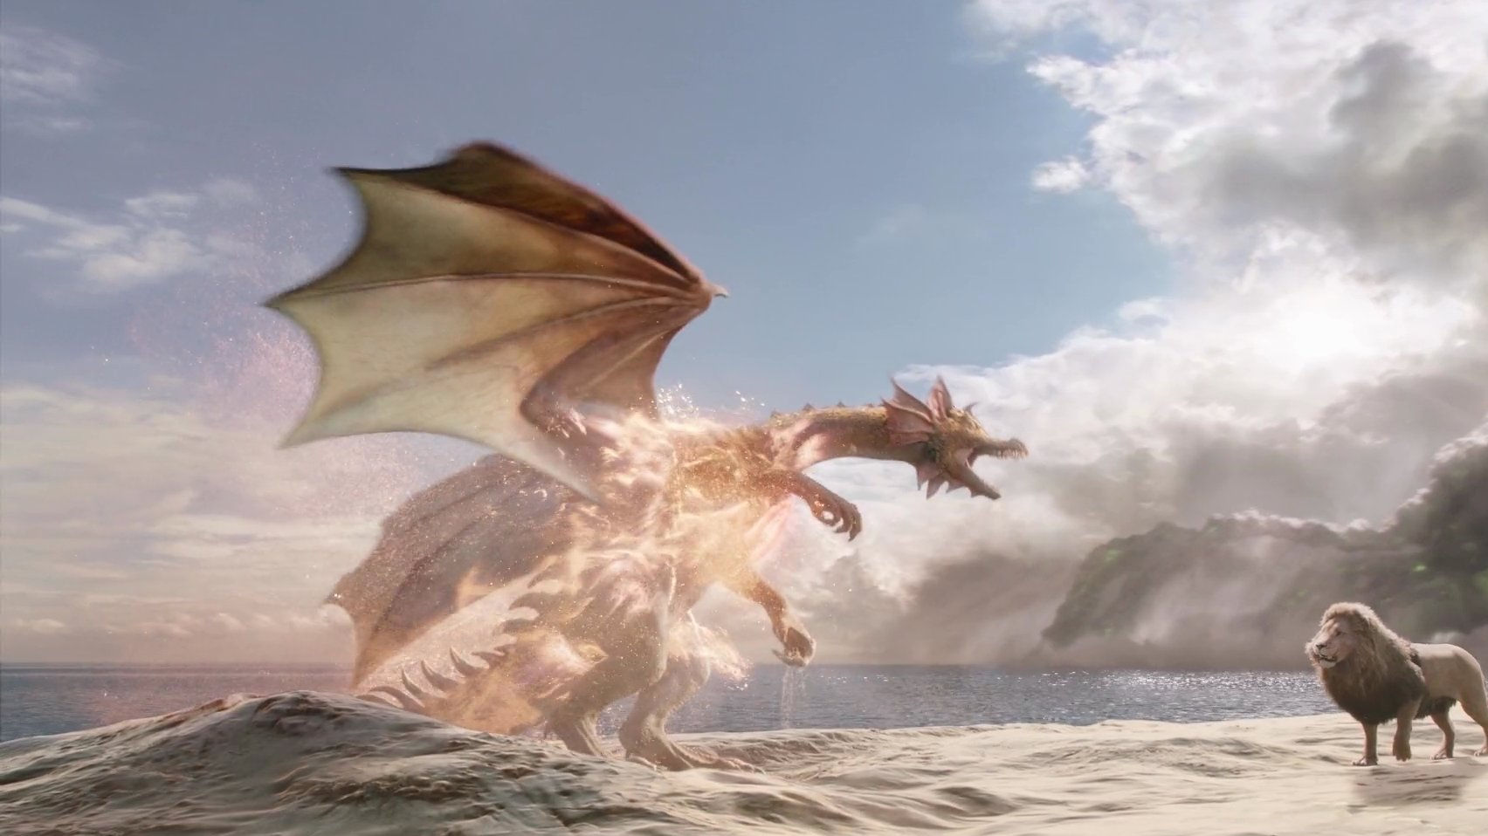
Notes:
Eustace
got heart desire – turned him into a dragon
couldn’t shed his own skin – needed aslan
jesus has claws – cut deep
Aslan comes to Eustace and leads him to a large pool
the water was so clear and he thought if he could get in there and bathe it would ease the pain
But Aslan told him he had to undress first
Eustace found that no matter how many layers of dragon skins he managed to peel off of himself, he was still a dragon. You will have to let me undress you.’ I was afraid of his claws, I can tell you, but I was pretty nearly desperate now. So I just lay flat down on my back to let him do it.
“The very first tear he made was so deep that I thought it had gone right into my heart. And when he began pulling the skin off, it hurt worse than anything I've ever felt. The only thing that made me able to bear it was just the pleasure of feeling the stuff peel off.
- C. S. Lewis, The Voyage of the Dawn Treader

Slide 15
dead because of your disobedience and your many sins
Notes:
1Once you were dead because of your disobedience and your many sins. 2You used to live in sin, just like the rest of the world, obeying the devil—the commander of the powers in the unseen world.a He is the spirit at work in the hearts of those who refuse to obey God. 3All of us used to live that way, following the passionate desires and inclinations of our sinful nature. By our very nature we were subject to God’s anger, just like everyone else.
(Eph 2:1-7) NLT

Slide 16
dead because of your disobedience and your many sins
You used to live in sin
Notes:
1Once you were dead because of your disobedience and your many sins. 2You used to live in sin, just like the rest of the world, obeying the devil—the commander of the powers in the unseen world.a He is the spirit at work in the hearts of those who refuse to obey God. 3All of us used to live that way, following the passionate desires and inclinations of our sinful nature. By our very nature we were subject to God’s anger, just like everyone else.
(Eph 2:1-7) NLT

Slide 17
dead because of your disobedience and your many sins
You used to live in sin
obeying the devil
Notes:
1Once you were dead because of your disobedience and your many sins. 2You used to live in sin, just like the rest of the world, obeying the devil—the commander of the powers in the unseen world.a He is the spirit at work in the hearts of those who refuse to obey God. 3All of us used to live that way, following the passionate desires and inclinations of our sinful nature. By our very nature we were subject to God’s anger, just like everyone else.
(Eph 2:1-7) NLT

Slide 18
dead because of your disobedience and your many sins
You used to live in sin
obeying the devil
refuse to obey God
Notes:
1Once you were dead because of your disobedience and your many sins. 2You used to live in sin, just like the rest of the world, obeying the devil—the commander of the powers in the unseen world.a He is the spirit at work in the hearts of those who refuse to obey God. 3All of us used to live that way, following the passionate desires and inclinations of our sinful nature. By our very nature we were subject to God’s anger, just like everyone else.
(Eph 2:1-7) NLT

Slide 19
dead because of your disobedience and your many sins
You used to live in sin
obeying the devil
refuse to obey God
following the passionate desires and inclinations of our sinful nature
Notes:
1Once you were dead because of your disobedience and your many sins. 2You used to live in sin, just like the rest of the world, obeying the devil—the commander of the powers in the unseen world.a He is the spirit at work in the hearts of those who refuse to obey God. 3All of us used to live that way, following the passionate desires and inclinations of our sinful nature. By our very nature we were subject to God’s anger, just like everyone else.
(Eph 2:1-7) NLT

Slide 20
dead because of your disobedience and your many sins
You used to live in sin
obeying the devil
refuse to obey God
following the passionate desires and inclinations of our sinful nature
By our very nature we were subject to God’s anger
Notes:
1Once you were dead because of your disobedience and your many sins. 2You used to live in sin, just like the rest of the world, obeying the devil—the commander of the powers in the unseen world.a He is the spirit at work in the hearts of those who refuse to obey God. 3All of us used to live that way, following the passionate desires and inclinations of our sinful nature. By our very nature we were subject to God’s anger, just like everyone else.
(Eph 2:1-7) NLT

Slide 21
But God is so rich in mercy
Notes:
But God is so rich in mercy, and he loved us so much, 5that even though we were dead because of our sins, he gave us life when he raised Christ from the dead. (It is only by God’s grace that you have been saved!) 6For he raised us from the dead along with Christ and seated us with him in the heavenly realms because we are united with Christ Jesus. 7So God can point to us in all future ages as examples of the incredible wealth of his grace and kindness toward us, as shown in all he has done for us who are united with Christ Jesus.
Eph 2 (NLT)

Slide 22
he loved us so much
But God is so rich in mercy
Notes:
But God is so rich in mercy, and he loved us so much, 5that even though we were dead because of our sins, he gave us life when he raised Christ from the dead. (It is only by God’s grace that you have been saved!) 6For he raised us from the dead along with Christ and seated us with him in the heavenly realms because we are united with Christ Jesus. 7So God can point to us in all future ages as examples of the incredible wealth of his grace and kindness toward us, as shown in all he has done for us who are united with Christ Jesus.
Eph 2 (NLT)

Slide 23
he gave us life
he loved us so much
But God is so rich in mercy
Notes:
But God is so rich in mercy, and he loved us so much, 5that even though we were dead because of our sins, he gave us life when he raised Christ from the dead. (It is only by God’s grace that you have been saved!) 6For he raised us from the dead along with Christ and seated us with him in the heavenly realms because we are united with Christ Jesus. 7So God can point to us in all future ages as examples of the incredible wealth of his grace and kindness toward us, as shown in all he has done for us who are united with Christ Jesus.
Eph 2 (NLT)

Slide 24
only by God’s grace that you have been saved!
he gave us life
he loved us so much
But God is so rich in mercy
Notes:
But God is so rich in mercy, and he loved us so much, 5that even though we were dead because of our sins, he gave us life when he raised Christ from the dead. (It is only by God’s grace that you have been saved!) 6For he raised us from the dead along with Christ and seated us with him in the heavenly realms because we are united with Christ Jesus. 7So God can point to us in all future ages as examples of the incredible wealth of his grace and kindness toward us, as shown in all he has done for us who are united with Christ Jesus.
Eph 2 (NLT)

Slide 25
raised us from the dead
only by God’s grace that you have been saved!
he gave us life
he loved us so much
But God is so rich in mercy
Notes:
But God is so rich in mercy, and he loved us so much, 5that even though we were dead because of our sins, he gave us life when he raised Christ from the dead. (It is only by God’s grace that you have been saved!) 6For he raised us from the dead along with Christ and seated us with him in the heavenly realms because we are united with Christ Jesus. 7So God can point to us in all future ages as examples of the incredible wealth of his grace and kindness toward us, as shown in all he has done for us who are united with Christ Jesus.
Eph 2 (NLT)

Slide 26
seated us with him in the heavenly realms
raised us from the dead
only by God’s grace that you have been saved!
he gave us life
he loved us so much
But God is so rich in mercy
Notes:
But God is so rich in mercy, and he loved us so much, 5that even though we were dead because of our sins, he gave us life when he raised Christ from the dead. (It is only by God’s grace that you have been saved!) 6For he raised us from the dead along with Christ and seated us with him in the heavenly realms because we are united with Christ Jesus. 7So God can point to us in all future ages as examples of the incredible wealth of his grace and kindness toward us, as shown in all he has done for us who are united with Christ Jesus.
Eph 2 (NLT)

Slide 27
united with Christ Jesus
seated us with him in the heavenly realms
raised us from the dead
only by God’s grace that you have been saved!
he gave us life
he loved us so much
But God is so rich in mercy
Notes:
But God is so rich in mercy, and he loved us so much, 5that even though we were dead because of our sins, he gave us life when he raised Christ from the dead. (It is only by God’s grace that you have been saved!) 6For he raised us from the dead along with Christ and seated us with him in the heavenly realms because we are united with Christ Jesus. 7So God can point to us in all future ages as examples of the incredible wealth of his grace and kindness toward us, as shown in all he has done for us who are united with Christ Jesus.
Eph 2 (NLT)

Slide 28
examples of the incredible wealth of his grace and kindness
united with Christ Jesus
seated us with him in the heavenly realms
raised us from the dead
only by God’s grace that you have been saved!
he gave us life
he loved us so much
But God is so rich in mercy
Notes:
But God is so rich in mercy, and he loved us so much, 5that even though we were dead because of our sins, he gave us life when he raised Christ from the dead. (It is only by God’s grace that you have been saved!) 6For he raised us from the dead along with Christ and seated us with him in the heavenly realms because we are united with Christ Jesus. 7So God can point to us in all future ages as examples of the incredible wealth of his grace and kindness toward us, as shown in all he has done for us who are united with Christ Jesus.
Eph 2 (NLT)

Slide 29
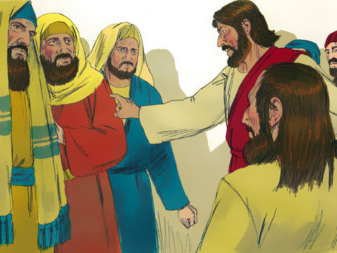
Now some teachers of the law were sitting there, thinking to themselves, “Why does this fellow talk like that? He’s blaspheming! Who can forgive sins but God alone?”
Notes:
Now some teachers of the law were sitting there, thinking to themselves, “Why does this fellow talk like that? He’s blaspheming! Who can forgive sins but God alone?”
Thinking to themselves
Not speaking out loud
Trying to figure it out themselves whilst the teacher/author is in the room – why not ask Him?
Heart not eager to discover
Blasphemy
First time getting angry reaction to Jesus – one step closer to the edge
Who can forgive sins but God alone?
Bingo – Messiah + Son of God right in front of you, allow your logic train to reach your last stop.
Sin is against God/Jesus
Knew in his spirit…what they were thinking in their hearts
Discernment – same way He saw their faith?

Slide 30
Which is easier: to say to this paralyzed man,
‘Your sins are forgiven’
‘Get up, take your mat and walk’
Notes:
Which is easier: to say to this paralyzed man, ‘Your sins are forgiven,’ or to say, ‘Get up, take your mat and walk’?
Think of the work Jesus would have to do in the background for Jesus to forgive

Slide 31
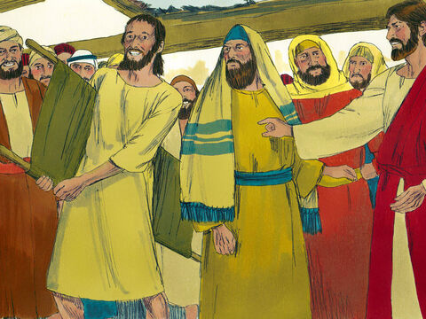
He got up, took his mat and walked out in full view of them all. This amazed everyone…
Notes:
Healing proves authority to forgive
Way to know for sure I have permission to go into airport VIP lounge is to enter and see if they admit me
Got up, took mat and walked out
What would they say when he WALKED home?
Amazed
This is our Jesus. Can you see Him yet?

Slide 32


