Slide 1
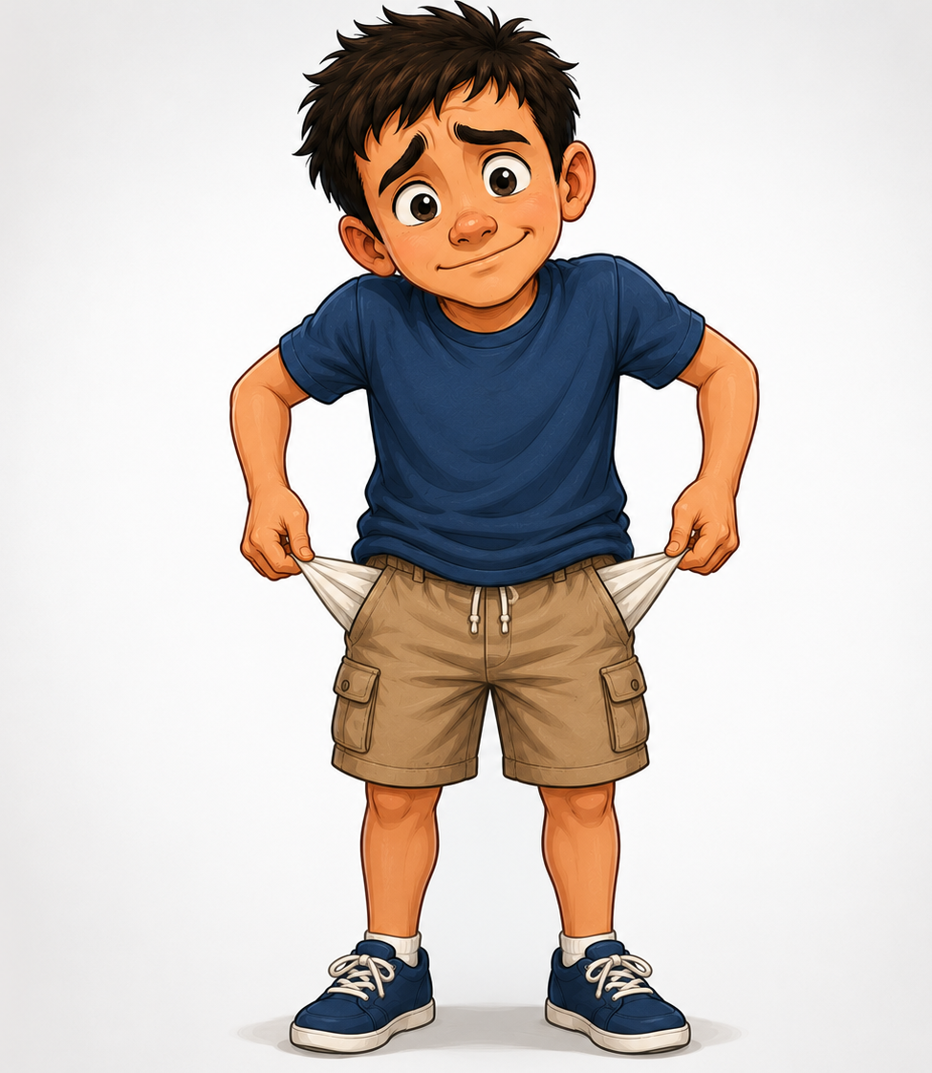
The Gospel of Mark
Episode 4
26/07/26
Notes:
What makes us a friend of Jesus

Slide 2
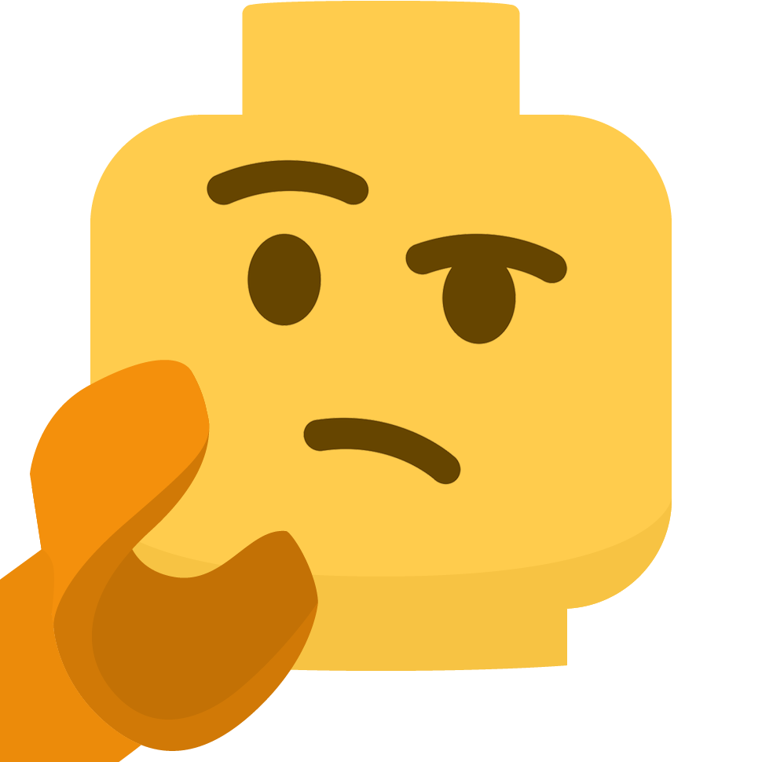
How can we become likeable?

Slide 3
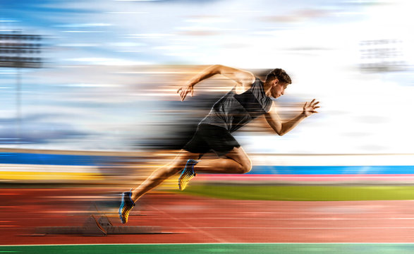

Slide 4
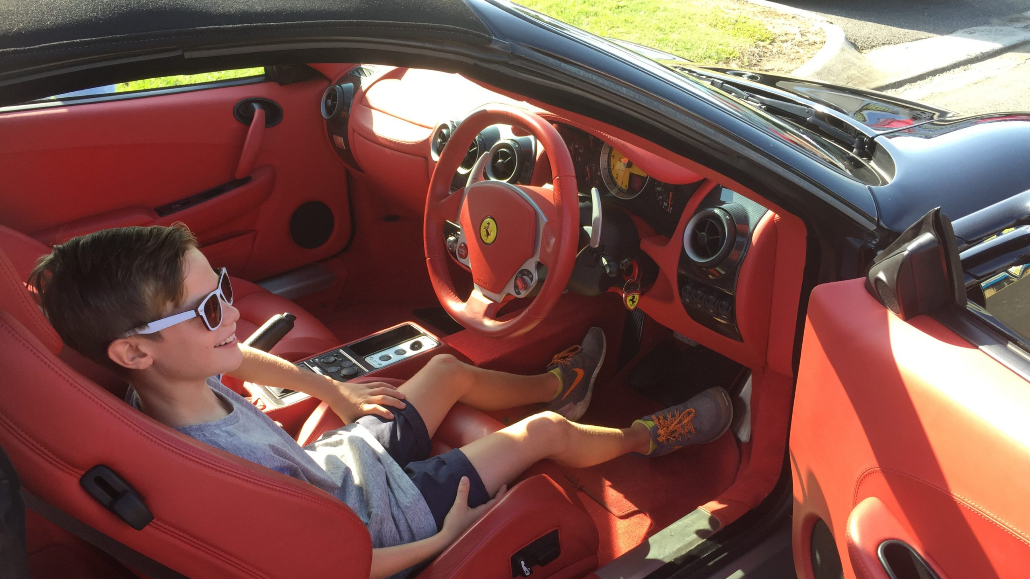

Slide 5
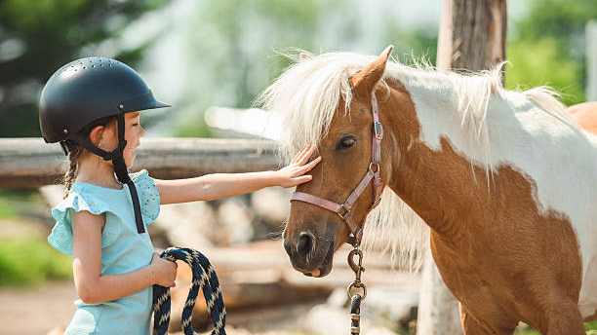

Slide 6
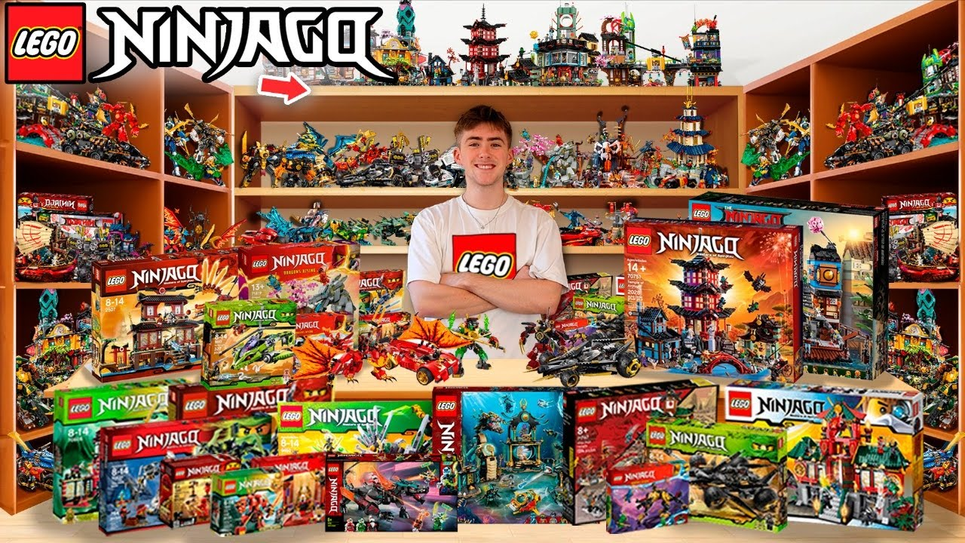

Slide 7
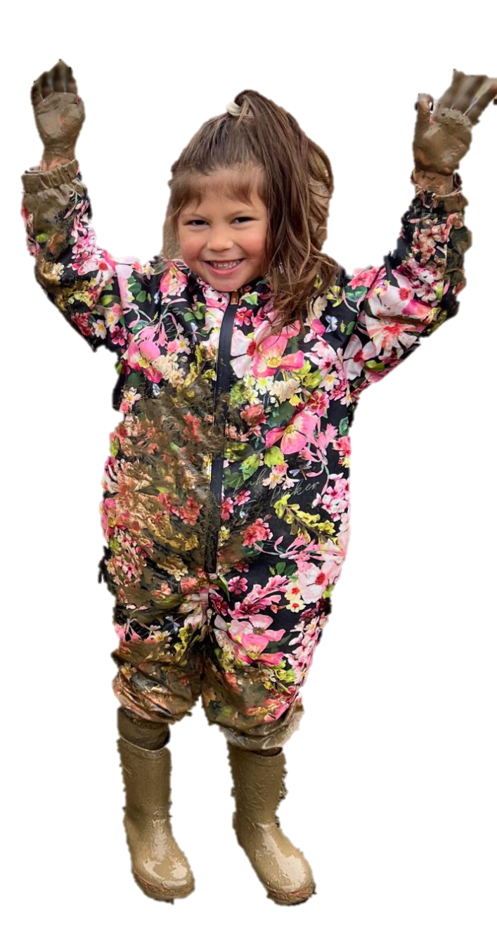
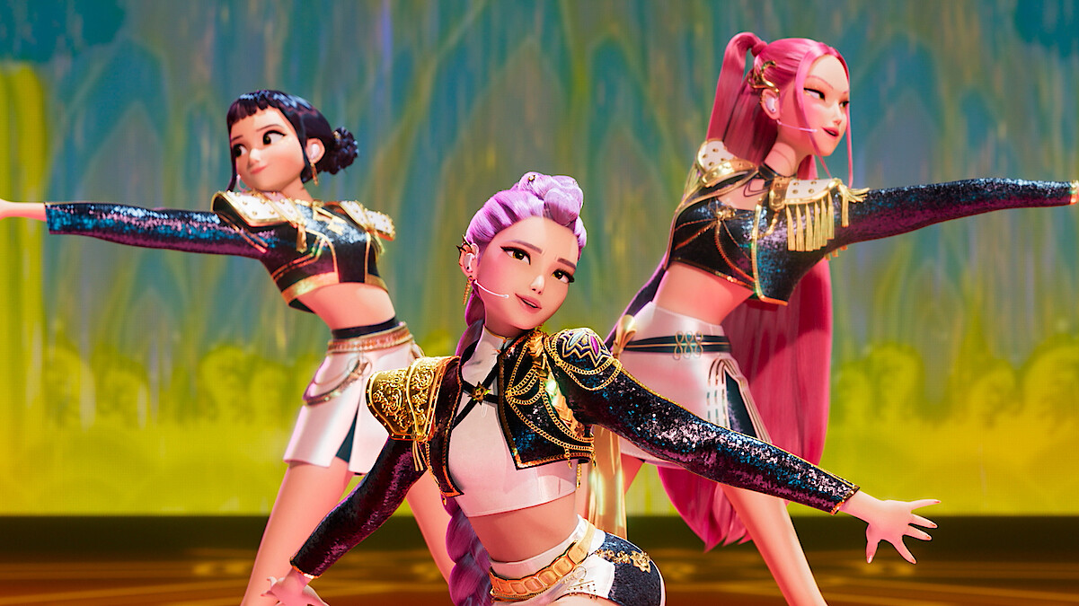
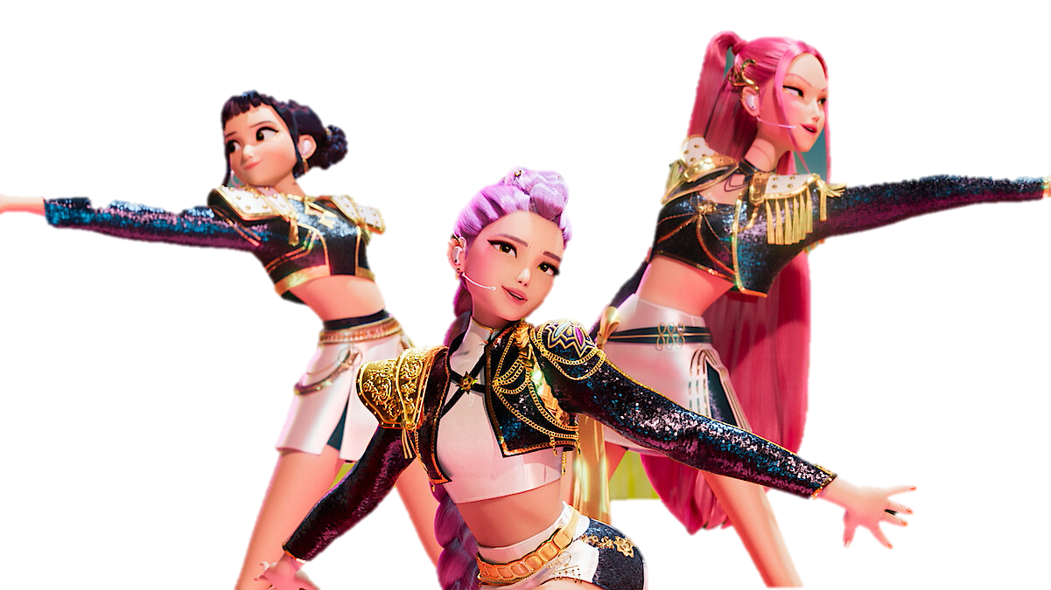

Slide 9


Slide 10
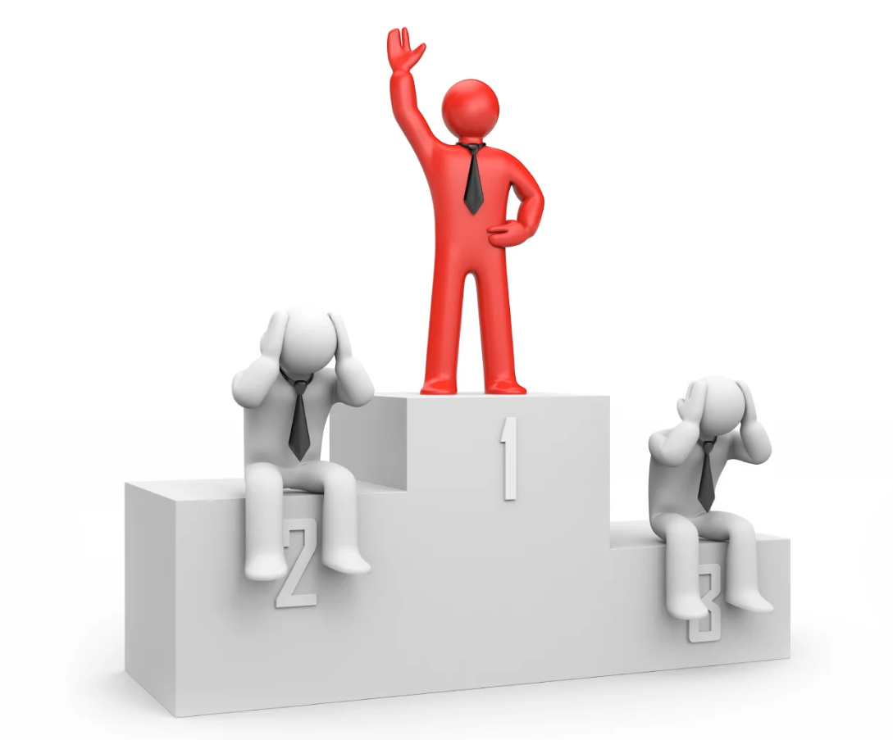
Popularity Contest
Notes:
Popularity Contest
I want to be best friends with the one who is best at football, or the most popular or the funniest

Slide 11
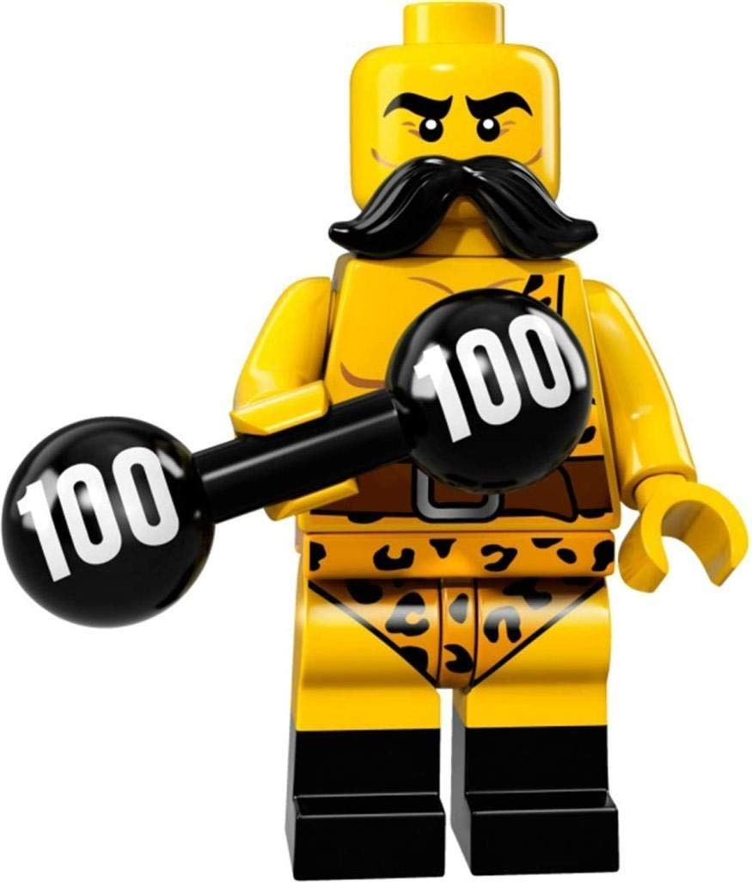
Strongest
Notes:
Bucket & weight

Slide 12
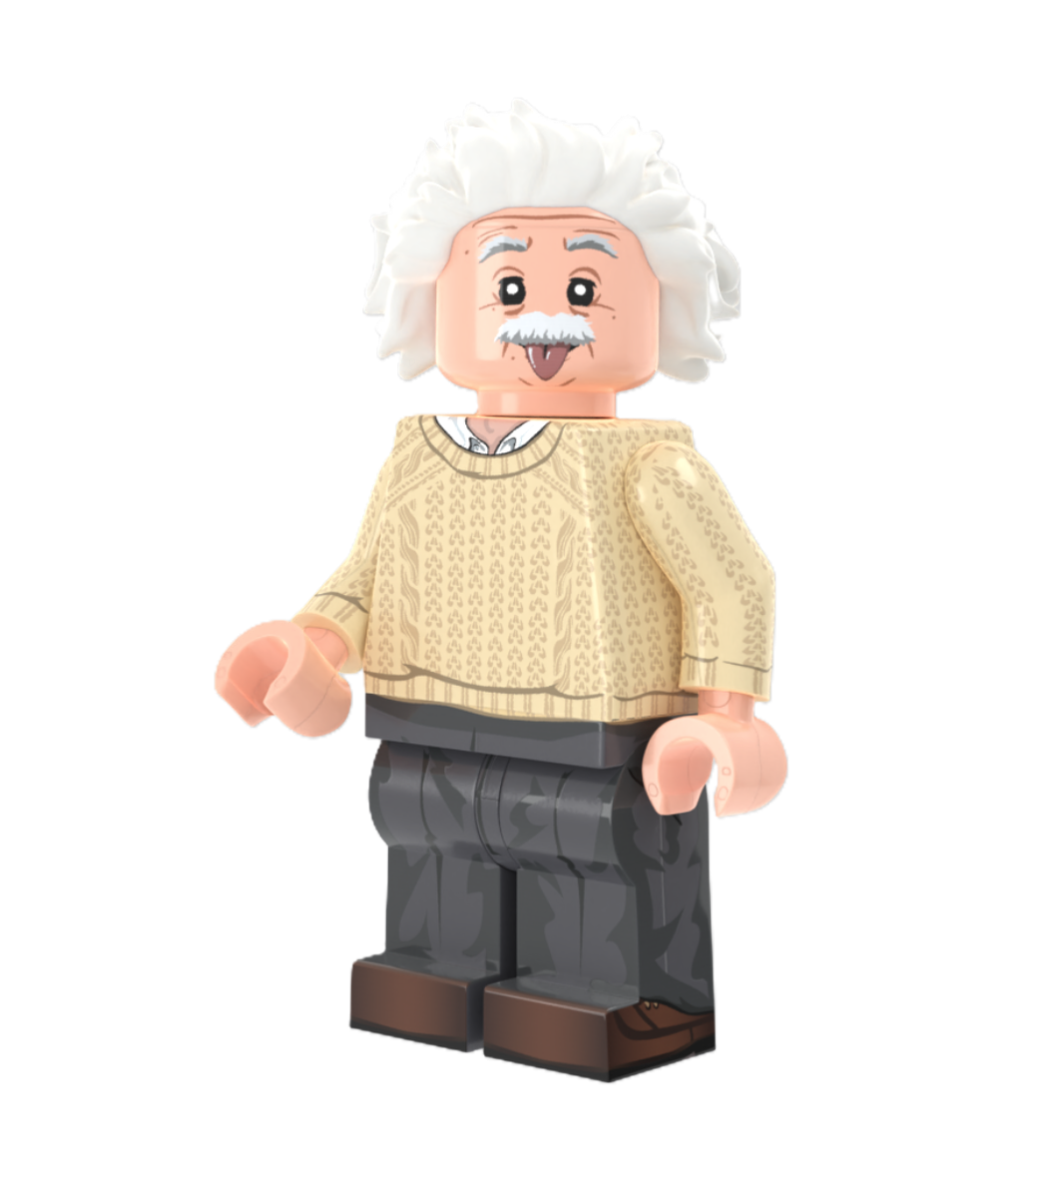
Cleverest

Slide 13
Contestant 1
Contestant 2

Slide 14
10 + 10 =
Contestant 1
Contestant 2

Slide 15
10 + 10 = 20
Contestant 1
Contestant 2

Slide 16
10 + 10 = 20
Contestant 1
Contestant 2
√751 =

Slide 17
10 + 10 = 20
Contestant 1
Contestant 2
√751 = 27.404379

Slide 18
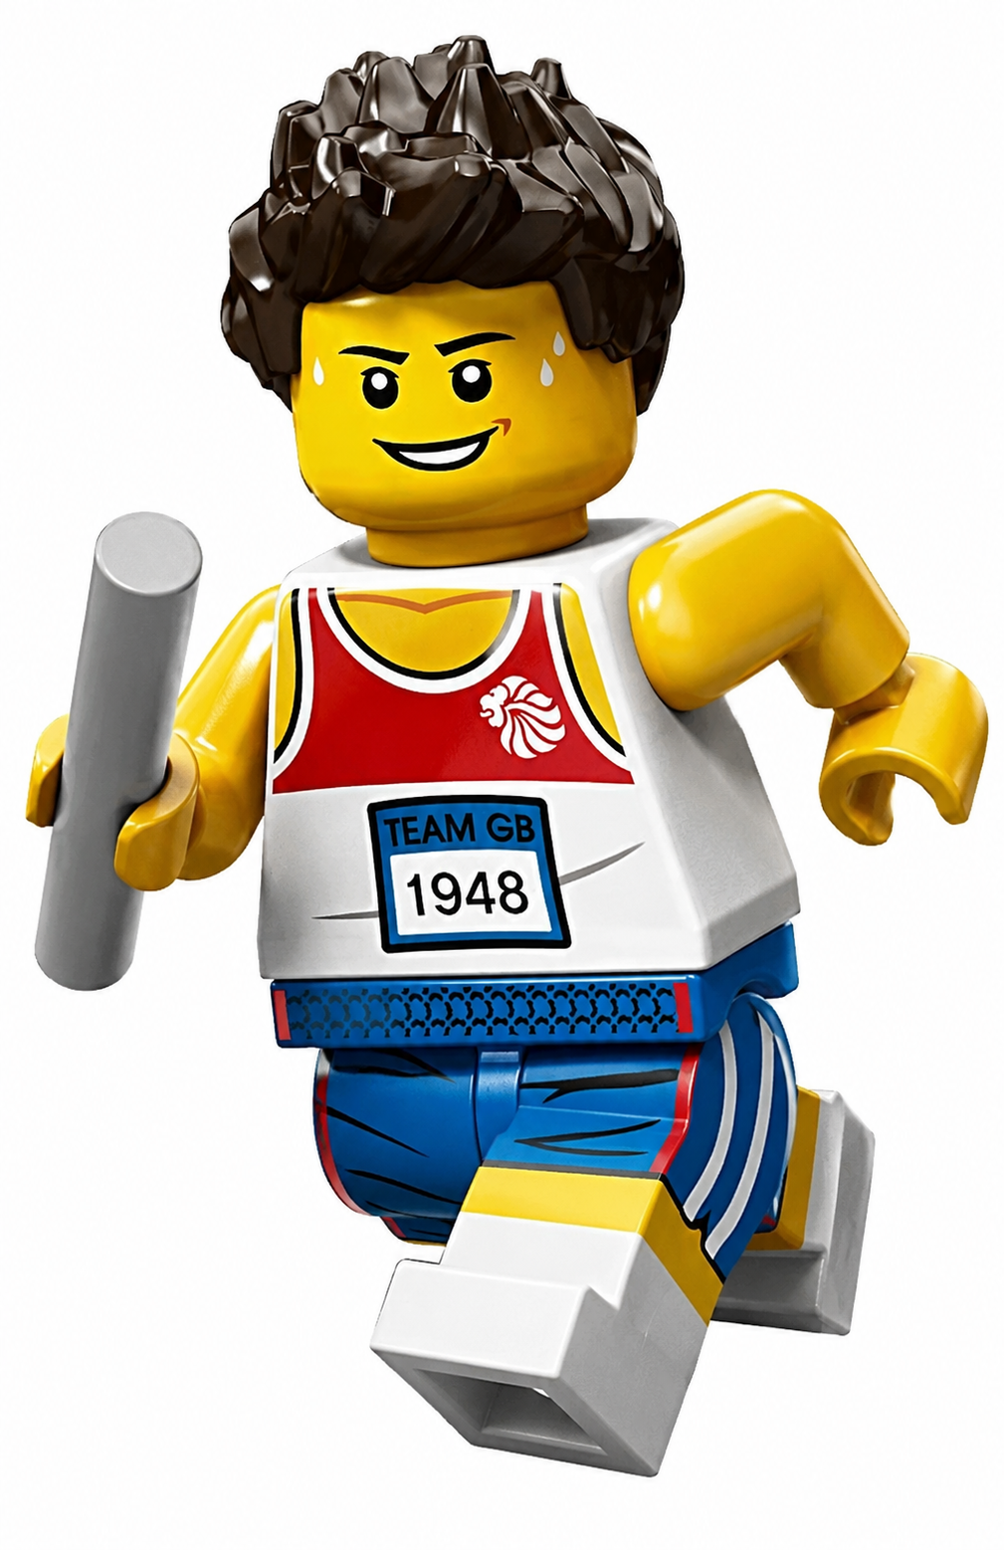
Fastest
Notes:
3 legged challenge vs child
Exercise band

Slide 19
To be a friend of Jesus I need…
Notes:
If this is what it takes to be a friend of a normal person – what if Jesus is even more demanding of those who want to be His friend!

Slide 20
To be a friend of Jesus I need…
To be Clever

Slide 21
To be a friend of Jesus I need…
To be Clever

Slide 22
To be a friend of Jesus I need…
To be Clever
To be Good

Slide 23
To be a friend of Jesus I need…
To be Clever
To be Good

Slide 24
To be a friend of Jesus I need…
To be Clever
To be Good
To be Funny

Slide 25
To be a friend of Jesus I need…
To be Clever
To be Good
To be Funny

Slide 26
To be a friend of Jesus I need…
To be Clever
To be Good
To be Funny
To be Attractive

Slide 27
To be a friend of Jesus I need…
To be Clever
To be Good
To be Funny
To be Attractive

Slide 28
To be a friend of Jesus I need…
To be Clever
To be Good
To be Funny
To be Attractive
To need Him

Slide 29
To be a friend of Jesus I need…
To be Clever
To be Good
To be Funny
To be Attractive
To need Him
Notes:
When do I need Him
When I’m sad, unwell, hopeless
When life is going well, healthy and happy
I need Him to make me right with God
I need Him because my sin has separated me from God – Only Jesus can reconnect – I need Him

Slide 30
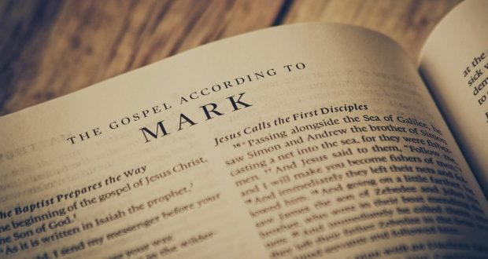
Notes:
Let’s turn to Mark to see what Jesus demands

Slide 31
The story so far…

Slide 32
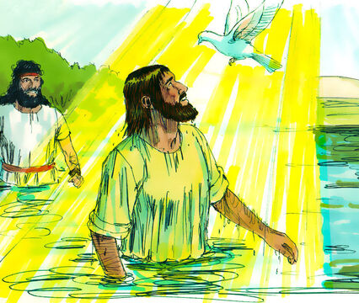

Slide 33
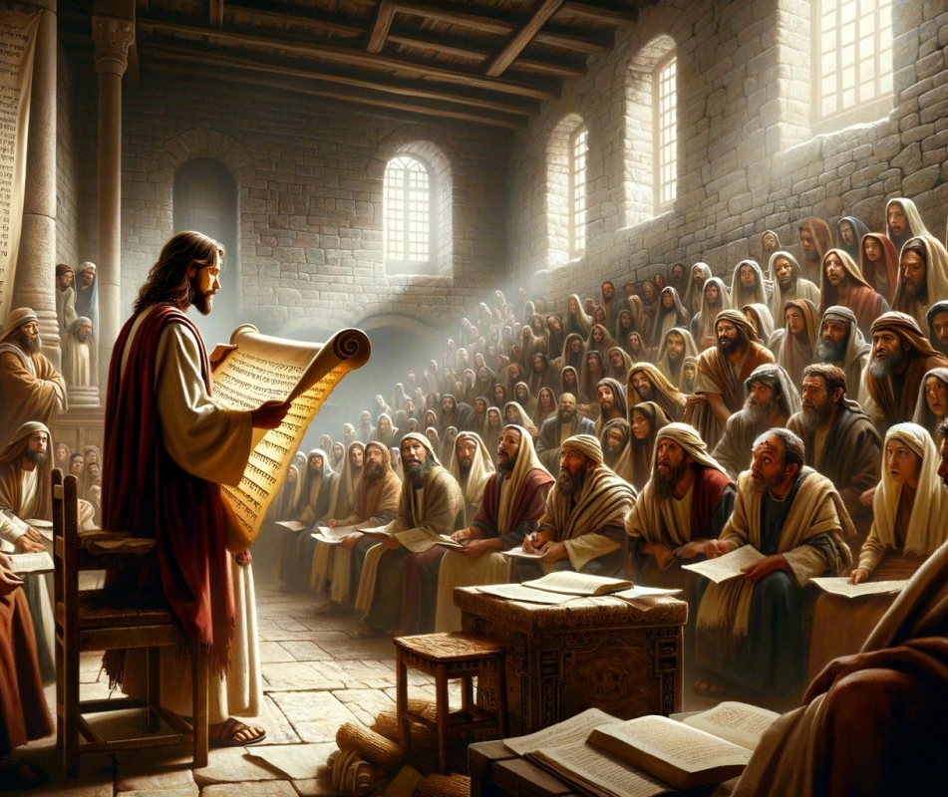

Slide 34
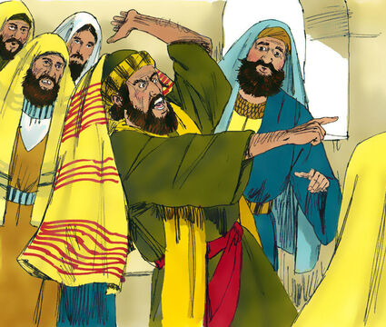

Slide 35
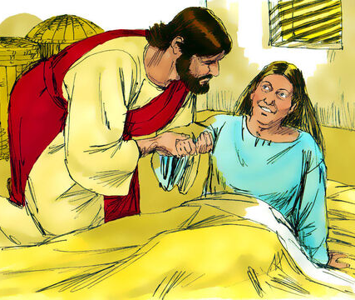

Slide 36
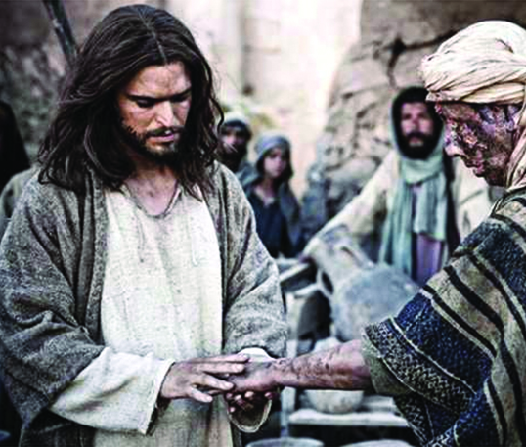

Slide 37
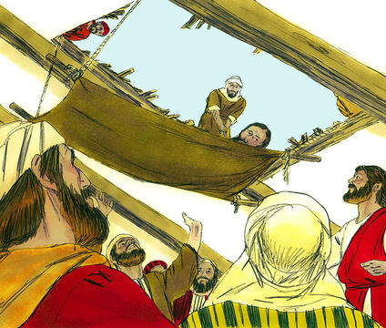

Slide 38
Story 1:
Dinner at Levi’s House

Slide 39
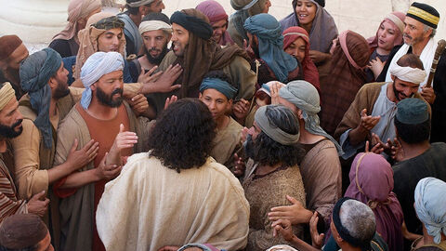
Notes:
Jesus has arrived on the scene and had a huge impact
Jesus is popular – always seems to have large crowds following him
He could hang out with anyone – even the most popular kids

Slide 40
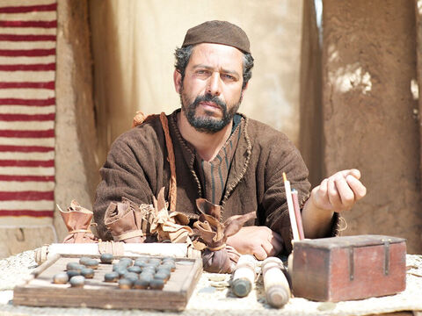

Slide 41
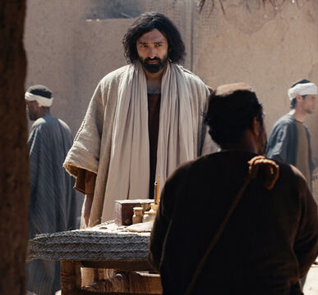

Slide 42
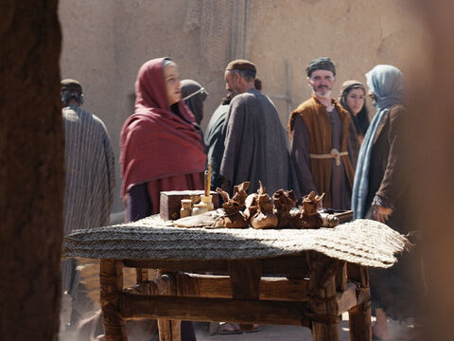
Notes:
The worst people = tax collectors and sinners
Jesus saw Levi was a tax collector
Jesus invited him to become his friend
Levi left his table and followed Jesus

Slide 43
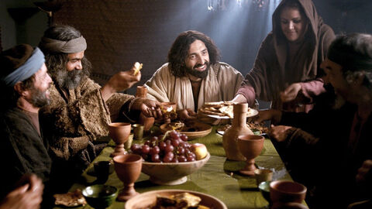
Notes:
felt comfortable to be with him
Ate with them = friendship

Slide 44
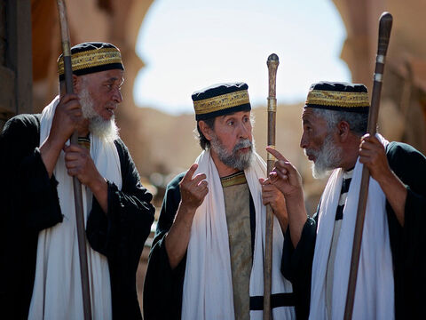
“Why does he eat with tax collectors and sinners?”
Notes:
Religious people didn’t like this – they thought they were more acceptable (they were better behaved, they had earned)
They would have preferred Levi was lonely and friendless

Slide 45
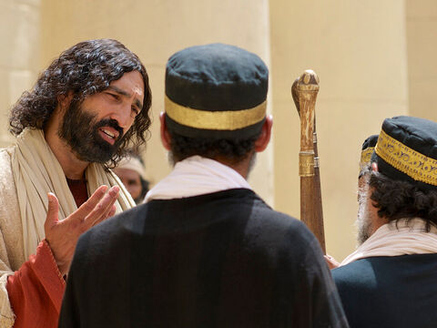
“It is not the healthy who need a doctor, but the sick. I have not come to call the righteous, but sinners.”
Notes:
I only came for those who realise they need me

Slide 46
To be a friend of Jesus I need…
To be Clever
To be Good
To be Funny
To be Attractive
To need Him
Notes:
The sick need a doctor

Slide 47
Story 2:
Picking Grain on the Sabbath

Slide 48
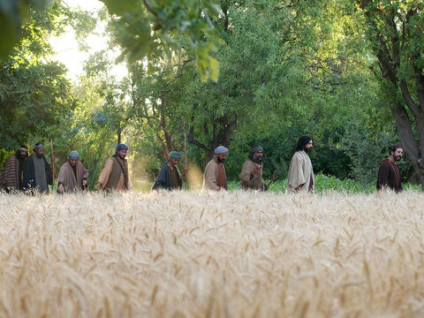
Notes:
Jesus was walking with his friends through a grain field

Slide 49
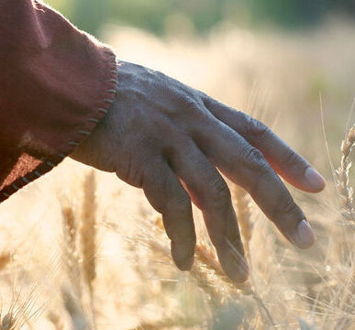
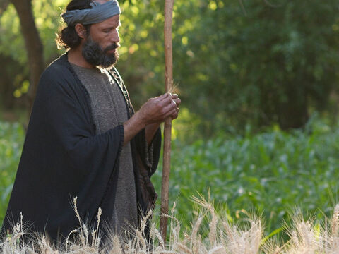
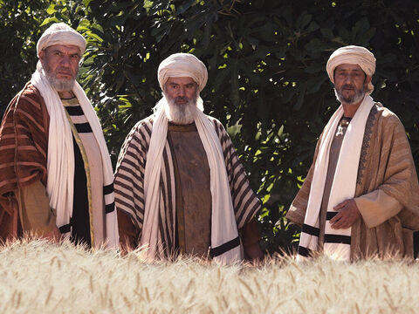
Notes:
During Jesus’ day there was one day of the week when you weren’t meant to work. It was called the Sabbath and it was a day of rest to help remember that God rested on the 7th day of creation.
This included not ‘even during the ploughing season and harvest you must rest." (Exodus 34:21)
Jesus disciples picked some grain
Religious people said they were ‘harvesting’

Slide 50
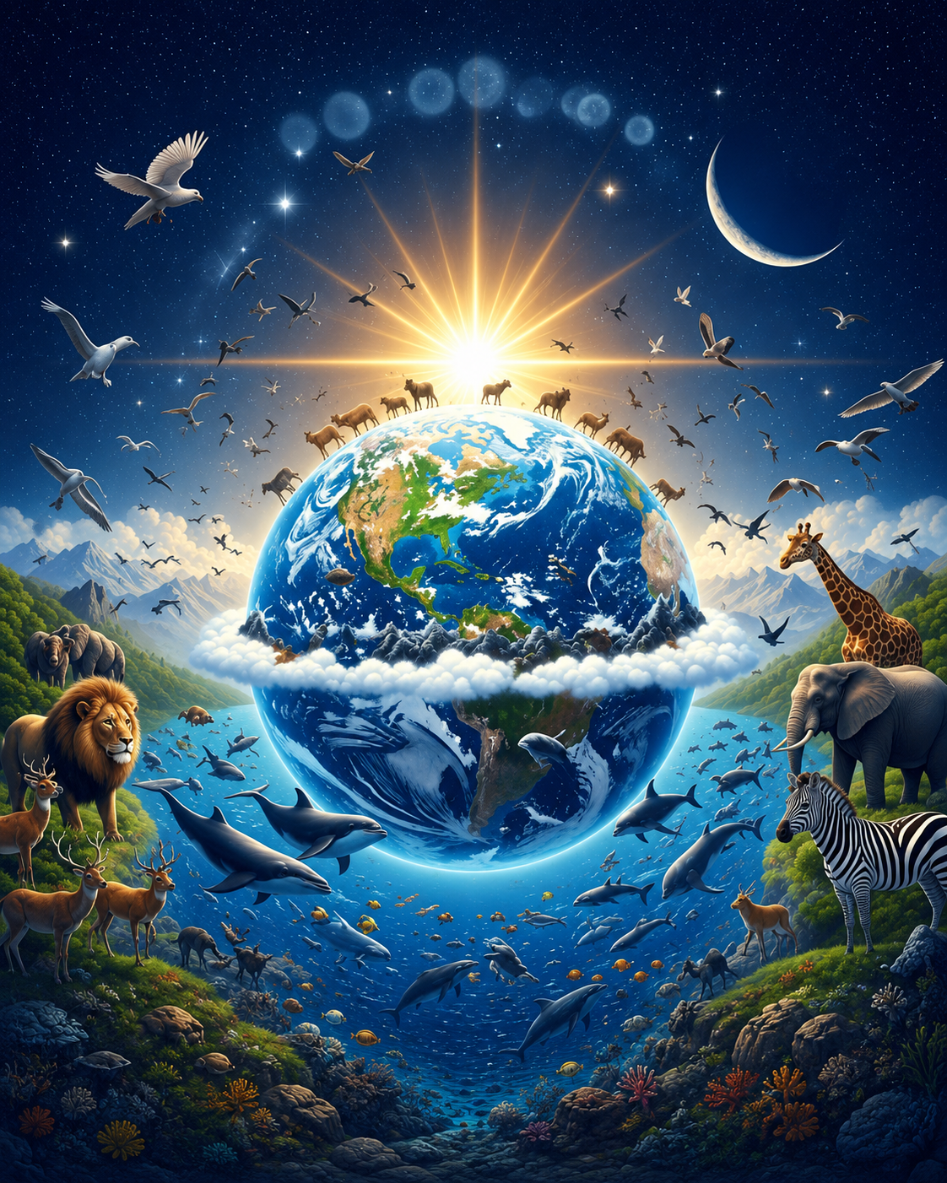
The Sabbath

Slide 51
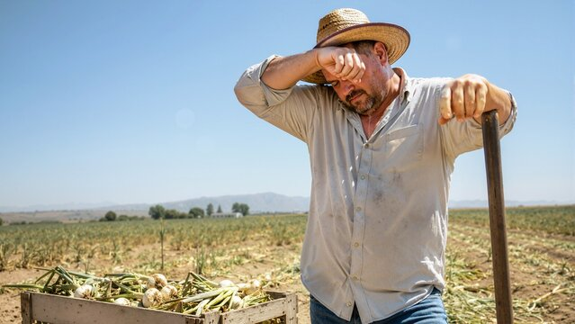
The Sabbath

Slide 52
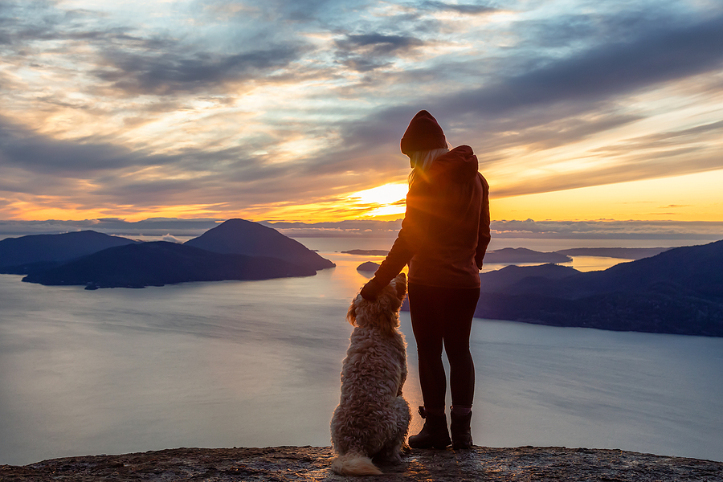
The Sabbath

Slide 53
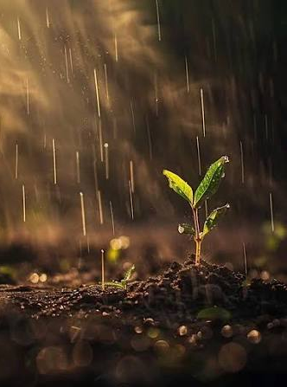
The Sabbath
Notes:
It was meant to be a good thing
Sabbath was intended to
God rested on 7th day
time to recuperate - not good for mind & body to constantly work
lift head out of work – to see there is a world outside work
to remember it is God who provides – how ever much you work, it is God who brings the increase
But Pharisees made this a burden – make added laws (claim disciples were harvesting) which isn’t about giving rest or celebrating who God is and has done – prefer disciples to remain hungry
Dawn – couldn’t kick a ball on a Sunday
Be careful when you add rules – what are you hoping to do…?

Slide 54
Story 3:
Healing man’s hand on the Sabbath

Slide 55
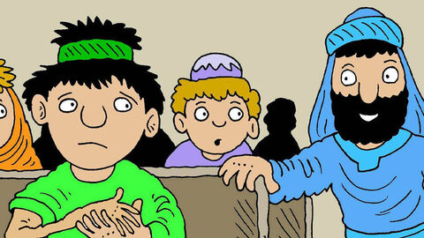
Notes:
Another time Jesus went into the synagogue, and a man with a shriveled hand was there.

Slide 56
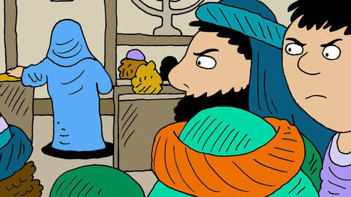
Notes:
Some of them were looking for a reason to accuse Jesus, so they watched him closely to see if he would heal him on the Sabbath.

Slide 57
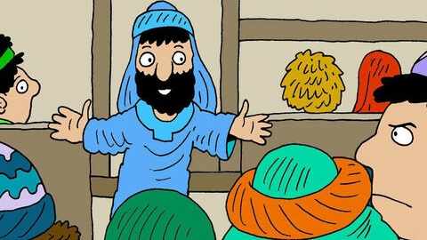
Notes:
³ Jesus said to the man with the shriveled hand, “Stand up in front of everyone.”
⁴ Then Jesus asked them, “Which is lawful on the Sabbath: to do good or to do evil, to save life or to kill?” But they remained silent.
⁵ He looked around at them in anger and, deeply distressed at their stubborn hearts, said to the man, “Stretch out your hand.”
Why do you think Jesus was angry at these religious people?

Slide 58
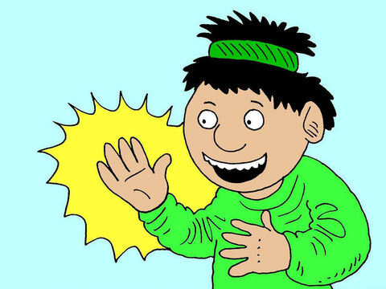
Notes:
He stretched it out, and his hand was completely restored.

Slide 59
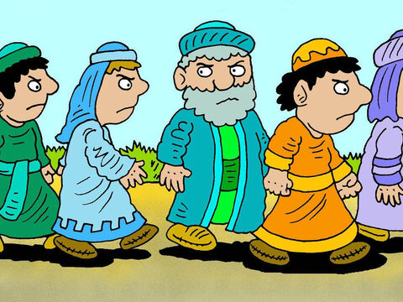
Notes:
⁶ Then the Pharisees went out and began to plot with the Herodians how they might kill Jesus.
What had Jesus done wrong for them to want to kill him?
All he had done was heal a man’s hand! They would prefer the guy to stay unhealed
And he had shown them, they weren’t good enough to get to God (no one was) – and they didn’t like that
But they missed the good news – that God had come to them, and He was standing right before their very eyes!

Slide 60
What is religion?
Notes:
Religion is about trying to make ourselves good enough for Jesus

Slide 61

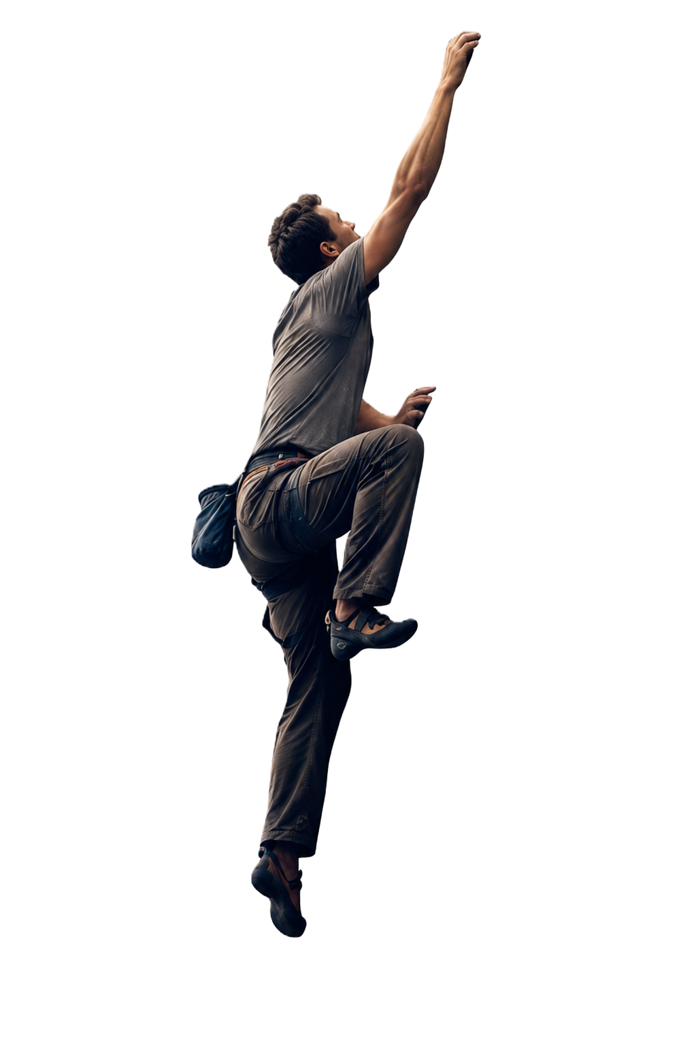
Religion is mankind trying to get to God
Notes:
Religion is mankind trying to get to God – the problem is we can never get to God, we can never make ourselves worthy of the goodness of God
Religion - do deeds to be accepted
Christianity - because accepted, do the deeds
religion says “do”; Jesus says “done”
Religion adds extra rules (like Sabbath) to try and get closer to God – but it will never be enough.
We need someone greater than us to rescue us – we need a doctor/saviour
Religious ppl think they don’t need a doctor/rescuer. They think they can make themselves good enough. Can climb the mountain

Slide 62
Religion is mankind trying to get to God
Notes:
Religion is mankind trying to get to God

Slide 63
Religion is mankind trying to get to God
Notes:
Religion is mankind trying to get to God

Slide 64
Religion is mankind trying to get to God
Notes:
Religion is mankind trying to get to God

Slide 65
Religion is mankind trying to get to God
Notes:
Religion is mankind trying to get to God

Slide 66
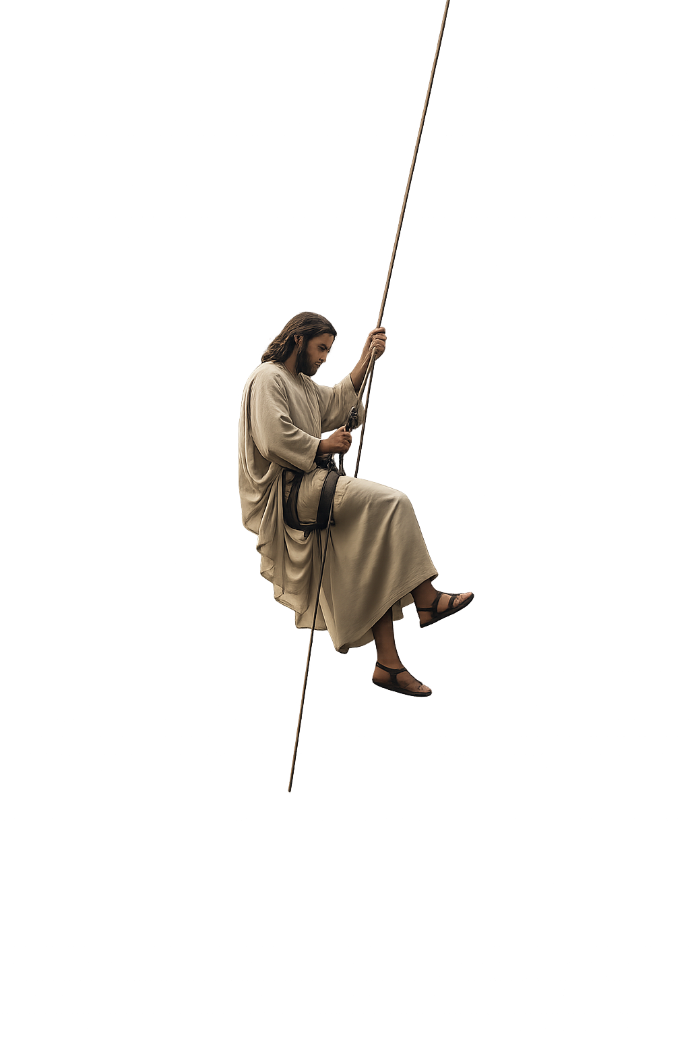
The Gospel is God coming to mankind
Notes:
The Gospel is God coming to mankind

Slide 67
The Gospel is God coming to mankind
Notes:
The Gospel is God coming to mankind

Slide 68
The Gospel is God coming to mankind
Notes:
The Gospel is God coming to mankind

Slide 69
The Gospel is God coming to mankind
Notes:
The Gospel is God coming to mankind

Slide 70
Notes:
On the 7th day God rested, not because he was tired but because he was finished and what he done was good
Religion can never rest because you are always trying to become God – but we can trust that JESUS has done it all

Slide 71
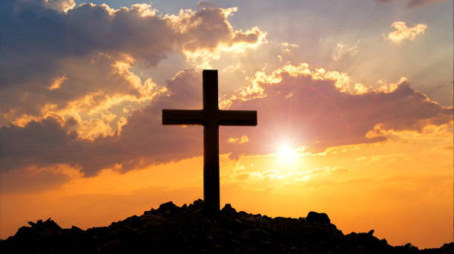
It is finished
Notes:
He completed the work – He has made us right with God
There is nothing He needs from us – we just need to need Him

Slide 72
To be a friend of Jesus I need…
To be Clever
To be Good
To be Funny
To be Attractive
To need Him
Notes:
The sick need a doctor

Slide 73
Why do we sometimes choose religion?
Notes:
Why do we sometimes choose religion?
We don’t trust that Jesus has done it all
It makes us feel good if we can say we have made ourselves good enough
We feel powerful if we think God ‘owes’ us
God, you have to accept me because I have
Read the bible
Gone to church meetings
Behaved well (I’m not a tax collector/sinner) – I’m better than other people
Cleaned my teeth

Slide 74
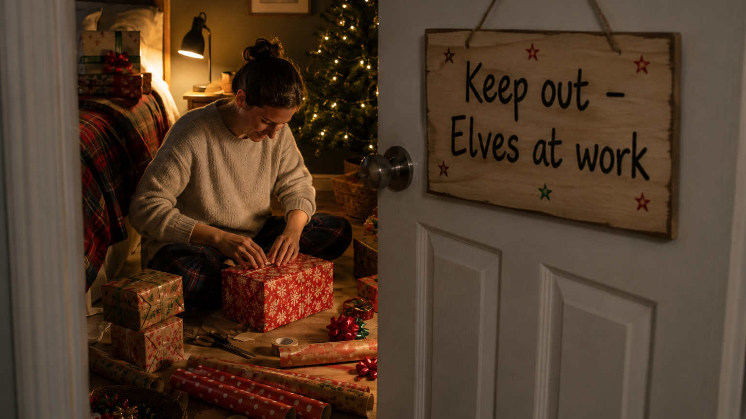

Slide 75
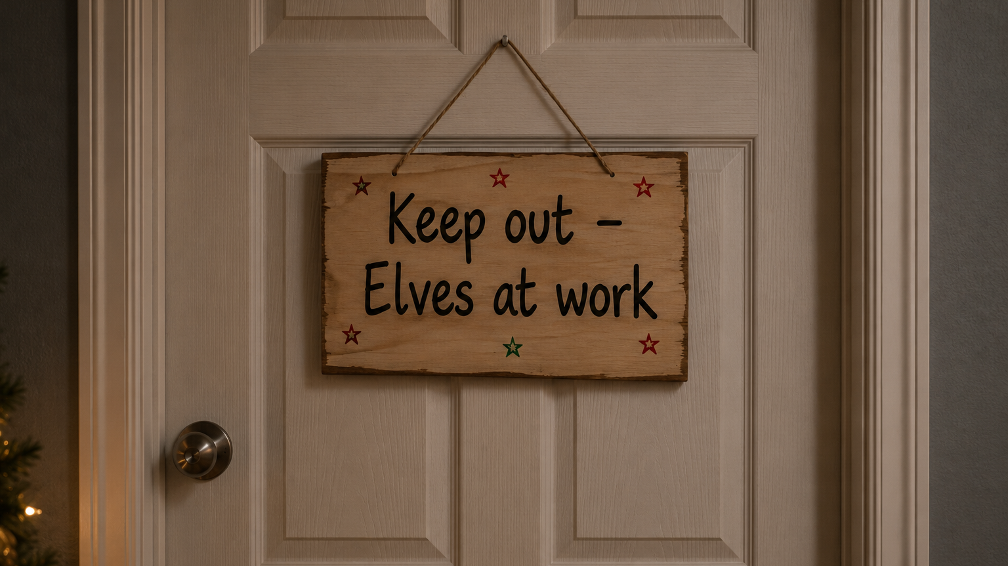

Slide 76
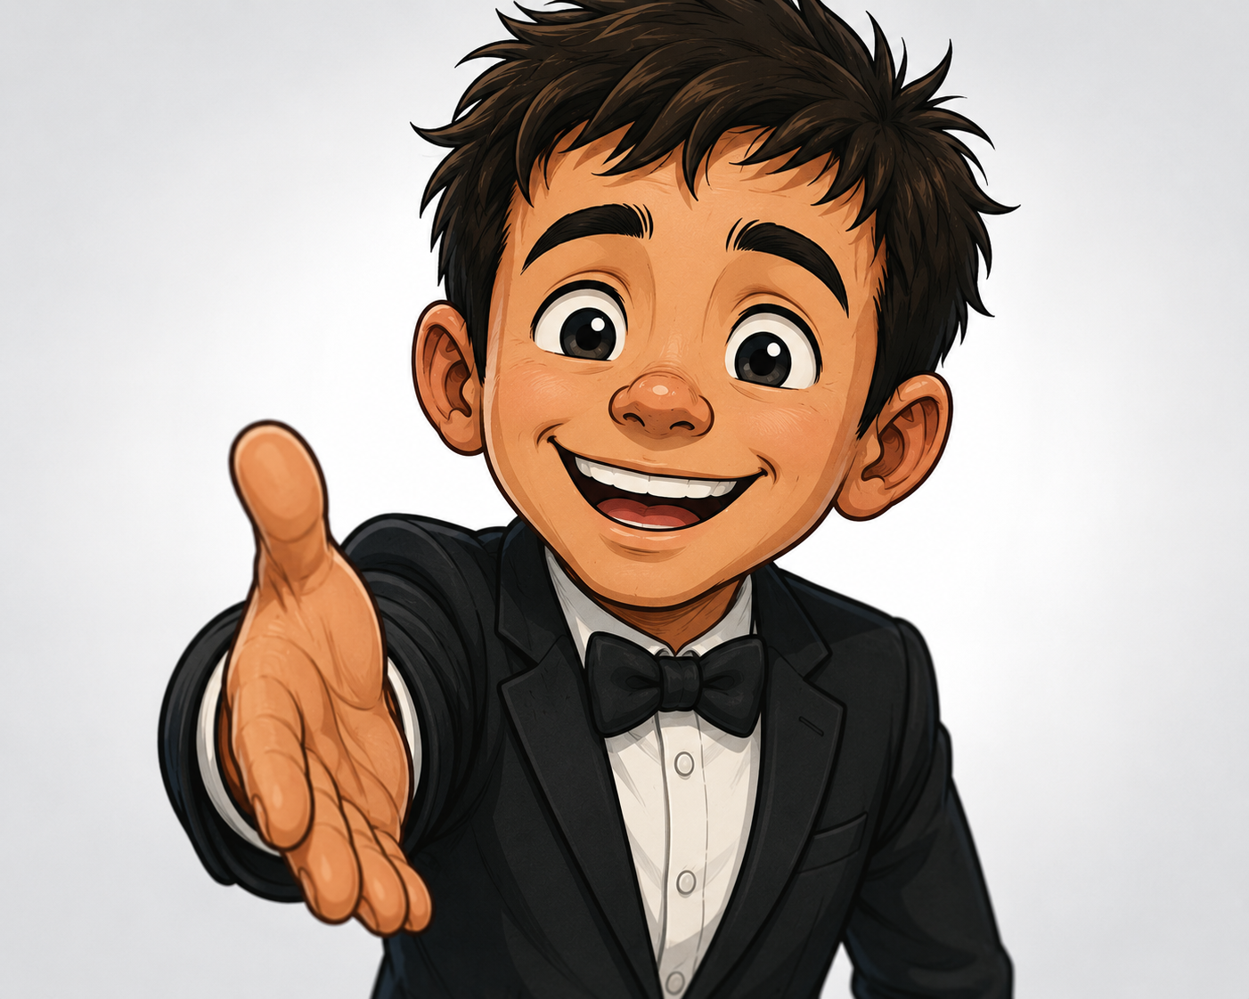
Notes:
Religion makes us want to dress up and look presentable so that God will accept us
When the truth is we are in a mess and in desperate need of Him

Slide 77
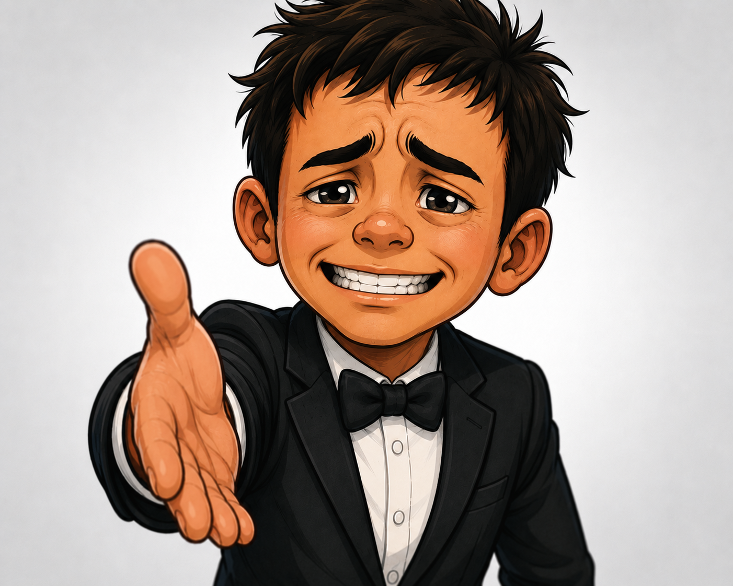

Slide 78
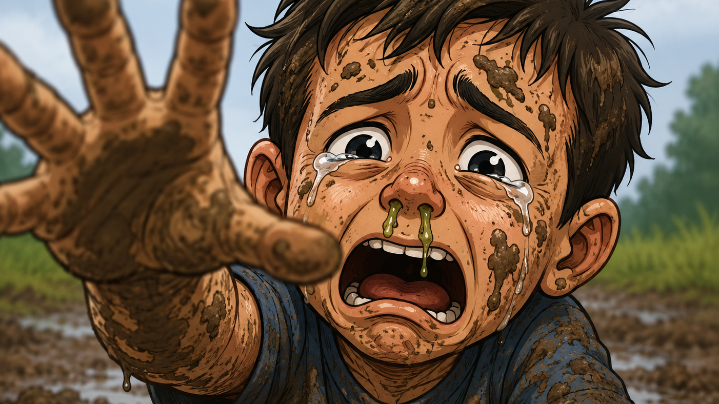
Notes:
This guy knows he is ‘sick’ and needs a ‘doctor’
We don’t have to present
We just need to need him

Slide 79
To be a friend of Jesus I need…
To be Clever
To be Good
To be Funny
To be Attractive
To need Him

Slide 80
God demonstrates his own love for us in this: While we were still sinners, Christ died for us.
Rom 5:8
Notes:
The only thing I brought to my salvation with the sin I needed to be saved from
The only thing I brought to the fire brigade was the fire I started
The only thing I brought to the doctor was the broken arm

Slide 81
Jesus has chosen you as a friend…
Notes:
Jesus has chosen you as a friend
Will you choose Him to be yours?

Slide 82
Jesus has chosen you as a friend…
Will you choose Him to be yours?
Notes:
Jesus has chosen you as a friend
Will you choose Him to be yours?

