Slide 1
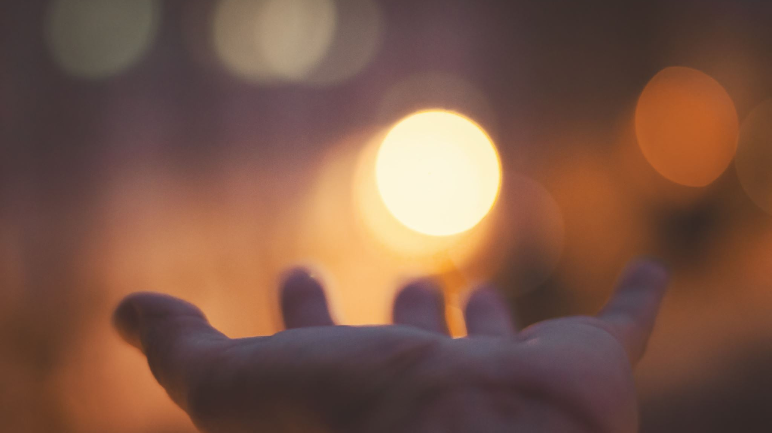
Light and darkness, sight and the Kingdom
Notes:
It's time to exercise our faith
it's time to draw close
lectio 365
Bible in one year
useful tools for drawing closer to God
thinking about light and darkness as I've read these things and basically listened to these things

Slide 2
John 5:19-20
¹⁹ “Very truly I tell you, the Son can do nothing by himself; he can do only what he sees his Father doing, because whatever the Father does the Son also does.
²⁰ For the Father loves the Son and shows him all he does. Yes, and he will show him even greater works than these, so that you will be amazed.
“How do we know what to pray?”
“How can we know what God wants?”
“Why does nothing happen when I pray?”
Notes:
Time to accelerate
I was listening to the Bible in one year on my way to work and this was a thing that Nicky Gumbel was talking about it being time to accelerate. I started getting excited. God was speaking to me. It’s time to leave the slow lane. We are entering into a new phase..
I was driving along, I reached about 10 minutes from school when the traffic stopped. I waited for 15 mins, but the only way I could get through, was to turn about and go back the way I had come. as soon as the word accelerate into my head the world around me stopped. sometimes our prayers can be a bit like that,

Slide 3

We need to have our eyes checked
Matthew 6
²² “The eye is the lamp of the body. If your eyes are healthy, your whole body will be full of light. ²³ But if your eyes are unhealthy, your whole body will be full of darkness. If then the light within you is darkness, how great is that darkness!
Proverbs 27:20
Death and Destruction are never satisfied, and neither are human eyes.
Notes:
How eyes are so powerful as an organ statistically we receive far more information about the world around us from our eyes than any other sense
Approximately 80% to 85% of our perception, learning, cognition, and activities are mediated through vision. It is considered the dominant human sense, with roughly half of our neural tissue involved in processing visual information.
this means that our eyes are particularly susceptible to being distracted and tempted so we need to look for ways to keep our eyes under control proverbs 2720 tells us that death and destruction are never satisfied and neither the humanise our eyes are hungry doom scrolling on the Internet the young man looking at **** these are things that arouse hunger and we push in to get more

Slide 4

Try these:-

Slide 5


Café wall illusion

Slide 6


Slide 7
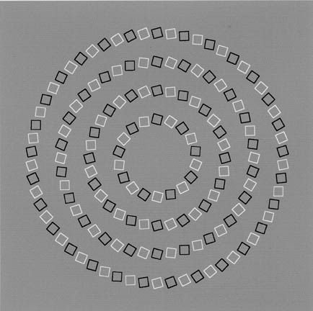

Slide 8
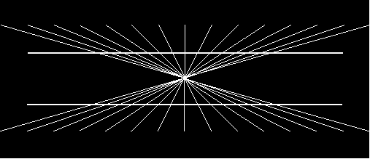
Notes:
Although our eyes are very good at seeing things that can be distracted by the surroundings

Slide 9
How healthy are my spiritual eyes?
How quick am I to recognise what God has done?
Ps 118
²² The stone the builders rejected has become the cornerstone;
²³ the Lord has done this, and it is marvellous in our eyes.

Slide 10
John 1
1 In the beginning was the Word, and the Word was with God, and the Word was God. ² He was with God in the beginning. ³ Through him all things were made; without him nothing was made that has been made. ⁴ In him was life, and that life was the light of all mankind. ⁵ The light shines in the darkness, and the darkness has not overcome* it.
⁶ There was a man sent from God whose name was John. ⁷ He came as a witness to testify concerning that light, so that through him all might believe. ⁸ He himself was not the light; he came only as a witness to the light.
⁹ The true light that gives light to everyone was coming into the world.
* (or understood it)

Slide 11
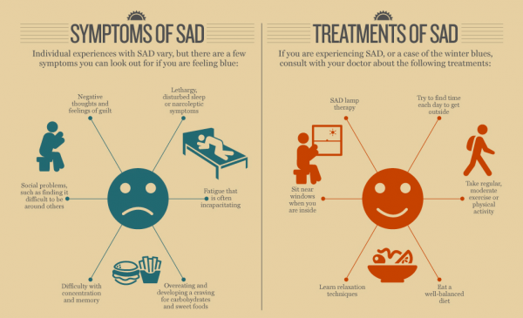
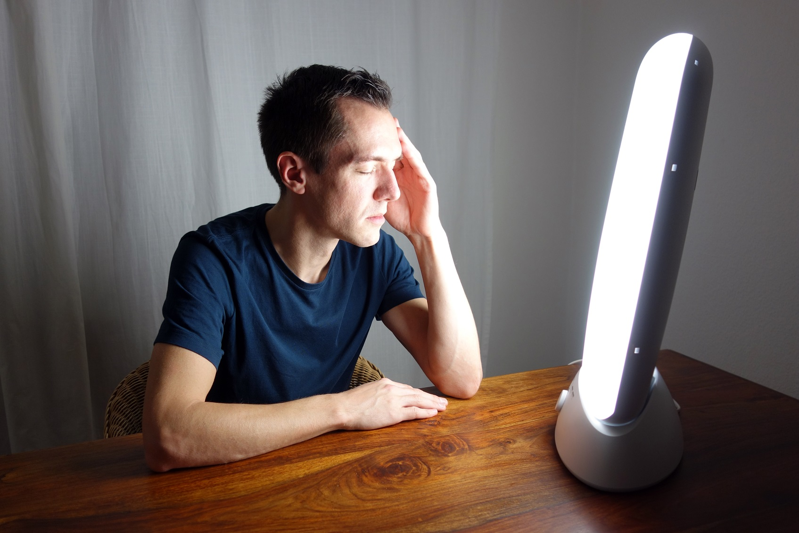
We are wired for light
A seasonal lack of light has real impact on us in the natural.
So how much more does a lack of spiritual light affect us?
The solution can be found in light!
Notes:
the eyes are powerful sense but they are easily distracted
it said the seasonal lack of light can have a real impact on us not just making us feel bit sad but actually bringing depression and this can have an impact on this in the light
the solution to this problem lies in the use of special lights in the natural

Slide 12
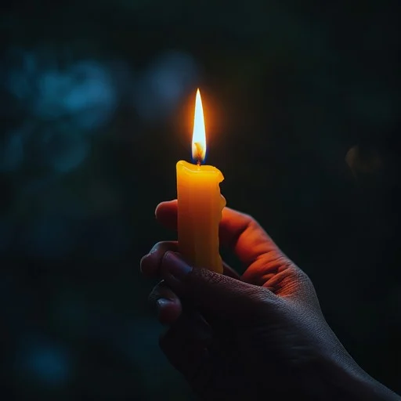
The true light has come into the world
Jesus is the light by which we can see everything else
Nothing makes sense without Him
Our world has many distractions – there can be false lights
Col 3:17… the reality, however, is found in Christ.
The light is greater than the darkness no matter how dark it seems
“All the darkness in the world cannot put out a single candle” St Frances of Assisi
The darkness does not understand the way of the Light.
(this gives us the advantage in the battle!)

Slide 13
How can we get more light in the Spirit?
John 8 ¹² Again Jesus spoke to them, saying,
“I am the light of the world.
Whoever follows me will not walk in darkness but will have the light of life.”
Following Him
  His ways
  His presence
  His word
  His people

Slide 14
His ways
Teach me your way*, LORD, that I may rely on your faithfulness; give me an undivided heart, that I may fear your name. Ps 86:11
Jesus answered, “I am the way and the truth and the life. No one comes to the Father except through me. John 14: 6
*Way – (derek)
  1. a road (as trodden)
  2. (figuratively) a course of life or mode of action or way of being

Slide 15
His presence
Ps 16 ¹¹ You make known to me the path of life;
you will fill me with joy in your presence,
with eternal pleasures at your right hand.

Slide 16
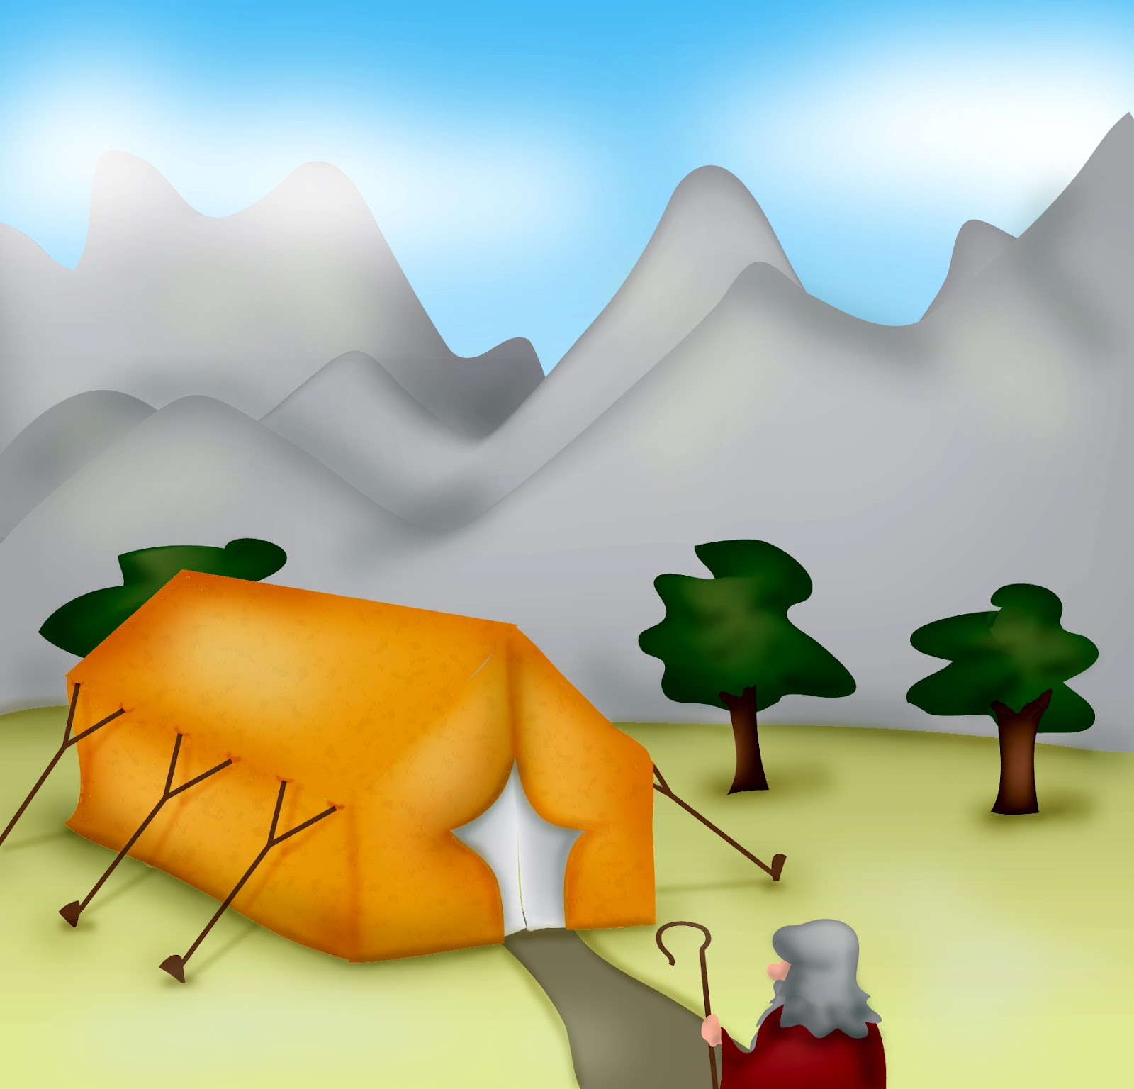
Exodus 33
⁷ Now Moses used to take a tent and pitch it outside the camp some distance away, calling it the “tent of meeting.” …⁸ And whenever Moses went out to the tent, all the people rose and stood at the entrances to their tents, watching Moses until he entered the tent. …¹⁰ Whenever the people saw the pillar of cloud standing at the entrance to the tent, they all stood and worshiped, each at the entrance to their tent.
¹¹ The Lord would speak to Moses face to face, as one speaks to a friend. Then Moses would return to the camp, but his young aide Joshua son of Nun did not leave the tent.
Notes:
Despite his weakness, Moses had a special relationship with God
He met him in the wilderness in a burning bush
And he continued to meet with him in the wilderness in the tent of the meeting
So keen was he not to lose it, he constructed the tabernacle
Meeting with God has to become part of our daily routine.
The psalmist longs for the presence of God – Ps 63. 1 You, God, are my God, earnestly I seek you; I thirst for you, my whole being longs for you, in a dry and parched land where there is no water.
Joshua never left the tent! Be hungry for God

Slide 17
His Presence is essential
Exodus 33
¹⁵ Then Moses said to him, “If your Presence does not go with us, do not send us up from here. ¹⁶ How will anyone know that you are pleased with me and with your people unless you go with us? What else will distinguish me and your people from all the other people on the face of the earth?”
¹⁷ And the Lord said to Moses, “I will do the very thing you have asked, because I am pleased with you and I know you by name.”
Notes:
Moses is at the point of entering into the land of promise.
Despite the weakness of the people God is moving them on, but Moses sees it is more than provision. It is more that being free of Egypt.
The presence of God is a must
For us we stand at the end of a major change; we are entering into a new phase together. But as Moses says here, unless your presence goes with us send us up not from here

Slide 18
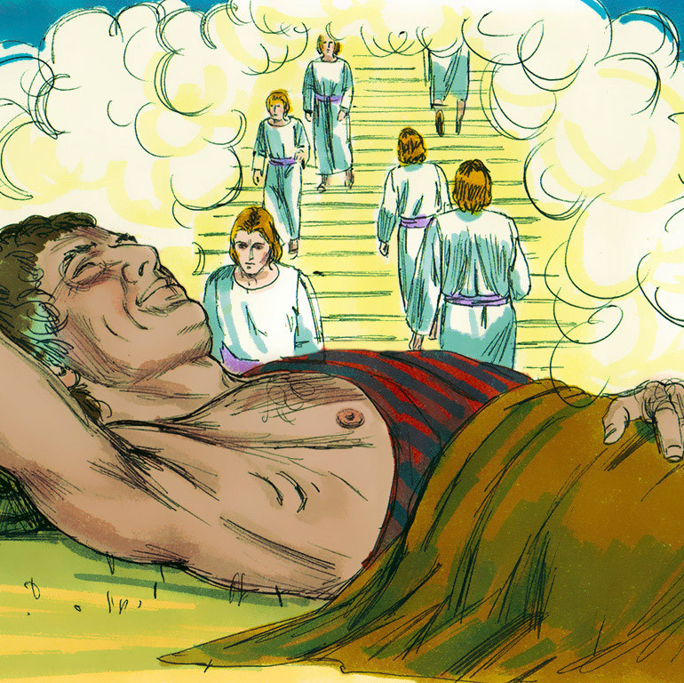
God is where we least expect Him
On the run from Esau, after deceiving his father into giving him the blessing of his brother, Jacob dreams about a stairway that links heaven and earth.
Gen 28 16 ‘Surely the Lord is in this place, and I was not aware of it.’
Notes:
Quite a mess, but god blessed him with a dream that was to change his perspective. How many things do we do in our lives because we don’t really believe that God is in this place?
Chapel experience.

Slide 19
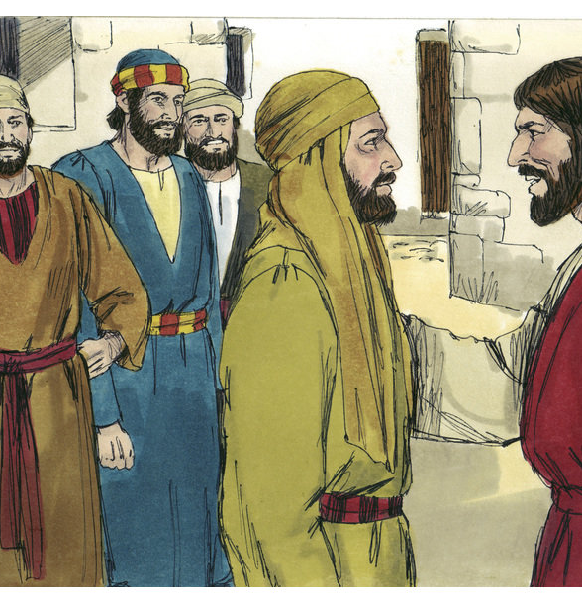
God sees you
John 1 ⁴⁷ When Jesus saw Nathanael approaching, he said of him, ‘Here truly is an Israelite in whom there is no deceit.’
⁴⁸ ‘How do you know me?’ Nathanael asked.
Jesus answered, ‘I saw you while you were still under the fig-tree before Philip called you.’
⁴⁹ Then Nathanael declared, ‘Rabbi, you are the Son of God; you are the king of Israel.’

Slide 20
God sees you
Gen 16 ⁷ The angel of the Lord found Hagar near a spring in the desert; it was the spring that is beside the road to Shur. ⁸ And he said,
‘Hagar, slave of Sarai, where have you come from, and where are you going?’
¹³ She gave this name to the Lord who spoke to her: ‘You are the God who sees me,’ for she said, ‘I have now seen^{[c]} the One who sees me.’
Notes:
16 Now Sarai, Abram’s wife, had borne him no children. But she had an Egyptian slave named Hagar; ² so she said to Abram, ‘The Lord has kept me from having children. Go, sleep with my slave; perhaps I can build a family through her.’
Abram agreed to what Sarai said. ³ So after Abram had been living in Canaan ten years, Sarai his wife took her Egyptian slave Hagar and gave her to her husband to be his wife. ⁴ He slept with Hagar, and she conceived.
When she knew she was pregnant, she began to despise her mistress. ⁵ Then Sarai said to Abram, ‘You are responsible for the wrong I am suffering. I put my slave in your arms, and now that she knows she is pregnant, she despises me. May the Lord judge between you and me.’
⁶ ‘Your slave is in your hands,’ Abram said. ‘Do with her whatever you think best.’ Then Sarai ill-treated Hagar; so she fled from her.
⁷ The angel of the Lord found Hagar near a spring in the desert; it was the spring that is beside the road to Shur. ⁸ And he said, ‘Hagar, slave of Sarai, where have you come from, and where are you going?’
‘I’m running away from my mistress Sarai,’ she answered.
⁹ Then the angel of the Lord told her, ‘Go back to your mistress and submit to her.’ ¹⁰ The angel added, ‘I will increase your descendants so much that they will be too numerous to count.’
¹¹ The angel of the Lord also said to her:
‘You are now pregnant
and you will give birth to a son.
You shall name him Ishmael,^{[a]}
for the Lord has heard of your misery.
¹² He will be a wild donkey of a man;
his hand will be against everyone
and everyone’s hand against him,
and he will live in hostility
towards^{[b]} all his brothers.’
¹³ She gave this name to the Lord who spoke to her: ‘You are the God who sees me,’ for she said, ‘I have now seen^{[c]} the One who sees me.’ ¹⁴ That is why the well was called Beer Lahai Roi;^{[d]} it is still there, between Kadesh and Bered.
¹⁵ So Hagar bore Abram a son, and Abram gave the name Ishmael to the son she had borne. ¹⁶ Abram was eighty-six years old when Hagar bore him Ishmael.

Slide 21
God sees you
Whether you are on the run from mistakes
Or resting in the shade of a tree
Trying to escape from others
Or spending time with friends
God sees you, knows you and longs for you to connect with Him
Notes:
“The Hiding Place.”
“Often I have heard people say, 'How good God is! We prayed that it would not rain for our church picnic, and look at the lovely weather!' Yes, God is good when He sends good weather. But God was also good when He allowed my sister, Betsie, to starve to death before my eyes in a German concentration camp.
I remember one occasion when I was very discouraged there.
Everything around us was dark, and there was darkness in my heart. I remember telling Betsie that I thought God had forgotten us. 'No, Corrie,' said Betsie, 'He has not forgotten us. Remember His Word: For as the heavens are high above the earth, so great is His steadfast love toward those who fear Him.'” Corrie concludes, "There is an ocean of God's love available--there is plenty for everyone. May God grant you never to doubt that victorious love--whatever the circumstances.“
How often do we think of God as capricious? He seems to answer some prayers and ignore others. We see evidence of His loving concern for us one moment and then wonder if he has forgotten us the next.
The truth is he has promised to never forsake us, he is right along side us all the time.

Slide 22
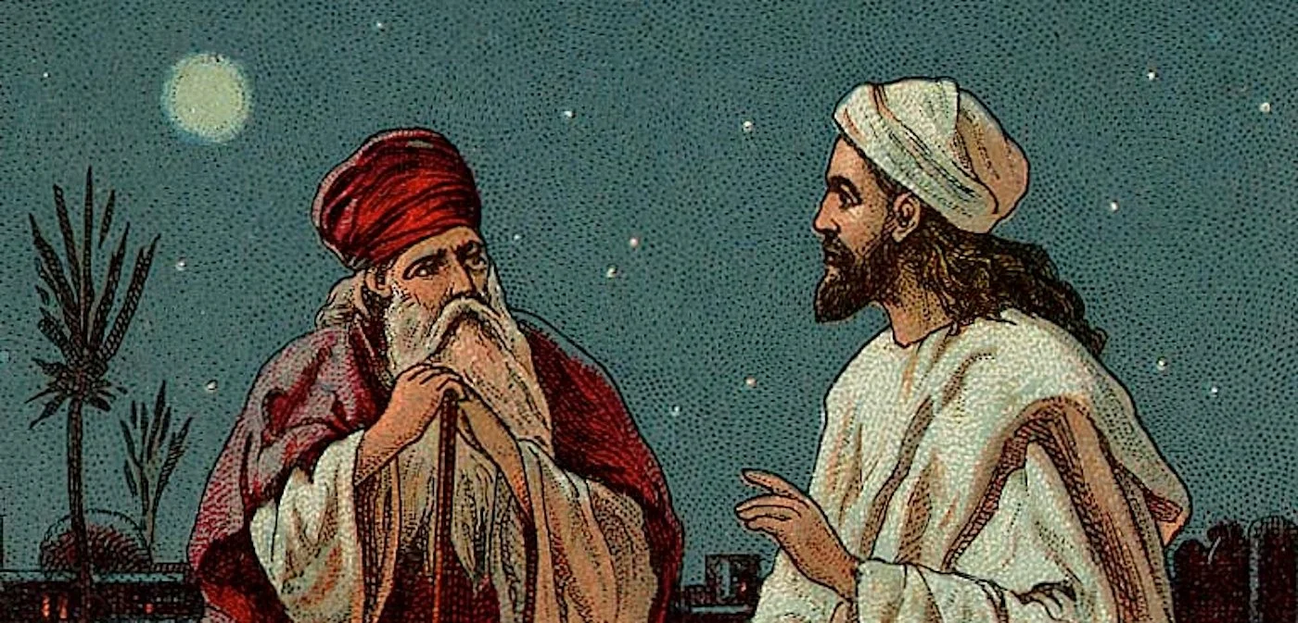
John 3
³ Jesus replied, ‘Very truly I tell you, no one can see the kingdom of God unless they are born again.*’
⁴ ‘How can someone be born when they are old?’ Nicodemus asked. ‘Surely they cannot enter a second time into their mother’s womb to be born!’
* or born from above
Notes:
3 Now there was a Pharisee, a man named Nicodemus who was a member of the Jewish ruling council. ² He came to Jesus at night and said, ‘Rabbi, we know that you are a teacher who has come from God. For no one could perform the signs you are doing if God were not with him.’
³ Jesus replied, ‘Very truly I tell you, no one can see the kingdom of God unless they are born again.^{[a]}’
⁴ ‘How can someone be born when they are old?’ Nicodemus asked. ‘Surely they cannot enter a second time into their mother’s womb to be born!’

Slide 23
John 3
⁶ Flesh gives birth to flesh, but the Spirit^{[b]} gives birth to spirit.
⁷ You should not be surprised at my saying, “You^{[c]} must be born again.”
Notes:
⁵ Jesus answered, ‘Very truly I tell you, no one can enter the kingdom of God unless they are born of water and the Spirit. ⁶ Flesh gives birth to flesh, but the Spirit^{[b]} gives birth to spirit. ⁷ You should not be surprised at my saying, “You^{[c]} must be born again.” ⁸ The wind blows wherever it pleases. You hear its sound, but you cannot tell where it comes from or where it is going. So it is with everyone born of the Spirit.’^{[d]}
⁹ ‘How can this be?’ Nicodemus asked.
¹⁰ ‘You are Israel’s teacher,’ said Jesus, ‘and do you not understand these things? ¹¹ Very truly I tell you, we speak of what we know, and we testify to what we have seen, but still you people do not accept our testimony. ¹² I have spoken to you of earthly things and you do not believe; how then will you believe if I speak of heavenly things? ¹³ No one has ever gone into heaven except the one who came from heaven – the Son of Man.^{[e]} ¹⁴ Just as Moses lifted up the snake in the wilderness, so the Son of Man must be lifted up,^{[f]} ¹⁵ that everyone who believes may have eternal life in him.’^{[g]}

Slide 24
John 3
¹⁶ For God so loved the world that he gave his one and only Son, that whoever believes in him shall not perish but have eternal life.
¹⁷ For God did not send his Son into the world to condemn the world, but to save the world through him.
¹⁸ Whoever believes in him is not condemned, but whoever does not believe stands condemned already because they have not believed in the name of God’s one and only Son.

Slide 25
John 3
¹⁹ This is the verdict: light has come into the world, but people loved darkness instead of light because their deeds were evil.
²⁰ Everyone who does evil hates the light, and will not come into the light for fear that their deeds will be exposed.
²¹ But whoever lives by the truth comes into the light, so that it may be seen plainly that what they have done has been done in the sight of God.
Notes:
I've got a lot of sympathy for Nicodemus in this story. Nicodemus spent his life learning the law and teaching others how to follow God closely. from his willingness to meet with Jesus we can see that his spiritual life was not dead
God stirred something in him that he wanted to know more he comes at night so nobody else can see him and he engages in this encounter with Jesus he has reputation he has wealth he has status but Jesus says you need to be born again
fundamentally there is something very humbling about this process
are we willing to lay down everything that we have learned about life the surrender it to him I think that's what God wants to do today

Slide 26
Being born again
Ephesians 2:8–9 states, “For it is by grace you have been saved, through faith—and this not from yourselves, it is the gift of God—not by works, so that no one can boast.”
“Therefore, if anyone is in Christ, he is a new creation: the old has gone, the new has come!” (2 Corinthians 5:17).
“Yet to all who received him, to those who believed in his name, he gave the right to become children of God—children born not of natural descent, nor of human decision or a husband’s will, but born of God” (John 1:12–13).
Notes:
The question logically comes, “Why does a person need to be born again?” The apostle Paul in Ephesians 2:1 says, “And you He made alive, who were dead in trespasses and sins” (NKJV). To the Romans he wrote, “For all have sinned and fall short of the glory of God” (Romans 3:23). Sinners are spiritually “dead”; when they receive spiritual life through faith in Christ, the Bible likens it to a rebirth. Only those who are born again have their sins forgiven and have a relationship with God.
Twice in His conversation with Nicodemus, Jesus stressed the truth that one must be born again to enter the kingdom of God (John 3:3, 5). Being born once makes us children of Adam, and we share Adam’s corruption. We need a second birth—a spiritual birth—to make us children of God. We must be born again.
How does the new birth come to be? Ephesians 2:8–9 states, “For it is by grace you have been saved, through faith—and this not from yourselves, it is the gift of God—not by works, so that no one can boast.” When one is saved, he has been born again, spiritually renewed, and is now a child of God by right of that new birth. Faith in Jesus Christ, the One who paid the penalty of sin when He died on the cross, is the means by which one is born again. “Therefore, if anyone is in Christ, he is a new creation: the old has gone, the new has come!” (2 Corinthians 5:17).
If you have never trusted in the Lord Jesus Christ as your Savior, will you consider the prompting of the Holy Spirit as He speaks to your heart? You need to be born again. Will you pray a prayer of repentance and faith and become a new creation in Christ today? “Yet to all who received him, to those who believed in his name, he gave the right to become children of God—children born not of natural descent, nor of human decision or a husband’s will, but born of God” (John 1:12–13).

Slide 27
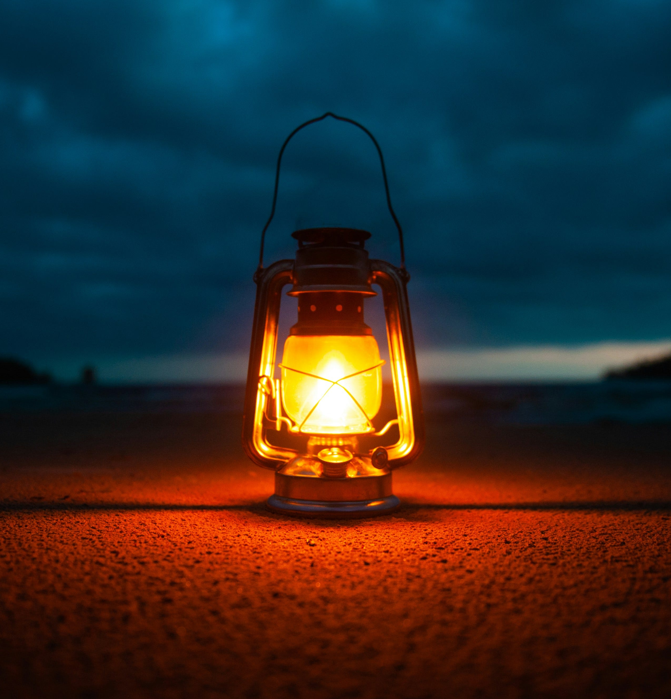
His word
His word
Ps 119 ¹⁰⁵ Your word is a lamp for my feet, a light on my path.
Proverbs 2
My son, if you accept my words
and store up my commands within you,
² turning your ear to wisdom
and applying your heart to understanding –
³ indeed, if you call out for insight
and cry aloud for understanding,
⁴ and if you look for it as for silver
and search for it as for hidden treasure,
⁵ then you will understand the fear of the Lord
and find the knowledge of God.
Notes:
Store up God’s word in your heart
Do you long to know God better? Would you like to be wiser, more skilful and to have more knowledge and understanding?
Make a lifelong, daily habit of reading God’s word. The writer of Proverbs urges, ‘store up my commands within you, turning your ear to wisdom and applying your heart to understanding… For wisdom will enter your heart’ (vv.1–2,10).
What do you need to do?
‘Store up’ God’s words within you (v.1). You need to ‘accept’ (v.1), listen and apply (v.2), ‘call out’ (v.3) and ‘search’ (v.4). ‘Searching for it like a prospector panning for gold, like an adventurer on a treasure hunt’ (v.4, MSG). This takes time and commitment.
Don’t just prioritise your schedule; schedule your priorities. Set aside a regular time to read the Bible and schedule it as a top priority.
What does God promise if you do this?
You will ‘find the knowledge of God’ (v.5). ‘God gives out Wisdom free’ (v.6, MSG). Because of God’s character he ‘gives wisdom’ and ‘understanding’ (v.6), ‘victory’ (v.7), protection (v.8) and ‘discretion’ (v.11). He promises that God will ‘keep his eye on’ you (v.8, MSG) and ‘protect you, and… guard you’ (vv.8,11).

Slide 28
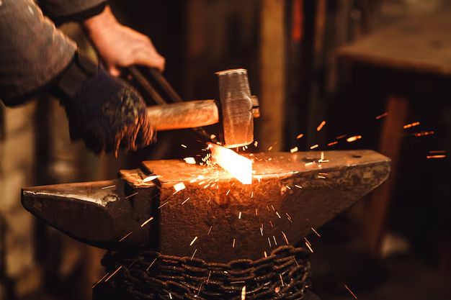
His people
Matt 5 ¹⁴ “You are the light of the world. A town built on a hill cannot be hidden.”
Proverbs 27: ¹⁷As iron sharpens iron, so one person sharpens another.
Col 1: ²⁸ He is the one we proclaim, admonishing and teaching everyone with all wisdom, so that we may present everyone fully mature in Christ. ²⁹ To this end I strenuously contend with all the energy Christ so powerfully works in me.

Slide 29
Invitation
To step more into the light means to follow Him
  His ways
  His presence
  His word
  His people
What has God prompted you to do?

Slide 30
Be Thou my vision, O Lord of my heart
Be all else but naught to me, save that Thou art
Be Thou my best thought in the day and the night
Both waking and sleeping, Thy presence my light.
Be Thou my wisdom, be Thou my true word
Be Thou ever with me, and I with Thee, Lord
Be Thou my great Father, and I Thy true son
Be Thou in me dwelling and I with Thee one.
Be Thou my breastplate, my sword for the fight;
Be Thou my whole armour, be Thou my true might;
Be Thou my soul’s shelter, be Thou my strong tower,
O raise Thou me heavenward, great power of my power.
Riches I heed not, nor vain, empty praise
Be Thou mine inheritance, now and always
Be Thou and Thou only the first in my heart
O high King of heaven, my treasure Thou art.
High King of heaven, Thou heaven’s bright sun
O grant me its joys, after victory is won;
Great Heart of my own heart, whatever befall,
Still be Thou my vision, O Ruler of all.

