Slide 1
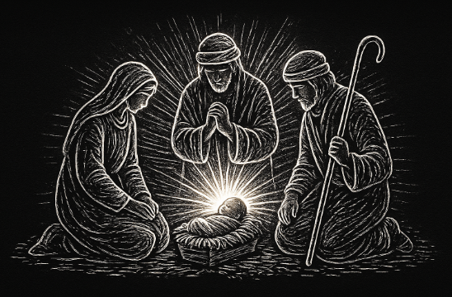
There is only room for one King on the throne

Slide 2
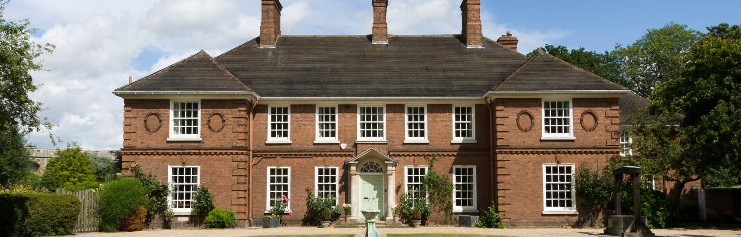

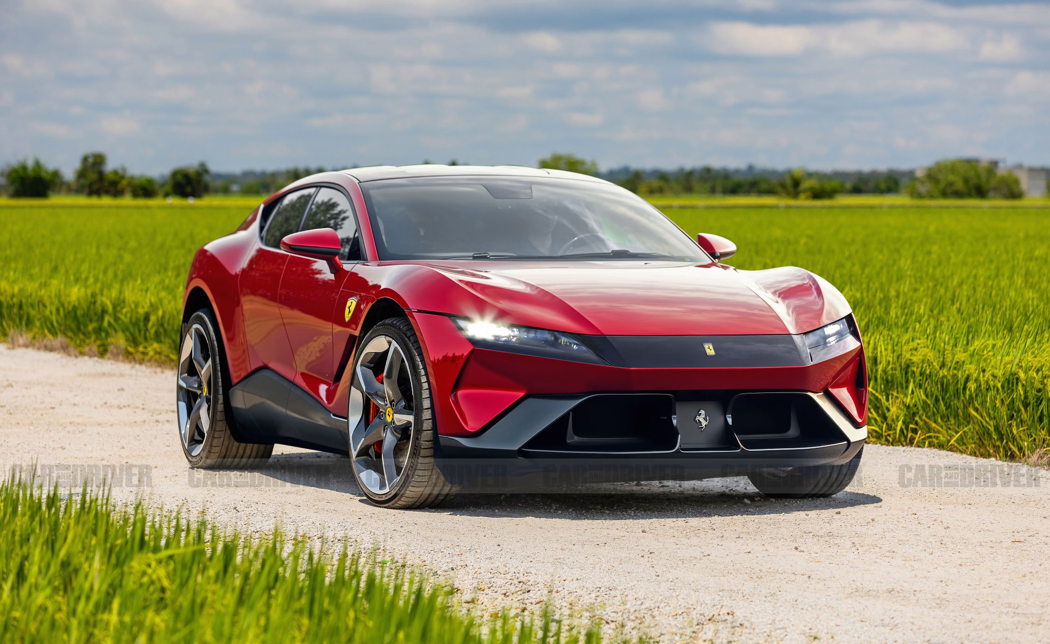
Don’t get caught up in building a comfortable life for yourself…
If only … then everything would be okay.

Slide 3
Matthew 2:1-3, 7-8, 13-16, 22-23
After Jesus was born in Bethlehem in Judea, during the time of King Herod, Magi from the east came to Jerusalem and asked, "Where is the one who has been born king of the Jews! We saw his star when it rose and have come to worship him." When King Herod heard this he was disturbed, and all Jerusalem with him.... Then Herod... sent them to Bethlehem and said, "Go and search carefully for the child. As soon as you find him, report to me, so that I too may go and worship him....
When they had gone, an angel of the Lord appeared to Joseph in a dream. "Get up," he said, "take the child and his mother and escape to Egypt. Stay there until I tell you, for Herod is going to search for the child to kill him." So he got up, took the child and his mother during the night and left for Egypt, where he stayed until the death of Herod....

Slide 4
Matthew 2:1-3, 7-8, 13-16, 22-23
After Jesus was born in Bethlehem in Judea, during the time of King Herod, Magi from the east came to Jerusalem and asked, "Where is the one who has been born king of the Jews! We saw his star when it rose and have come to worship him." When King Herod heard this he was disturbed, and all Jerusalem with him.... Then Herod... sent them to Bethlehem and said, "Go and search carefully for the child. As soon as you find him, report to me, so that I too may go and worship him....
When they had gone, an angel of the Lord appeared to Joseph in a dream. "Get up," he said, "take the child and his mother and escape to Egypt. Stay there until I tell you, for Herod is going to search for the child to kill him." So he got up, took the child and his mother during the night and left for Egypt, where he stayed until the death of Herod....

Slide 5
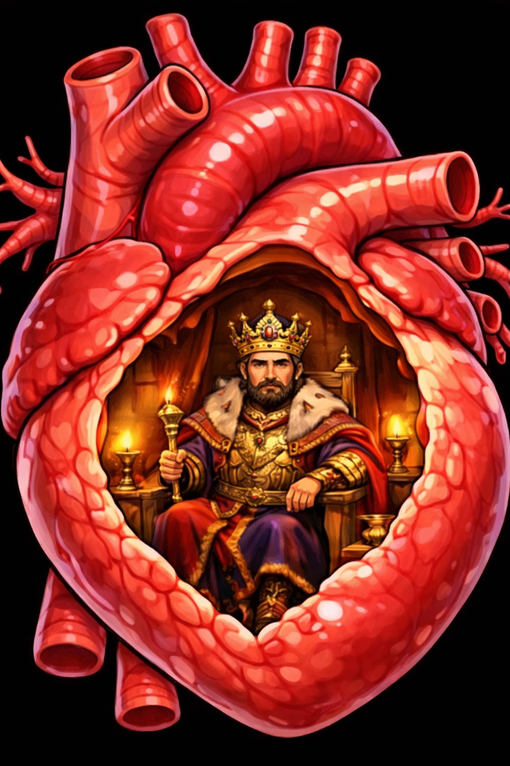

Herod’s reaction is a picture of us all

Slide 6

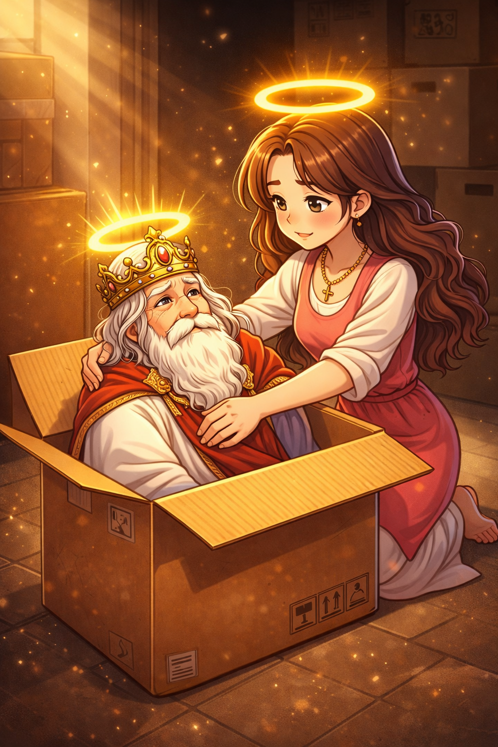
How might we respond like Herod?
Asking for more from God rather than more of God
2) Putting God into a box
There must be more than this…
Lord, have your way with us.

Slide 7
Luke 2: 8-20
“And there were shepherds living out in the fields nearby, keeping watch over their flocks at night. An angel of the Lord appeared to them, and the glory of the Lord shone around them, and they were terrified. But the angel said to them, “Do not be afraid. I bring you good news that will cause great joy for all the people. Today in the town of David a Savior has been born to you; he is the Messiah, the Lord. This will be a sign to you: You will find a baby wrapped in cloths and lying in a manger.” Suddenly a great company of the heavenly host appeared with the angel, praising God and saying, “Glory to God in the highest heaven, and on earth peace to those on whom his favor rests.” When the angels had left them and gone into heaven, the shepherds said to one another, “Let’s go to Bethlehem and see this thing that has happened, which the Lord has told us about.” So they hurried off and found Mary and Joseph, and the baby, who was lying in the manger. When they had seen him, they spread the word concerning what had been told them about this child, and all who heard it were amazed at what the shepherds said to them. But Mary treasured up all these things and pondered them in her heart. The shepherds returned, glorifying and praising God for all the things they had heard and seen, which were just as they had been told.”

Slide 8
Luke 2: 8-20
“And there were shepherds living out in the fields nearby, keeping watch over their flocks at night. An angel of the Lord appeared to them, and the glory of the Lord shone around them, and they were terrified. But the angel said to them, “Do not be afraid. I bring you good news that will cause great joy for all the people. Today in the town of David a Savior has been born to you; he is the Messiah, the Lord. This will be a sign to you: You will find a baby wrapped in cloths and lying in a manger.” Suddenly a great company of the heavenly host appeared with the angel, praising God and saying, “Glory to God in the highest heaven, and on earth peace to those on whom his favor rests.” When the angels had left them and gone into heaven, the shepherds said to one another, “Let’s go to Bethlehem and see this thing that has happened, which the Lord has told us about.” So they hurried off and found Mary and Joseph, and the baby, who was lying in the manger. When they had seen him, they spread the word concerning what had been told them about this child, and all who heard it were amazed at what the shepherds said to them. But Mary treasured up all these things and pondered them in her heart. The shepherds returned, glorifying and praising God for all the things they had heard and seen, which were just as they had been told.”

Slide 9
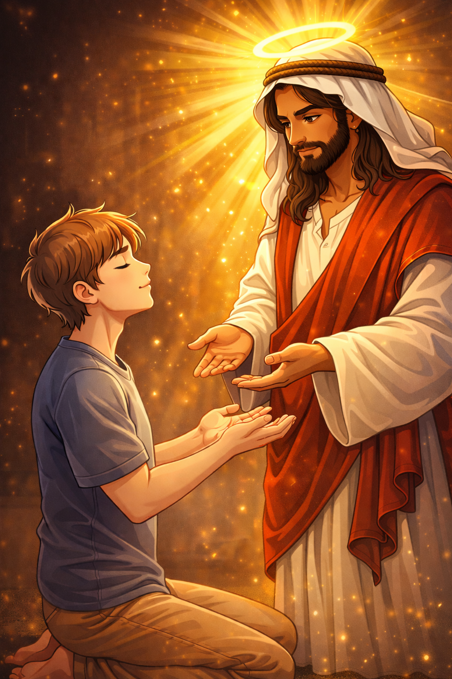
How might we respond like the Shepherds?
Obedience to God’s call
2) Empty hands and open hearts
There must be more than this…
Lord, have your way with us.

Slide 10
How will we respond to the Good News?
Lord, I don’t want be to the King of my own heart, I want you to be the Lord of my life.
Lord, forgive me for only accepting part of who you are, open my eyes to see you in the fullness of your glory.
Jesus, Prince of Peace, take all that I am as a living sacrifice to honour and glorify you.

Slide 11
I am an instrument of exaltation
And I was born to lift the name above all names
You hear the melody of all creation
But there's a song of praise that only I can bring
Who else is worthy? Who else is worthy?
There is no one, only You, Jesus
Who else is worthy? Who else is worthy?
There is no one, only You, Jesus
You are the infinite God of the ages
Yet You chose to make my heart your dwelling place
You healed my brokenness, showed me your glory
So I have songs of thanks not even angels sing
Lamb of God, anointed one
Who was and is and is to come
Seated on the throne above
Holy, Holy
Righteous one who shed His blood
To prove to us the Father's love
Jesus Christ be lifted up
Holy, Holy

