Slide 1
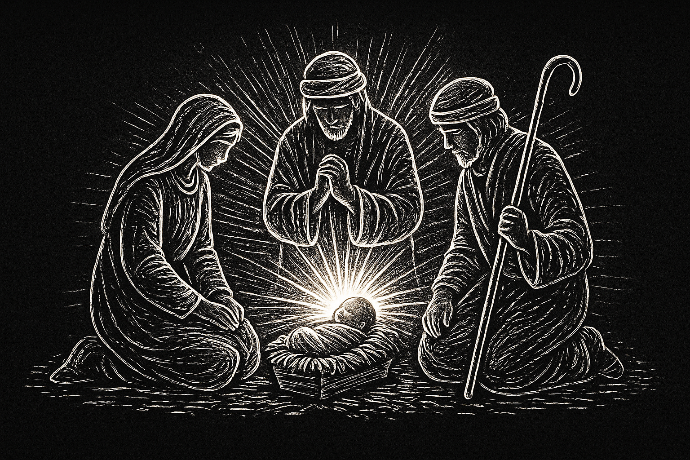
Christmas Series: Make Room for the King

Slide 2


Slide 3

Malachi 3:10
Test me in this,” says the Lord Almighty, “and see if I will not throw open the floodgates of heaven and pour out so much blessing that there will not be room enough to store it.

Slide 4


Slide 5
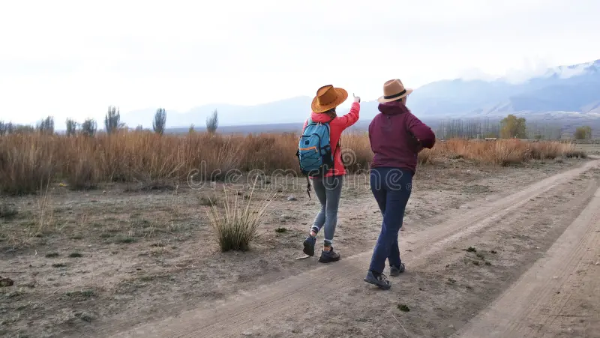
Malachi 3:10
Test me in this,” says the Lord Almighty, “and see if I will not throw open the floodgates of heaven and pour out so much blessing that there will not be room enough to store it.
Ephesians 4:30-32
And do not grieve the Holy Spirit of God, with whom you were sealed for the day of redemption. 31 Get rid of all bitterness, rage and anger, brawling and slander, along with every form of malice.

Slide 6
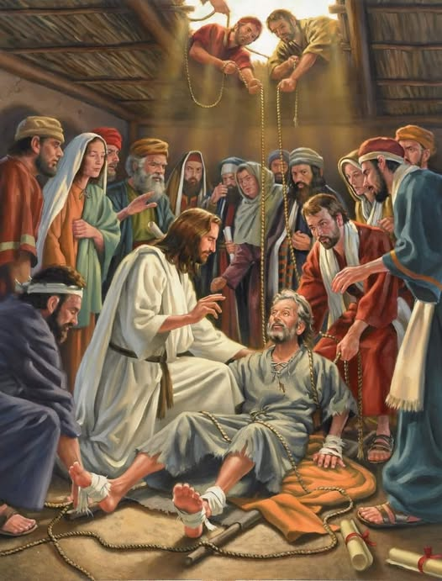
5 When Jesus saw their faith, he said to the paralyzed man, “Son, your sins are forgiven.”... So he said to the man, 11 “I tell you, get up, take your mat and go home.” 12 He got up, took his mat and walked out in full view of them all. This amazed everyone and they praised God, saying, “We have never seen anything like this!”
Mark 2:1-12

Slide 7
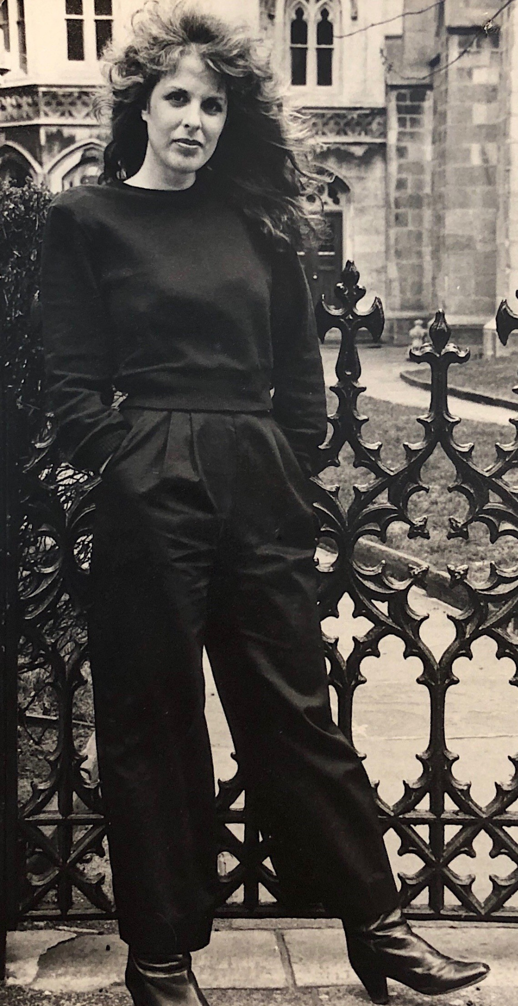
I pity celebrities, no I really do – [celebrities], were once perfectly pleasant human beings. But now their wrath is awful. They worked, they pushed and the morning after each of them became famous they wanted to take an overdose. Because that giant thing they were striving for, that fame thing that was going to make everything OK, that was going to make their lives bearable, that was going to provide them with personal fulfillment and happiness had happened and they were still them. The disillusionment turned them howling and insufferable.
Cynthia Heimel

Slide 8
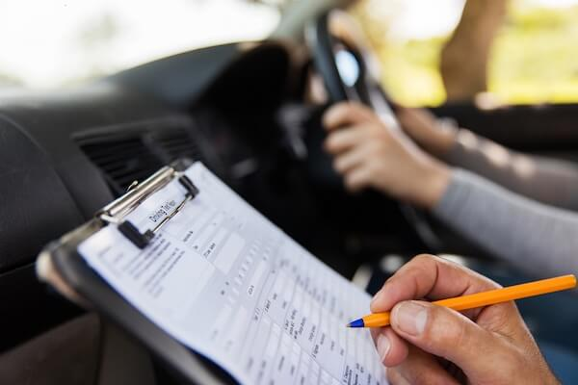
Notes:
Jonty driving test - God is the ultimate prize

Slide 9
You are our daily bread, You are our daily bread
And we will seek Your face before we seek Your hand
You are our daily bread, You are our daily bread
And we desire You before the Promised Land
Daily Bread
Song by Kari Jobe and Pat Barrett

Slide 10
The Mothers of Jesus

Slide 11
The Mothers of Jesus
This is the genealogy of Jesus the Messiah…
…Judah the father of Perez and Zerah, whose mother was Tamar,
…Salmon the father of Boaz, whose mother was Rahab
…Boaz the father of Obed, whose mother was Ruth…
…David was the father of Solomon, whose mother had been Uriah’s wife,...
…Joseph, the husband of Mary, and Mary was the mother of Jesus who is called the Messiah…
[Matthew 1:1, 3, 5 and 6]

Slide 12
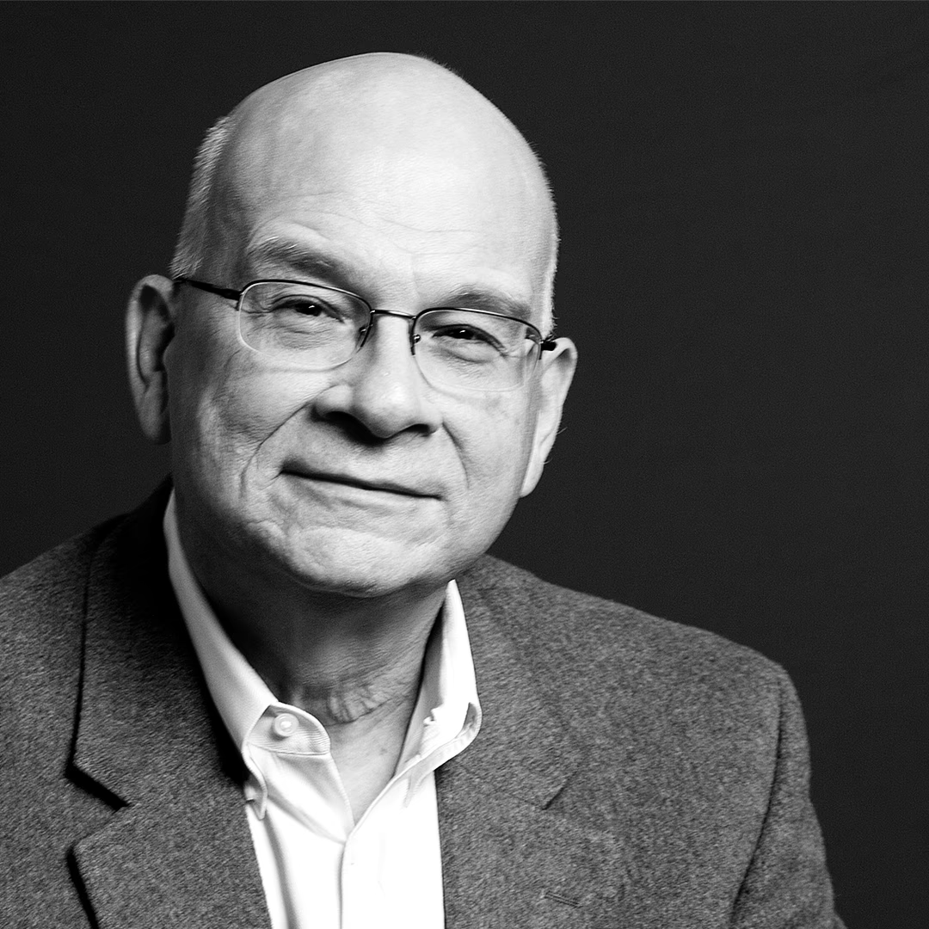
These things that matter so much outside Jesus’ church must not be bought inside. He says, in a sense, ‘in my family, those things that are so important out there in the world, must not be so important’.
Tim Keller

Slide 13
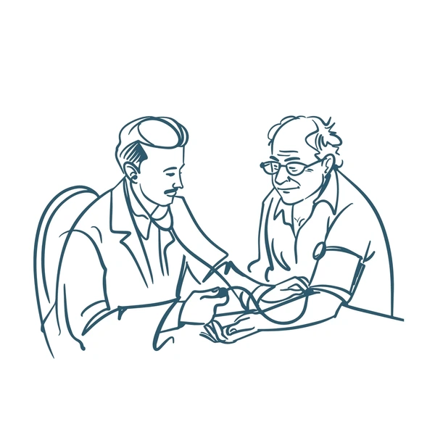
Super-hero complex
Identity is found in being needed
self-focused
Doesn’t see their own potential
self-deprecating
self-focused

Slide 14
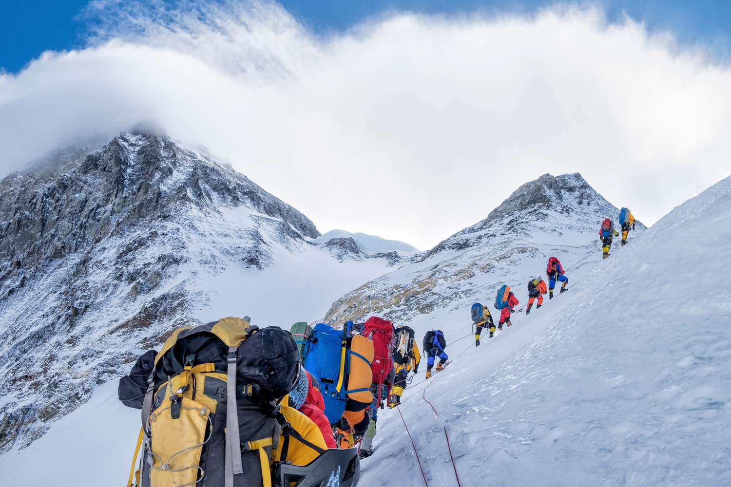
The security of Jesus’ love allows us to need less and love more

Slide 15
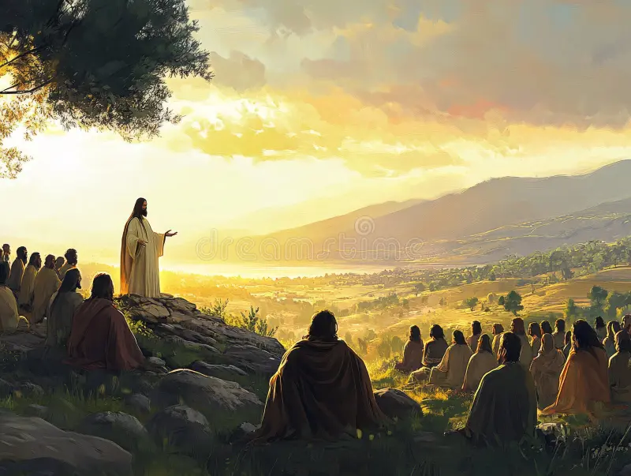
19 Therefore go and make disciples of all nations, baptizing them in the name of the Father and of the Son and of the Holy Spirit, 20 and teaching them to obey everything I have commanded you. And surely I am with you always, to the very end of the age.”
Matthew 28:19-20
Notes:
Once we become followers of Christ we are called to make disciples. To invest in others without concern for our own need. We are called to relate to people in a completely transformed way.

