Slide 1

Attitudes and actions in marriage

Slide 2
Matthew 22:34
³⁴ Hearing that Jesus had silenced the Sadducees, the Pharisees got together. ³⁵ One of them, an expert in the law, tested him with this question: ³⁶ “Teacher, which is the greatest commandment in the Law?”
³⁷ Jesus replied: “‘Love the Lord your God with all your heart and with all your soul and with all your mind.’^{[c]} ³⁸ This is the first and greatest commandment. ³⁹ And the second is like it: ‘Love your neighbour as yourself.’^{[d]} ⁴⁰ All the Law and the Prophets hang on these two commandments.”

Slide 3
1 Corinthians 7:32
³² I would like you to be free from concern. An unmarried man is concerned about the Lord’s affairs—how he can please the Lord.
³³ But a married man is concerned about the affairs of this world—how he can please his wife— ³⁴ and his interests are divided. An unmarried woman or virgin is concerned about the Lord’s affairs: Her aim is to be devoted to the Lord in both body and spirit. But a married woman is concerned about the affairs of this world—how she can please her husband.
³⁵ I am saying this for your own good, not to restrict you, but that you may live in a right way in undivided devotion to the Lord.

Slide 4
Matthew 19
¹ When Jesus had finished saying these things, he left Galilee and went into the region of Judea to the other side of the Jordan. ² Large crowds followed him, and he healed them there.
³ Some Pharisees came to him to test him. They asked, “Is it lawful for a man to divorce his wife for any and every reason?”
⁴ “Haven’t you read,” he replied, “that at the beginning the Creator ‘made them male and female,’^{[a]} ⁵ and said, ‘For this reason a man will leave his father and mother and be united to his wife, and the two will become one flesh’^{[b]}? ⁶ So they are no longer two, but one flesh. Therefore, what God has joined together, let no one separate.”

Slide 5


Slide 6
Wives’ attitudes and actions
Wives submit to your own husbands as you do to the Lord. (Ephesians 5: 22)
Now as the church submits to Christ, so also wives should submit to her husbands in everything. (verse 24)
The wife must respect her husband. (verse 33)
Wife of noble character from Proverbs 31:10-31

Slide 7
1 Corinthians 16:16
“You know that the household of Stephanas were the first converts in Achaia, and they have devoted themselves to the service of the Lord’s people. I urge you, brothers and sisters, to ‘hypotasso’ such people and to everyone who joins in the work and labours at it.”
Genesis 2:18
¹⁸ The Lord God said, “It is not good for the man to be alone. I will make a helper suitable for him.”

Slide 8
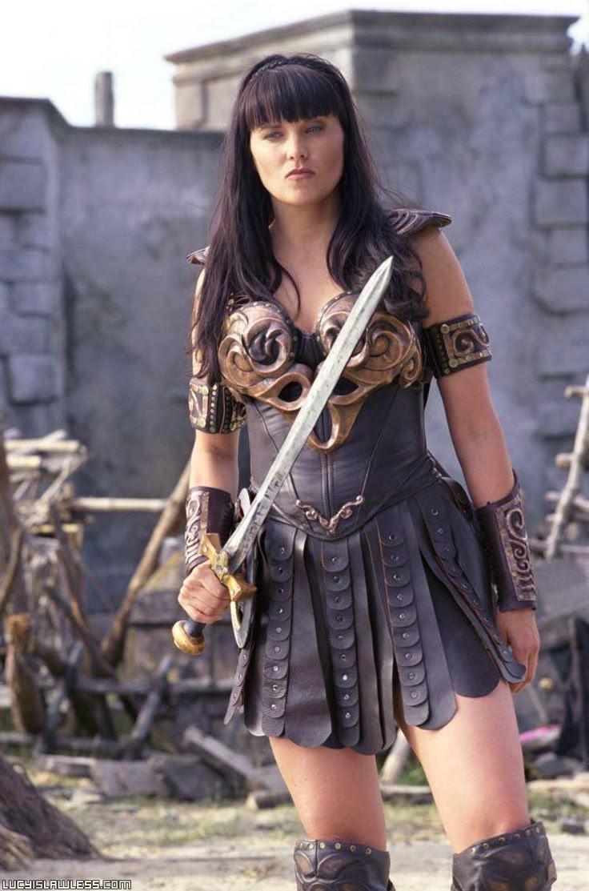


Slide 9

Attitudes and actions in marriage

