Slide 1
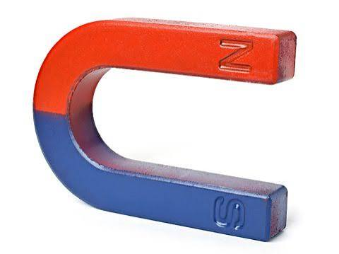
The Gospel of Mark
Episode 5
09/08/26
Notes:
What makes us a friend of Jesus

Slide 2
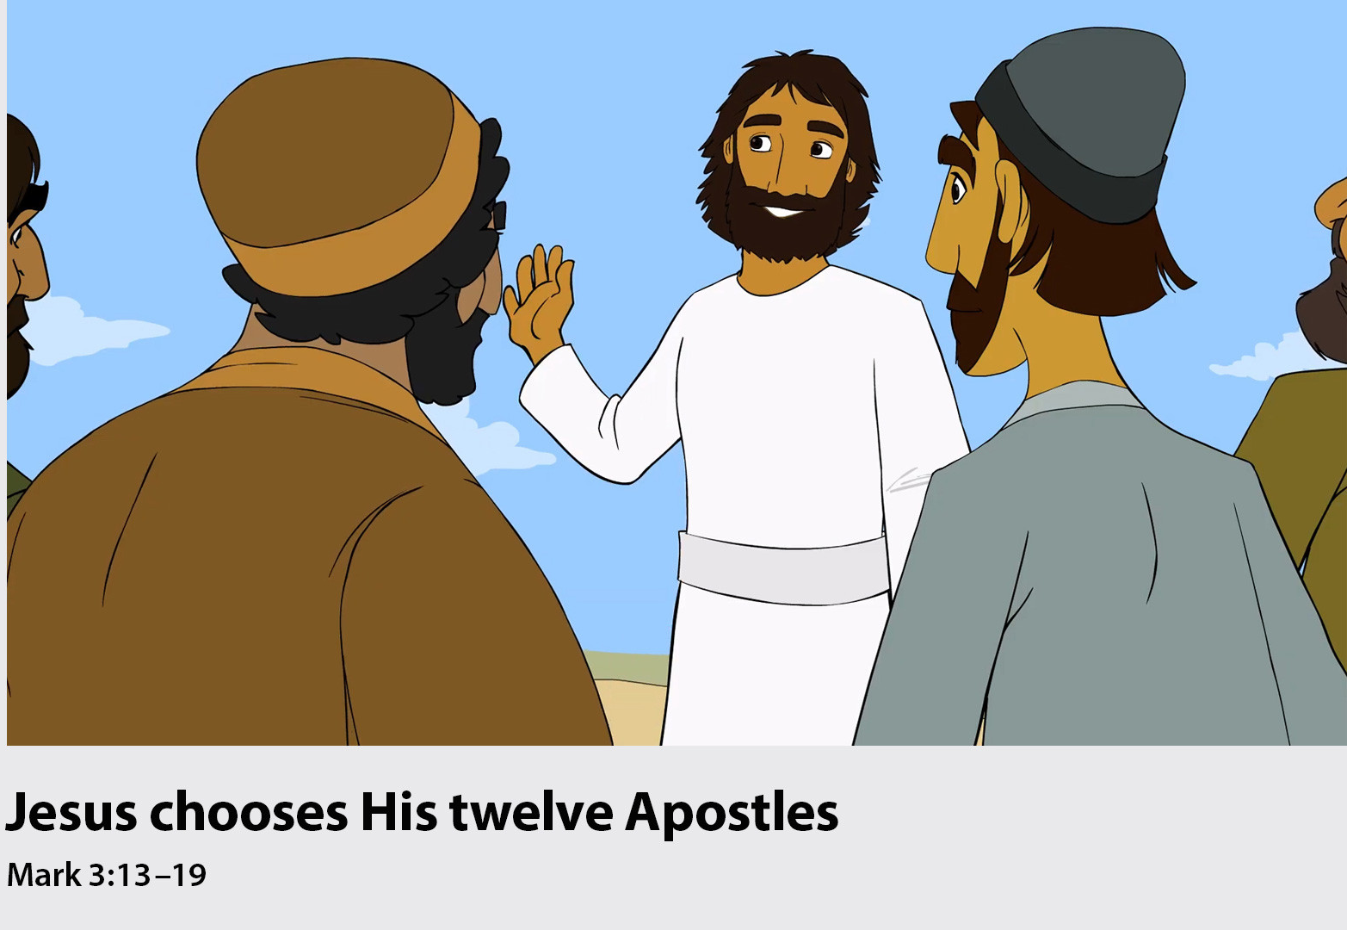

Slide 3
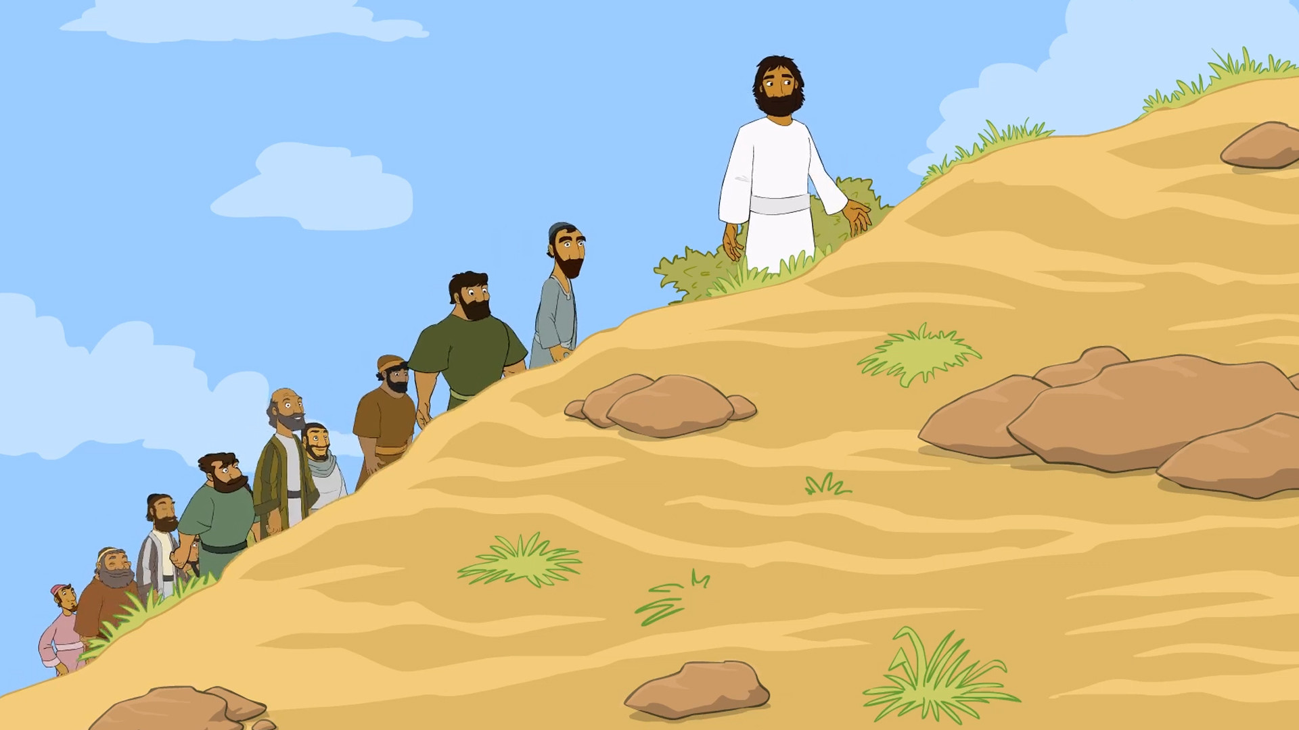
Notes:
Jesus went up on a mountainside and called to him those he wanted, and they came to him.

Slide 4
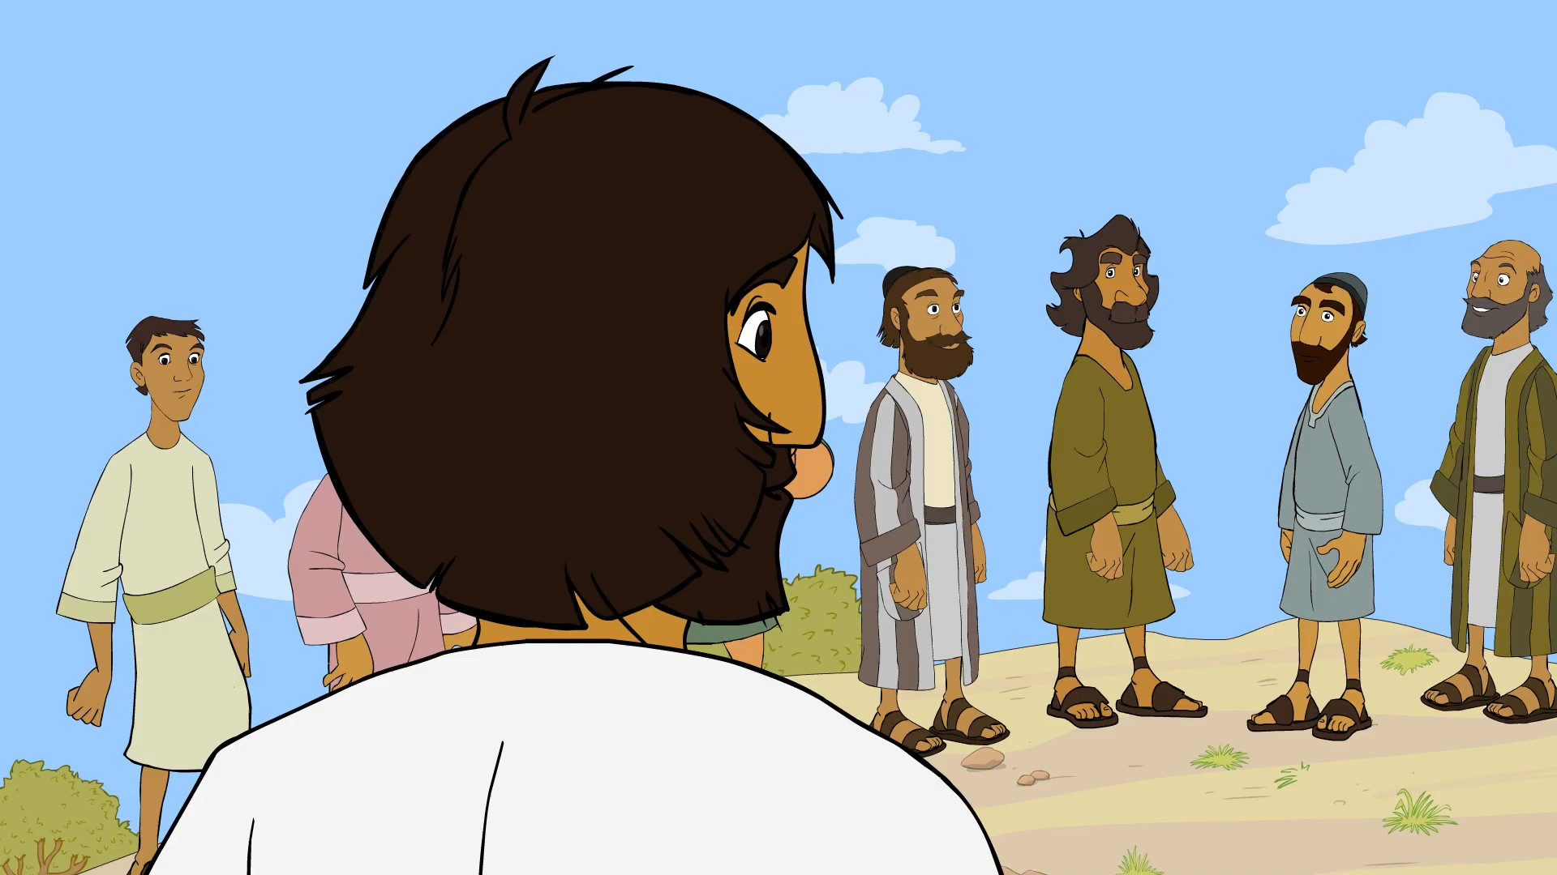
Notes:
He chose twelve of them to be His apostles …

Slide 5
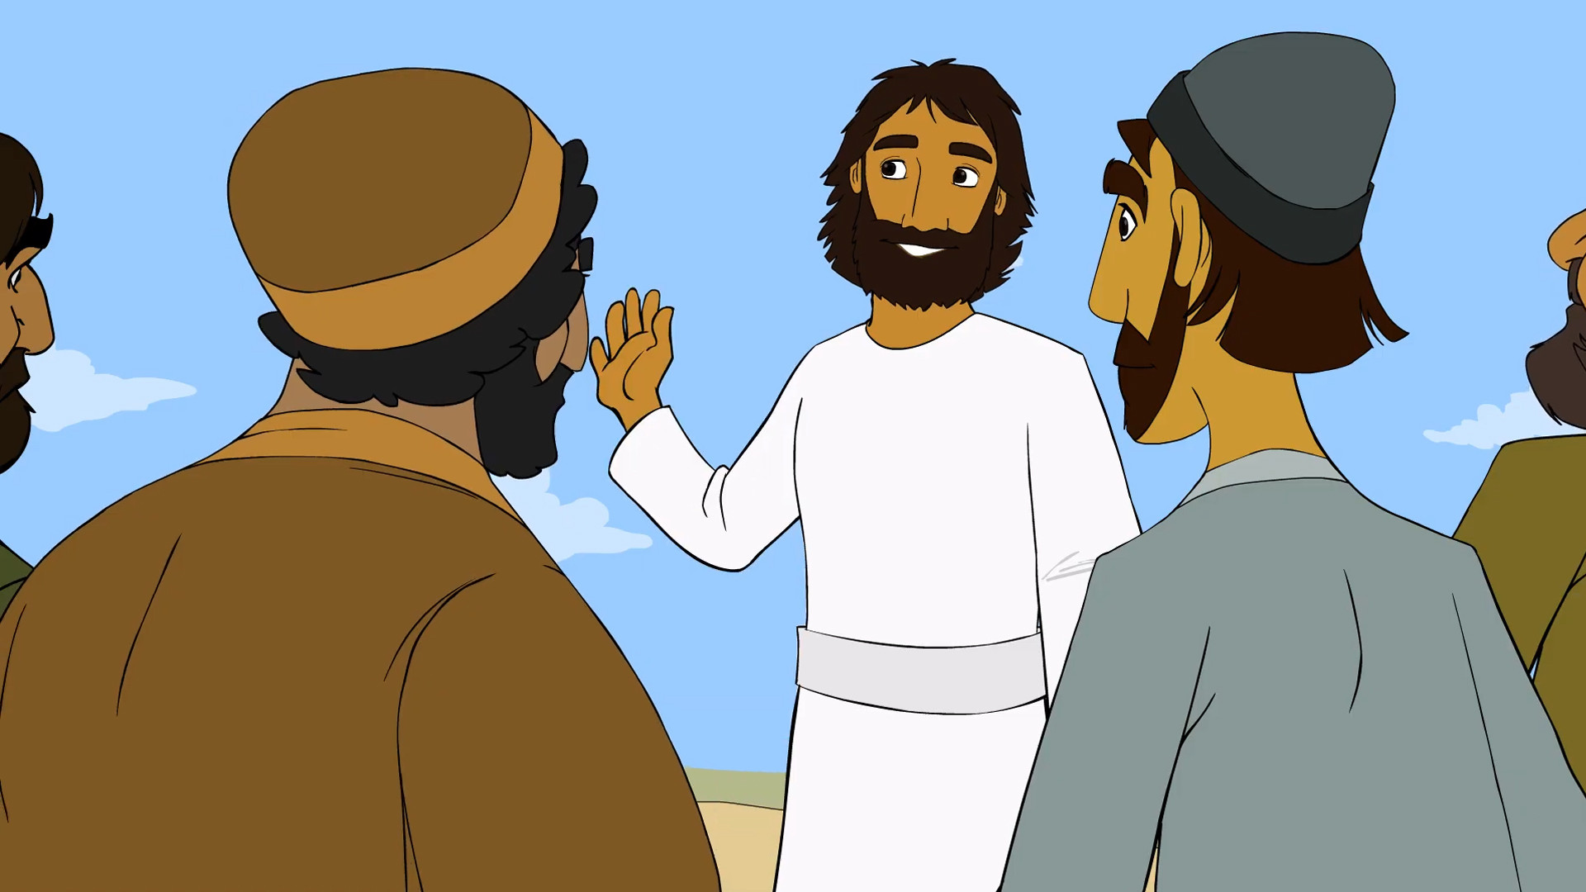
Notes:
… so they could be with Him.

Slide 6
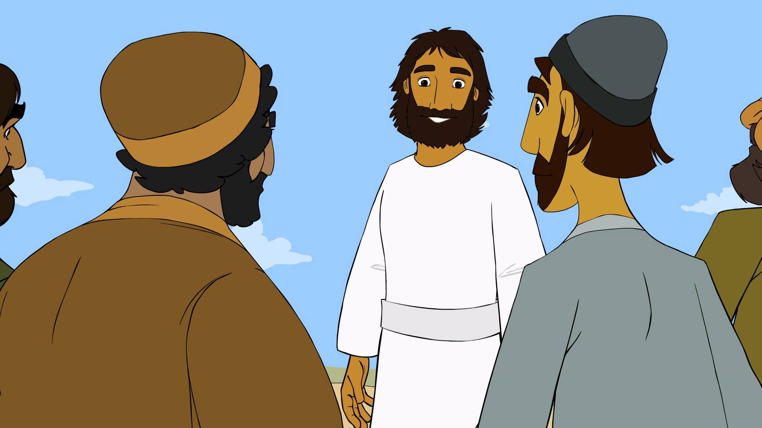
Notes:
and that he might send them out to preach and to have authority to drive out demons.

Slide 7
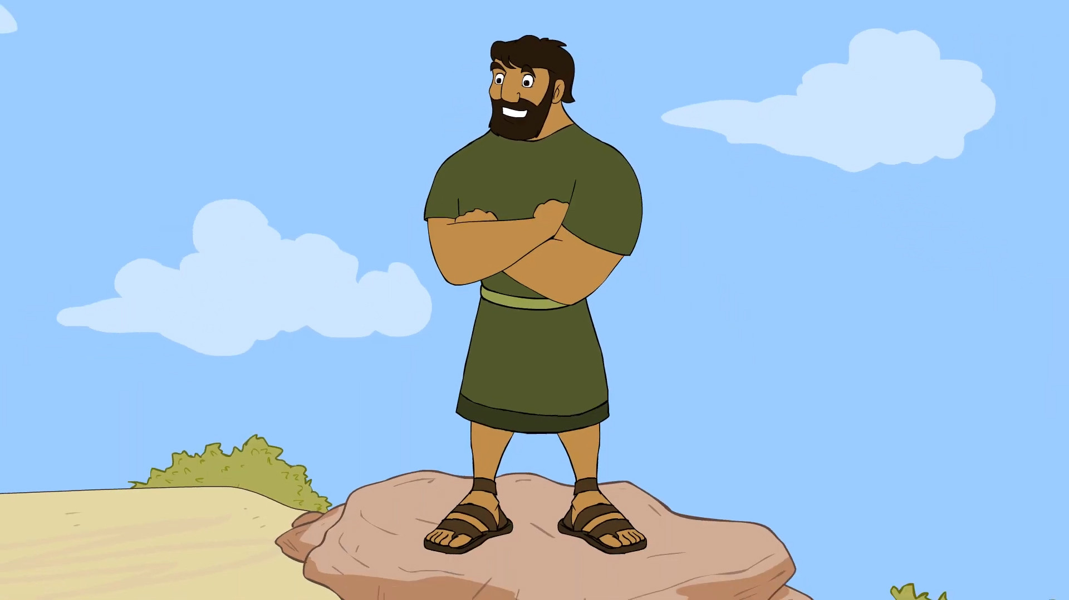
Notes:
Simon was one of the twelve, and Jesus named him Peter.

Slide 8
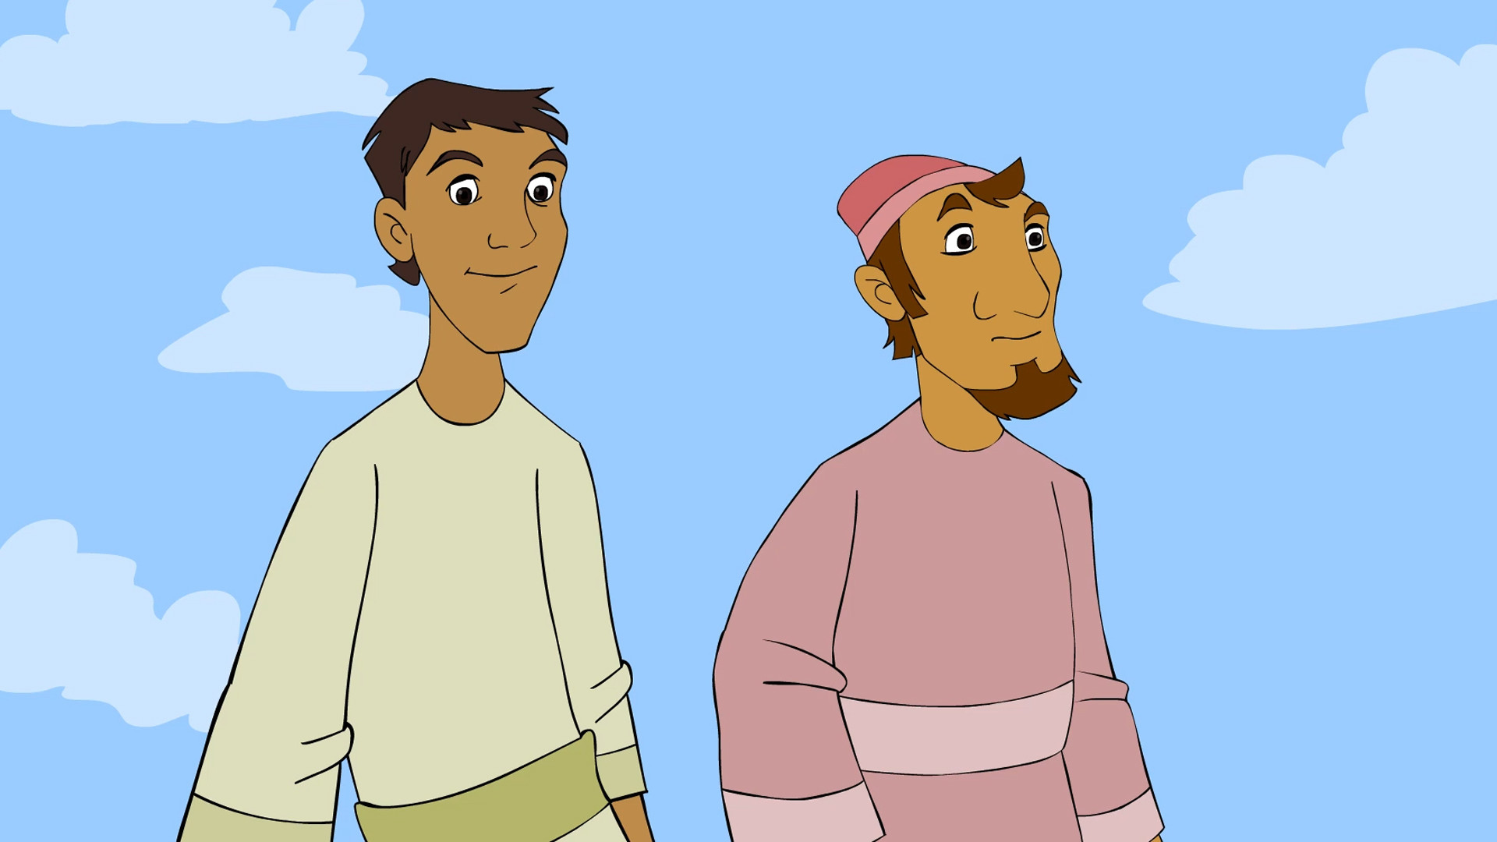
Notes:
There were also James and John …

Slide 9
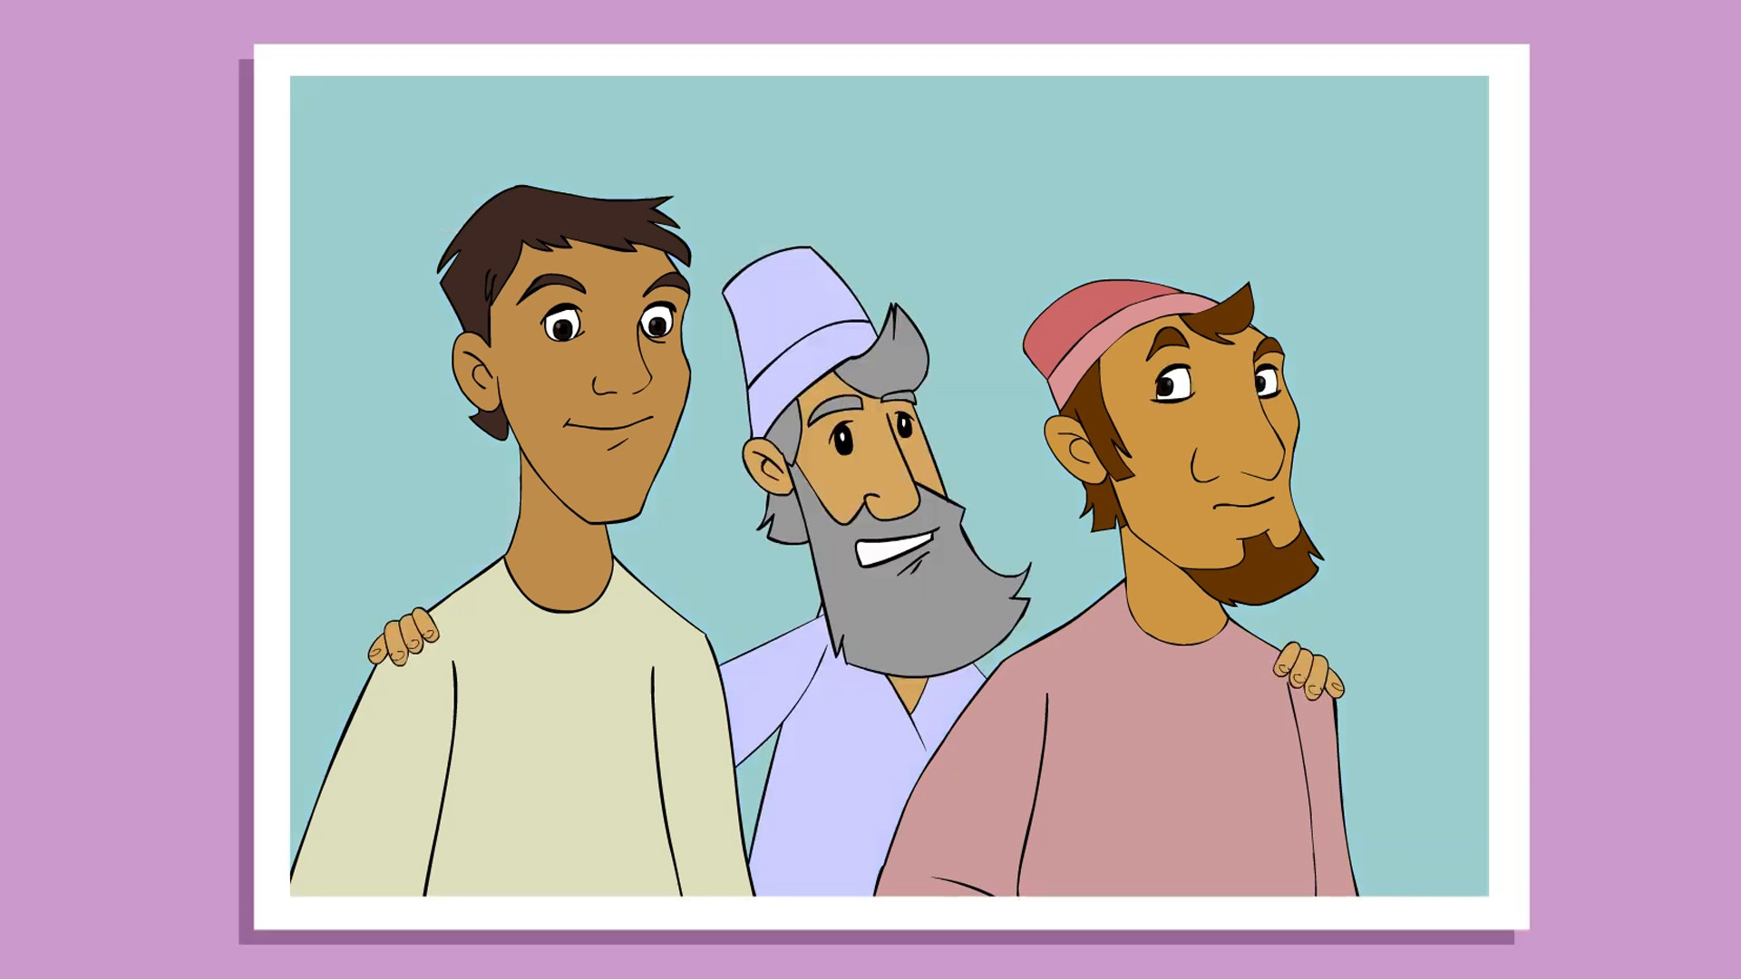
Notes:
… the two sons of Zebedee.

Slide 10
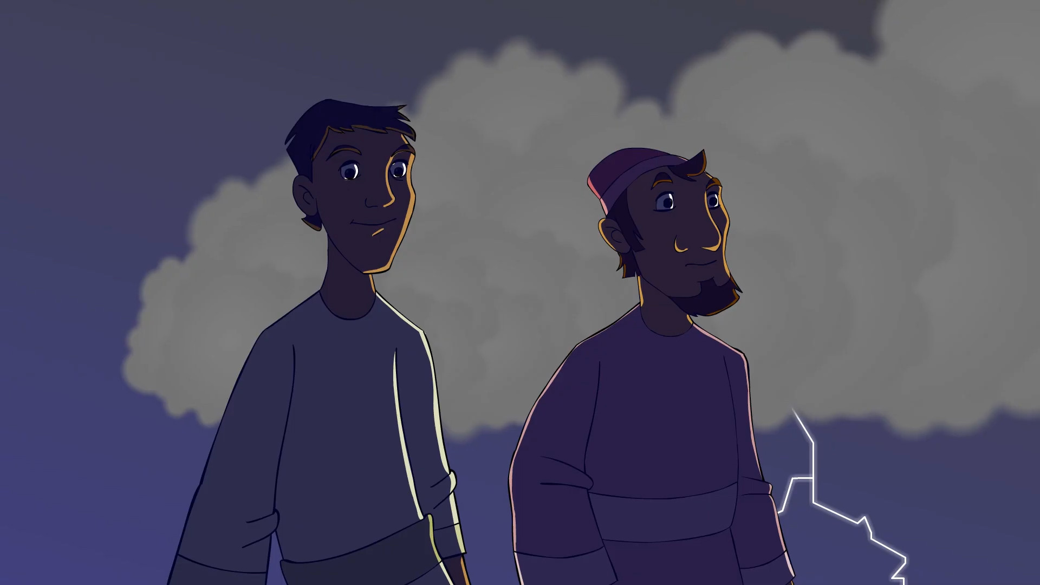
Notes:
to them he gave the nickname - “sons of thunder”

Slide 11
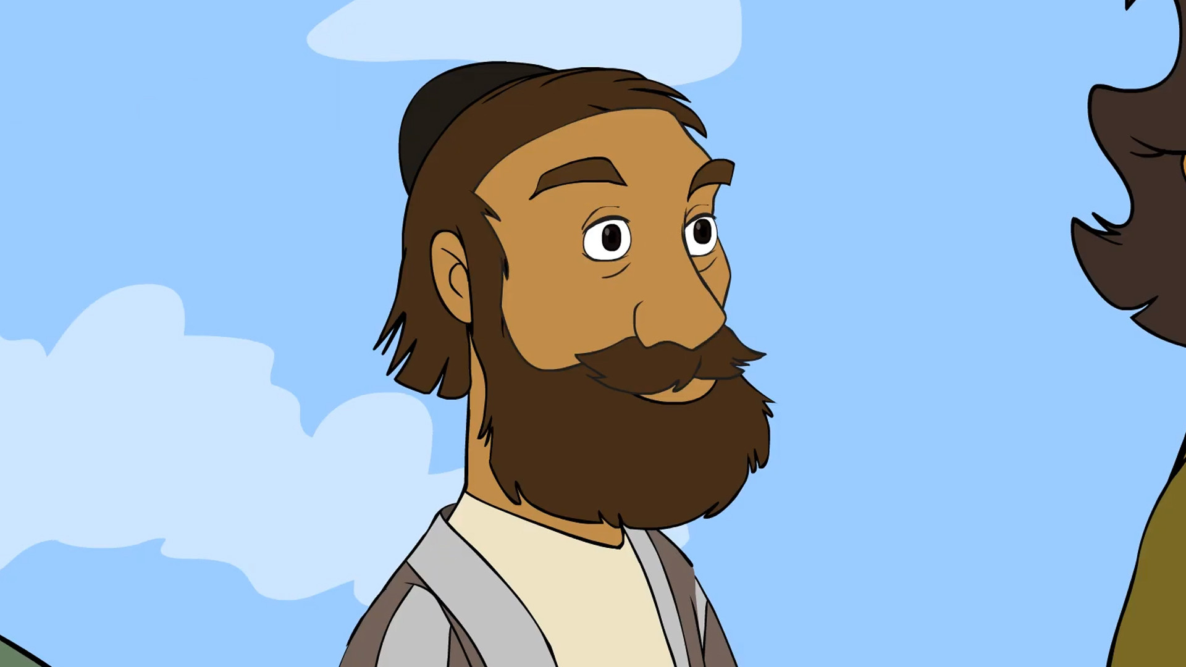
Notes:
Andrew …

Slide 12
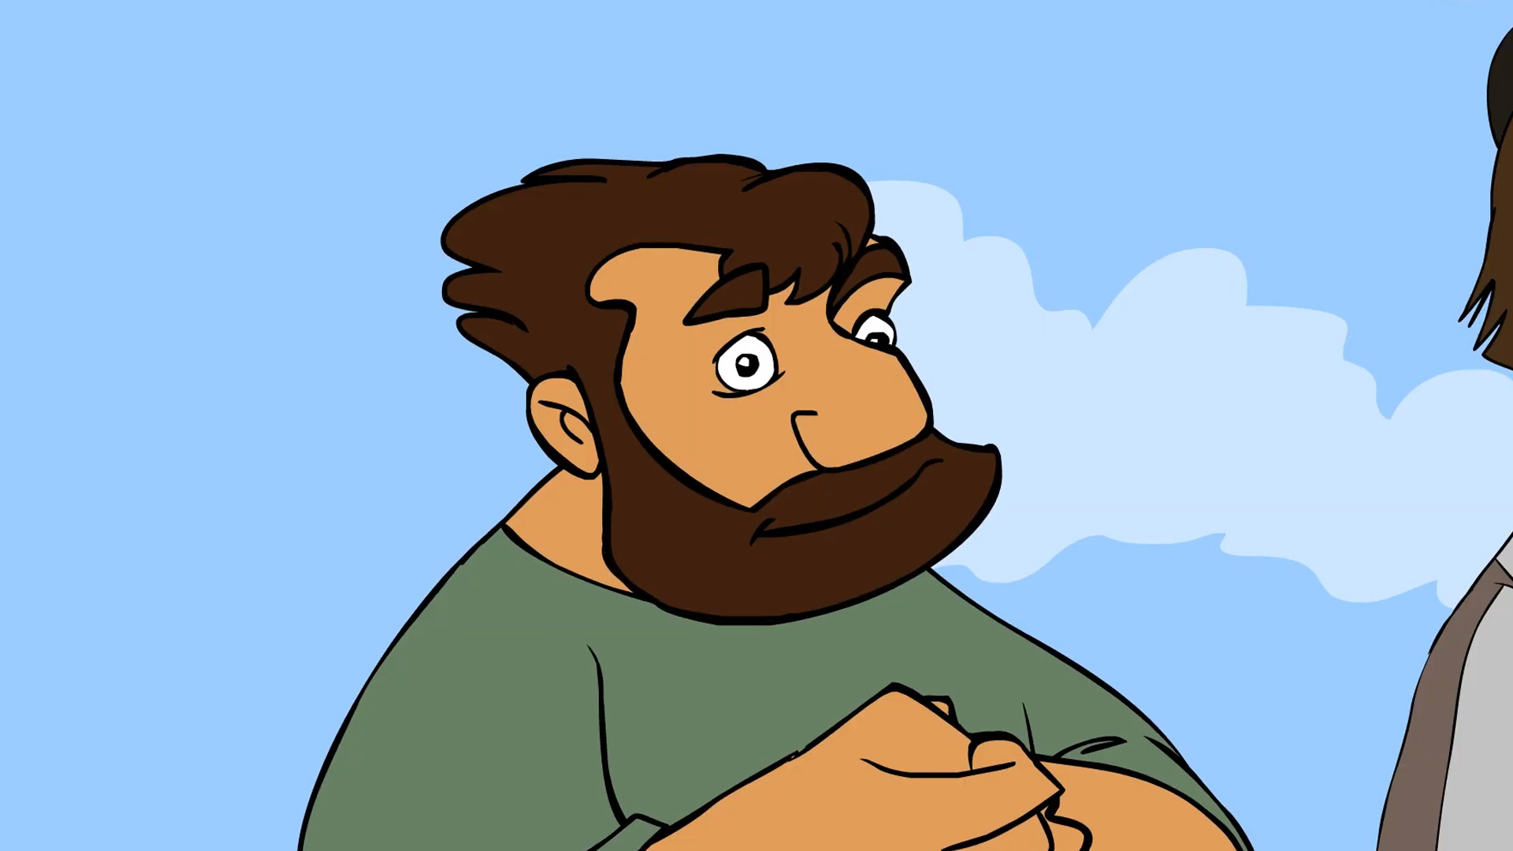
Notes:
Philip …

Slide 13
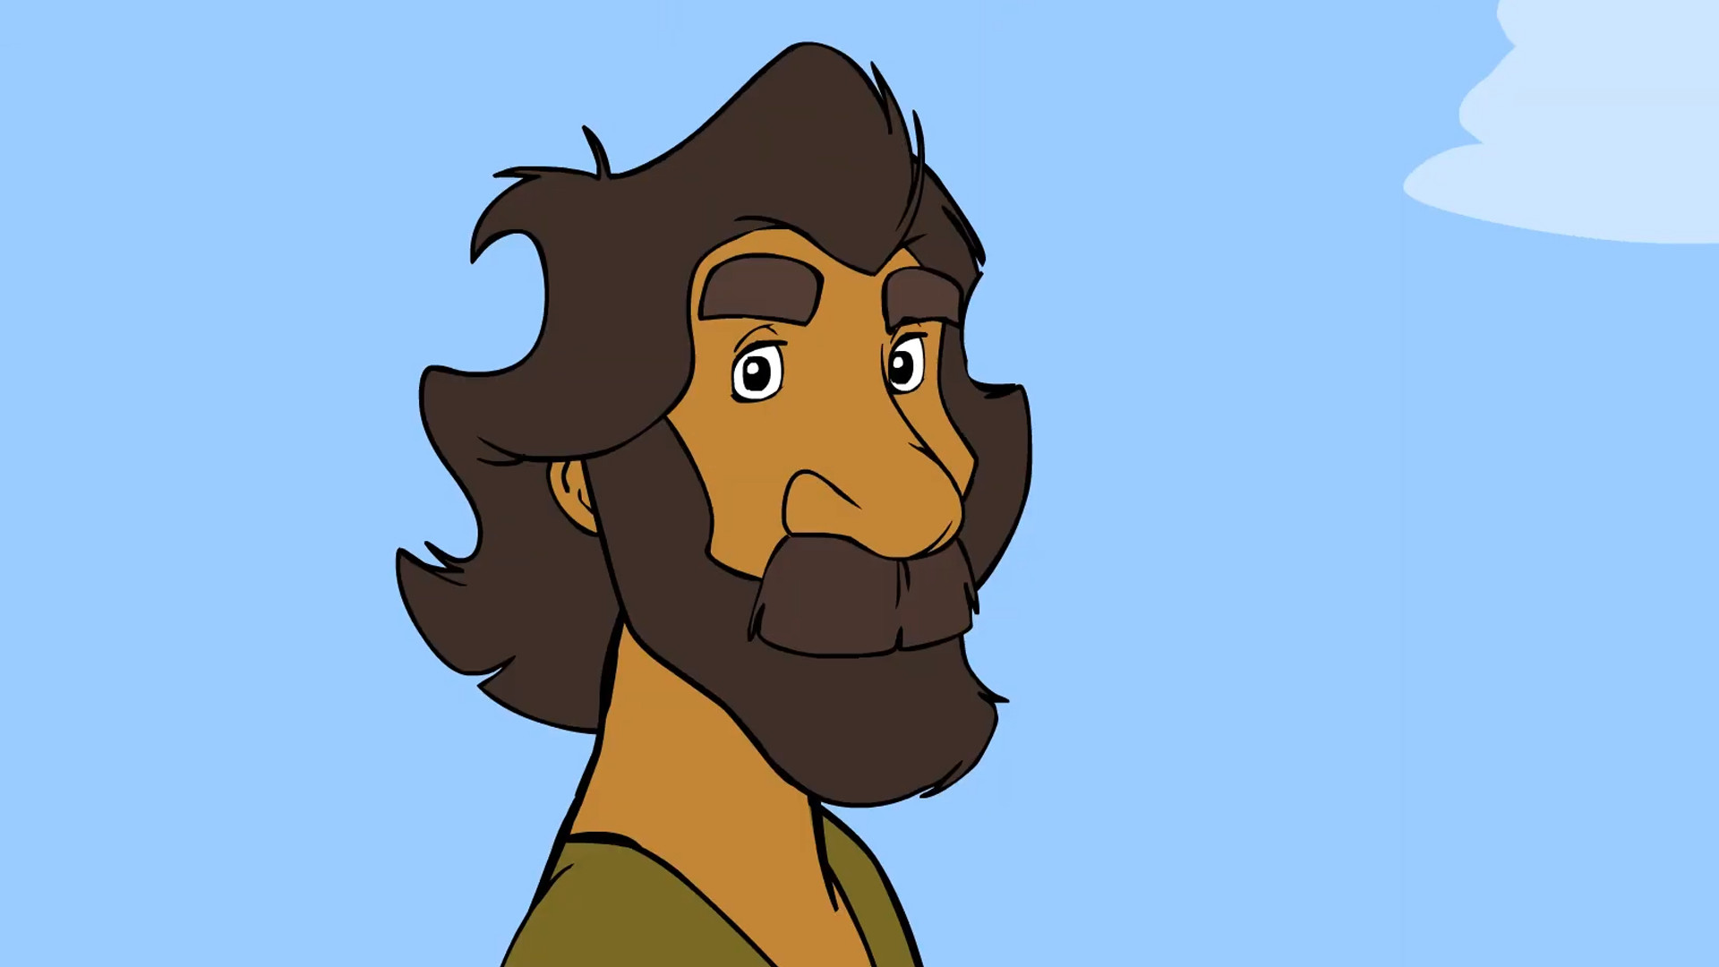
Notes:
Bartholomew …

Slide 14
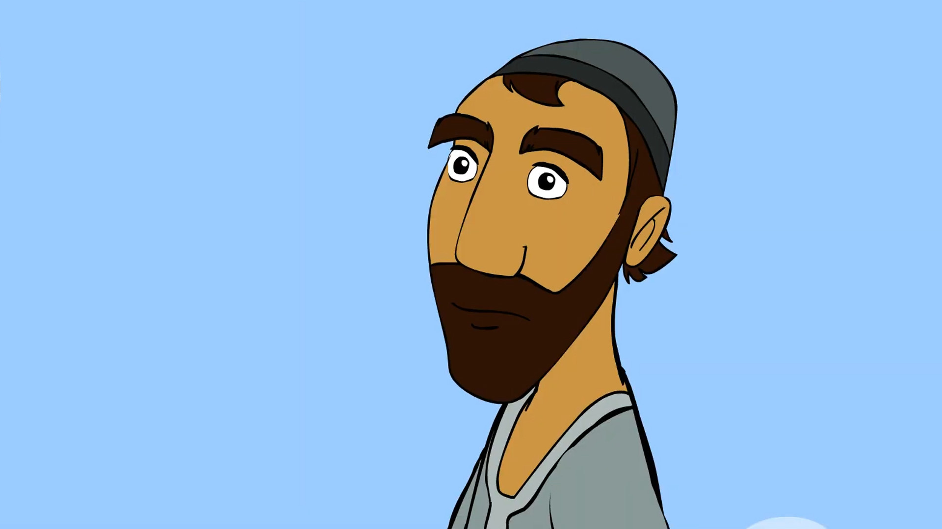
Notes:
Matthew …

Slide 15
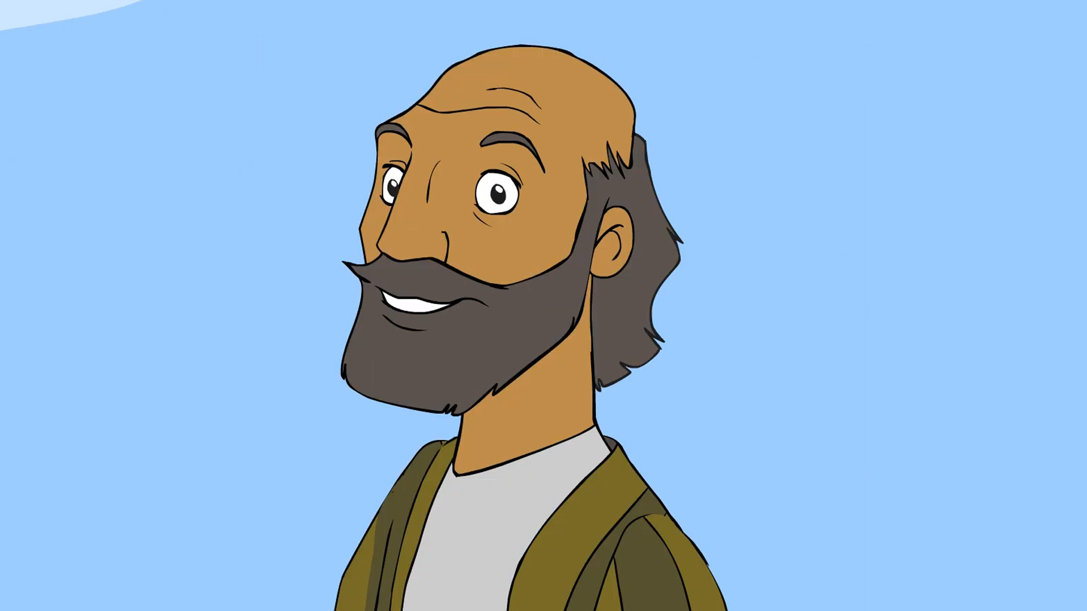
Notes:
Thomas …

Slide 16
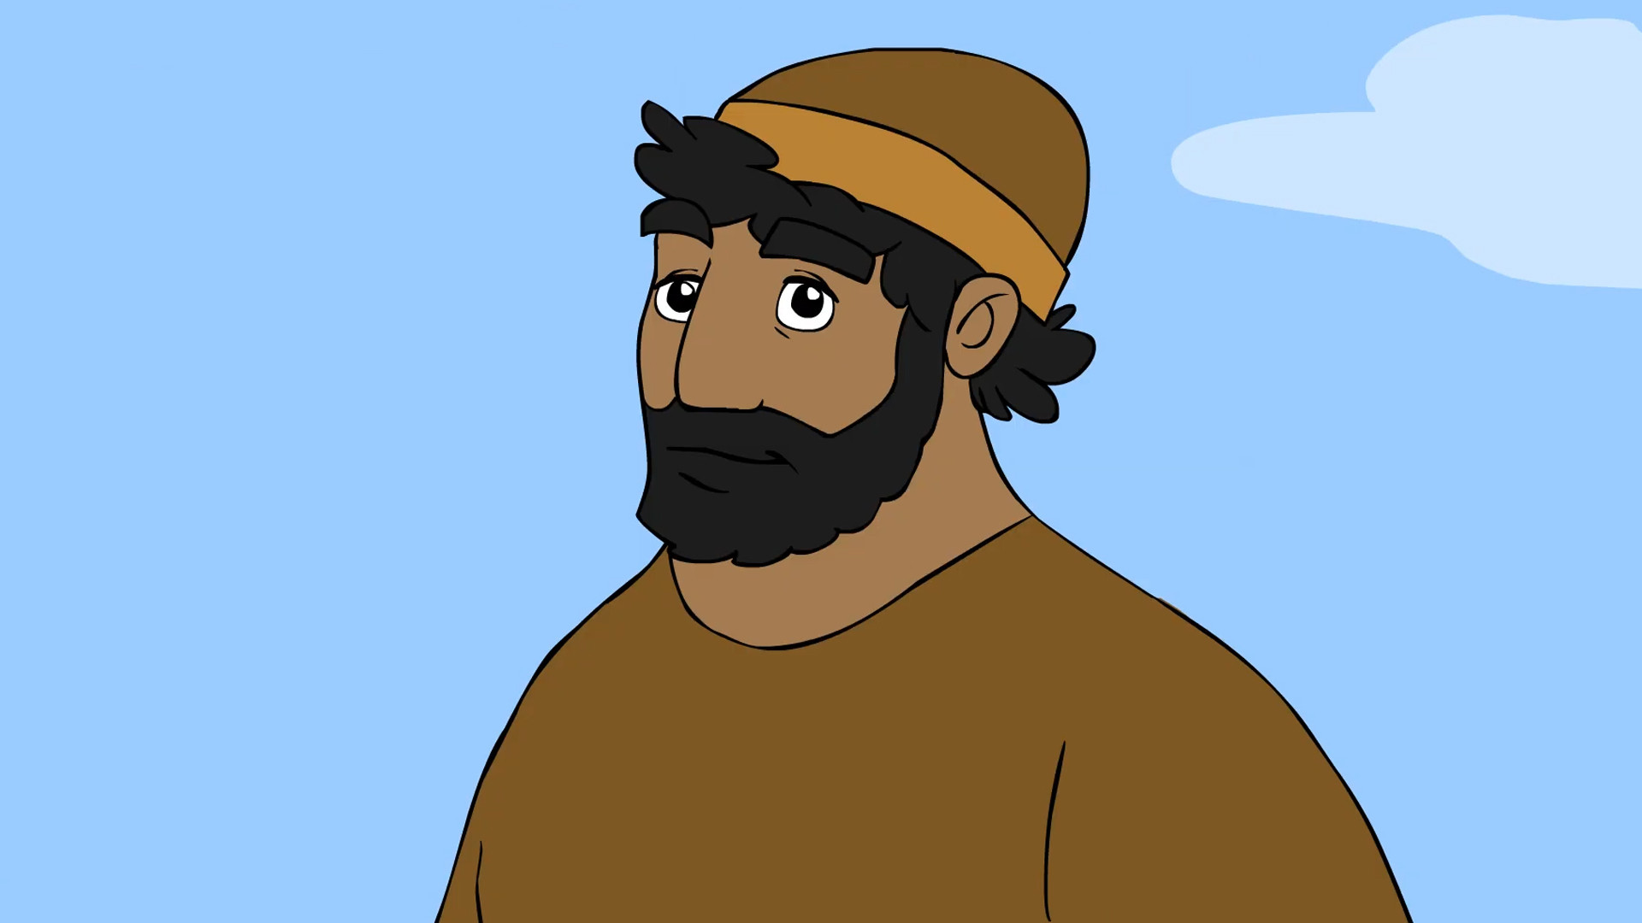
Notes:
James son of Alphaeus …

Slide 17
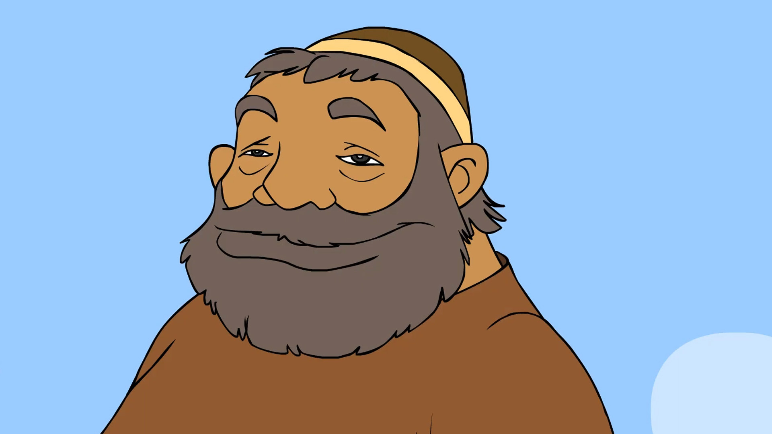
Notes:
… and Thaddaeus were also apostles

Slide 18
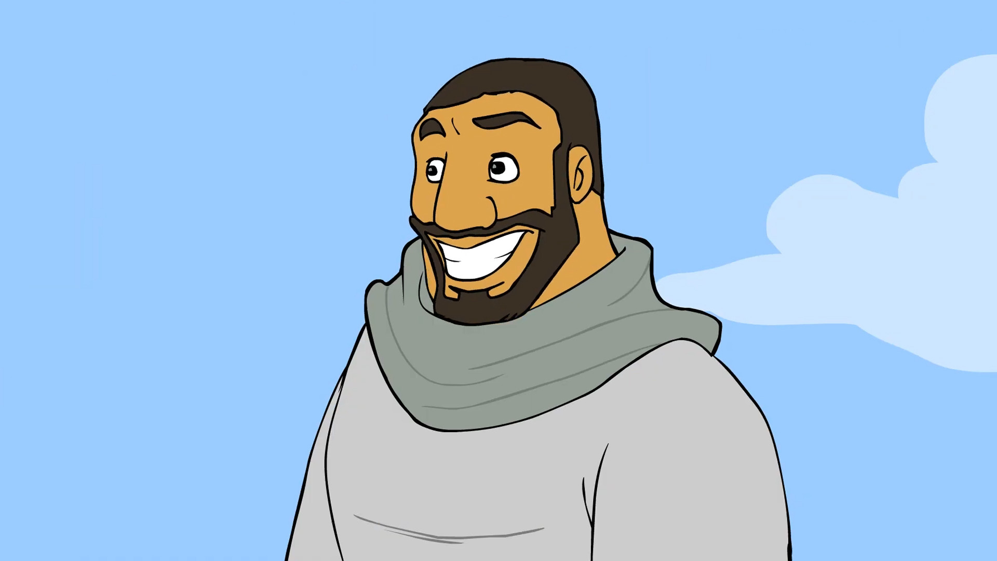
Notes:
Simon the Zealot

Slide 19
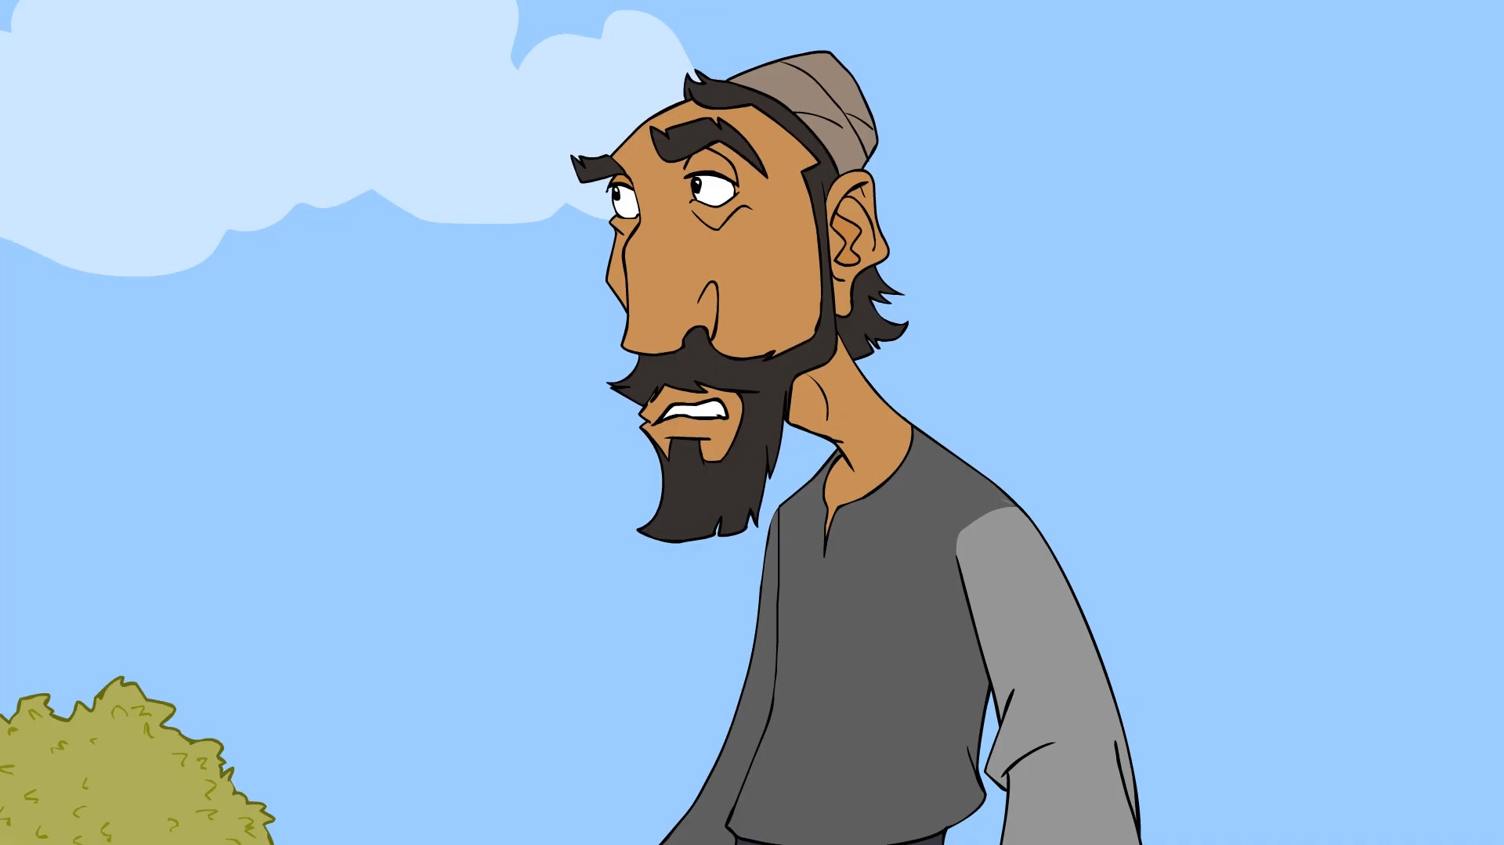
Notes:
and Judas Iscariot …

Slide 20
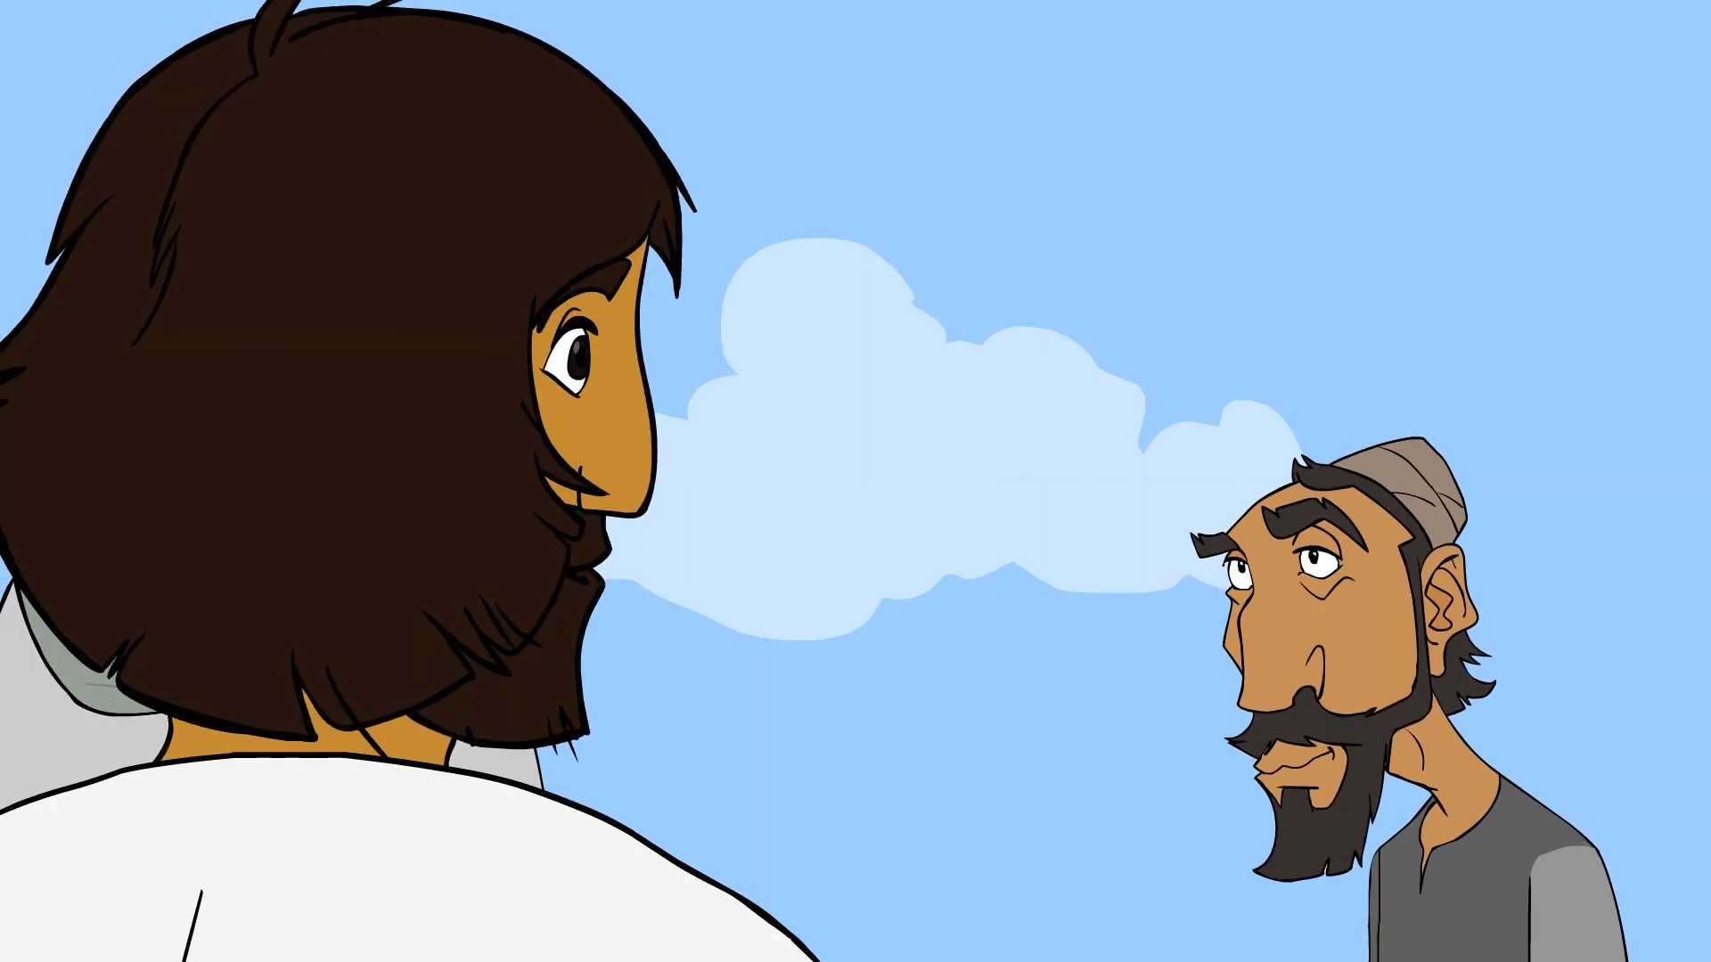
Notes:
… who later betrayed Jesus.

Slide 21
To be a friend of Jesus I need…
Notes:
If this is what it takes to be a friend of a normal person – what if Jesus is even more demanding of those who want to be His friend!

Slide 22
To be a friend of Jesus I need…
To be Clever

Slide 23
To be a friend of Jesus I need…
To be Clever

Slide 24
To be a friend of Jesus I need…
To be Clever
To be Good

Slide 25
To be a friend of Jesus I need…
To be Clever
To be Good

Slide 26
To be a friend of Jesus I need…
To be Clever
To be Good
To be Funny

Slide 27
To be a friend of Jesus I need…
To be Clever
To be Good
To be Funny

Slide 28
To be a friend of Jesus I need…
To be Clever
To be Good
To be Funny
To be Attractive

Slide 29
To be a friend of Jesus I need…
To be Clever
To be Good
To be Funny
To be Attractive

Slide 30
To be a friend of Jesus I need…
To be Clever
To be Good
To be Funny
To be Attractive
To need Him

Slide 31
To be a friend of Jesus I need…
To be Clever
To be Good
To be Funny
To be Attractive
To need Him
Notes:
When do I need Him
When I’m sad, unwell, hopeless
When life is going well, healthy and happy
I need Him to make me right with God
I need Him because my sin has separated me from God – Only Jesus can reconnect – I need Him

Slide 32
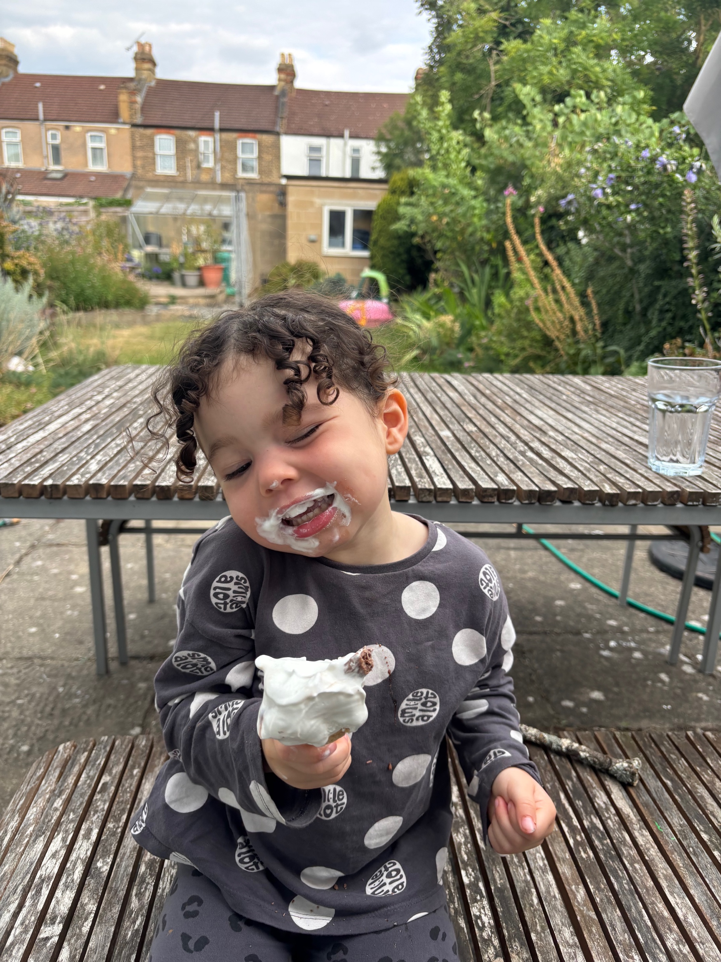

Slide 34
PETER
MATTHEW
SIMON THE ZEALOT
JAMES AND JOHN
Notes:
Simon was one of the twelve, and Jesus named him Peter.

Slide 35
This or That

Slide 36
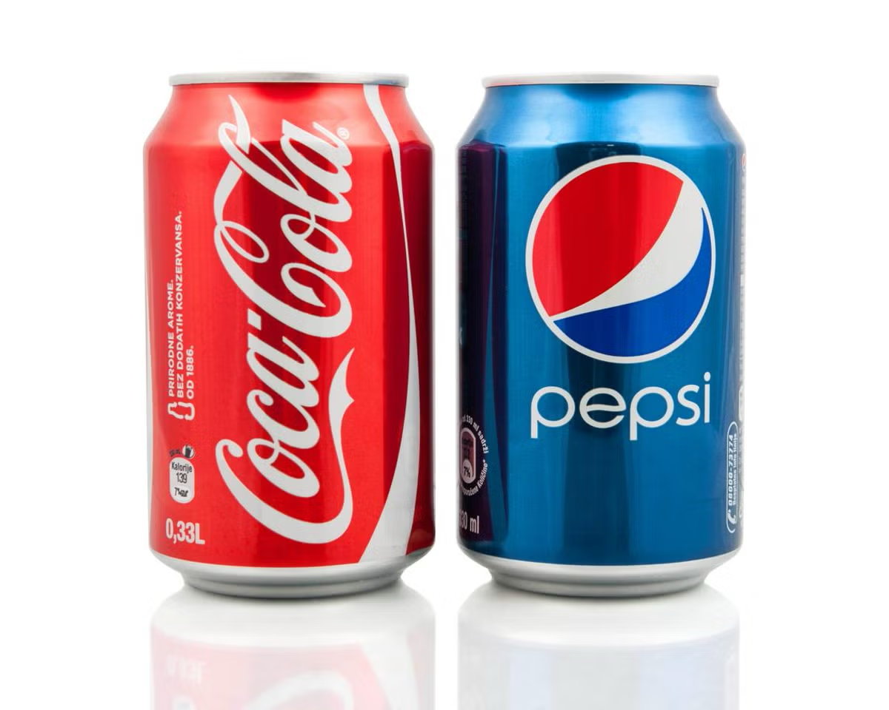

Slide 37
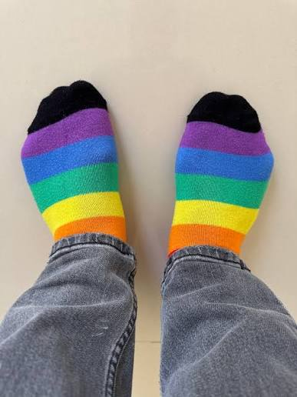

Slide 38
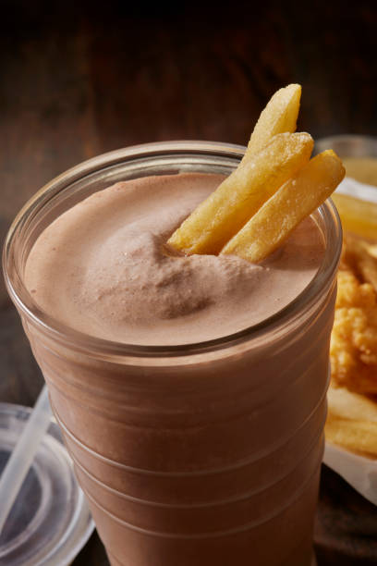

Slide 39


Slide 40
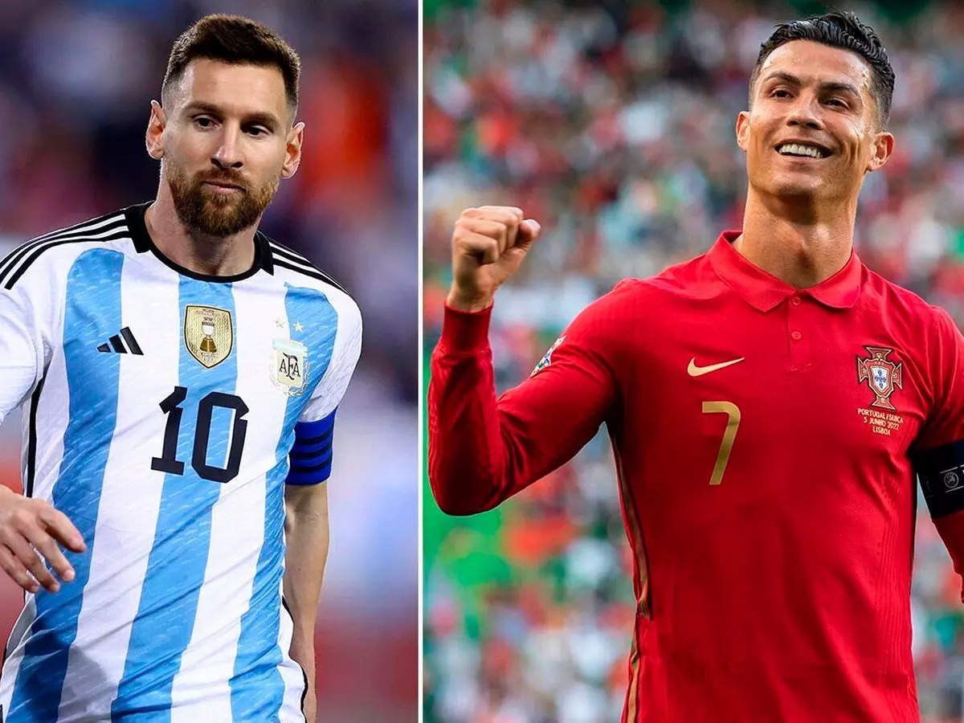

Slide 41
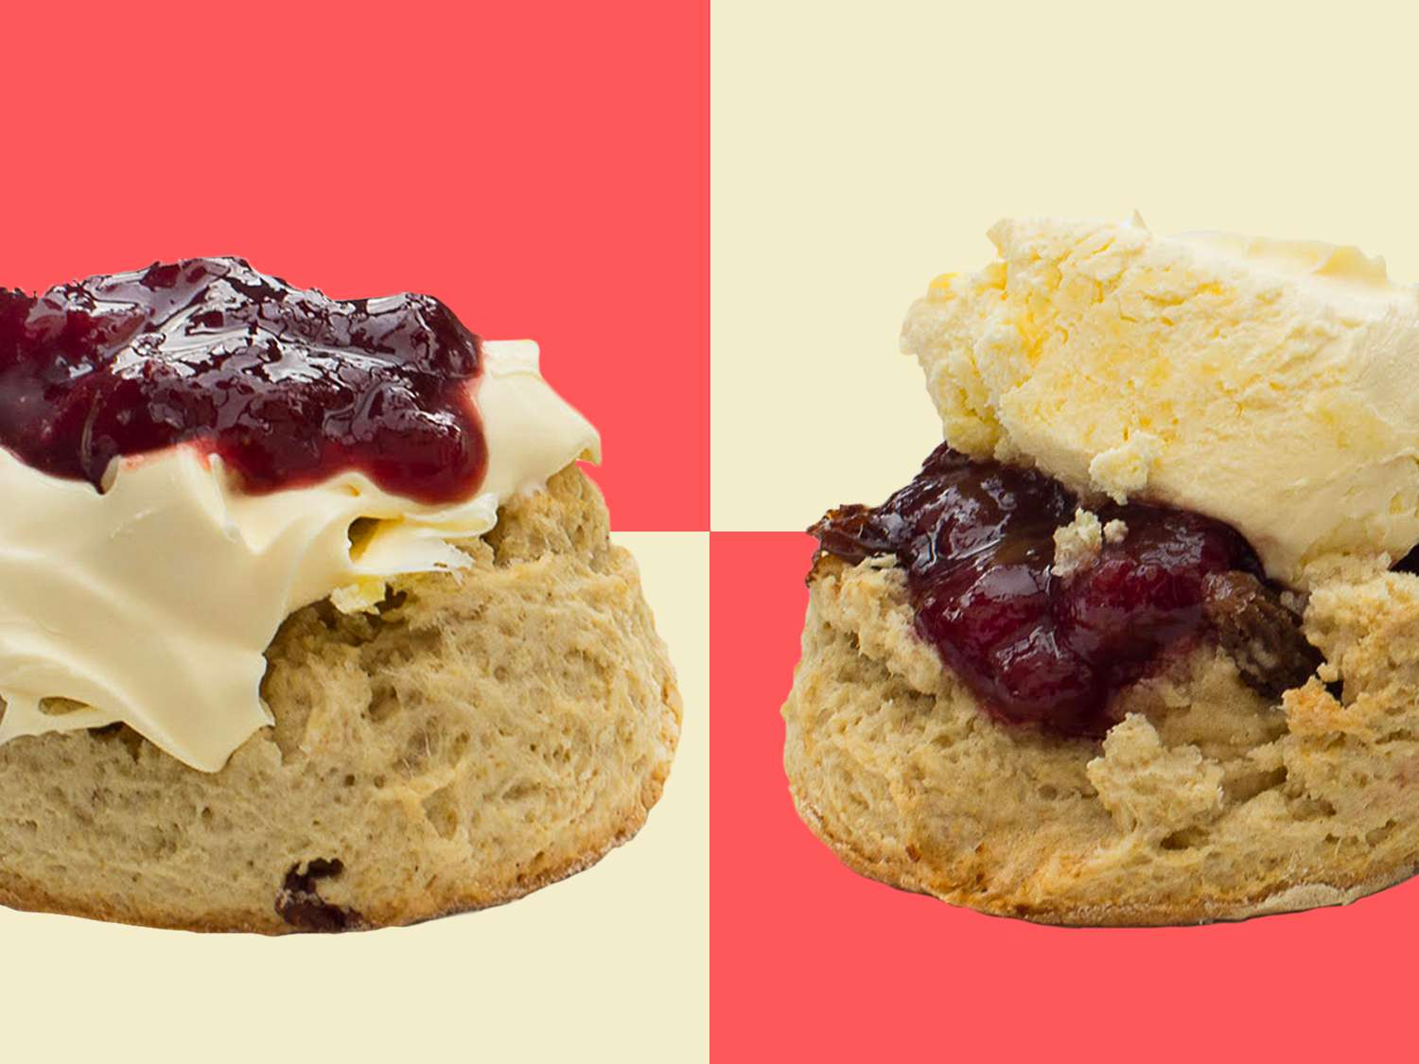

Slide 42
PETER
MATTHEW
SIMON THE ZEALOT
JAMES AND JOHN
JUDAS
Notes:
Simon was one of the twelve, and Jesus named him Peter.

Slide 43
Jesus is inviting you to come close to Him

