Slide 1

The Gospel of Mark
Episode 11
Mark 7:24-37
25th Oct 2026

Slide 2
Mark 7:24-30
²⁴ Jesus left that place and went to the vicinity of Tyre. He entered a house and did not want anyone to know it; yet he could not keep his presence secret. ²⁵ In fact, as soon as she heard about him, a woman whose little daughter was possessed by an impure spirit came and fell at his feet. ²⁶ The woman was a Greek, born in Syrian Phoenicia. She begged Jesus to drive the demon out of her daughter.
²⁷ “First let the children eat all they want,” he told her, “for it is not right to take the children’s bread and toss it to the dogs.”
²⁸ “Lord,” she replied, “even the dogs under the table eat the children’s crumbs.”
²⁹ Then he told her, “For such a reply, you may go; the demon has left your daughter.”
³⁰ She went home and found her child lying on the bed, and the demon gone.

Slide 3

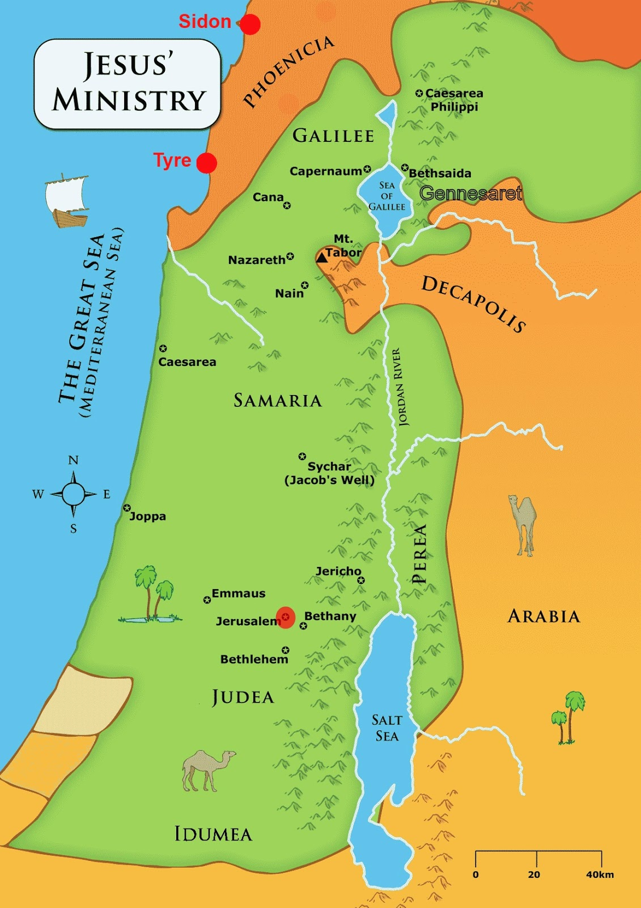
‘the vicinity of Tyre’
Notes:
Trying to keep a low profile so leaves Judea
“could not keep his presence secret” – his fame had spread beyond borders to extent he was sought out
Peter Kay never planned to leave Bolton – the tour that didn’t tour – now on tour

Slide 4


The Approach
Notes:
“fell at his feet” – different from
Those who voluntary come down low…
Mark 1:40 A man with leprosy^{[a]} came to him and begged him on his knee
Mark 3:11 (NIV) states: "Whenever the impure spirits saw him, they fell down before him and cried out, 'You are the Son of God.’
Mark 5:6 demon-possessed man
Mark 5:22 Jairus pleading for his dying daughter
Mark 5:33 Woman with bleeding falls at his feet
Are lifted up…
Mark 5:41 He took her by the hand and said to her, “Talitha koum!” (which means “Little girl, I say to you, get up!”). ⁴² Immediately the girl stood up
Those who come to Jesus high & mighty (imagine they are on the same level of Jesus) will be brought low
Mark 7:1 The Pharisees and some of the teachers of the law who had come from Jerusalem gathered around Jesus
aware of His wonder and her inadequacy but desperate
Matthew 23:12 “For those who exalt themselves will be humbled, and those who humble themselves will be exalted.”
A young preacher was about to preach one of his first sermons. He had studied hard, felt extremely well prepared, and was confident that he was going to preach an impressive sermon.
He walked up the steps to the pulpit with his head held high, full of confidence.
But the sermon went terribly. He stumbled over his words, lost his train of thought and eventually brought the sermon to an embarrassed, premature conclusion.
He then walked slowly back down the pulpit steps with his head bowed, thoroughly humbled.
An older and wiser Christian watched him and afterwards said:
“Young man, if you had gone up the way you came down, you might have come down the way you went up.”
QUESTION: How do you approach Jesus?
You owe me for all the good stuff I’ve done for you?
Can you add the cherry cus I’ve managed the rest
You can have 100% of the 10% I have left
Sceptical, look from a distance, I’ll sus out if you have anything that suits me (but anything I don’t like is dismissed)
Or
- Fall at his feet – recognising he is Lord and anything He requires I willingly give

Slide 5
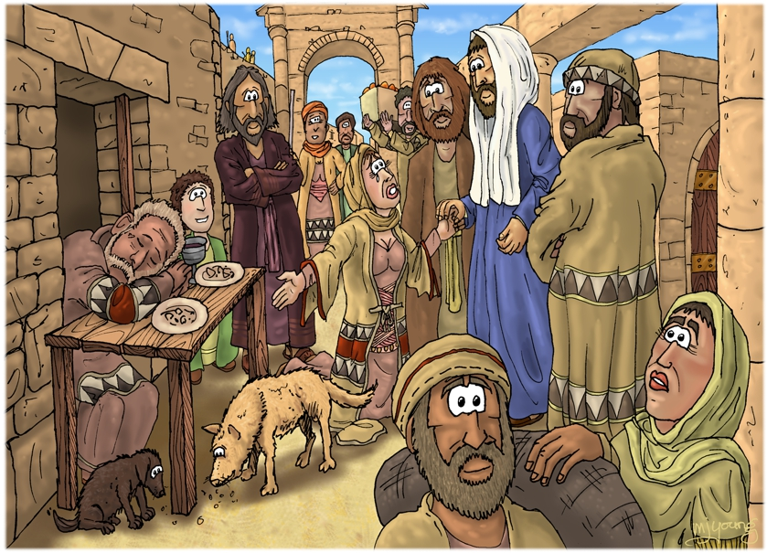
Gentile
Uninvited guest
Woman
Impure
Notes:
Gentile
uninvited guest
Woman
Impure (contagious from daughter)
– culturally stacked against – started begging and wouldn’t stop

Slide 6
NATIONS

Slide 7
NATIONS
FAMILY
ABE
ISRAEL

Slide 8
NATIONS
FAMILY
ABE
ISRAEL
KING
DAVID

Slide 9
NATIONS
FAMILY
ABE
ISRAEL
KING
DAVID

Slide 10
NATIONS
FAMILY
ABE
ISRAEL
KING
DAVID
MESSIAH
JC

Slide 11
NATIONS
FAMILY
ABE
ISRAEL
KING
DAVID
MESSIAH
JC

Slide 12
NATIONS
NATIONS
FAMILY
ABE
ISRAEL
KING
DAVID
MESSIAH
JC

Slide 13
NATIONS
NATIONS
FAMILY
ABE
ISRAEL
KING
DAVID
MESSIAH
JC

Slide 14
NATIONS
NATIONS
FAMILY
ABE
ISRAEL
KING
ISRAEL
DAVID
MESSIAH
JC

Slide 15
Syrophoenician woman
NATIONS
NATIONS
FAMILY
ABE
ISRAEL
KING
ISRAEL
DAVID
MESSIAH
JC
Notes:
God’s intention has been to reach the nations (all people) and invite into union with Him
God committed to restoring through partnership with willing humans
Nations = fail
God chooses 1 man & his family, nation of Israel to be channel of blessing for nations = fail
God choose 1 line from Israel to lead the nation into identity & purpose = fail
God chooses Jesus to succeed where all others failed
Intention to reach the nations in the end but for now
Focus to call Israel back to identity & purpose – this is mission of Jesus’ 3-year ministry (not to go to beyond yet – Matt 10, 15)
Into this scene appears the Syrophoenician woman

Slide 16
An Offensive Parable
Notes:
Jesus explains this order through offensive parable
Being referred to as a dog is offensive (so is being called a sheep)

Slide 17

1st
Notes:
“First let the children…”

Slide 18

2nd
1st
Notes:
“First let the children…”
It’s not time yet
But the woman engages with the parable and undermines it

Slide 19

1st & 2nd
Notes:
At the same time
What you have for them NOW you also have for me NOW

Slide 20
Syrophoenician woman
NATIONS
NATIONS
FAMILY
ABE
ISRAEL
KING
ISRAEL
DAVID
MESSIAH
JC

Slide 21

Why the back and forth?
Rabbi teaching style
Like Abraham & God
For her sake – to draw out what was in her that she wasn’t even aware of
For our sake – to show Him and what He wants from us
Notes:
Why this back and forth?
Hebrew rabbi teaching style
Similar to Abraham & God
For her sake – to draw out what was in her that she wasn’t even aware of
For our sake – to show Him and what He wants from us

Slide 22
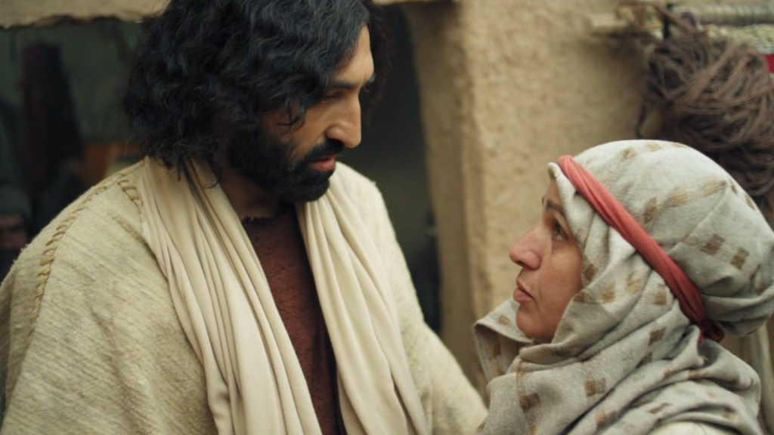
The Woman’s Response
Perceive Jesus’ identity & mission
Demanded a future promise in the present
Didn’t take offense
Received Jesus as His mercy deserves
Gave Jesus ‘permission to land’
Notes:
1. By the grace of God she perceived who Jesus was and His mission and didn’t argue it away
2. She see where His-story is heading and asks for a foretaste
She pulls the future into the present
3. She doesn’t take offense - She accept the terms of Jesus’ parable and undermines it
Western culture don’t know how to contend unless it is for your rights
4. She is contending in spite of her unworthiness – I’m boldly approaching not in my name but in Yours
I will not insult J by not receiving Him as His mercy deserves
John Newton
“You say you feel overwhelmed with guilt and a sense of unworthiness? Well, indeed you cannot be too aware of the evils inside of yourself, but you may be, indeed you are, improperly controlled and affected by them. You say it is hard to understand how a holy God could accept such an awful person as yourself. You then express not only a low opinion of yourself, which is right, but also too low an opinion of the person, work, and promises of the Redeemer, which is wrong. You complain about sin, but when I look at your complaints, they are so full of self-righteousness, unbelief, pride, and impatience that they are little better than the worst evils you complain of.”
5. Gave him space & permission to land – to be Himself in her life – Faith series
Jesus seeks desperately to teach his chosen disciples—yet they are dull and uncomprehending; this pagan woman is the first person in Mark to hear and understand a parable of Jesus
(James Edwards, The Gospel of Mark, p. 221).
You ‘get’ me – You allow Me to be everything I am in your life!
QUESTION: Are you receiving Jesus according to who He is? Are you coming to Him in His name and not in yours?

Slide 23
Mark 7:31-37
31 Then Jesus left the vicinity of Tyre and went through Sidon, down to the Sea of Galilee and into the region of the Decapolis. 32 There some people brought to him a man who was deaf and could hardly talk, and they begged Jesus to place his hand on him.
33 After he took him aside, away from the crowd, Jesus put his fingers into the man’s ears. Then he spit and touched the man’s tongue. 34 He looked up to heaven and with a deep sigh said to him, “Ephphatha!” (which means “Be opened!”). 35 At this, the man’s ears were opened, his tongue was loosened and he began to speak plainly.
36 Jesus commanded them not to tell anyone. But the more he did so, the more they kept talking about it. 37 People were overwhelmed with amazement. “He has done everything well,” they said. “He even makes the deaf hear and the mute speak.”

Slide 24
‘region of the Decapolis’

Slide 25
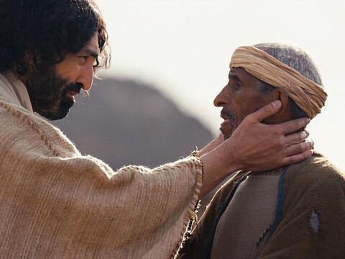
Notes:
away from the crowd – sensitivity not to allow man to be circus
fingers into the man’s ears.
touched the man’s tongue.
looked up to heaven
Sign language

Slide 26
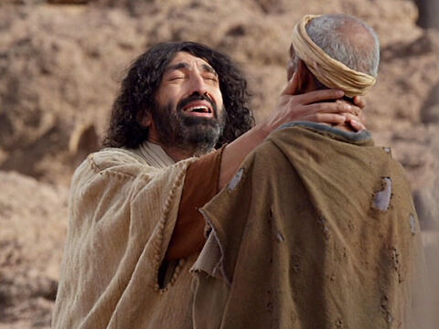
Isaiah 35:4-6
“Be strong, do not fear;
your God will come,
he will come with vengeance;
with divine retribution
he will come to save you.”
5Then will the eyes of the blind be opened
and the ears of the deaf unstopped.
6Then will the lame leap like a deer,
and the mute tongue shout for joy.
Notes:
Could hardly talk = mute
Mark chooses the word - Deaf/mute = mogilalos (Not used anywhere else)
But Septuagint used it for Isa 35:5
Then will the eyes of the blind be opened and the ears of the deaf unstopped.
Mark wants to hyperlink – to this prophecy of the messiah

Slide 27
Isaiah 35:4-6
“Be strong, do not fear;
your God will come,
he will come with vengeance;
with divine retribution
he will come to save you.”
5Then will the eyes of the blind be opened
and the ears of the deaf unstopped.
6Then will the lame leap like a deer,
and the mute tongue shout for joy.
Notes:
and with a deep sigh
Deep sign/moan – why not saying ‘just you wait until you see what I’m about to do for you!’?
Because he know to unlock the healing he is doing the hammer of God’s divine retribution needs to fall on those who have failed to live up to God’s standard – and that will be either us or Him
Jesus is sighing because he is thinking of the falling hammer
Every healing is another nail in his coffin/through his body into the cross
The child (Jesus) was cast from the table so the dogs (we) can eat
For the mute to speak, Jesus became like a lamb dumb before shearers
He paid for every privilege we experience

Slide 28
Response
Notes:
Receive Him on a basis of what He has done, not what you need to do

