Slide 1
What Does God Look Like?

Slide 2


Slide 3
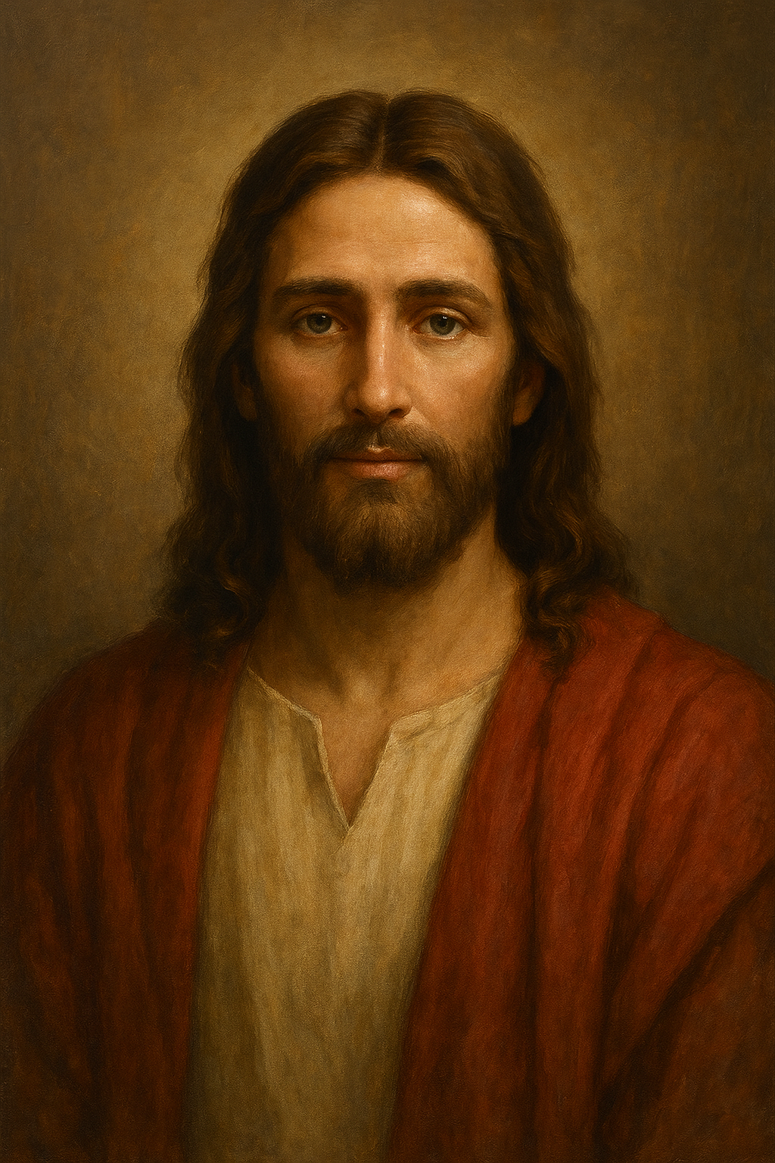
Col 1:15,19
Jesus the Image of the Invisible God
The fullness of God dwells in Him

Slide 4
Heb 4:15
“We do not have a high priest who is unable to identify with our weaknesses, but we have one who was tempted in every way without sin”

Slide 5
Jesus Fully God
Jesus Fully Man

Slide 6
Jesus Sighs
Mark 8:12
When he heard this, he sighed deeply in his spirit and said, “Why do these people keep demanding a miraculous sign? I tell you the truth, I will not give this generation any such sign.
Mark 7:33-34
³³ Jesus led him away from the crowd so they could be alone. He put his fingers into the man’s ears. Then, spitting on his own fingers, he touched the man’s tongue. ³⁴ Looking up to heaven, he sighed and said, “Ephphatha,” which means, “Be opened !”

Slide 7
How will recognising who Jesus is make a difference?
Jesus is the Author and Perfector of our Faith
And let us run with endurance the race God has set before us. ² We do this by keeping our eyes on Jesus, the champion who initiates and perfects our faith. Hebrews 12:1-2
In him lie hidden all the treasures of wisdom and knowledge. Col. 2:3
⁶ And now, just as you accepted Christ Jesus as your Lord, you must continue to follow him. ⁷ Let your roots grow down into him and let your lives be built on him. Then your faith will grow strong in the truth you were taught, and you will overflow with thankfulness. Col. 2:6-7

Slide 8
Endurance
Why do we need Endurance?
We are at War – sometimes with the devil, but much with ourselves
¹¹ Dear friends, I warn you as “temporary residents and foreigners” to keep away from worldly desires that wage war against your very souls. 1 Peter 2:11
⁵ So put to death the sinful, earthly things lurking within you. Col 3:5

Slide 9
Endurance
Why do we need Endurance?
….you must clothe yourselves with tender hearted mercy, kindness, humility, gentleness, and patience. ¹³ Make allowance for each other’s faults and forgive anyone who offends you. Col. 3:12-13
¹⁴ Above all, clothe yourselves with love, which binds us all together in perfect harmony Col.3:14

Slide 10
The benefits of Endurance
Patient endurance is what you need now, so that you will continue to do God’s will. Then you will receive all that he has promised. Hebrews 10:36
⁴ And endurance develops strength of character, and character strengthens our confident hope of salvation. Romans 5:4
³ For you know that when your faith is tested, your endurance has a chance to grow. ⁴ So let it grow, for when your endurance is fully developed, you will be perfect and complete, needing nothing. James 1:3-4
Notes:
Making the right choices strengthens us in our walk with God

Slide 11

We each have an individual race to run – it is not winning that matters, but finishing
“And let us run with endurance the race God has set before us”

Slide 12
It is all about Jesus
I want them to have complete confidence that they understand God’s mysterious plan, which is Christ himself Colossians 2:2
God is revealed through Jesus; Jesus is revealed through us as we see Him as the author and perfector of our faith.
Notes:
I want them to have complete confidence that they understand God’s mysterious plan, which is Christ himself Colossians 2:2

Slide 13
Jesus and Judas
Jesus replied, “A person who has bathed all over does not need to wash, except for the feet, to be entirely clean. And you disciples are clean, but not all of you.” For Jesus knew who would betray him. John 13:10-11
²¹ Now Jesus was deeply troubled, and he exclaimed, “I tell you the truth, one of you will betray me!” John 13:21

Slide 14
LifeLine Legacy
As a church community we have turned these principles of Living into Lifestyle Values
Love
Acceptance
Forgiveness
Serving
Generosity
Integrity

Slide 15
More than a Legacy
The source of these values is Jesus Himself
The greatest servant of all is the Author and Perfector of our Serving
The man who never sinned is the Author and Perfector of our Integrity
The man who sacrificed his life for us is the Author and Perfector of our love
The man who forgave all those who destroyed His life is the Author and Perfector of our forgiveness
The man who gave Himself even though He was God is the Author and Perfector of our Generosity

Slide 16
How do look to Jesus?
²⁶ "But when the Helper comes, whom I shall send to you from the Father, the Spirit of truth who proceeds from the Father, He will testify of Me. John 15:26-27
We ask the Holy Spirit to reveal Him to us

Slide 17
Response
What situations are you facing where you need to fix your eyes on Jesus for grace and faith to endure?
Is there a disappointment you are still carrying that you need Jesus to lead you out from?
Where do you need to fix your eyes on Jesus more to become effective in expressing the heart of Jesus to others?

