Slide 1

Ch... ch... changes
July 13th 2025
"Time may change me, but I can't trace time"
David Bowie 1971
Notes:
Jack little July 2025
I had a sense that there's a new day dawning. I actually had a picture of the sun rising and everything lighting up. There's a new day dawning. And maybe for some of you, that means that the darkness is going to be scattered and it's going to begin to shine. And I don't think it's any one individual's together.
You know, it's always brighter together. If we all had a candle, like a candlelight service, one little candle can light the whole room up, but not very much.
And two, three, a hundred, it gets really bright.

Slide 2

Change
When do you last change or do something new?
How did you feel beforehand?
What happened?
Was it difficult or easy?
How did you feel after?

Slide 3
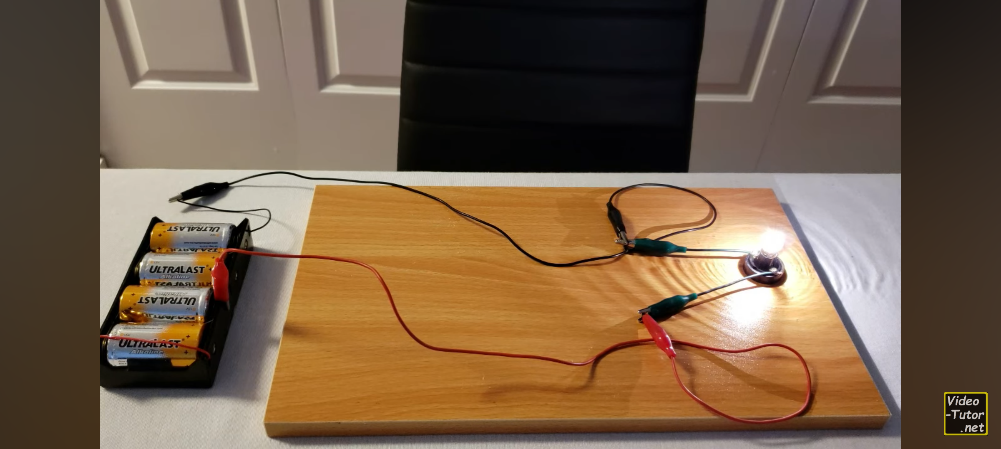

Slide 4
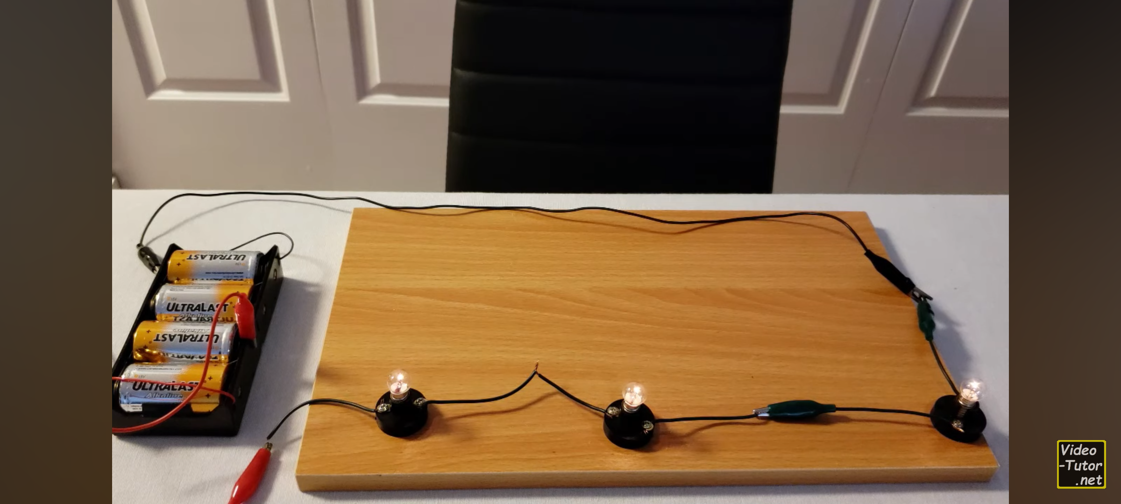

Slide 5
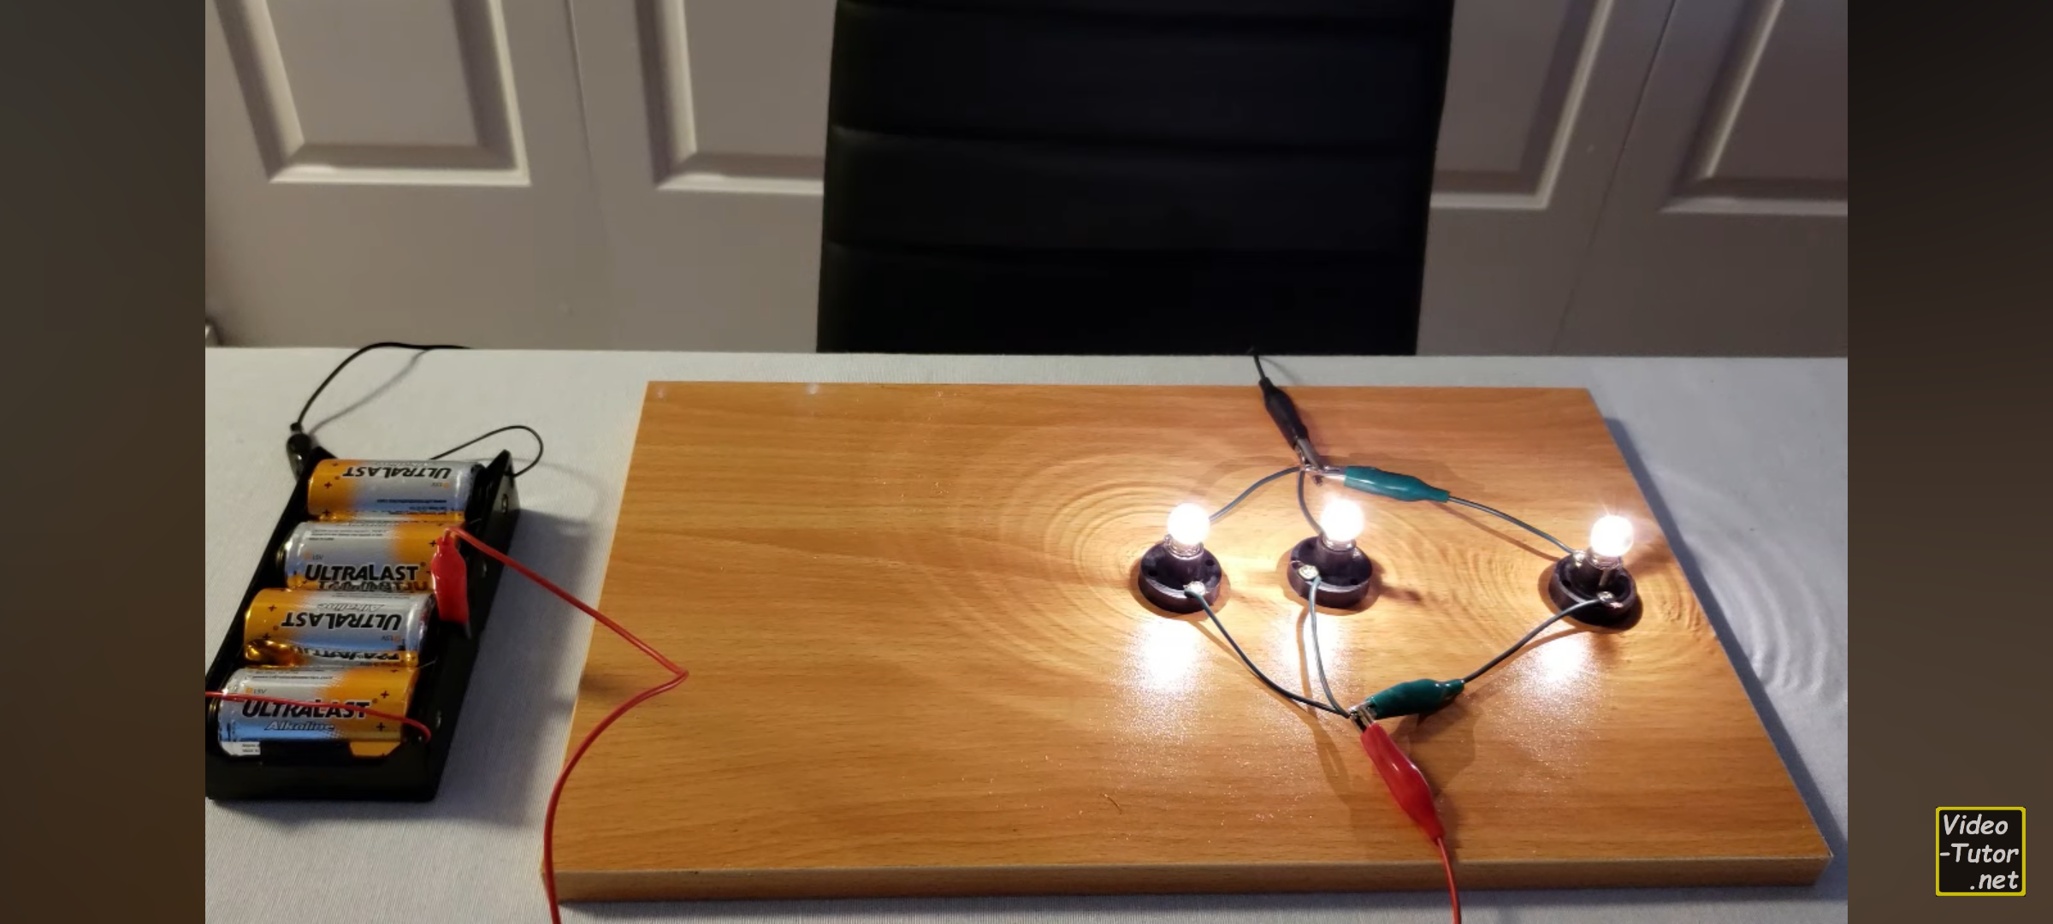
There is more power when we are directly connected to the source. Be ready for divine rearrangement!

Slide 6
God is unchanging
Psalm 102:25–27 Of old you laid the foundation of the earth,
and the heavens … and they will pass away,
but you are the same, and your years have no end.
Heb 13 ⁸ Jesus Christ is the same yesterday and today and forever.
James 1:17 Every good and perfect gift is from above, coming down from the Father of the heavenly lights, who does not change like shifting shadows.
Notes:
Psalm 102:25–27
Of old you laid the foundation of the earth,
and the heavens are the work of your hands.
They will perish, but you will remain;
they will all wear out like a garment.
You will change them like a robe, and they will pass away,
but you are the same, and your years have no end.

Slide 7
But the things He does are new
Isaiah 43:19 Behold, I will do a new thing, now it shall spring forth; shall you not know it? I will even make a road in the wilderness and rivers in the desert.
2 Corinthians 5:17 Therefore, if anyone is in Christ, he is a new creation; old things have passed away; behold all things have become new.
Revelation 21:5, “Behold, I make all things new.”
Hebrews 10 ¹⁹ Therefore, brothers and sisters, since we have confidence to enter the Most Holy Place by the blood of Jesus, ²⁰ by a new and living way opened for us through the curtain

Slide 8
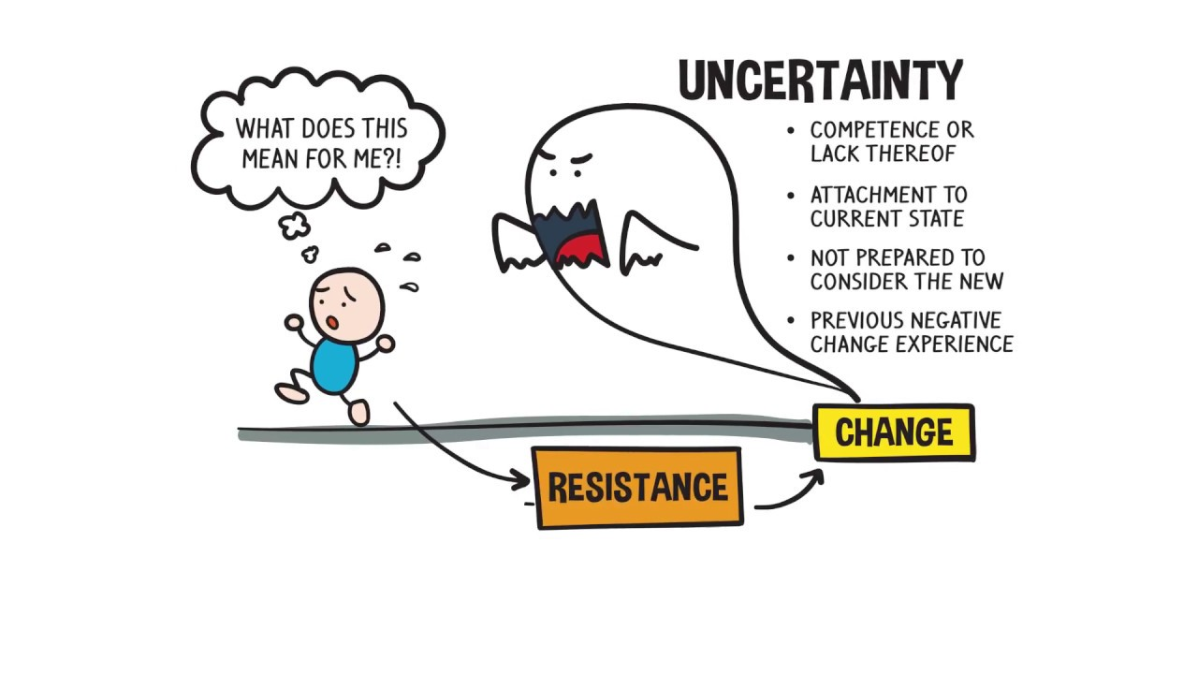
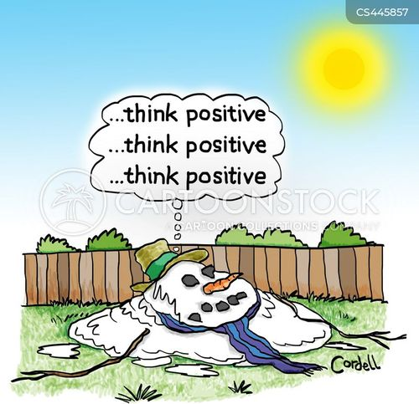
How do you approach change?
Unreasonably positive?
Deeply fearful?

Slide 9
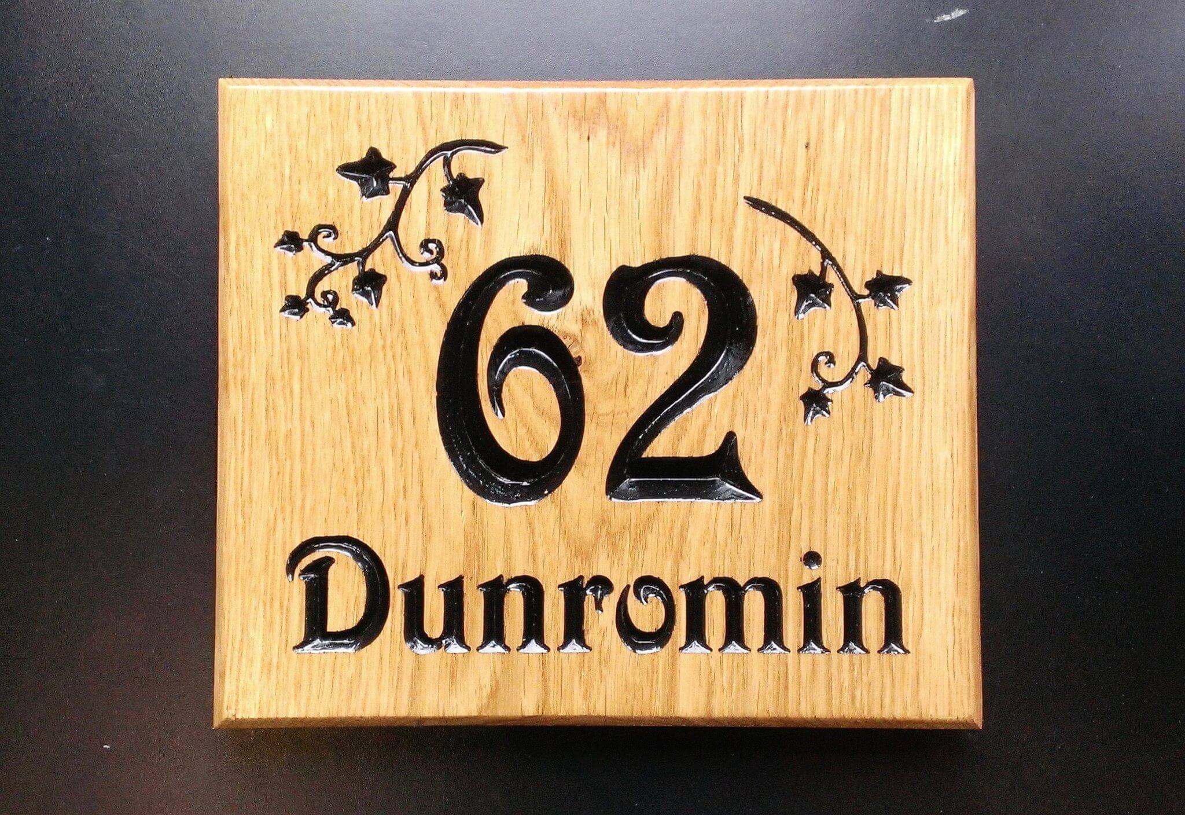

What’s the sign on my door?
Notes:
Personal examples
Work thing
#
What am I good at

Slide 10

Types of change
Temporary
Permanent
Seasonal
Ecc 3: 1 There is a time for everything,
and a season for every activity under the heavens:
Notes:
Really important to know which is which!
Stress can arise when we confuse the changes with one another.
Peace comes when we learn to accept them for what they are.
Ecc 3
There is a time for everything,
and a season for every activity under the heavens:
² a time to be born and a time to die,
a time to plant and a time to uproot,
³ a time to kill and a time to heal,
a time to tear down and a time to build,
⁴ a time to weep and a time to laugh,
a time to mourn and a time to dance,
⁵ a time to scatter stones and a time to gather them,
a time to embrace and a time to refrain from embracing,
⁶ a time to search and a time to give up,
a time to keep and a time to throw away,
⁷ a time to tear and a time to mend,
a time to be silent and a time to speak,
⁸ a time to love and a time to hate,
a time for war and a time for peace.
^{2Cor 4 16} Therefore we do not lose heart. Though outwardly we are wasting away, yet inwardly we are being renewed day by day. ¹⁷ For our light and momentary troubles are achieving for us an eternal glory that far outweighs them all. ¹⁸ So we fix our eyes not on what is seen, but on what is unseen, since what is seen is temporary, but what is unseen is eternal.
23But now that he is dead, why should I go on fasting? Can I bring him back again? I will go to him, but he will not return to me.”

Slide 11
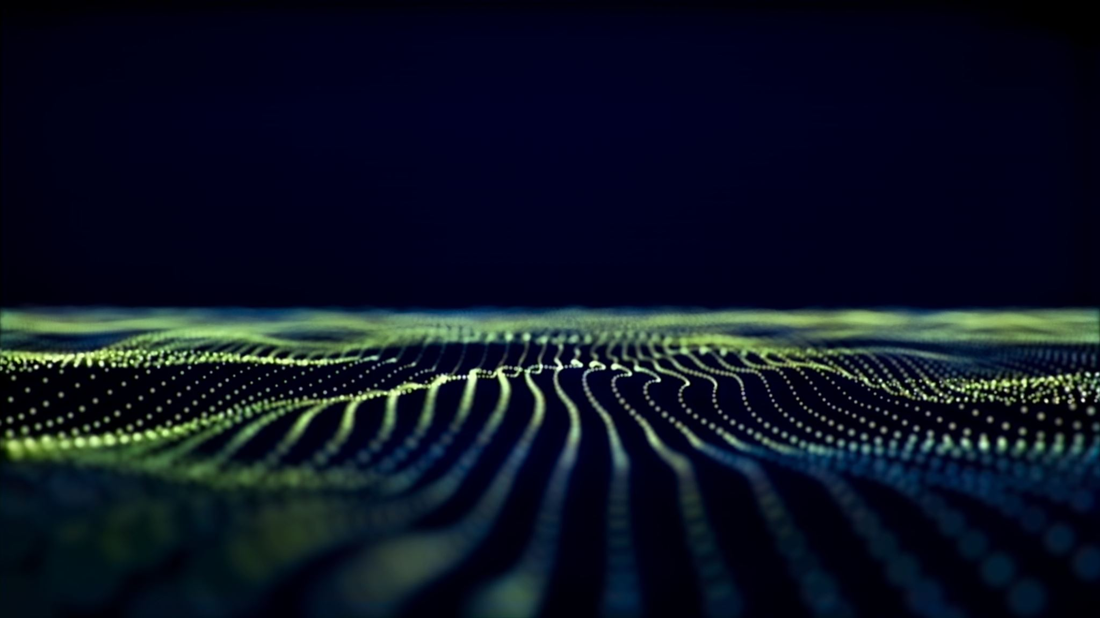
Reasons for change in life
Circumstances
Active choice
Growth
Response to God

Slide 12

Unless we’re already perfect, God wants us to change!
Hebrews 10:14
“By one sacrifice he has made perfect for ever those who are being made holy.”
Notes:
In his mercy, God has made us new.
He has made us holy, and he works in us to make us holy.
We are saved, and are being saved:

Slide 13
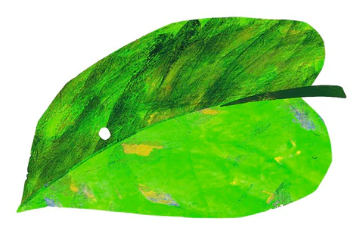
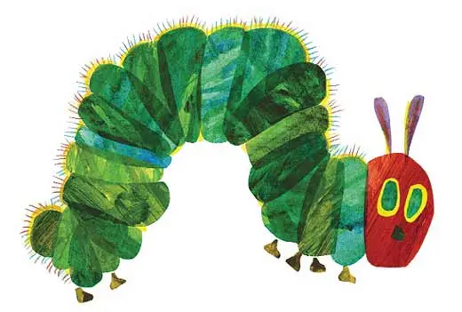
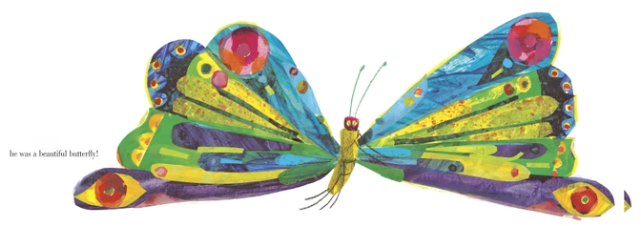
God is changing you into something wonderful
2 Cor 3:18
We all, who with unveiled faces contemplate the Lord’s glory, are being transformed into his image with ever-increasing glory, which comes from the Lord, who is the Spirit.
You cannot go on indefinitely being just an ordinary, decent egg. We must be hatched or go bad. C. S. Lewis
Notes:
It may be hard for an egg to turn into a bird: it would be a jolly sight harder for it to learn to fly while remaining an egg. We are like eggs at present. And you cannot go on indefinitely being just an ordinary, decent egg. We must be hatched or go bad.
C. S. Lewis
Romans 12:2
Do not conform to the pattern of this world, but be transformed by the renewing of your mind.
Then you will be able to test and approve what God’s will is—his good, pleasing and perfect will.

Slide 14
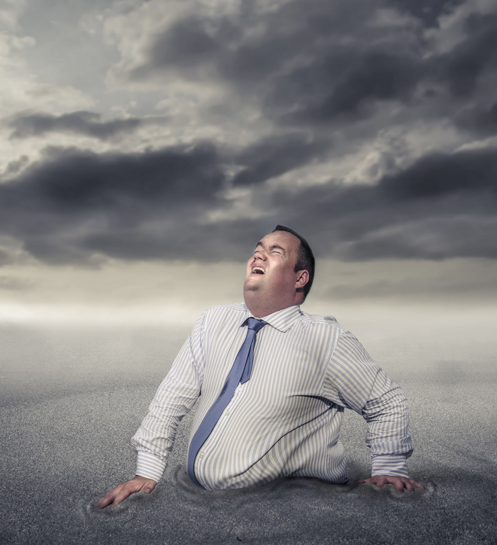

Don’t get stuck
Notes:
God doesn’t want us to settle where we are. We haven’t got there yet!

Slide 15


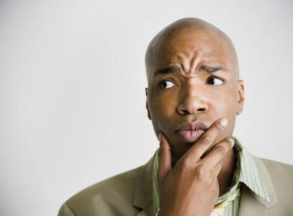
Be transformed…
G_____ without r_________ is a dead end
C_________ (recognition) of sin
The power to ________ (be r__________)
R_________e
C__________
F__________
Notes:
neil

Slide 16
The Reformation roundabout
Guilt without repentance is a dead end
Conviction (recognition) of sin
The power to change (be reformed)
Repentance
Confession
Forgiveness
Notes:
It may be hard for an egg to turn into a bird: it would be a jolly sight harder for it to learn to fly while remaining an egg. We are like eggs at present. And you cannot go on indefinitely being just an ordinary, decent egg. We must be hatched or go bad.
C. S. Lewis
This cycle is part of life, and the sacrament of the breaking of bread can be a means of grace to break free.

Slide 17
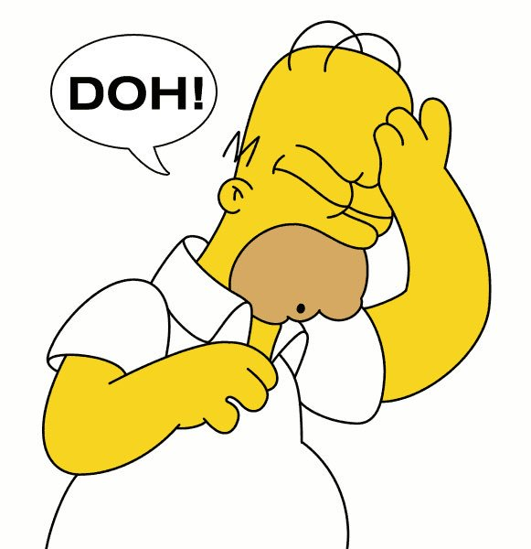
Conviction
Conviction is about seeing that what you have done is wrong and realising who we have offended.
This will lead to “feeling guilty”, but God does not us intend to remain there for long. Godly sorrow is the doorway to repentance.
2 Cor 7:10 Godly sorrow brings repentance that leads to salvation and leaves no regret, but worldly sorrow brings death.
Conviction is linked with regret, but should bring release.
In our Christian lives it is more “Doh!” than “Oh no!”
Notes:
God has given us an internal “gong” that he uses to let use know when we’ve got things wrong in our lives. With practice we can begin to sense the gong before we’ve actually messed up. At times it needs to be activated by a rebuke, or we can sense the prompting of the Spirit in our conscience direct.
However it happens, conviction is about seeing that what you have done is wrong and realising who we have offended. This will lead to feeling guilty, but God does not us intend to remain there for long. Guilt is the doorway to repentance.
Nathan the prophet brings a challenge from God (2 Samuel 12:7)
He had sinned against Uriah, Bathsheba and the Israelites
But David knows who he has really wronged (2 Samuel 12:13 “I have sinned against the Lord”).

Slide 18
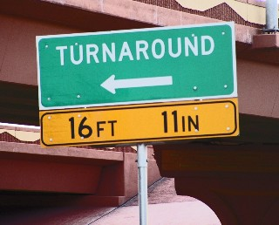
Repentance
Choosing to turn back to God and away from the sin. A heart attitude proven by changed actions (Acts 26:20) as it involves surrendering again to the rule of Christ in our lives.
Real repentance... is reached after a long struggle, after a stormy defence. It is reached, above all, only when conviction of sin grows from within and not from without, when it rises from the depths of our own being, from intimate communion with God, from the prompting of the Holy Spirit, and not from the judgement of men.
Paul Tournier.
Notes:
Acts 26:20 I preached that they should repent and turn to God and demonstrate their repentance by their deeds.

Slide 19
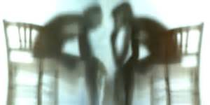
Confession
Confession is about stepping out of the darkness into the light.
Real confession will not come without cost. To go through with it we must overcome formidable resistance caused by our instinct of self-preservation, our pride, the desire to protect our reputation.
We humble ourselves with a sense of shame.
We expose our wretchedness.
We state our guilt.
We admit failure.
We take responsibility for our actions.
We apologise, ask forgiveness
We become vulnerable.
We reveal what once we concealed with great determination.

Slide 20
Forgiveness
If we confess our sins, He is faithful and just and will forgive us our sins and purify us from all unrighteousness.
1 John 1:9
Not only will He forgive, but He will also forget! Micah 7:12 “For I will forgive their wickedness and will remember their sins no more.”
7:19 you will tread our sins underfoot
and hurl all our iniquities into the depths of the sea.
That means God will never raise those issues with you again. If He has forgotten them, so can you! You never have to confess them again.
Notes:
Neil

Slide 21
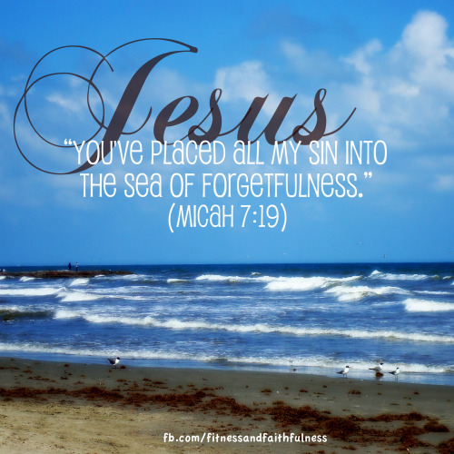
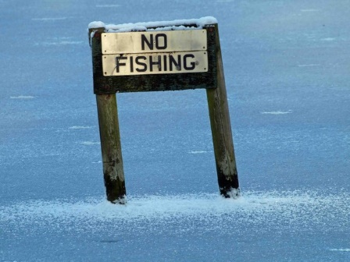
Corrie ten Boom
I can do something that God cannot do.
I can remember my sins.
Notes:
Neil

Slide 22
He will …purify us from all unrighteousness.
Confession brings buried sin to the surface so that we can experience the forgiveness of God. The legal price He paid has not altered in its sufficiency, but before we confess we cannot know that forgiveness experientially.
It humbles the soul and deals with pride.
It breaks the power of self-preservation.
It surrenders the ‘home’ of sin.
It dislodges Satan’s foothold.
It sheds light on demonic activity like shining light on rats in a dark corner.

Slide 23
Jesus provides a way back to the Father
Mark 14:32-36 As God He could not bear the presence of sin
Hebrews 2:9 As man he was able to absorb our sin into his very being
1 John 4:9,10 This is how God showed his love among us: He sent his one and only son into the world that we might live through him. This is love: not that we loved God but that he loved us and sent his son as an atoning sacrifice (propitiation) for our sins.
Notes:
But now…
Our sins can be wiped out forever.
Now you know what effect our sin has on God and what Jesus went through for us you should be able to understand better why it grieves the Holy Spirit when we sin.
Unconfessed sin separates us from God and prevents us from experiencing forgiveness. We need to deal with it quickly so we can get back into contact with our Father.

Slide 24
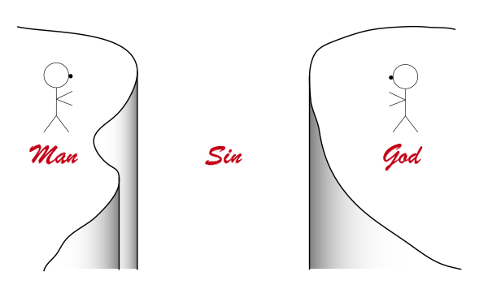
Unconfessed sin separates us from God
Confession means saying the same thing about our sin as God does
Confession brings us into the reality of God’s already given forgiveness.
Breaking bread is a good time to step into that reality

Slide 25
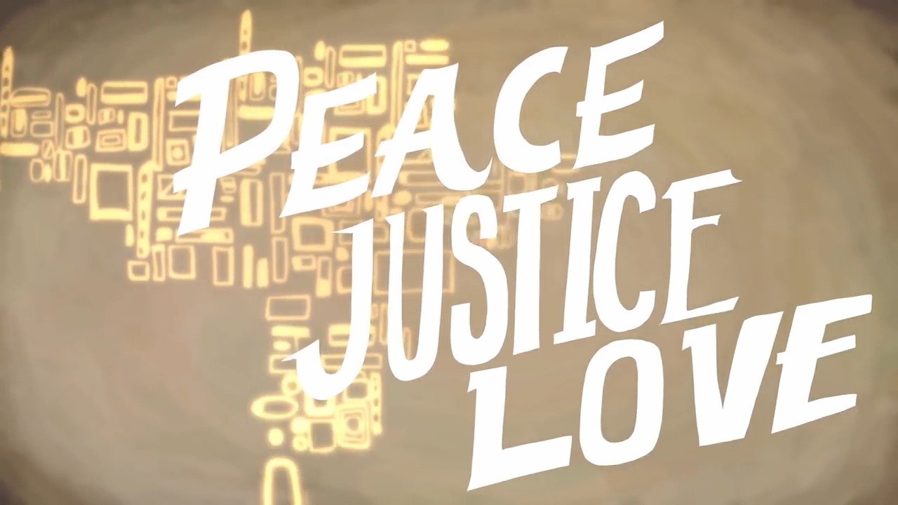
Sin makes a mess
Deut 9:7
Sin is rebellion against God – going my way not his way.
1 John 3:4 - Everyone who sins breaks the law; in fact, sin is lawlessness.
James 4:17 - If anyone, then, knows the good they ought to do and doesn’t do it, it is sin for them.
As we are surrounded by so much of a mess, what hope is there?
1 Cor 15: 57 But thanks be to God! He gives us the victory through our Lord Jesus Christ.
Notes:
Sin of omission or commission – things we have done and things we have not done
Set yourself apart to God. Old clothing doesn't fit any more. Throw off that which hinders.
Therefore, since we are surrounded by such a great cloud of witnesses, let us throw off everything that hinders and the sin that so easily entangles. And let us run with perseverance the race marked out for us, Hebrews 12:1
56The sting of death is sin, and the power of sin is the law. 57But thanks be to God! He gives us the victory through our Lord Jesus Christ.
58Therefore, my dear brothers and sisters, stand firm. Let nothing move you. Always give yourselves fully to the work of the Lord, because you know that your labor in the Lord is not in vain.

Slide 26

What have you heard today? Is there anything you need to do in response?

Slide 27
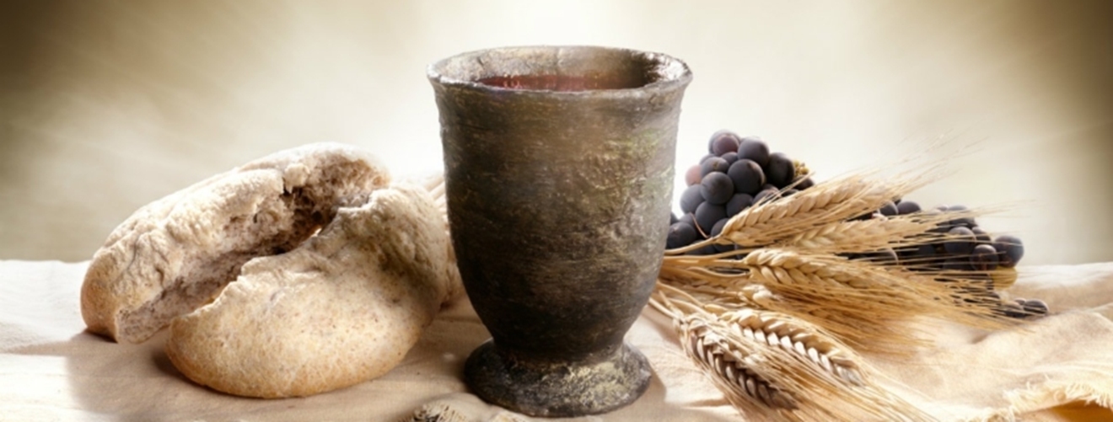
Breaking Bread
Notes:
1 Cor 12
¹² Just as a body, though one, has many parts, but all its many parts form one body, so it is with Christ. ¹³ For we were all baptized by^{[c]} one Spirit so as to form one body—whether Jews or Gentiles, slave or free—and we were all given the one Spirit to drink. ¹⁴ Even so the body is not made up of one part but of many.
¹⁵ Now if the foot should say, “Because I am not a hand, I do not belong to the body,” it would not for that reason stop being part of the body. ¹⁶ And if the ear should say, “Because I am not an eye, I do not belong to the body,” it would not for that reason stop being part of the body. ¹⁷ If the whole body were an eye, where would the sense of hearing be? If the whole body were an ear, where would the sense of smell be? ¹⁸ But in fact God has placed the parts in the body, every one of them, just as he wanted them to be. ¹⁹ If they were all one part, where would the body be? ²⁰ As it is, there are many parts, but one body.
²¹ The eye cannot say to the hand, “I don’t need you!” And the head cannot say to the feet, “I don’t need you!” ²² On the contrary, those parts of the body that seem to be weaker are indispensable, ²³ and the parts that we think are less honorable we treat with special honor. And the parts that are unpresentable are treated with special modesty, ²⁴ while our presentable parts need no special treatment. But God has put the body together, giving greater honor to the parts that lacked it, ²⁵ so that there should be no division in the body, but that its parts should have equal concern for each other. ²⁶ If one part suffers, every part suffers with it; if one part is honored, every part rejoices with it.
²⁷ Now you are the body of Christ, and each one of you is a part of it.

Slide 28
Breaking bread – getting ready
It is time to remember our covenant with God and one another.
Not about the things we use. It's about the process. Not a religious thing. More serious than a routine.
We choose to embrace the activities that build. We reject those that destroy.
It's more important that we are right with one another than we do this thing.
Because we are fewer in number this time, we are going to get into clusters of around 10 people to break bread this week.
If you don’t want to take the bread and wine, then you can still join a group and we will pray together.
Notes:
Unworthiness
Our mind is elsewhere
Being over casual
Doing it out of duty - legalism
Failing to remember the significance of what we are doing – its power and reality
Going through the motions eg if you have not made Jesus Lord of your life

Slide 29
Please get into groups of 10 (ish) by shuffling the chairs, then wait further instructions.
Please be ready to make space for a steward to join you when they have served things later.

Slide 30
Now you are the body of Christ, and each one of you is a part of it.
1 Cor 12:27
To the person on your left and the person on your right, I want you to say
I thank God that he has joined us together in this group today. I appreciate you.
Notes:
Look around you in your groups.
These people are here today because god has called them here, or they are seeking his voice.
To the person on your left and the person on your right, I want you to say I thank God that he has joined us (or is joining us) together in this group today. I appreciate you.
Then let’s wait. Perhaps God will give you a specific encouragement. If he does, share it.

Slide 31
Distributing the Bread
Wait on God as the stewards bring bread to your group.
The bread will be a gluten free roll.
Please just keep this unbroken for now.
Notes:
There is also a tray of alcohol free wine. Each tray will be shared between two groups when we come to that part.
When the stewards have joined a group and sat down, we will move onto the next stage.

Slide 32
In each group we are now going to share the bread as we say:
For I received from the Lord what I also passed on to you:
The Lord Jesus, on the night he was betrayed,
took bread, and when he had given thanks,
he broke it and said,
“This is my body, which is for you;
do this in remembrance of me.”

Slide 33
Now the stewards will serve the wine.
When everyone has some, we will drink it together.
In the same way, after supper he took the cup, saying,
“This cup is the new covenant in my blood;
do this, whenever you drink it, in remembrance of me.”
For whenever you eat this bread and drink this cup,
you proclaim the Lord’s death until he comes.
Once we have shared the bread and wine, let’s keep the silence for a few minutes.

Slide 34
Father of all,
we give you thanks and praise,
that when we were still far off
you met us in your Son and brought us home.
Dying and living, he declared your love,
gave us grace, and opened the gate of glory.
May we who share Christ’s body live his risen life;
we who drink his cup bring life to others;
we whom the Spirit lights give light to the world.
Keep us firm in the hope you have set before us,
so we and all your children shall be free,
and the whole earth live to praise your name;
through Christ our Lord.
Amen.

